Slide 1
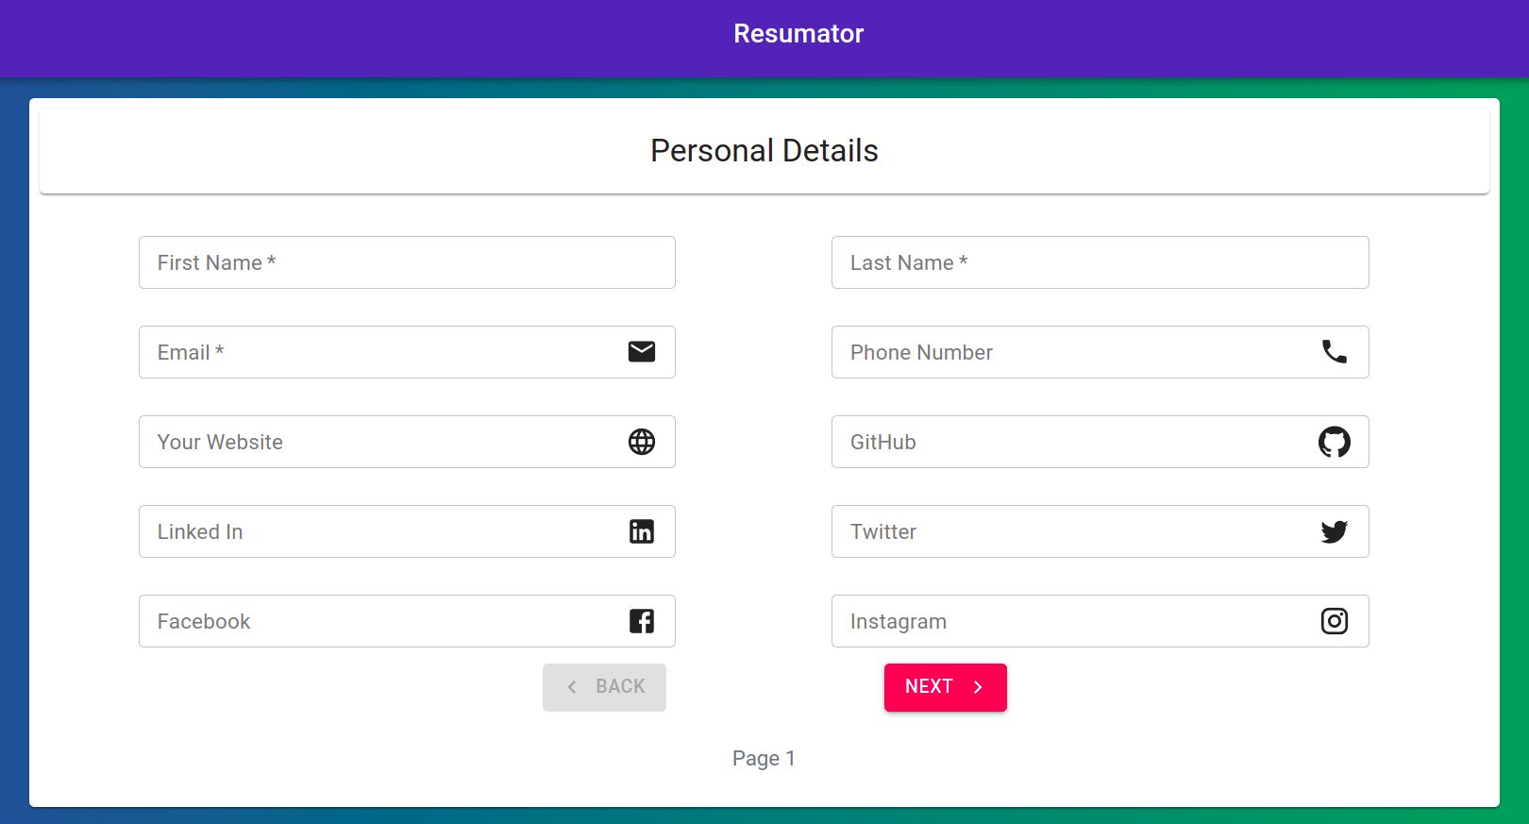
Resumator
Abu Shahid- B20CS003
Jahnab Dutta- B20CS091

Slide 2
Contributions
Responsiveness and UI- Abu Shahid
Components (Profile.js, Education.js)- Abu Shahid
Components (Experience.js, Extras.js, Resume.js, Projects.js)- Jahnab Dutta
Middleware & Server.js- Jahnab Dutta
Resume format layout- Abu Shahid

Slide 3
Other Details
Approximate number of lines of code- 5000
Approx 2700 by Abu Shahid
Approx 2300 by Jahnab Dutta
Video Demo Link
Link to the github repo.
Link to commit histories.
Development was done locally in the initial stages and therefore the commit history does not give accurate picture.

Slide 4
Objectives
Completed
Detail entry interface consisting of
Personal details
Educational details
Experiences
Projects
Skills and Interests
Middleware to parse enters details in a pdf
Module to download the same
Yet to be Completed
Format selection of pdf
Autocorrection/recommendation API
Module for sharing of pdf
Hyperlink accessibility

Slide 5
THANK YOU
:)

