Slide 1
Project : Smart Education Platform using AI
Smart Education Platform using AI
Smart Education with AI analyzes each student's learning style, performance, and progress to provide personalized education. It uses artificial intelligence to recommend study materials, identify weak areas, and support teachers with real-time insights.
📚 Personalized Learning Paths
🤖 AI-Powered Study Recommendations
📈 Student Performance Analytics
📝 Smart Quiz & Instant Feedback
An AI-powered smart education platform that helps students learn more effectively through personalized guidance, adaptive learning, and intelligent performance tracking.
Name: Vipul Prajapati | Enrollment: 23084013116
Stream: Computer Science & Engineering | College: R. N.G. Patel Institute Of Technology

Slide 2
UN SDG 4: Quality Education
•Education is the foundation for a better future.
• Use AI to make learning personalized, interactive, and accessible for every student.
•Improve student performance, teacher efficiency, and lifelong learning opportunities.

Slide 3

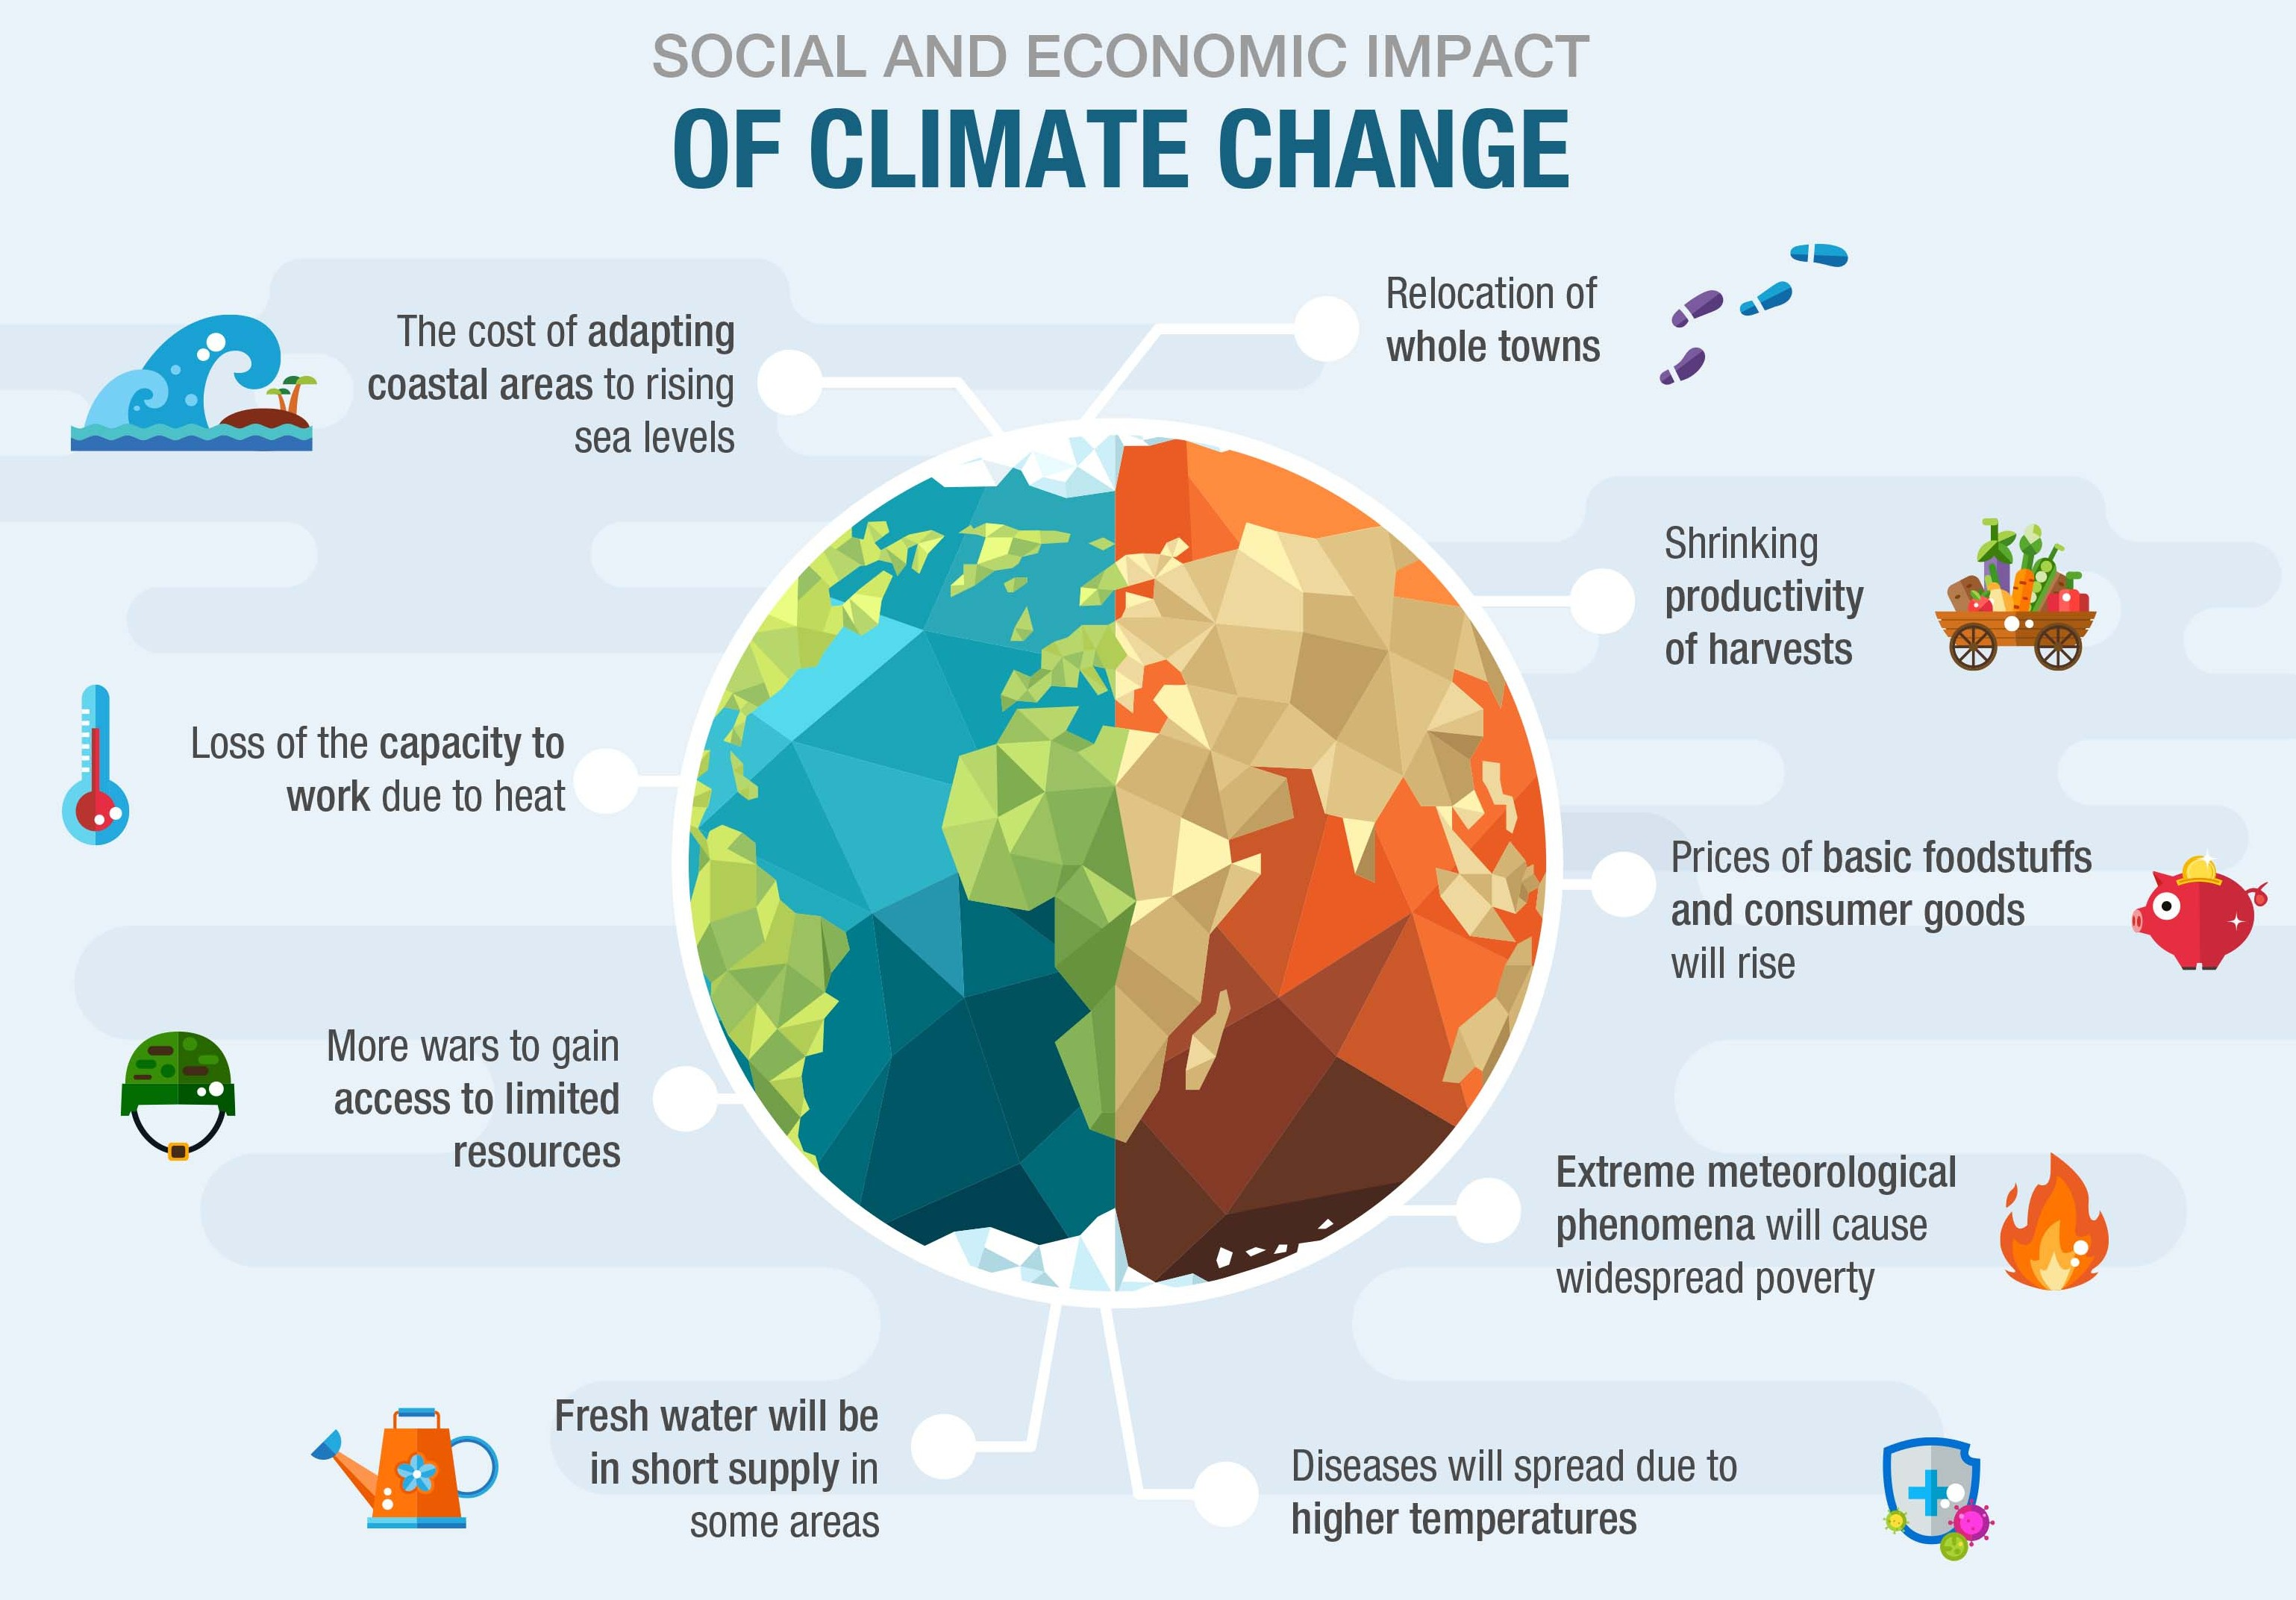
Challenges & Global Impact
• AI requires internet access
• quality data
• should protect student privacy
• Personalized Learning Paths
• AI Study Recommendations
• Smart Quiz & Instant Feedback

Slide 4
AI & Technology
🤖 AI personalizes learning for every student.
📚 Smart recommendations for study materials and courses.
📊 Real-time performance tracking and learning analytics.
📝 AI-powered quizzes with instant feedback.

Slide 5
Solutions & Our Contribution
🎓 Provide personalized AI-powered learning for every student.
🤖 Use an AI tutor for 24/7 learning support and doubt solving.
📊 Track student progress with real-time performance analytics.
🌍 Enable anytime, anywhere learning through a smart online platform.

