Slide 1
Clustering Assignment
Viral Prajapati
00001412334

Slide 2
Dataset -1 : Iris
Number of attributes: 4
Sepal length
Sepal width
Petal length
Petal width
Classes: Iris Setosa, Iris Versicolor, Iris Virginica
Total number of instances : 150

Slide 3
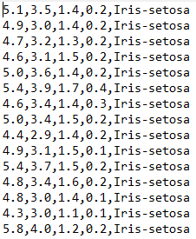

Slide 4
Dataset 2: Drinking Fountain
Number of Attributes : 2
Longitude
Latitude
Classes : Is it pet friendly or not : Y/N
Place named Adelaide, Where there are longitude, latitude different types of parks, Fountain type and Type of monument e.g. curved, memorial, post (Alpha)
Total number of instances : 237

Slide 5
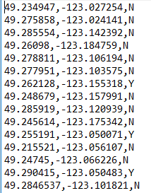

Slide 6
 | Single Linkage | Average Linkage | Complete Linkage | Lloyds | K-means ++
Iris | 0.174 | 0.063 | 0.092 | 0.078 | 0.076
Drinking Fountain | 0.233 | 0.259 | 0.137 | 0.151 | 0.144

Slide 7
Thank You
Viral

