Slide 1
CHARACTERQUILT · TECHNICAL SCREEN 2
Deployments an operator can trust
What this service guarantees, when it may say a deployment succeeded, and what it still cannot promise.
11
8
37
6
cases grouped
guarantees
checks
stress assertions
Zeel Prajapati
github.com/prajapatizeel240024/02-durable-run-relay
Notes:
Screen 2 summary. The repo, its git history and the raw transcript are the real deliverable; this deck is the two-minute version.

Slide 2
The operator does not trust it
Four things they reported, and no way to tell which are the same problem.
“Sometimes there are more drafts than we approved.”
“Once there were fewer, and the receipt still said verified.”
eight drafts for four approved assets
the destination lost objects and nothing noticed
“A campaign someone cancelled kept going.”
“A stuck run takes the whole queue down with it.”
cancel wrote a status nobody read
two campaigns behind it never went out at all
And the crash-and-restart demo runs clean anyway.
That is the actual problem: the demo exercises the one path that already works, so a green run proves nothing.
fixtures/operator_report.txt

Slide 3
Evidence first, then a plan, then code
In that order, on purpose. Running the starter is not editing it, and half of what is wrong here is invisible in the source.
1
2
3
4
Run it, don't just read it
Reproduce all eleven cases
Commit ROADMAP.md alone
Mutation-check the tests
Put the system into states the demo never reaches. Eight processes, not eight threads.
By hand, against the untouched starter, so the grouping is a finding rather than a guess.
Before any source edit, with five claims in it another engineer could reasonably reject.
Break each guarantee in turn. A test that passes on broken code is worthless.
Git history reads in that order: starter → roadmap alone → relay → tests → demo and stress → docs → write-ups.
ROADMAP.md · committed on its own, before any source or test edit

Slide 4
Two findings that changed the design
The destination rewrites what you send
The destination loses writes, and threads hide it
It strips and truncates display names to 40 characters. Three of the four approved names come back different.
It rewrites its entire state with a read-modify-write and no locking.
approved
Summer 2026 ABM campaign - primary landing page
279 / 320
stored
Summer 2026 ABM campaign - primary landi
approved
Summer 2026 ABM campaign email - product deep dive
stored
Summer 2026 ABM campaign email - product
writes lost when eight processes write at once, with the state file left unparseable
approved
Summer 2026 ABM campaign email - product deep dive, part two
Under threads make stress loses one object about one run in six, which reads like noise. It is not noise — the GIL was hiding it. This is the finding I would not have got from reading the code.
stored
Summer 2026 ABM campaign email - product
The last two are identical. A marketer cannot tell those two drafts apart — and the starter called it verified: true.
ROADMAP.md §1 · reproduced against the unmodified starter

Slide 5
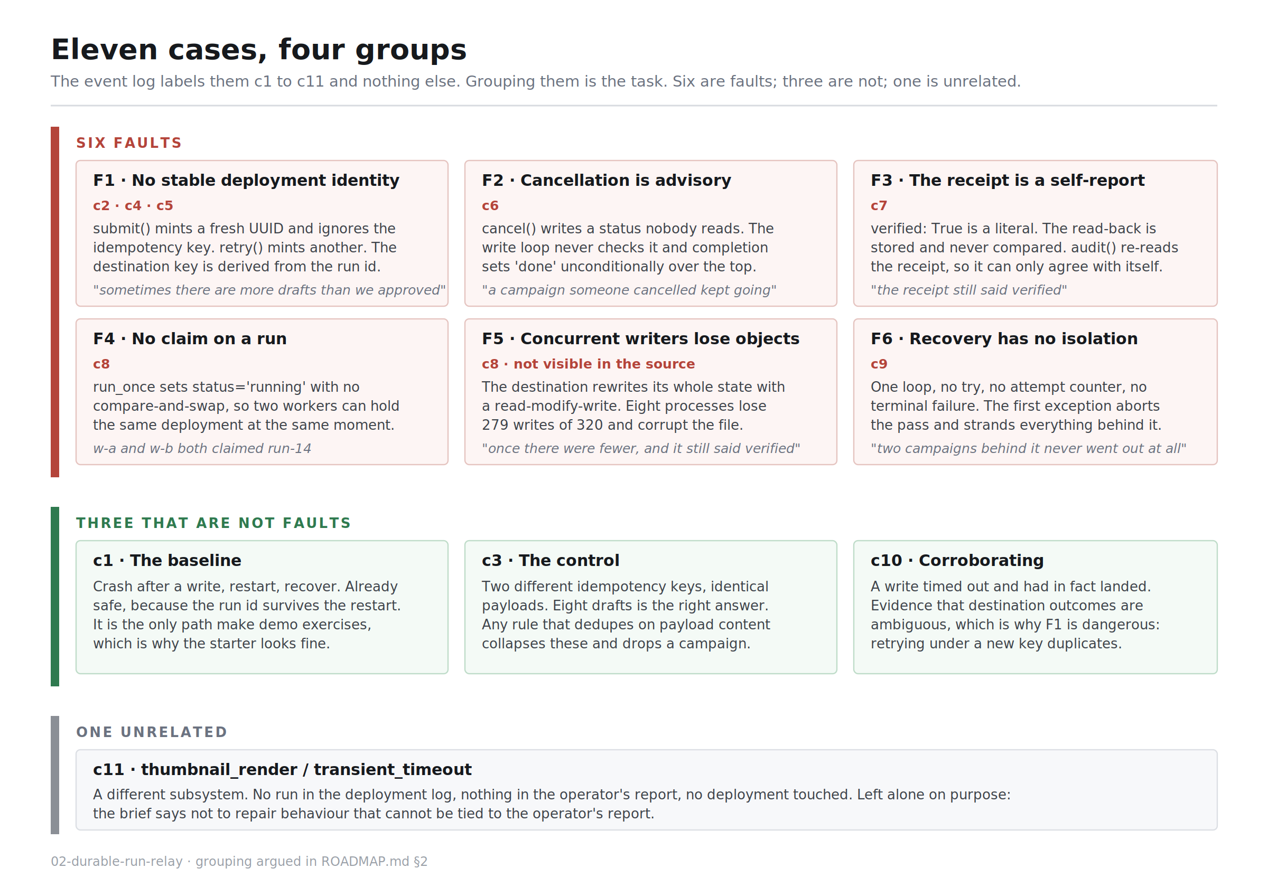
Grouping the eleven cases
The log labels them c1 to c11 and gives nothing else.
Six are faults. Three are not faults at all. One is unrelated to anything the operator reported.
c3 is the control: two different keys, identical payloads, eight drafts is correct. Deduping on content would drop a campaign.
c11 is a thumbnail-render timeout in another subsystem. Left alone on purpose, and said so.
ROADMAP.md §2 · docs/diagrams/01-case-map.svg

Slide 6
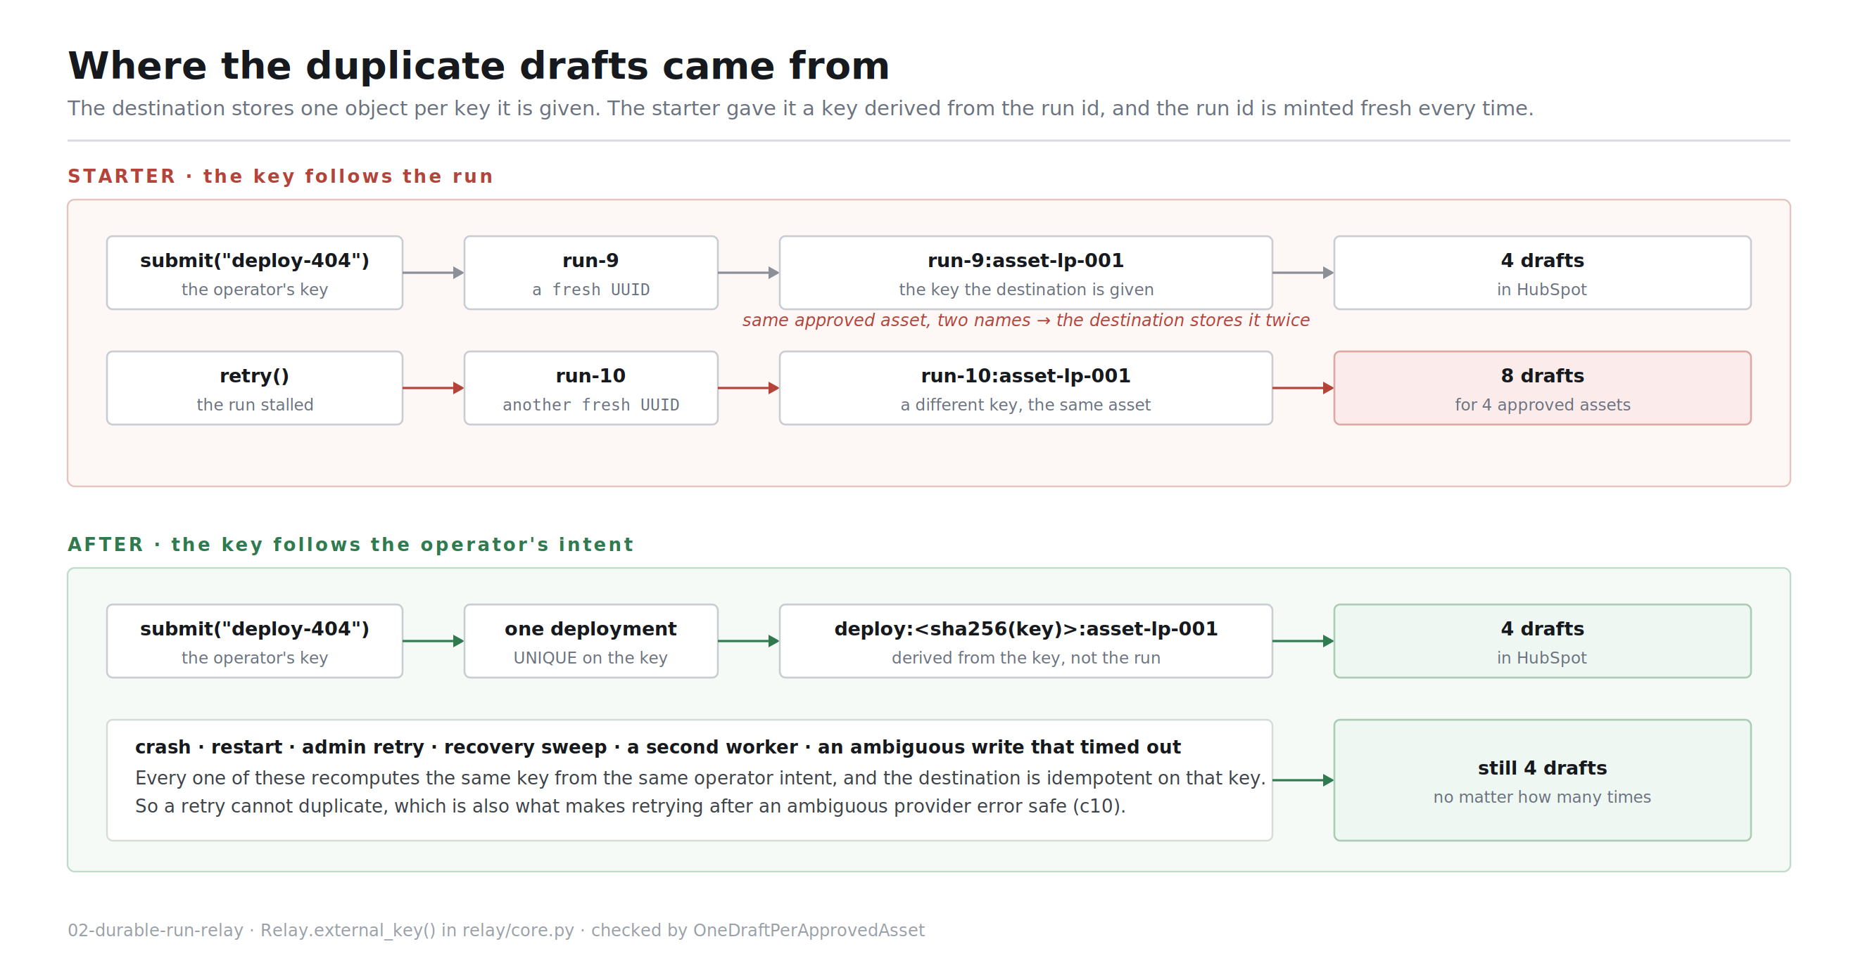
Where the duplicate drafts came from
Three of the six faults share one root cause.
The destination stores one object per key it is given.
The starter's key was f"{run_id}:{asset_id}" — and the run id is minted fresh on every submit and every retry.
Deriving it from the operator's idempotency key closes c2, c4 and c5, and is what makes a retry safe after an ambiguous write.
relay/core.py · Relay.external_key() · checked by OneDraftPerApprovedAsset

Slide 7
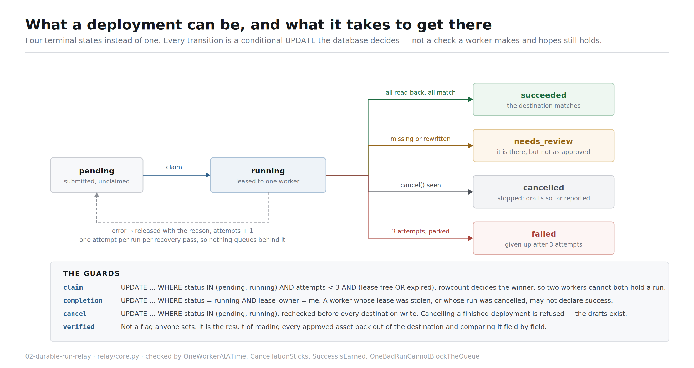
What a deployment is allowed to be
One terminal state became four.
Every transition is a conditional UPDATE the database decides, not a check a worker makes and hopes still holds.
'succeeded' is now expensive to reach: you get it only by reading every approved asset back and finding it matching.
Anything else lands somewhere that says what is wrong.
relay/core.py · checked by OneWorkerAtATime and CancellationSticks

Slide 8
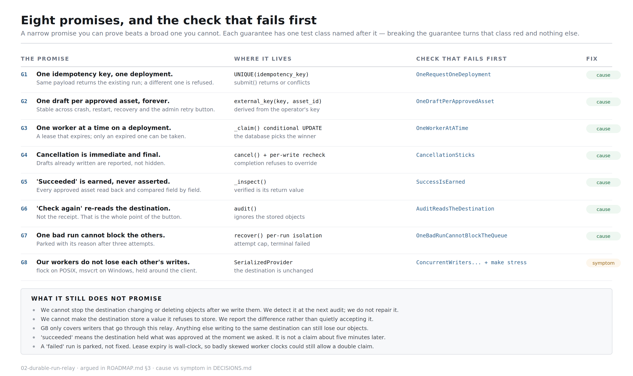
Eight promises, and the check that fails first
A narrow promise you can prove beats a broad one you cannot.
Each guarantee has exactly one test class named after it.
I broke each guarantee in core.py in turn and confirmed only the matching class goes red — five mutations, five clean hits.
Seven remove a cause. One only stops a symptom, and the deck and the write-up both say so.
ROADMAP.md §3 · tests/test_guarantees.py

Slide 9
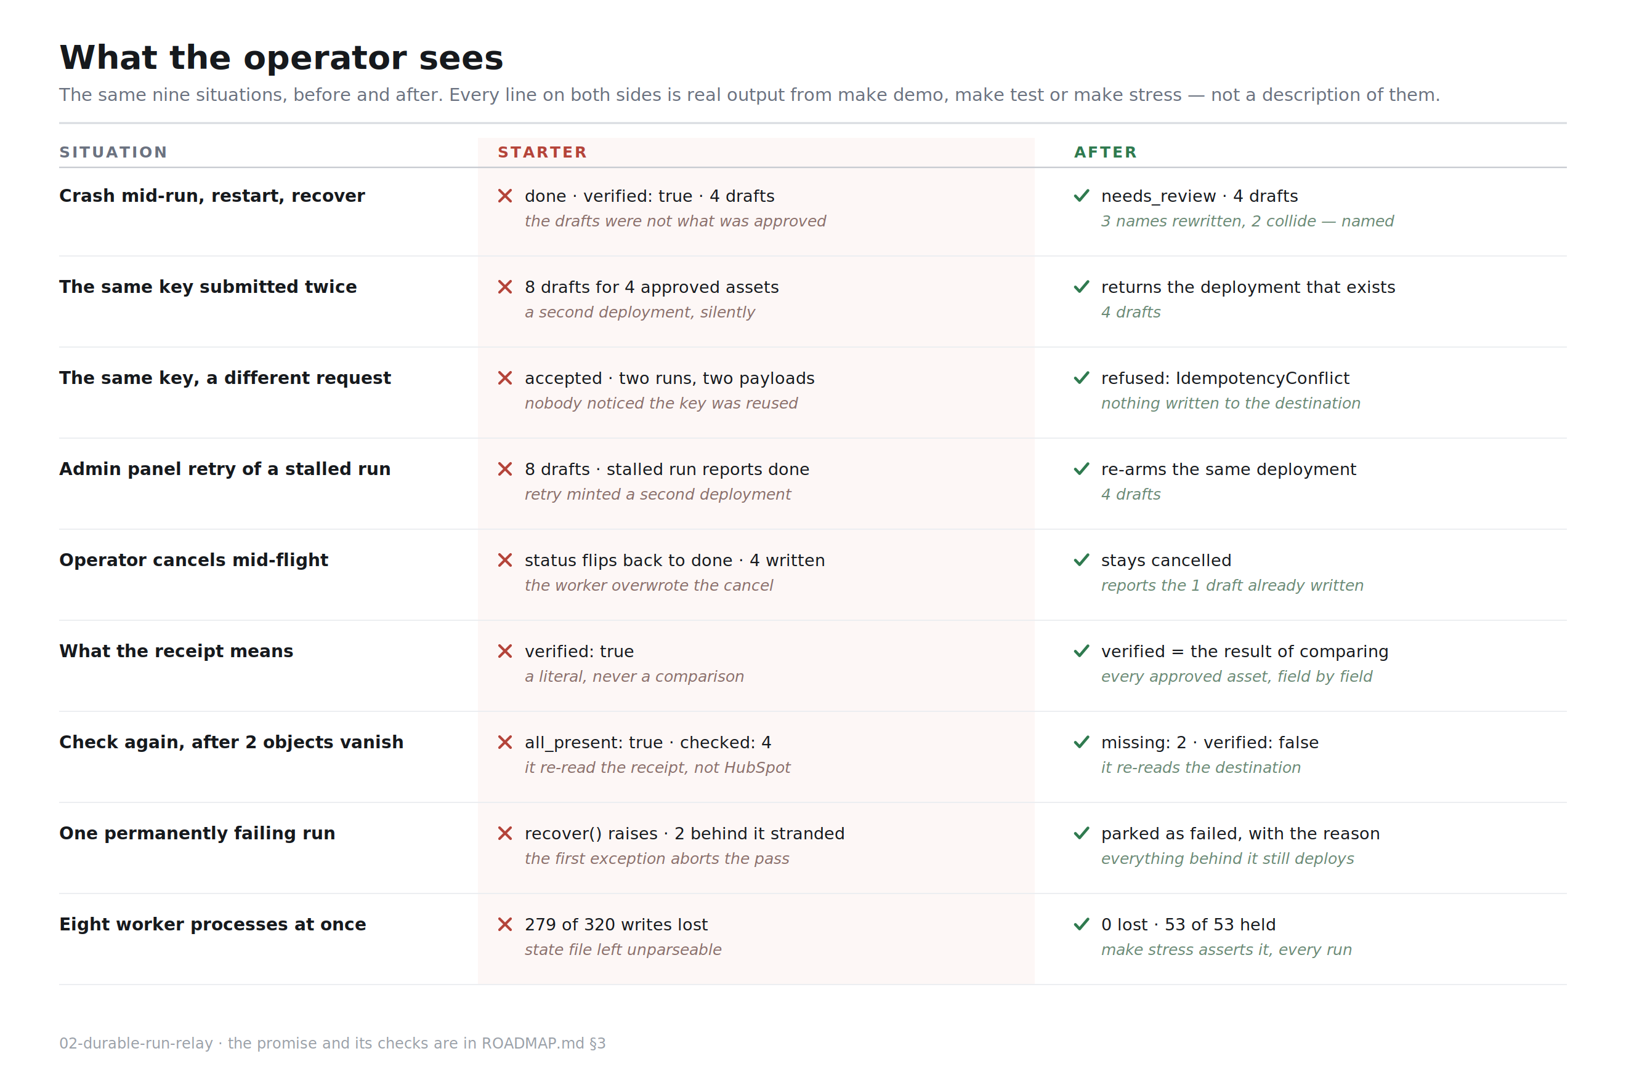
The result, side by side
The same nine situations, before and after.
Every line on both sides is real output from make demo, make test or make stress — not a description of them.
make demo no longer prints a clean run. The main fixture ends needs_review, and that is the point.
The short fixture is there to show succeeded is still reachable.
make demo · make test · make stress

Slide 10
Cause removed, or symptom stopped
Both can be the right call under time pressure. Shipping one while describing it as the other is not.
CAUSE REMOVED
SYMPTOM STOPPED, CAUSE STILL THERE
Identity is the operator's key, enforced by a UNIQUE index — duplicates cannot be created rather than cleaned up after.
Claiming is a conditional UPDATE, so the double claim cannot happen.
Completion is conditional on still holding the lease, so cancellation cannot be overwritten.
verified is the output of a comparison, so the receipt cannot claim more than it checked.
Recovery isolates per run and parks after three attempts, so one run cannot strand the queue.
The lock around the destination. The cause is a destination that is not safe for concurrent writers, and it is not mine to change. This removes us as a cause of the loss — nothing more.
The read-back after an ambiguous write. It does not stop the destination timing out; it stops us guessing wrong about which way the call went.
needs_review on the rewritten names is reporting, not repair. The drafts in HubSpot are still not what the marketer approved. Somebody has to shorten the names.
Five fixes, five causes gone.
Labelled as symptoms in the write-up, not dressed up as fixes.
DECISIONS.md

Slide 11
Three bugs of my own, all caught by running things
None of these showed up by reading the code. Two of them recreated the exact failure I was fixing.
1
2
3
My first recover() recreated c9
My first stress.py stole live leases
My first destination lock was POSIX-only
It broke out of the loop when a run made no progress, so the runs queued behind a failing one stayed pending — the exact bug I was fixing, in new clothes.
Pool workers passed reclaim_after=0.0, which force-expires a live lease. Every worker stole every run mid-flight and eight healthy deployments were parked as failed.
It caught the ImportError for fcntl and fell through to a thread lock — no lock at all across processes. Green on Linux, corrupted the destination on Windows.
A failing run now gets one attempt per pass and is stepped over for the rest of it.
The harness told me, which is the argument for making make stress exit non-zero rather than print a report.
It now dispatches to msvcrt on Windows, and where neither exists the check for that guarantee skips with the reason instead of passing.
DECISIONS.md · what changed between the roadmap and what shipped

Slide 12
What it still cannot promise
The honest edge of the design. All of this is in the write-up and printed by make demo.
We cannot stop the destination changing or deleting objects after we write them. We detect it at the next audit; we do not repair it, and nothing re-audits on a schedule.
We cannot make the destination store a value it refuses to store. We report the difference rather than quietly renaming the operator's asset to fit.
The lock only covers writers that go through this relay. Anything else writing to the same destination can still lose our objects.
'succeeded' means the destination held what was approved at the moment we asked. It is not a claim about five minutes later.
A failed run is parked, not fixed. Lease expiry is wall-clock, so badly skewed worker clocks could still allow a double claim.
CHECK IT YOURSELF
make demo
nine sections, walks the report
make test
37 checks, one class per promise
make stress
8 processes, non-zero if one breaks
github.com/prajapatizeel240024/02-durable-run-relay
ROADMAP.md is the plan · docs/DESIGN.md is the walkthrough · DECISIONS.md is the write-up

