Slide 1




£0
APACHE AIRFLOW & K8

Slide 2
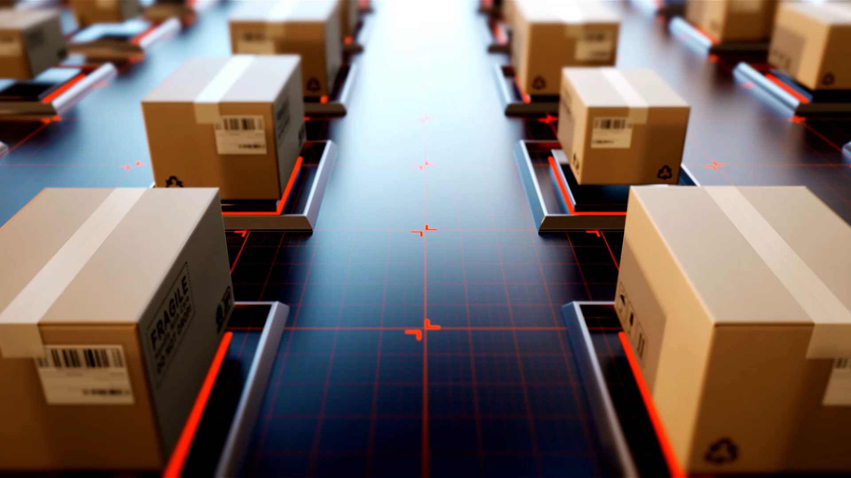
It will take almost a DECADE to SPEND £180,000 on Kubernetes
WHILE WE WAIT FOR ANOTHER BIG THINGs

Slide 3
WHAT YOU WILL WITNESS NEXT IS A CULTURE SHIFT AND DIFFERENT WAY OF THINKING DATA & PIPELINES. SCALABLE. RELIABLE. ACCURATE.
DEMO
(SUDHAKAR)

Slide 4
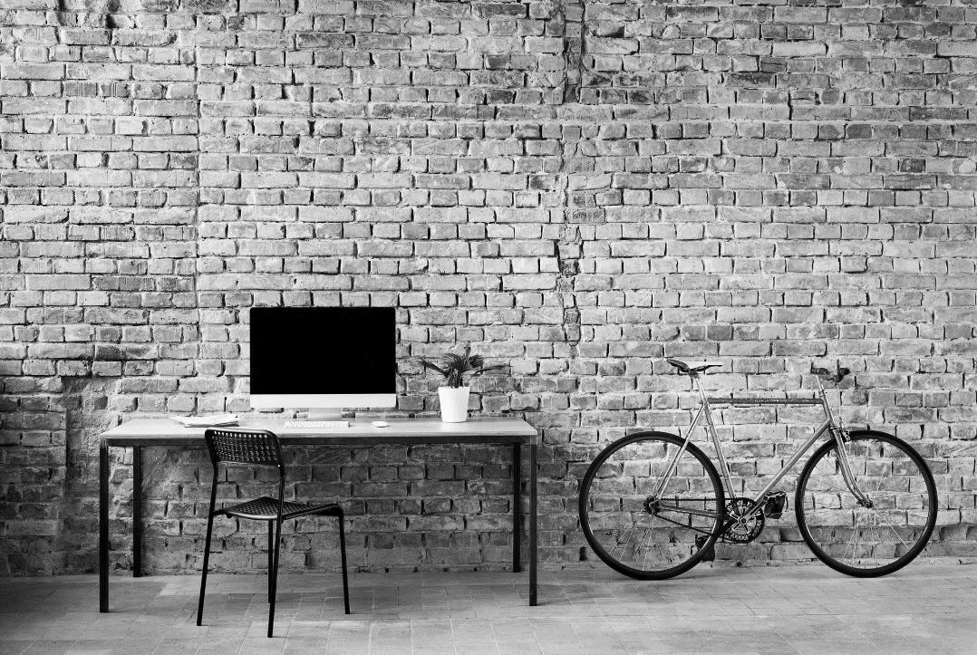
What’s next
LOOKING AHEAD

