Slide 1


BACK ORDER PREDICTION
Group No. 4
Team Members:
Prajeesh P
Rachana
Mohammed Touqeer Ar
Sudhan Murugavel
Anmol Gupta
Under Esteemed Guidance of
Ms. Prachi Tare

Slide 2

BRIEF OVERVIEW
Backorder prediction is a process of estimating the likelihood of a stockout or a backorder, i.e., when the inventory is depleted and the customer is unable to receive their order.
Backorder prediction helps businesses to avoid stockouts and improve customer satisfaction by ensuring that products are always in stock.
Backorder prediction is usually performed by analyzing historical sales data, inventory levels, and other relevant factors.
Backorder prediction can be useful for a variety of businesses, including retailers, manufacturers, and wholesalers.
By accurately predicting demand, businesses can optimize their inventory levels, reduce the risk of stockouts, and improve customer satisfaction.

Slide 3


PROJECT OBJECTIVE
The primary business objective of Back Order Prediction is to improve inventory management and avoid stockouts.
The following are the specific business objectives that Back Order Prediction seeks to achieve:
Increase sales revenue
Improve customer satisfaction
Optimize inventory management
Improve supply chain management
Reduce costs

Slide 4
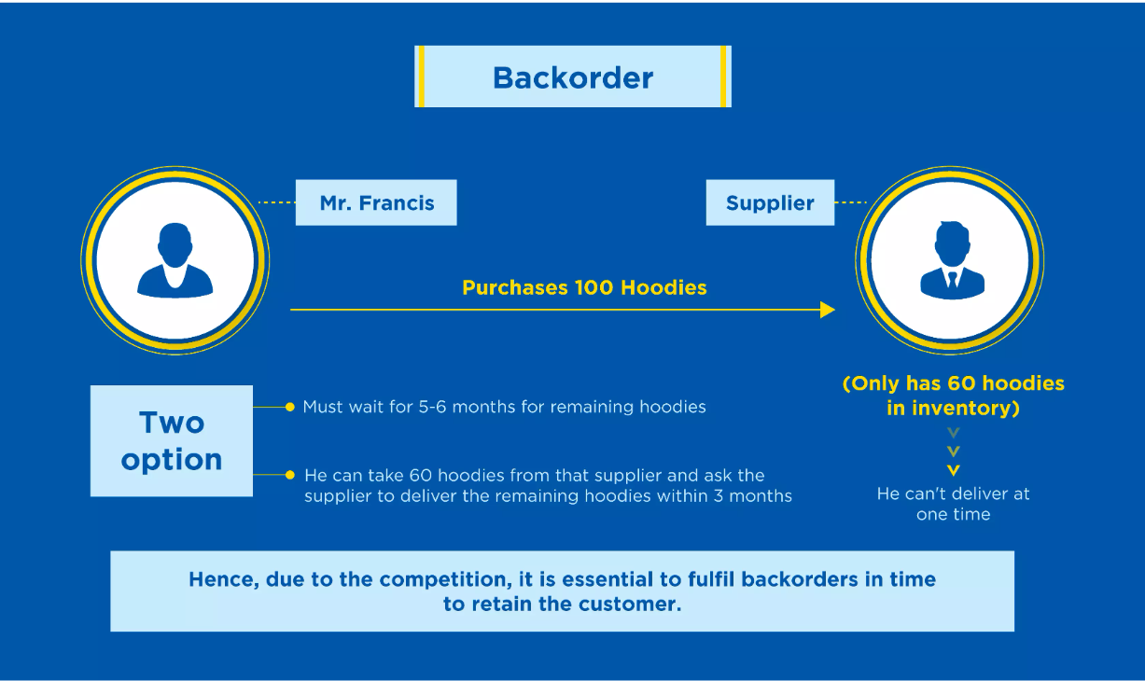
HOW DO BACKORDERS WORK?

Slide 5

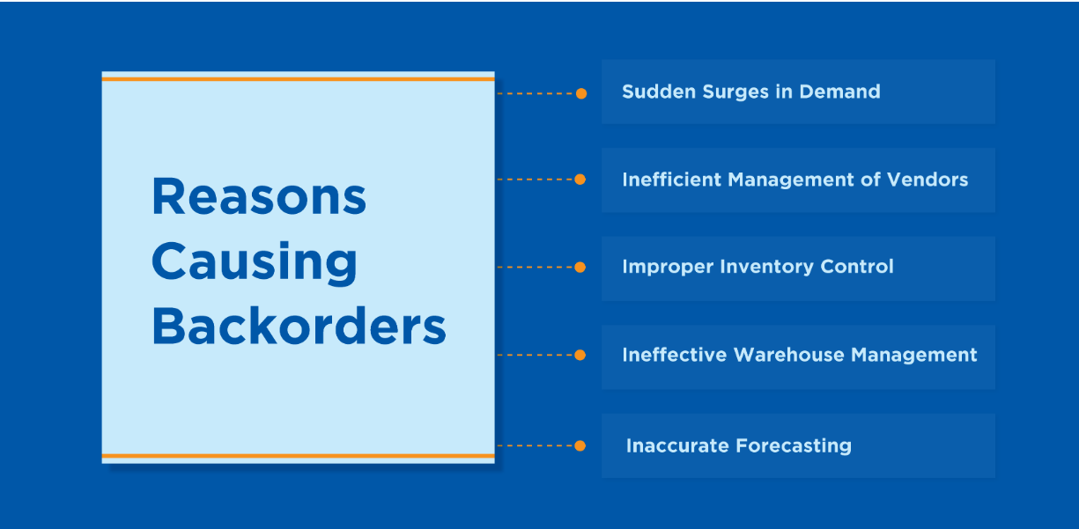
REASONS CAUSING BACKORDERS

Slide 6




TIPS TO MINIMIZE BACKORDERS

Slide 7

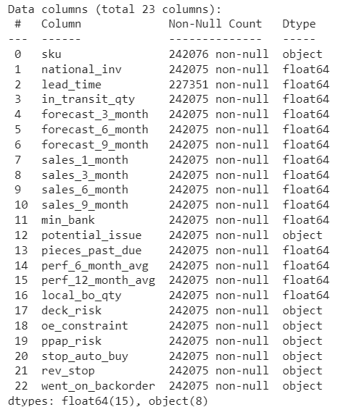
DATASET INFORMATION
Data is taken from Kaggle (Back Order Prediction)
No. of features: 23
No. of records: 242076
Target Column: went_on_backorder
Redundant columns: sku
No. categorical columns : 7

Slide 8
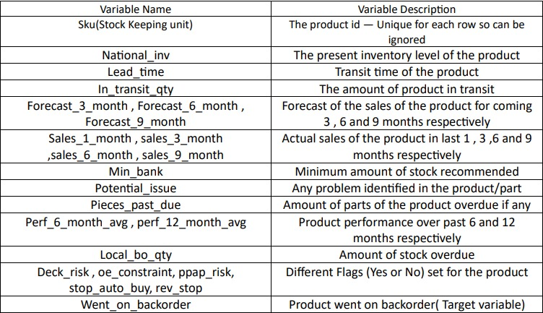
VARIABLE DESCRIPTION

Slide 9
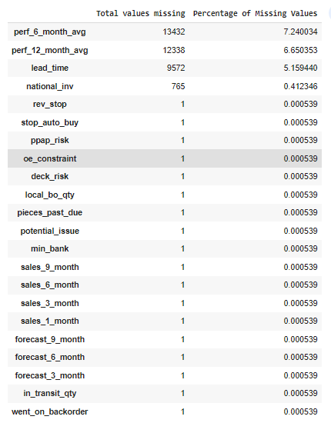
EXPLORATORY DATA ANLYSIS(EDA)
Missing Values
Out of 23 features 3 feature variable has majority of the missing values.
20 of them had less than 1% of missing values, hence the rows were deleted directly.
Droping record with index=185523 since it is have null values all columns.
Imputation
Since Outliers are present , for imputation of missing value we use median Imputation

Slide 10
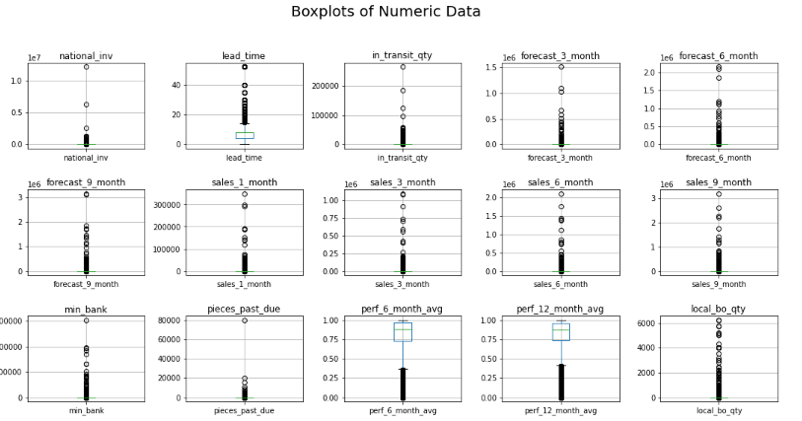
EXPLORATORY DATA ANLYSIS (EDA)
Outlier Treatment
The box plots above are plotted for entire data. As there is a high variance in the scale(range) of each feature the Box or IQR(Inter Quartile Range) (25th — 75th Percentile) is not clearly visible.
Winsorization can be a good approach to handle a large number of outliers, particularly because the outliers are genuine extreme values and removing them would significantly alter the results of the analysis.

Slide 11
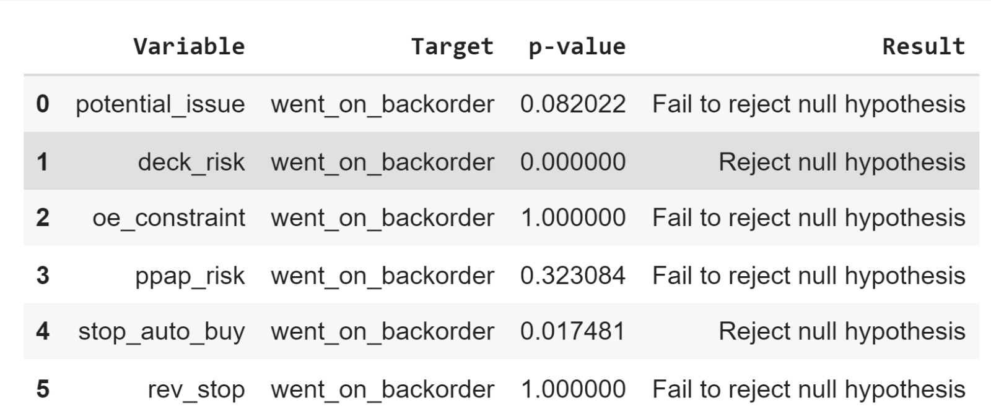
STATISTICAL ANALYSIS OF DATA
Chi-square test of independence
Null hypothesis: There is no relationship between the two categorical variables.
Alternative hypothesis: There is a relationship between the two categorical variables.
Based on the results of the hypothesis tests, we can infer that the variables 'deck_risk' and 'stop_auto_buy' are significant in predicting whether an item will go on backorder or not.

Slide 12
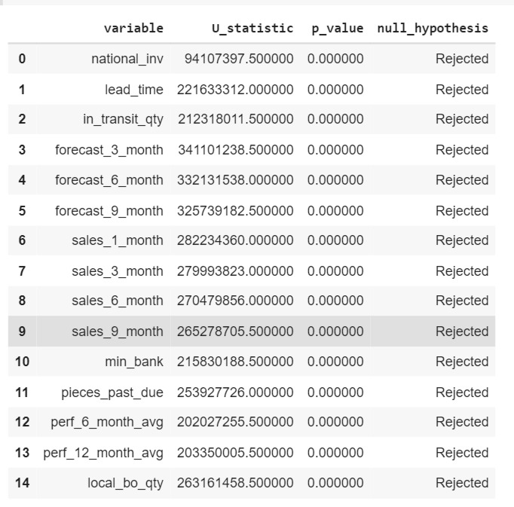
STATISTICAL ANALYSIS OF DATA
Mann-Whitney test
Null Hypothesis: There is no difference between the medians of the two groups.
Alternative Hypothesis: There is a significant difference between the medians of the two groups.
We can conclude that there are significant differences in the numerical variables between the two groups, and these variables could be useful in predicting whether a product will go on backorder or not.

Slide 13
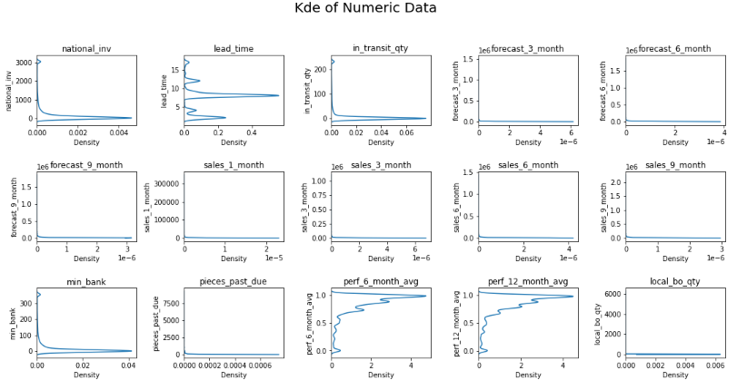
EXPLORATORY DATA ANALYSIS (EDA)
Univariate Analysis (Numerical Variable)
`lead_time` is moderately skewed.
`perf_6_month_avg` and `perf_12_month_avg` are
negatively skewed.
Rest of the variables are highly positively skewed.

Slide 14

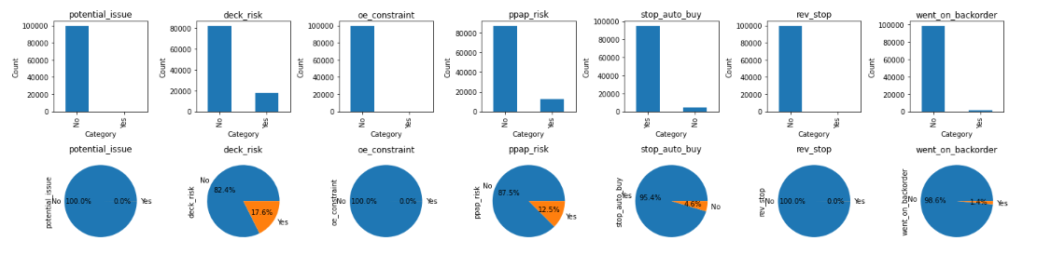
EXPLORATORY DATA ANALYSIS (EDA)
Univariate Analysis (Categorical Variable)
The Bar plots shows the percentage of product going/not going into backorder for every value of categorical Feature.
For example , the Blue bar illustrates the percentage of products not going to Backorder when Potential_issue =’Yes’/’No’ and the Orange bar illustrates percentage of products going to backorder when Potential_issue=’Yes’/’No’.

Slide 15
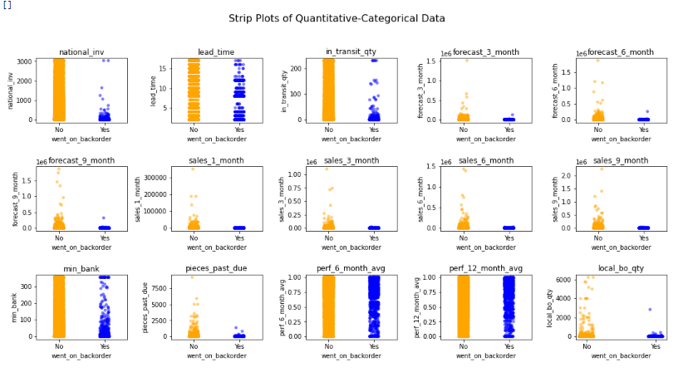
Exploratory Data Analysis (EDA)
Bivariate And Multivariate Analysis
'Strip Plots of Quantitative-Categorical Data(Target Variable:-went_on_backorder)
Orange(No) category of the binary variable is densely distributed while the other is partially empty, it may suggest that the feature being visualized has a stronger relationship with one of the binary categories except for perf_6_month_avg and perf_12_month_avg

Slide 16

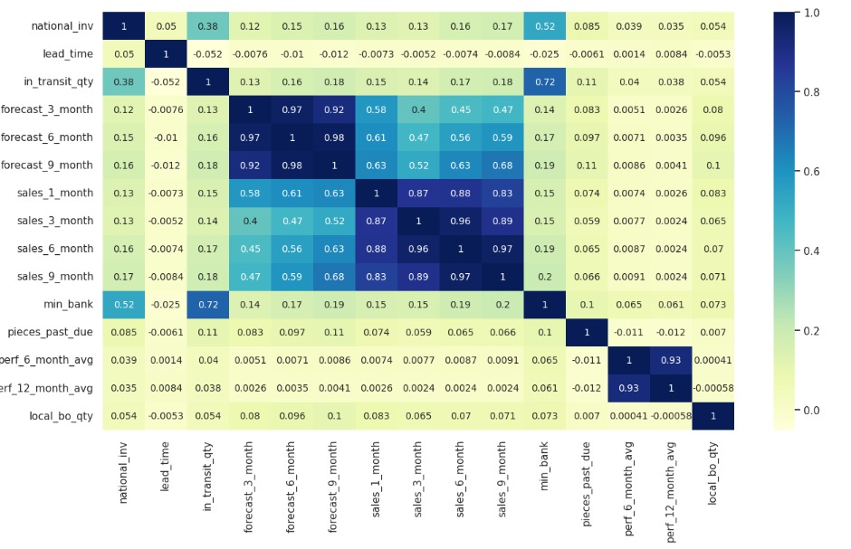
Bivariate And Multivariate Analysis
EXPLORATORY DATA ANALYSIS (EDA)

Slide 17
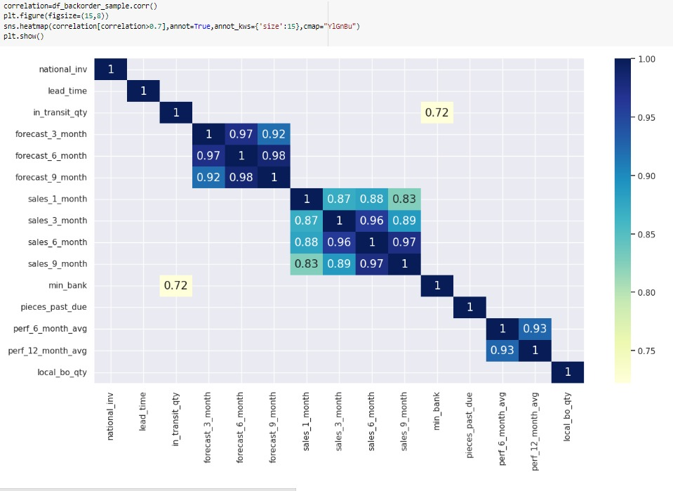
EXPLORATORY DATA ANALYSIS (EDA)
Bivariate And Multivariate Analysis
From the correlation matrix , we can easily interpret that features from in_transit_qty to min_bank are more correlated with each other. Also the perf_6_months_avg and perf_12_months_avg is highly correlated with each other.
Apart from the above mentioned features, other features are very weakly correlated.

Slide 18

EXPLORATORY DATA ANALYSIS (EDA)
ENCODING
Many machine learning algorithms require numerical inputs.
Here we have mapped No with ‘0’ and yes with ‘1’ for every categorical variable.
SCALING AND TRANSFORMATION
Here we have done Robust Scaling to scale numerical data so that it has a mean of 0 and a standard deviation of 1, while being robust to the presence of outliers.
And later performed Yeo-Johnson Power Transformation to normalize numerical data that may not follow a normal distribution. It is an extension of the Box-Cox transformation that can handle both positive and negative values.

Slide 19

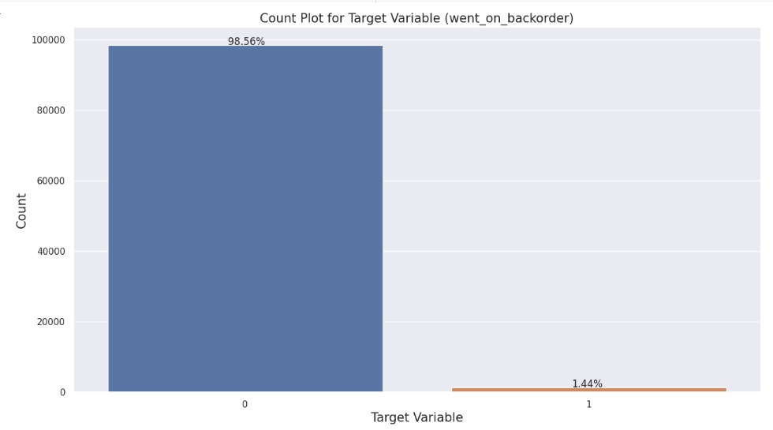
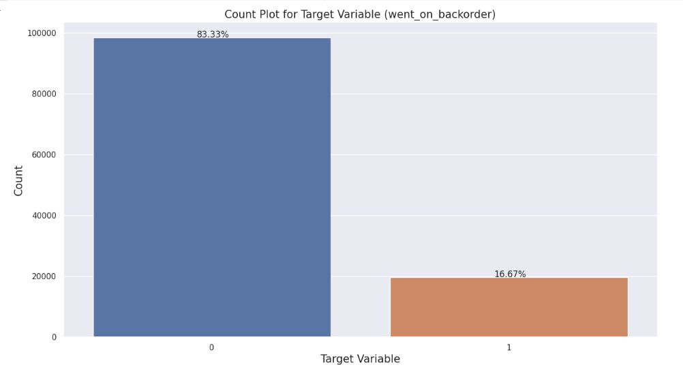
CHECKING FOR CLASS IMBALNCE
In this case, the '0' class represents about 98.56% of the samples, while the '1' class represents only 1.44% of the samples.
This level of imbalance can cause problems for a binary classification model, as it may be biased towards predicting the majority class and may not perform well on the minority class
SMOTE
SMOTE(Synthetic Minority Over-sampling Technique) works by generating synthetic examples of the minority class using the existing data.
To address this imbalance, we can use algorithms specifically designed for imbalanced data, such as SMOTE (Synthetic Minority Over-sampling Technique).
Minority class will be oversampled to have 20% of the number of samples of the majority class.

Slide 20

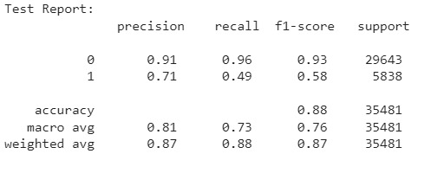
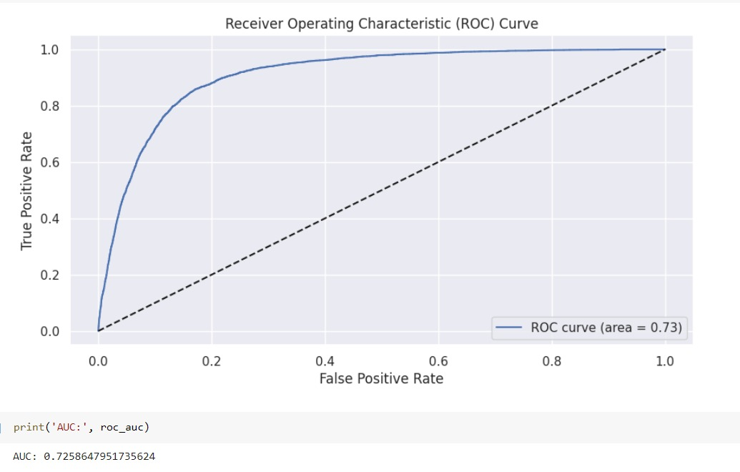
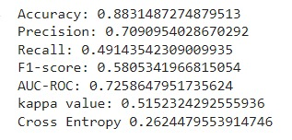
LOGISTIC REGRESSION (BASE MODEL)
Classification Report:
Accuracy of model is 0.88
ROC Curve:
In this case, the AUC-ROC is 0.7258, indicating that the model performs moderately well at distinguishing between positive and negative instances.

Slide 21

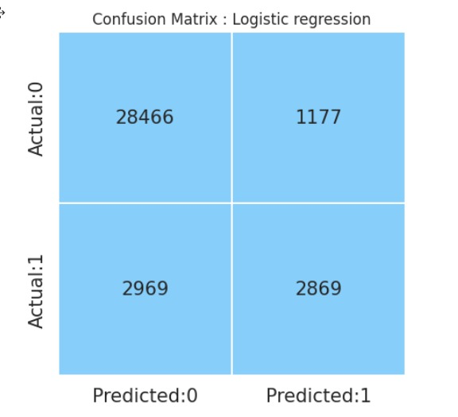
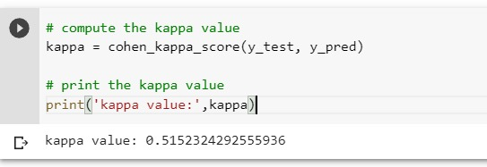
LOGISTIC REGRESSION (BASE MODEL)
Confusion Matrix
In this confusion matrix, there are a total of 35,481 samples.
The true negatives (TN) are 28,466.
The false negatives (FN) are 2,969.
The true positives (TP) are 2,869.
The false positives (FP) are 1,177.
Kaapa Score
In this case, the kappa value is 0.5152, which indicates moderate agreement between the predicted and actual classifications. This means that the model's predictions are better than chance, but there is still some room for improvement in its performance.

Slide 22

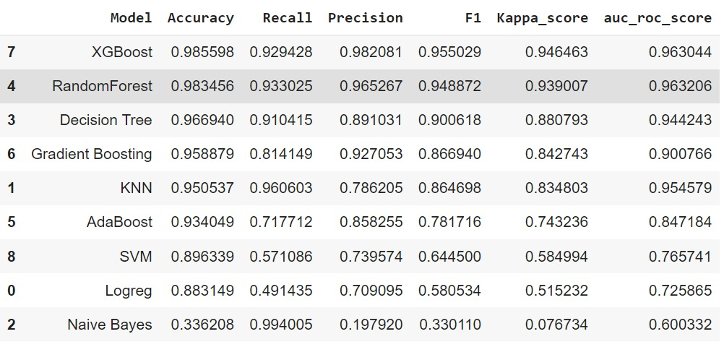
Comparison Of Performance Of Various Model
Based on the evaluation metrics, the XGBoost model has the highest accuracy (0.986), score (0.946), and AUC ROC score (0.963) among all the mode recall (0.929), precision (0.982), F1 score (0.955), kappa ls evaluated.

Slide 23

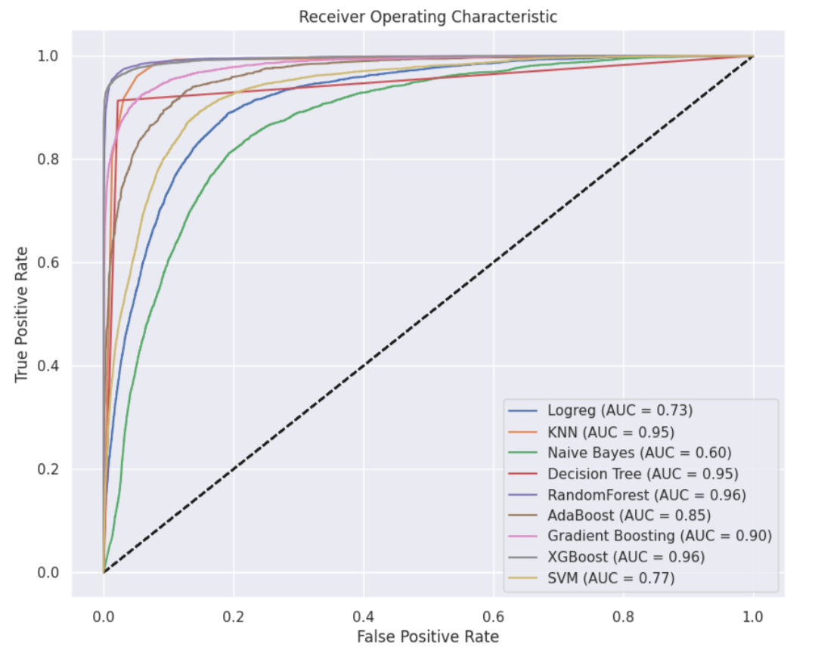
Receiver Operating Characteristic (ROC)

Slide 24

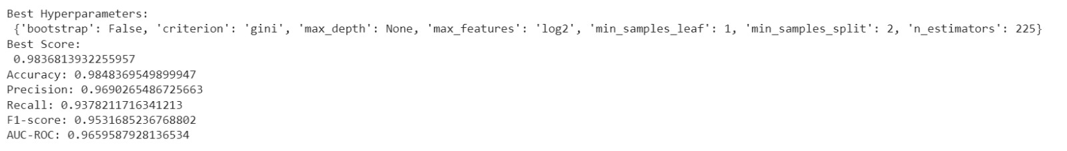
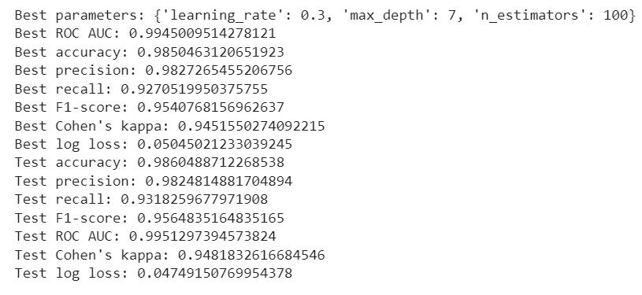
HYPERPARAMETER TUNING
Random Forest Using RandomizedSearchCV
XG Boost using GridSearchCV

Slide 25

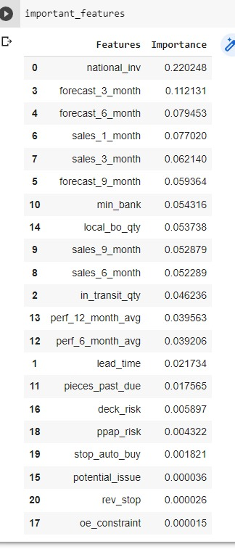
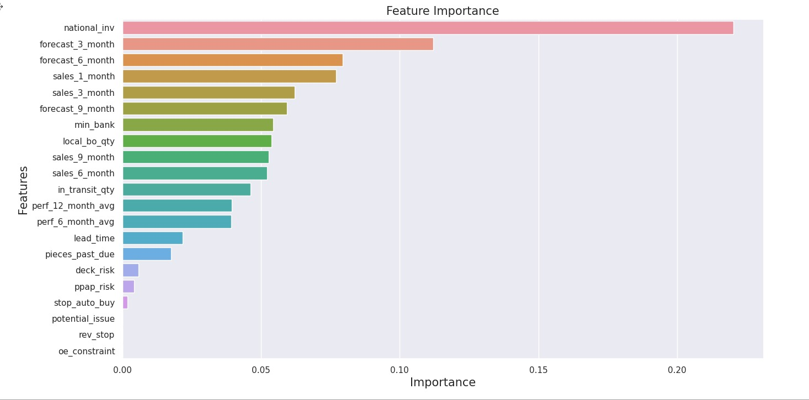
FEATURE IMPORTANCE
The most important feature for the model is "national_inv", which has an importance score of 0.2202.
The next most important features are "forecast_3_month" with importance scores of 0.1121.
The least important features are "potential_issue", "rev_stop", and "oe_constraint", all with importance scores less than 0.0001.

Slide 26

CONCLUSION
XGBoost and RandomForest models are the best performing models for backorder prediction, based on their high accuracy, recall, precision, F1, and kappa scores.
Decision Tree and Gradient Boosting models also show good performance.
KNN, AdaBoost, SVM, and logistic regression models have lower performance compared to the top-performing models, while the Naive Bayes model is not recommended for backorder prediction.

Slide 27

Thank You

