Slide 1
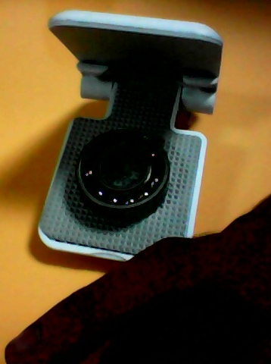
SSN · VISION TO VENTURE
EXtendQuality
Quality intelligence that knows
when to ask for help.
Local YOLO for routine inspection.
Selective VLM for uncertainty.
Human authority for every final decision.
TEAM ZeAI_MIH_407 · INDUSTRY 4.0 & MANUFACTURING
Notes:
Open with the outcome: affordable assisted inspection for MSMEs, not a claim of production autonomy.
[Sources]
- Local project photograph: storage/raw/7f8e3e9a4924486a8ef38419bd878cd3.jpg

Slide 2
EXtendQuality
02
THE MANUFACTURING GAP
Precision inspection is hard to democratize
MSMEs face a three-way constraint: consistency, data and deployment cost.
01
02
03
Human inspection varies
Industrial data is scarce
Cloud-first AI adds friction
Fatigue, lighting and judgement affect repeatability across shifts.
A few repeated views cannot represent parts, batches, severities and capture conditions.
Sending every frame to a reasoning model increases latency, cost and privacy exposure.
The opportunity is not another black box.
It is a governed inspection workflow that exposes uncertainty.
Notes:
Frame the problem without inventing market size or claiming all factories behave identically.
[Sources]
- User-provided mentor insights and EXtendQuality SSN pitch runbook

Slide 3
EXtendQuality
03
OUR ANSWER
Keep the common path local; escalate only ambiguity
Five explicit stages replace one mysterious confidence score.
01
02
03
04
05
CAPTURE
OPENCV
YOLO
DECISION
HUMAN
Frame
Quality gate
Known condition
Threshold route
Final authority
UNCERTAIN ONLY
SELECTIVE VLM
Advisory observation · reversible action
Confident cases: no API call
Uncertain cases: explain + review
Notes:
Keep image quality, YOLO confidence and decision threshold separate. The VLM never overturns the decision by itself.
[Sources]
- Repository: backend/app/services/decision/engine.py
- Repository: backend/app/services/vlm/adapter.py

Slide 4
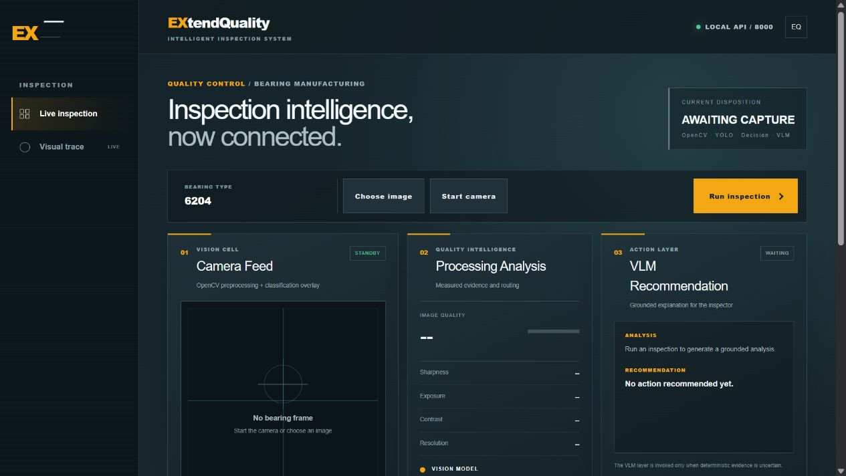
EXtendQuality
04
WORKING PROTOTYPE
One dashboard connects capture, evidence and action
The inspector sees what happened, why it routed, and what must happen next.
LIVE INPUT
Camera or prepared image
SEPARATE SIGNALS
Quality · class confidence
· disposition
EVIDENCE LOOP
SQLite metadata
+ local image artifacts
+ human confirmation
Notes:
Transition directly into the live demo after this slide.
[Sources]
- Live local dashboard screenshot captured 2026-08-22 from http://localhost:3000/

Slide 5
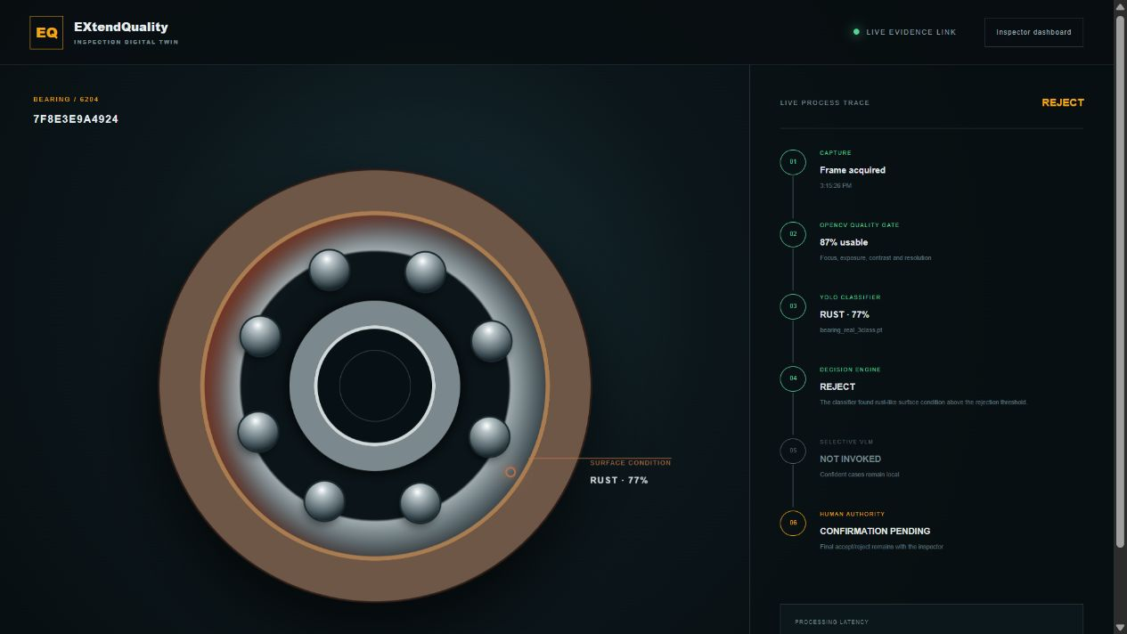
EXtendQuality
05
EXPLAINABILITY
The second screen makes routing visible
A presentation layer linked to stored evidence—not a claim of live 3D reconstruction.
RUST · 77%
REJECT
VLM NOT INVOKED
Confidence cleared the deterministic rejection threshold, so the case stayed local.
Human confirmation remains pending.
Notes:
Say explicitly that the bearing rendering is evidence-linked visualization, not reconstruction or calibrated metrology.
[Sources]
- Live local visualizer screenshot captured 2026-08-22 from http://localhost:3000/inspection-visualizer

Slide 6
EXtendQuality
06
TECHNICAL EVIDENCE
The POC works on photographed parts—within a narrow boundary
We report the number and its limitation together.
31 / 33
WHAT THIS PROVES
Prepared workflow feasibility
on the photographed bearings
harder excluded views correct
NORMAL
7/7
WHAT IT DOES NOT PROVE
Transfer to unseen bearings
Industrial accuracy
Millimetre measurement
DISPLACED
7/7
RUST
17/19
Two rust views were predicted normal.
Notes:
If asked for accuracy: repeated-view CV was 100%; excluded-view stress was 93.94% (31/33). Both use the same few physical bearings, so neither is unseen-bearing accuracy.
[Sources]
- docs/model_evaluation.md
- docs/demo_rehearsal_2026-08-22.md

Slide 7
EXtendQuality
07
MSME ECONOMICS
Spend reasoning cost only where uncertainty exists
The architecture controls cost before we claim a rupee figure.
ROUTINE LANE
UNCERTAIN LANE
OpenCV + local YOLO
VLM + human review
No per-image VLM call
Local metadata and artifacts
Warm inference measured in tens of ms
Only below threshold
Safe offline fallback
No autonomous safety decision
Pilot economics to measure
INSPECTION TIME SAVED
UNCERTAIN-CASE RATE
FALSE REJECT COST
CALLS / 1,000 PARTS
No fabricated pricing. Validate value at one factory cell, then price against measured savings.
Notes:
Our cost case is architectural today. Do not invent hardware savings or ROI without a pilot baseline.
[Sources]
- docs/ssn_pitch_runbook.md
- Repository implementation: selective VLM routing and local storage

Slide 8
EXtendQuality
08
PATH TO PRODUCT
A controlled pilot turns a good demo into defensible evidence
Hold out complete bearings and capture sessions—not random repeated frames.
01
02
03
04
05
BASELINE
CAPTURE
CURATE
VALIDATE
DEPLOY
Measure current inspection time, misses and rejects.
Fixed camera, fixture, lighting and bearing variants.
Independent parts, verified defects and reviewer agreement.
Per-class recall, false accepts, latency and repeatability.
One assisted cell with audit trail and rollback.
GO / NO-GO GATE
Advance only when unseen-bearing performance and false-accept risk meet the factory’s agreed threshold.
Notes:
This slide is the answer to 'what happens after the hackathon?'. Emphasize independent physical parts and agreed acceptance criteria.
[Sources]
- docs/model_evaluation.md
- docs/ssn_pitch_runbook.md

Slide 9
EXtendQuality
09
THE VENTURE ASK
Help us validate one
inspection cell—not sell
an unproven factory system.
THE RETURN
A measured pilot
with transparent evidence,
controlled cost, human governance
and a clear deployment gate.
WE NEED
Factory access · independent bearing samples
Defect-definition support · pilot mentorship
EXtendQuality
Local when confident. Assisted when uncertain. Human when it matters.
Notes:
Close with a concrete pilot ask. Do not end with a generic thank-you slide.
[Sources]
- docs/ssn_pitch_runbook.md

