Slide 1
Explainable Artificial Intelligence (XAI)
Concepts and Practical Application in Credit Risk Modeling
Name – Prajesh Bandhu Banerjee
Roll – 002510502004
Department of Computer Science & Engineering
Jadavpur University
Notes:
Introduce the topic, highlighting the need for explainable machine learning in credit risk systems.

Slide 2
Motivation: The Problem with Modern ML
Modern machine learning systems increasingly rely on complex, high-capacity models
These models achieve strong predictive performance but operate as black boxes
Model outputs provide predictions without insight into underlying reasoning
In credit risk modeling, such opacity limits human understanding of decisions
This creates a gap between model accuracy and human interpretability

Slide 3
Why Explainability is Necessary
Users cannot trust or effectively use predictions they do not understand
Feature-level explanations are required to validate model behavior
Explainability enables identification of spurious correlations learned by complex models
Attribution methods allow human accountability for automated decisions
Notes:
Explain why interpretability, fairness, and trust are mandatory in credit decision systems.

Slide 4
What is Explainable AI (XAI)?
A set of methods designed to explain individual predictions of complex machine learning models
Focuses on providing human-interpretable explanations without modifying the underlying model
Produces explanations in terms of input features and their contributions to a prediction
Aims to make model behavior inspectable, debuggable, and accountable
Complements predictive performance by enabling interpretation beyond accuracy metrics
Notes:
Define XAI and distinguish it from inherently interpretable models.

Slide 5
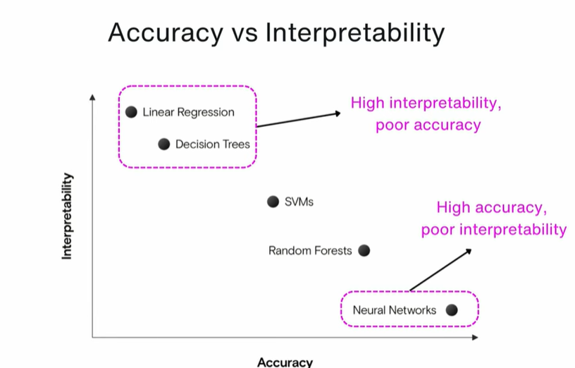

Slide 6
Taxonomy of Explainable AI
Inherently interpretable models Models whose structure is directly understandable, such as linear models or small decision trees
Post-hoc explanation methods Techniques that explain predictions after training a complex model, without modifying it (Ribeiro et al., 2016)
Local explanation methods Explain the reasoning behind individual predictions rather than the entire model
Global explanation methods Describe overall model behavior by aggregating explanations across many predictions (Lundberg et al., 2019)
Notes:
Explain why credit scoring is a high-stakes ML application.

Slide 7
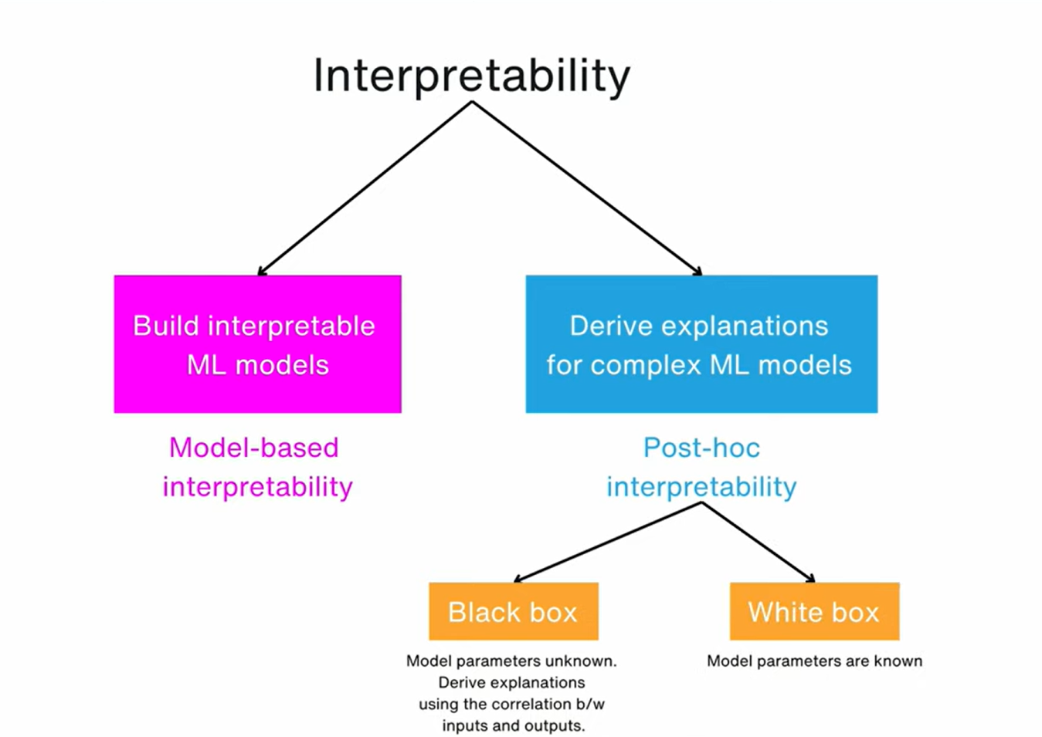

Slide 8
Local vs Global Explanations
Local Explanations
Explain why a specific prediction was made for an individual instance (Ribeiro et al., 2016)
Provide feature-level contributions for a single decision
Used to assess whether a particular prediction is reasonable and trustworthy
Implemented in this work using LIME and local SHAP explanations
Global Explanations
Describe how the model behaves overall across the dataset (Lundberg et al., 2019)
Identify which features are consistently important for predictions
Enable inspection of systematic patterns and biases
Implemented in this work by aggregating SHAP values across samples
Notes:
Briefly describe the dataset and why it is suitable for explainable AI analysis.

Slide 9
Post-hoc Explainability
Explanation methods applied after a model has been trained, without altering its internal structure (Ribeiro et al., 2016)
Treat the predictive model as a black box, requiring only access to inputs and outputs
Enable interpretation of high-performing but opaque models, such as ensemble trees
Allow explanations to be generated at prediction time
This work focuses on post-hoc explainability using LIME and SHAP applied to XGBoost
Notes:
Explain domain-informed feature encoding and why two pipelines were used.

Slide 10
LIME: Conceptual Foundation
Local Interpretable Model-Agnostic Explanations (LIME) proposed by Ribeiro et al. (2016)
Designed to explain individual predictions of any black-box classifier
Assumes that a complex model can be locally approximated by an interpretable model
Generates explanations using a simple, human-interpretable surrogate model
Focuses on explaining why this specific prediction was made, not the entire model
Notes:
Discuss why multiple models were compared.

Slide 11
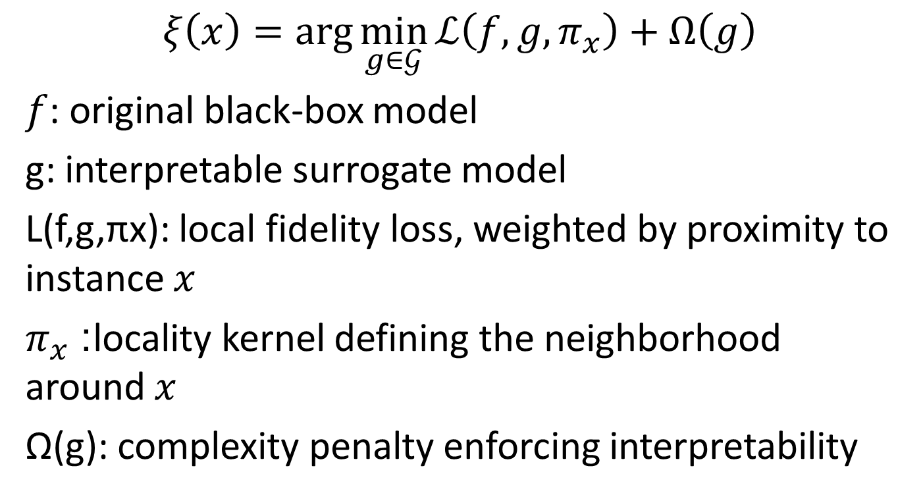
LIME: Mathematical Formulation
$$ξ\left(x\right)=\arg{\min_{g∈𝒢}{ℒ\left(f,g,π_{x}\right)}}+Ω\left(g\right)$$ $f$: original black-box model
g: interpretable surrogate model
L(f,g,πx​): local fidelity loss, weighted by proximity to instance $x$
$π_{x}$: locality kernel defining the neighborhood around $x$
Ω(g): complexity penalty enforcing interpretability
Notes:
Justify evaluation metrics and methodology.

Slide 12
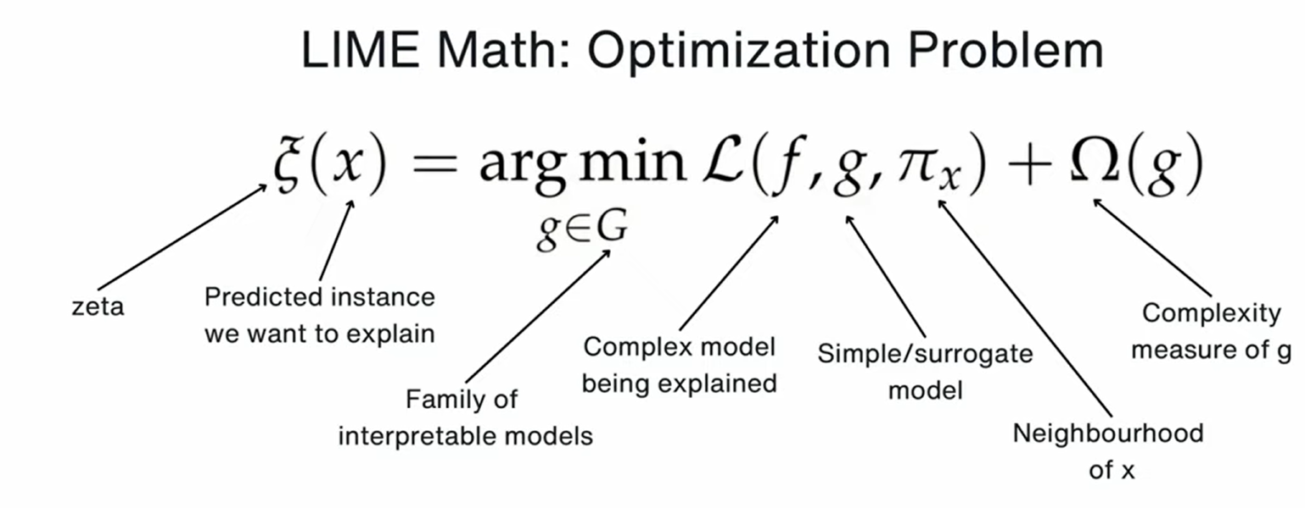


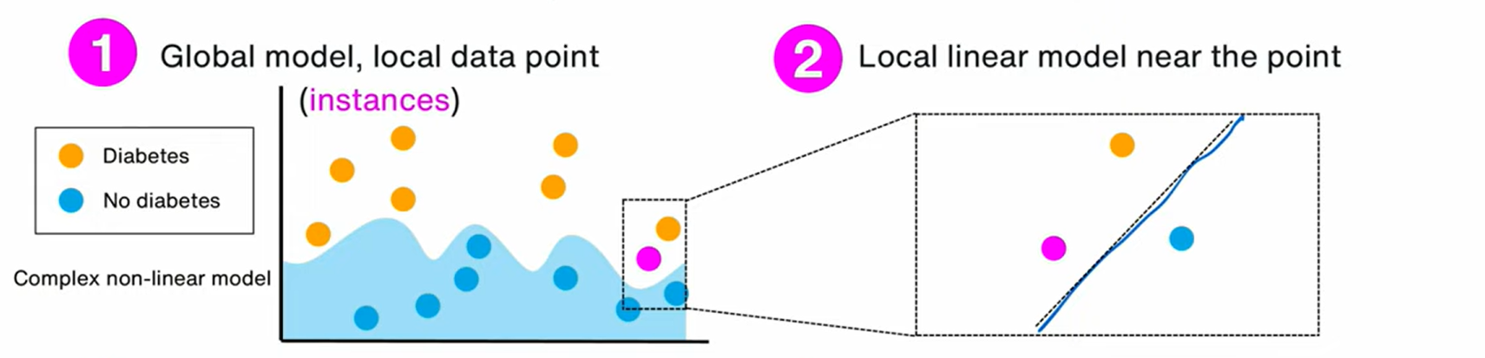


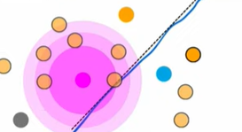

Slide 13
LIME: Strengths and Limitations
Strengths
Model-agnostic: applicable to any classifier with input–output access (Ribeiro et al., 2016)
Produces human-interpretable explanations using simple surrogate models
Enables users to assess trust in individual predictions
Useful for debugging and validating specific model decisions
Limitations
Explanations are locally faithful, with no guarantees of global correctness
Different local explanations may be inconsistent across instances
Results depend on the sampling strategy and neighborhood definition
Not suitable for explaining overall model behavior
Notes:
Explain the rationale for choosing XGBoost.

Slide 14
SHAP: Conceptual Foundation
SHapley Additive exPlanations (SHAP) proposed by Lundberg & Lee (2017)
Based on Shapley values from cooperative game theory
Treats each input feature as a player contributing to the prediction
Attributes prediction outcomes through fair and principled feature contributions
Provides explanations that are additive and comparable across instances
Notes:
Introduce LIME and its purpose.

Slide 15

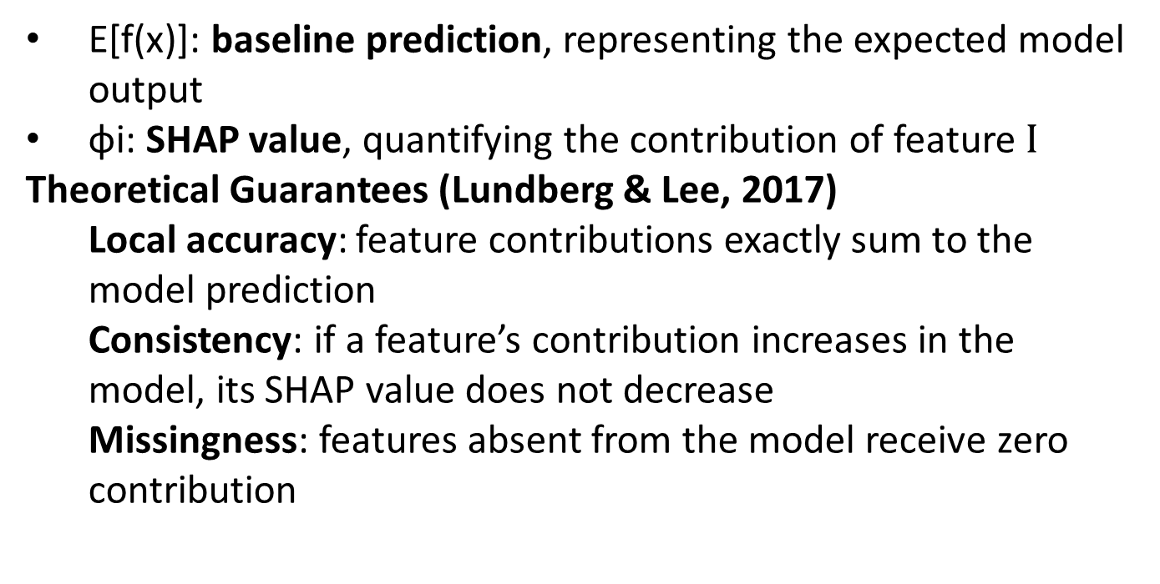
SHAP: Theory and Guarantees
E[f(x)]: baseline prediction, representing the expected model output
ϕi​: SHAP value, quantifying the contribution of feature $I$
Theoretical Guarantees (Lundberg & Lee, 2017)
Local accuracy: feature contributions exactly sum to the model prediction
Consistency: if a feature’s contribution increases in the model, its SHAP value does not decrease
Missingness: features absent from the model receive zero contribution
Notes:
Explain the mathematical formulation of LIME.

Slide 16
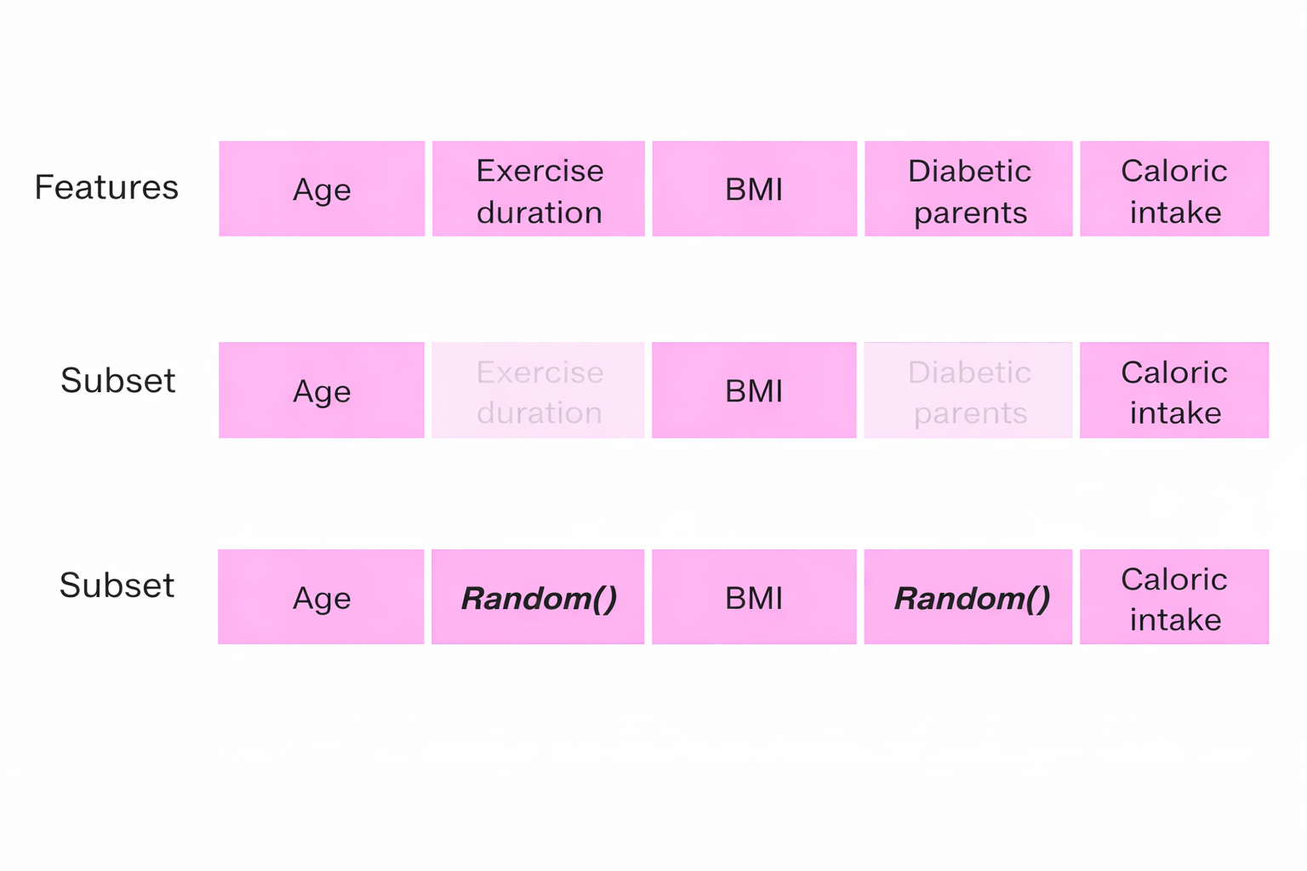
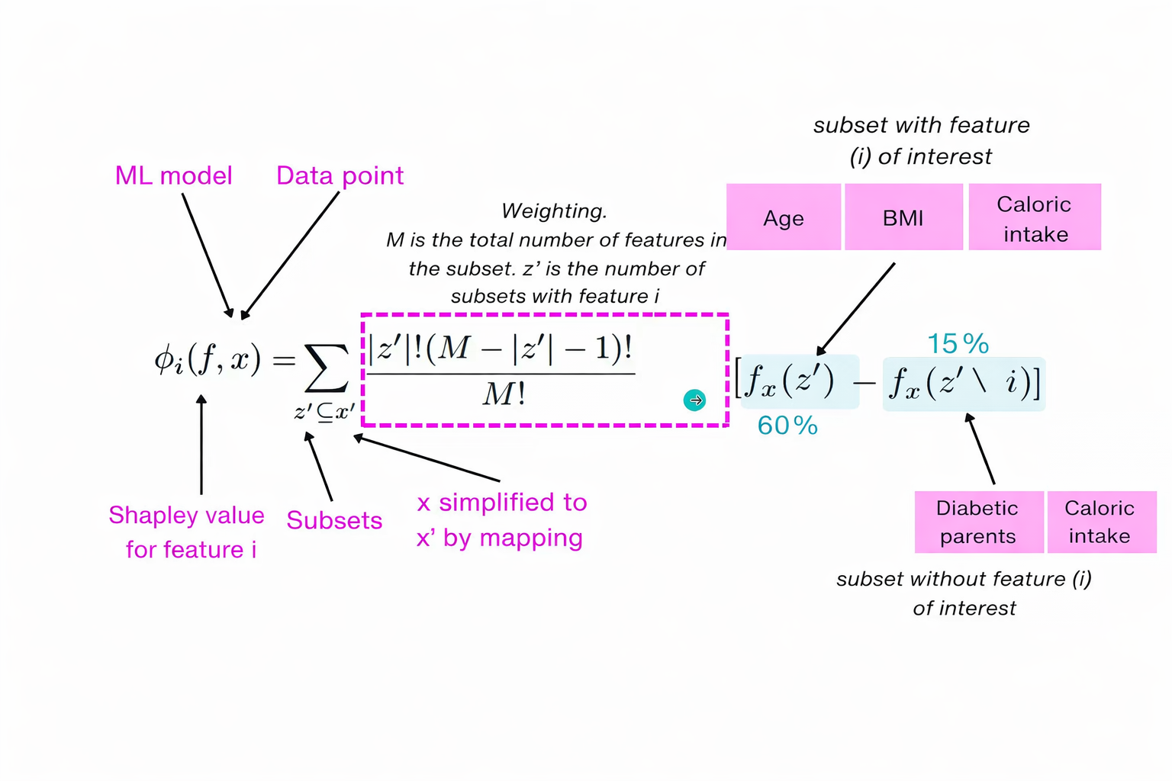

Slide 17
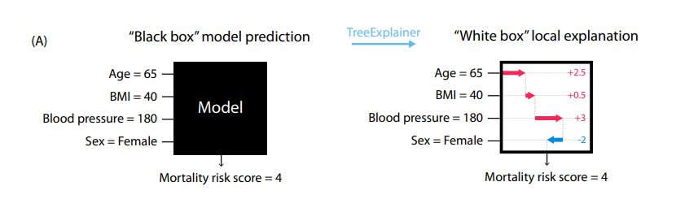
TreeExplainer
TreeExplainer is a specialized SHAP algorithm for tree-based models (Lundberg et al., 2019)
Computes exact SHAP values by exploiting the structure of decision trees
Avoids sampling-based approximations used in generic SHAP methods
Efficiently scales to tree ensembles, including Random Forests and XGBoost
Used in this work to explain the trained XGBoost credit risk model

Slide 18
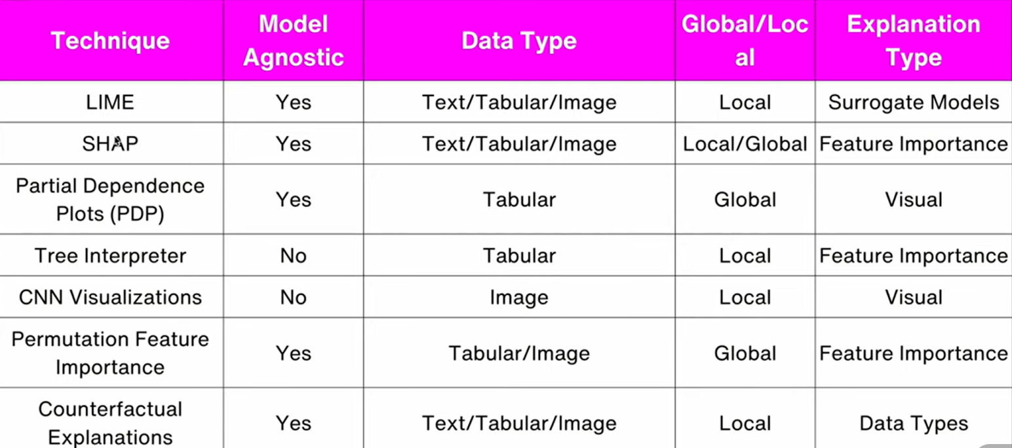

Slide 19
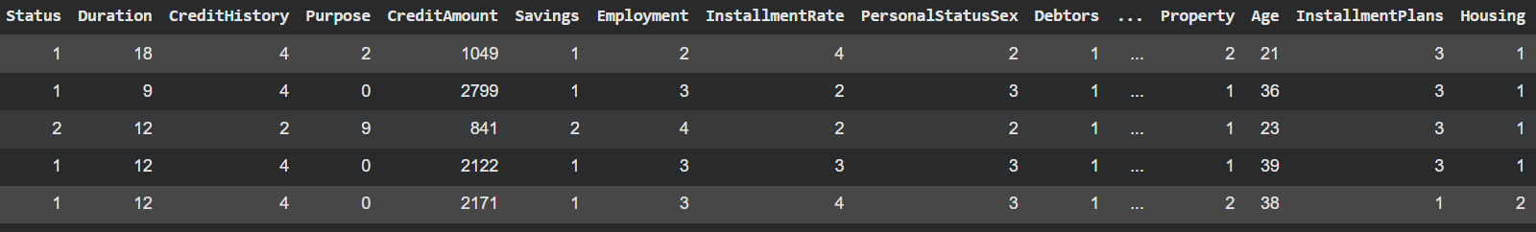
Practical Validation of Explainable AI
Binary credit risk prediction task (good vs bad credit)
Dataset: UCI Machine Learning Repository – German Credit Dataset
Trained and evaluated multiple classification models:
Logistic Regression
Decision Tree
Random Forest
Multi-Layer Perceptron (MLP)
XGBoost
Performed model comparison using ROC-AUC and cross-validation
Notes:
Introduce SHAP and its theoretical advantages.

Slide 20
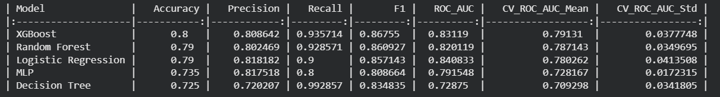
Practical Validation of Explainable AI
XGBoost achieved the highest ROC-AUC performance among the evaluated models
Selected XGBoost for detailed explainability analysis
Applied LIME for instance-level explanations
Applied SHAP (TreeExplainer) for local and global feature attribution

Slide 21
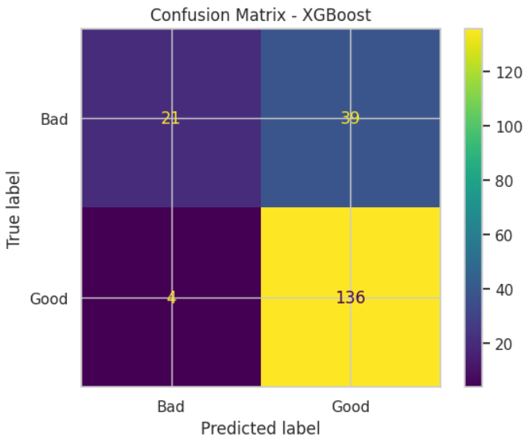
Findings and Conclusion
High recall for good credit applicants (97.1%)
Very few good customers incorrectly rejected (FN = 4)
Moderate false positives (39 bad customers approved)
Model favors approval → suitable for pre-screening, not final decision
Notes:
Explain SHAP values and their properties.

Slide 22
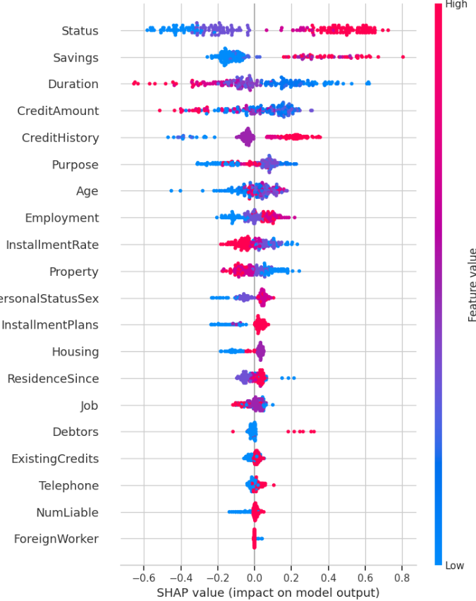
Findings and Conclusion
Status and Savings are the most influential features
Poor financial buffers strongly reduce approval probability
Longer loan duration and higher credit amount increase risk
Demographic features have relatively smaller global impact

Slide 23
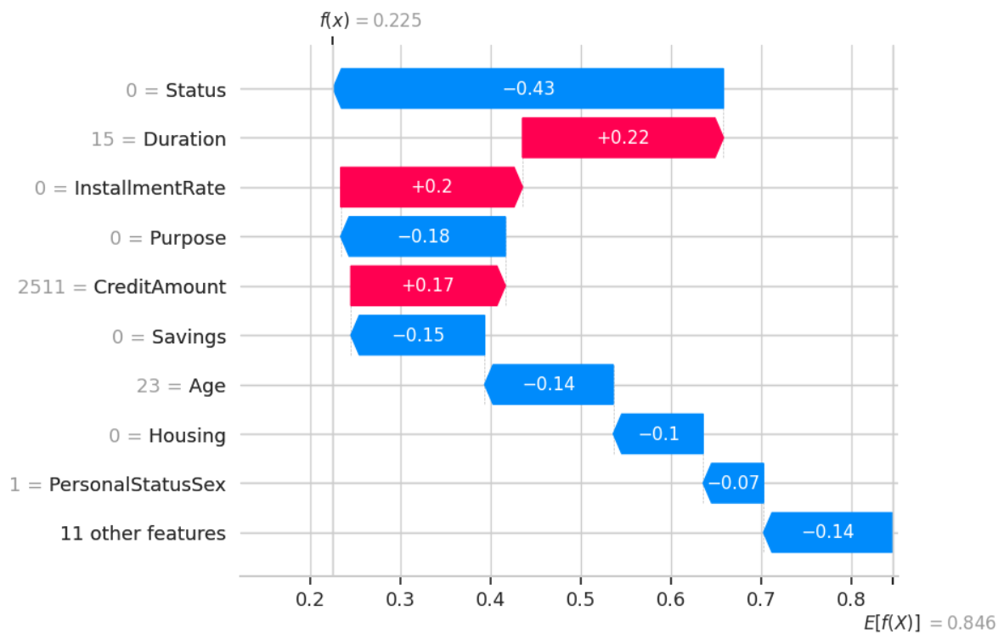
Findings and Conclusion
Base approval probability: 0.846
Final predicted probability: 0.225
Largest negative contributors:
Poor account status
No savings
Young age
Positive contributors:
Manageable installment rate
Moderate credit amount

Slide 24
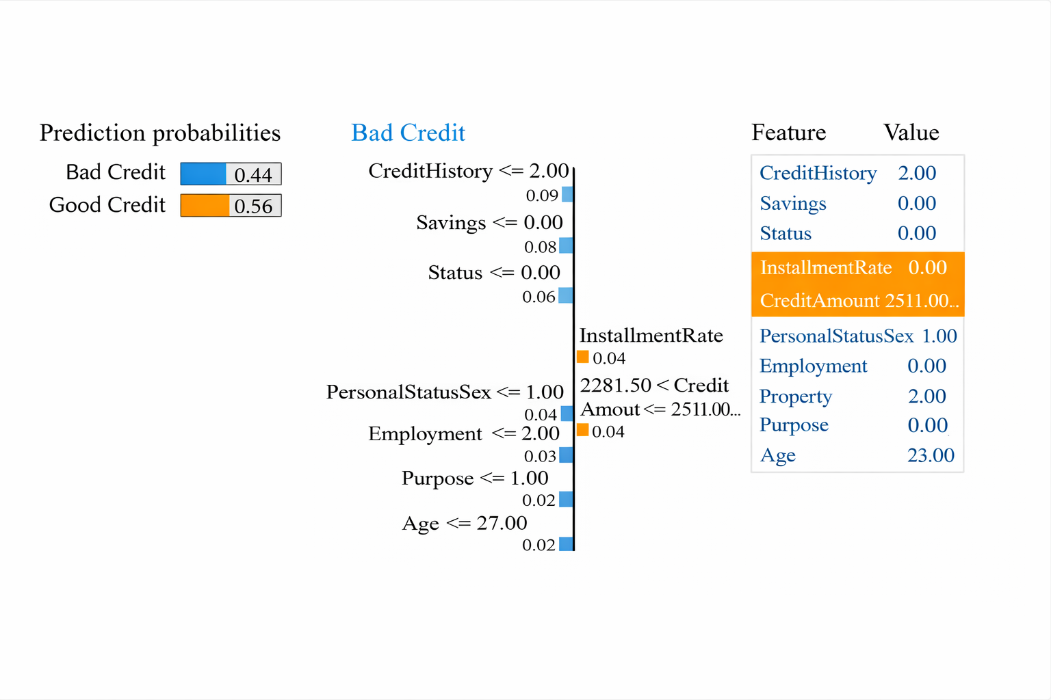
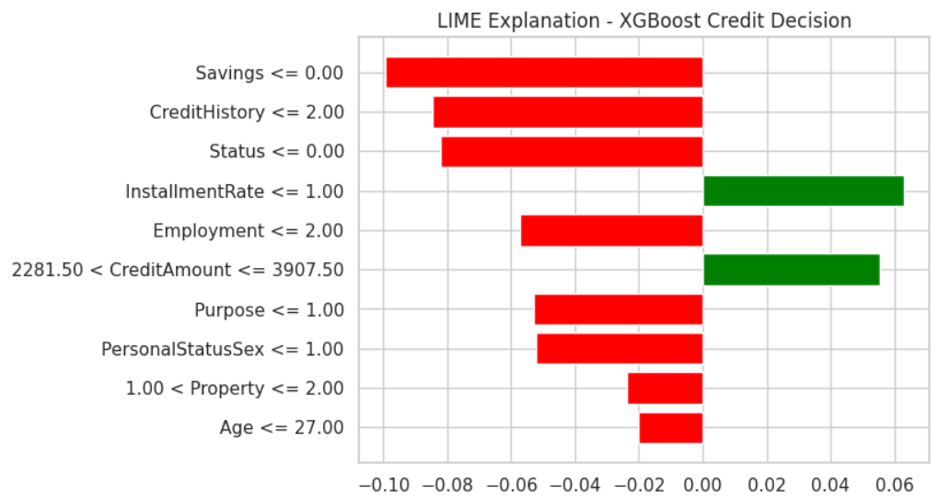
Findings and Conclusion
Notes:
Explain why TreeExplainer is ideal for tree-based models.

Slide 25
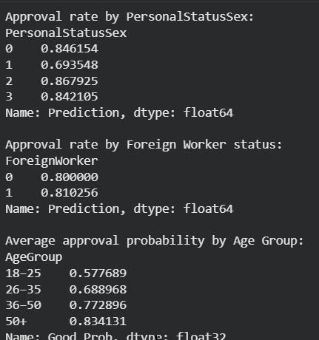
Findings and Conclusion
Bias & Fairness Audit
Approval Rate by Personal Status / Sex (proxy)
Group 0: 84.6%
Group 1: 69.4% ⬅ lowest
Group 2: 86.8%
Group 3: 84.2%
Moderate disparity across groups Suggests proxy effects, not explicit discrimination
Approval Rate by Foreign Worker Status
Non-foreign: 80.0%
Foreign worker: 81.0%
Very small difference No strong evidence of adverse impact
Notes:
Interpret global SHAP plots.

Slide 26
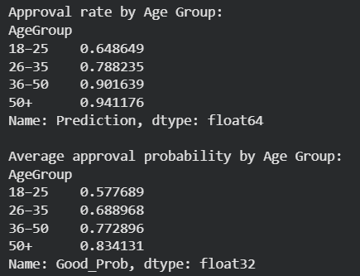
Findings and Conclusion
Average Approval Probability by Age Group
18–25: 0.578
26–35: 0.689
36–50: 0.773
50+: 0.834
Approval Rate by Age Group
18–25: 64.9%
26–35: 78.8%
36–50: 90.2%
50+: 94.1%
Clear monotonic increase with age Indicates age sensitivity, important for regulatory discussion Likely driven by correlated financial stability features

Slide 27
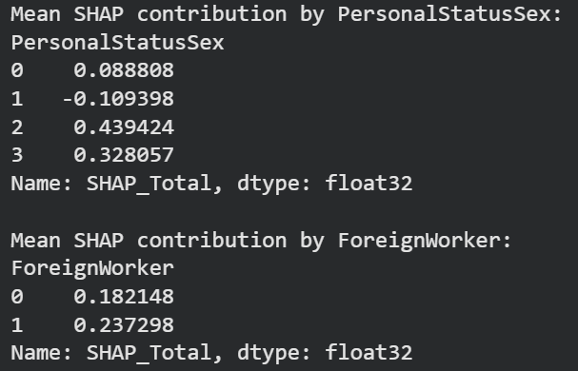
Findings and Conclusion
Mean SHAP Contribution (Bias Signal)
PersonalStatusSex
Group 0: +0.089
Group 1: −0.109
Group 2: +0.439
Group 3: +0.328
Some groups receive systematically lower SHAP contributions Suggests indirect bias via correlated features
Foreign Worker
Non-foreign: +0.182
Foreign worker: +0.237
No negative SHAP bias detected

Slide 28

Findings and Conclusion
Counterfactual Analysis -What would need to change for the decision to change?
Original approval probability: 0.578
After improving Savings + Status by one tier: 0.594
Even small financial improvements measurably increase approval Supports actionable, customer-facing explanations

Slide 29
References
[1] M. T. Ribeiro, S. Singh, and C. Guestrin, “Why Should I Trust You? Explaining the Predictions of Any Classifier,” Proceedings of the 22nd ACM SIGKDD International Conference on Knowledge Discovery and Data Mining (KDD), San Francisco, CA, USA, 2016, pp. 1135–1144.
[2] S. M. Lundberg and S.-I. Lee, “A Unified Approach to Interpreting Model Predictions,” Proceedings of the 31st International Conference on Neural Information Processing Systems (NeurIPS), Long Beach, CA, USA, 2017, pp. 4765–4774.
[3] S. M. Lundberg, G. Erion, H. Chen, A. DeGrave, J. M. Prutkin, B. Nair, R. Katz, J. Himmelfarb, N. Bansal, and S.-I. Lee, “Explainable AI for Trees: From Local Explanations to Global Understanding,” Nature Machine Intelligence, vol. 2, no. 1, pp. 56–67, 2020.

Slide 30
THANK YOU
Notes:
Explain how counterfactuals improve decision transparency.

