Slide 1
Agentic AI Hackathon: Building Intelligent Agents with IBM Granite and LangFlow

Slide 2
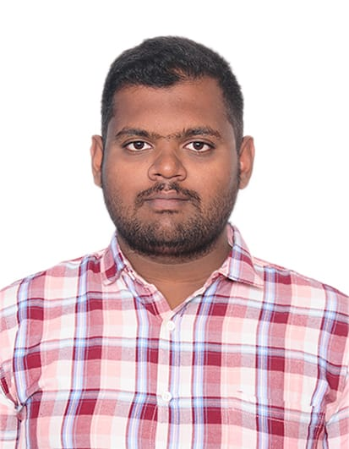
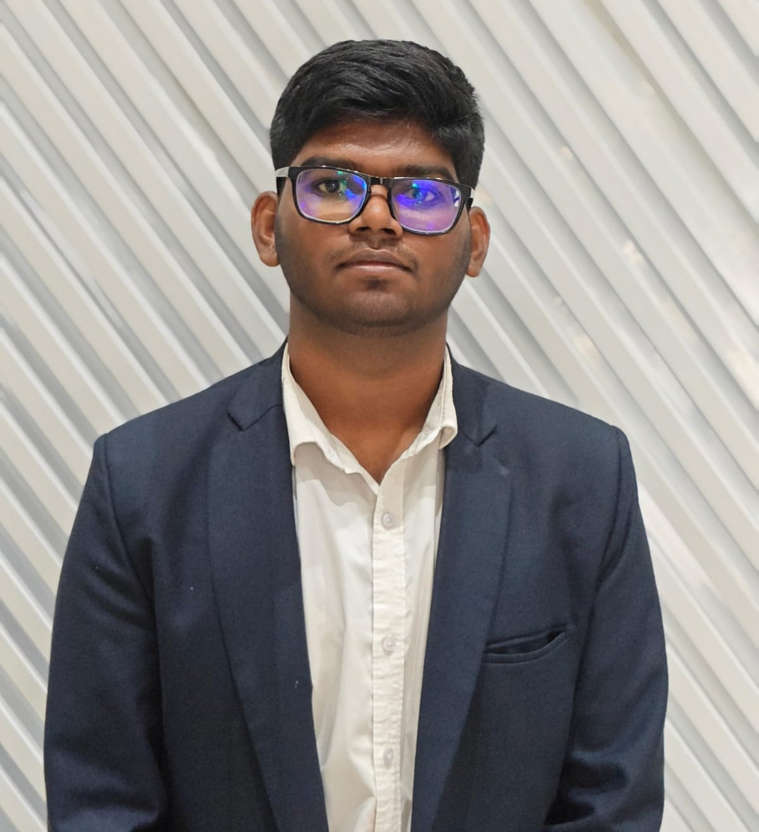

Name of the team: SKYMINDS
Details of Team members
TEAM MEMBER NAME | Recent Passport Photo | Email ID | Phone number [WhatsApp]
Prajesh.L |  | Prajeshl.mca25@bmsce.ac.in | 7411604573
Vishwa Moorthy S |  | vishwamoorthys@bmsce.ac.in | 8050524532
Prashant Kumar Thakur |  | prashantkumar.mca25@bmsce.ac.in | 9155252202

Slide 3
Problem Statement
Agriculture
Agricultural decision-making can be overwhelming, as farmers often struggle with:
Information overload – managing millions of daily data points from diverse sensors, IoT devices, and proprietary platforms that often don't communicate with each other.
Personalization gaps – receiving generic, "one-size-fits-all" advice that fails to account for local soil variations, specific crop needs, or the unique constraints of small-scale family farms.
Unreliable sources – scattered and inconsistent information, including digital misinformation, biased datasets centered on large industrial farms, and a lack of expert-validated guidance.
Dynamic conditions – rapid, unpredictable shifts in weather patterns (erratic rainfall, heatwaves), volatile market prices for commodities, and evolving pest or disease threats.
Without a reliable, intelligent assistant, farmers spend excessive time trying to integrate conflicting data and still end up making suboptimal choices, leading to reduced crop yields, financial instability, and wasted resources.

Slide 4
Proposed solution
The solution is a comprehensive AI-powered intelligence platform that evaluates and predicts climate-related risks for agri-food systems. It moves beyond simple data observation, using advanced machine learning models (such as Random Forests and K-Nearest Neighbors) to analyze historical records alongside real-time inputs. The system acts as a "digital agronomist," offering hyper-local advice tailored to specific field conditions and crop types. With future RNN improvements the model behaves more like a AI assistant guiding farmers and researchers by receiving scenarios, infers data from said scenarios and proposes a risk assessment based on past records.

Slide 5
Need of project
The need for an AI tool to check climate risk in farming is urgent because the old way of doing things is failing. Farmers can no longer rely on 'gut feel' or past weather patterns because climate change has made the weather unpredictable and extreme. Following the 'business as usual' path is now a huge risk that threatens our food supply and the bank accounts of farmers everywhere. This project fixes the 'data gap' by giving farmers a clear look at what is happening on their specific land, not just their general region. It turns farming from a guessing game into a smart strategy. Instead of waiting for a disaster like a flood or heatwave to happen and then reacting, this AI lets farmers see the danger coming two weeks early. It provides the high-tech 'early warning' needed to save crops, stop the waste of water and fertilizer, and keep the global food system stable in a changing world.

Slide 6
End user of project
The project initially serves agricultural researchers as a sophisticated diagnostic platform, allowing them to use Random Forest and KNN models to validate data patterns, fine-tune feature weights, and map climate analogs for long-term resilience testing. As the system evolves through the integration of Recurrent Neural Networks (RNNs) and LSTMs, it will transition into a simplified, field-ready assistant for farmers, capable of processing complex weather sequences into clear, actionable sowing advisories. By replacing technical dashboards with intuitive mobile interfaces and plain-language guidance, the final solution democratizes expert-level agronomy, shifting the end-user experience from data analysis to proactive disaster prevention and resource management. This evolution ensures that the complex predictive power developed in the lab becomes a practical, daily tool that helps farmers reduce waste, secure financial support, and protect their livelihoods against an increasingly unpredictable environment.

Slide 7
Technology Used
Langflow platform
Langflow component name – Agent , Chat input , Chat output, API Connectors, Prompt Template, LLM Node
IBM Grainte model - ibm/granite-3-8b-instruct
Cloud Platform- IBM Cloud
AI-Studio- IBM Watsonx.ai
Watsonx

Slide 8
Novelty and Uniqueness
Reduces Resource Waste: Helps farmers avoid applying fertilizer or water right before a heavy rain or flood event that would wash it away.
​Protects Yield Integrity: By predicting frost or drought early, it allows for "preventative" rather than "reactive" farming, saving the harvest.
​Financial Planning: Assists in estimating potential yield losses, which helps farmers secure better insurance rates or bank loans by showing they have a "Risk Mitigation" plan.
​Climate Adaptation: It guides the farmer on when to shift planting dates or change crop varieties to match the changing climate of their specific plot.

Slide 9
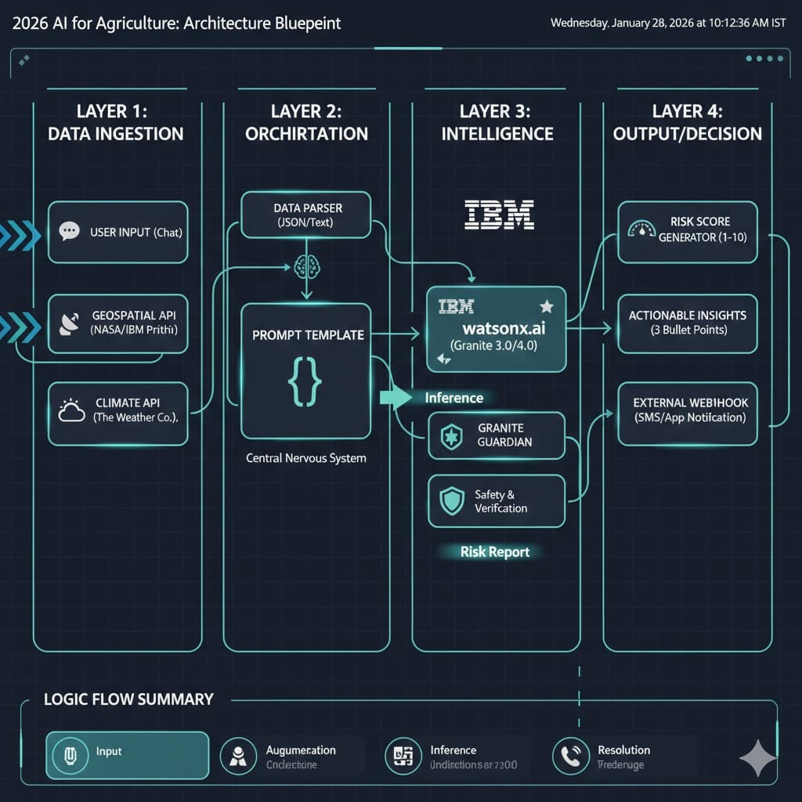
Technical flow diagram - Architecture blueprint

Slide 10
Langflow component Used
Each component in your Langflow project serves as a specific "department" in the workflow, handling everything from user communication to complex data analysis. Here is the breakdown of the components you've used:
​1) Chat Input
​This is the starting point of your project. It acts as the gateway between the user and the AI..
​Function: It takes the text you type and packages it as a "Message" object. This object doesn't just contain your text; it also carries metadata like the timestamp and session ID, which it passes to the next component in the chain.
​2) IBM watsonx AI Agent (or LLM Node)
​This is the intellectual engine or the "brain" of the project.
​Role: It performs the actual reasoning and risk assessment.
​Function: Using the IBM Granite foundation models, this component receives the instructions (Prompt) and the data (Weather/Satellite) and processes them. It "reasons" through the information to determine if the conditions are dangerous for the specific crop and location you provided. It is responsible for generating the professional, actionable advice you see at the end.
​​4) Chat Output
​This is the finishing line of your project.
​Role: It delivers the final answer back to the user.
​Function: It takes the generated text response from the IBM watsonx component and displays it in the chat interface. It ensures the response is formatted correctly so that the farmer can easily read the risk score and the recommended steps.
​Additional Component Used: Prompt Template
​Your project wouldn't work without this hidden "translator" between the components.
​Role: It structures the "work order" for the AI.

Slide 11
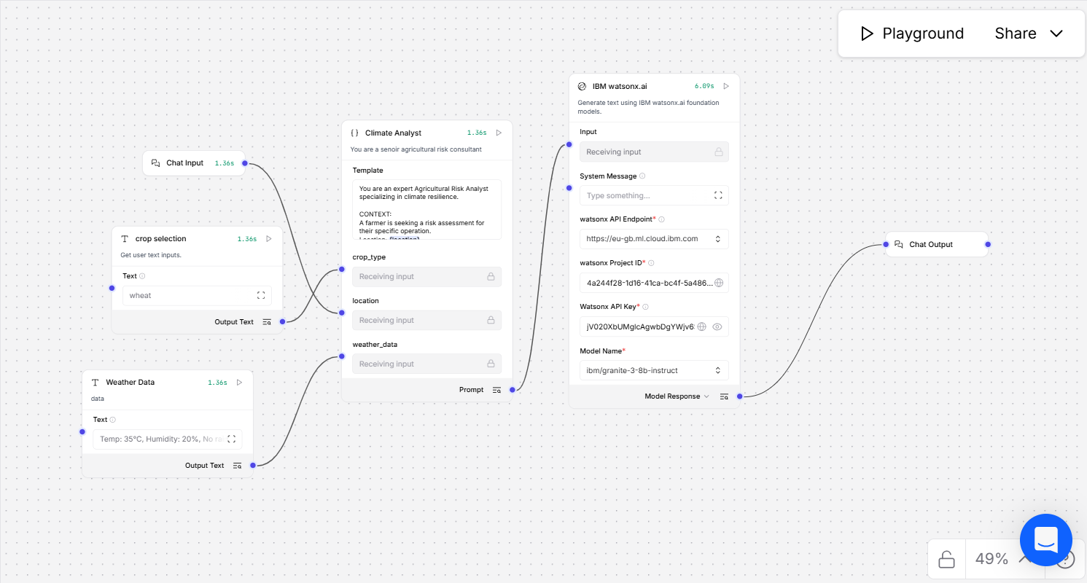
Input Screenshot 1

Slide 12
Input Screenshot 2

Slide 13
Output Screenshot 1

Slide 14
Input Screenshot 2

Slide 15
Git Hub Link
https://github.com/prajesh102004/Astra-DB-lang-flow.git
·
·
·

Slide 16
Future Scope
The future of this project lies in moving from basic data analysis to a fully "smart" farming ecosystem that thinks ahead. By upgrading to Recurrent Neural Networks (RNNs), the tool will be able to track weather patterns over time, spotting hidden trends like a slow-building drought that simple models might miss. We plan to connect the AI directly to on-farm soil sensors and drones, creating a real-time "Digital Twin" of the field that provides instant alerts for water or fertilizer needs. To make the tool usable for everyone, we will develop a simple mobile app that works offline and supports multiple languages, allowing farmers in remote areas to get expert advice just by asking a question. Eventually, this could even link to "smart insurance," where the AI automatically verifies weather damage to trigger instant payouts, providing a complete safety net for the global food supply.

Slide 17
Thank You

