Slide 1
Slide 1
Artificial intelligence (AI) is the simulation of human intelligence in machines to perform complex decision-making and problem-solving tasks.
These machines replicate human behavior by applying logic, learning from mistakes, and adapting to new information.

Slide 2
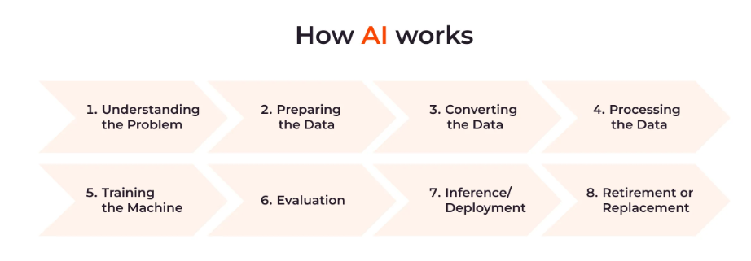
Slide2 Diagram

Slide 3
Slide 3
AI Applications
AI has become indispensable in various industries, providing innovative solutions to complex problems.
Healthcare
E-commerce
Cybersecurity

