Slide 1
QUIQ POS - UX Design Document

Slide 2
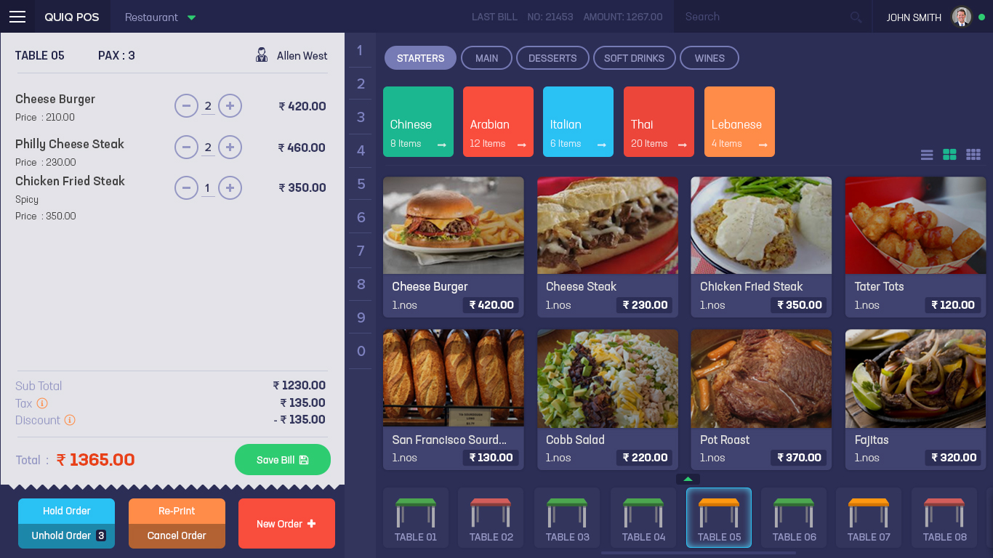

Slide 3
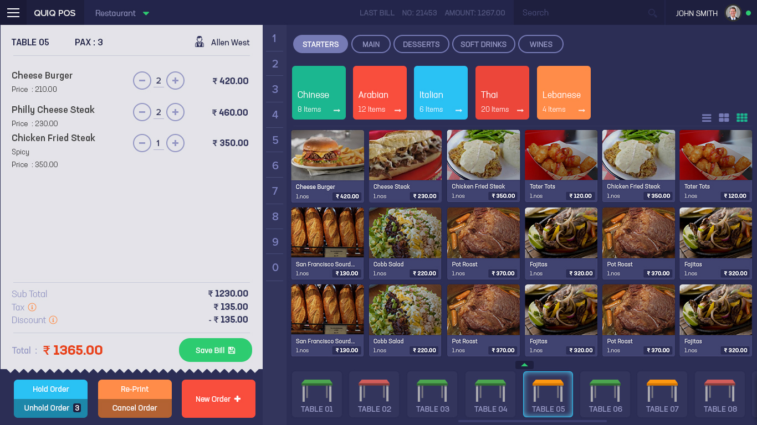

Slide 4
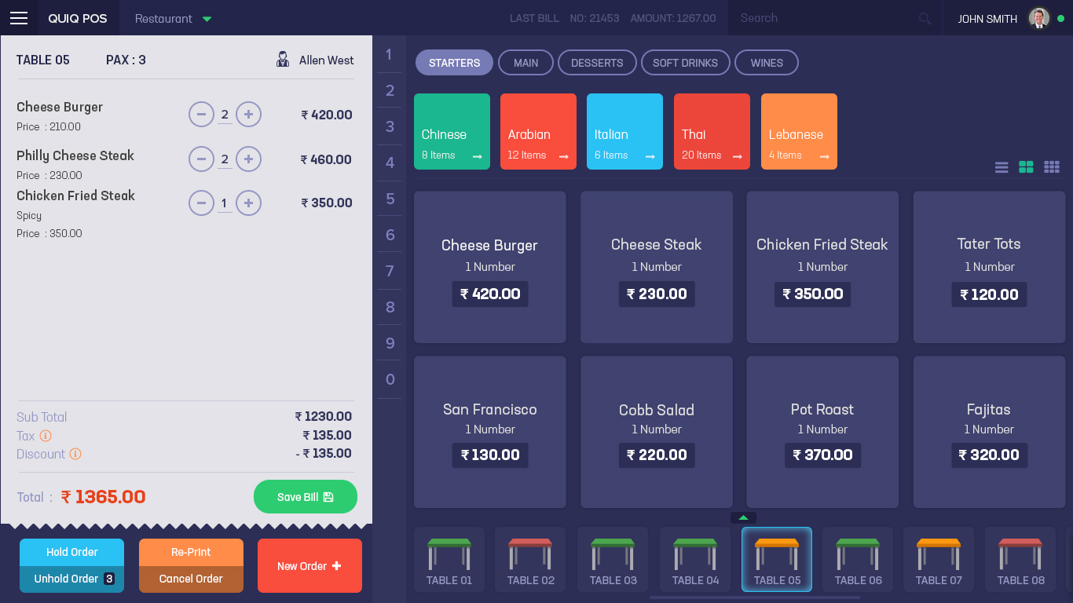

Slide 5
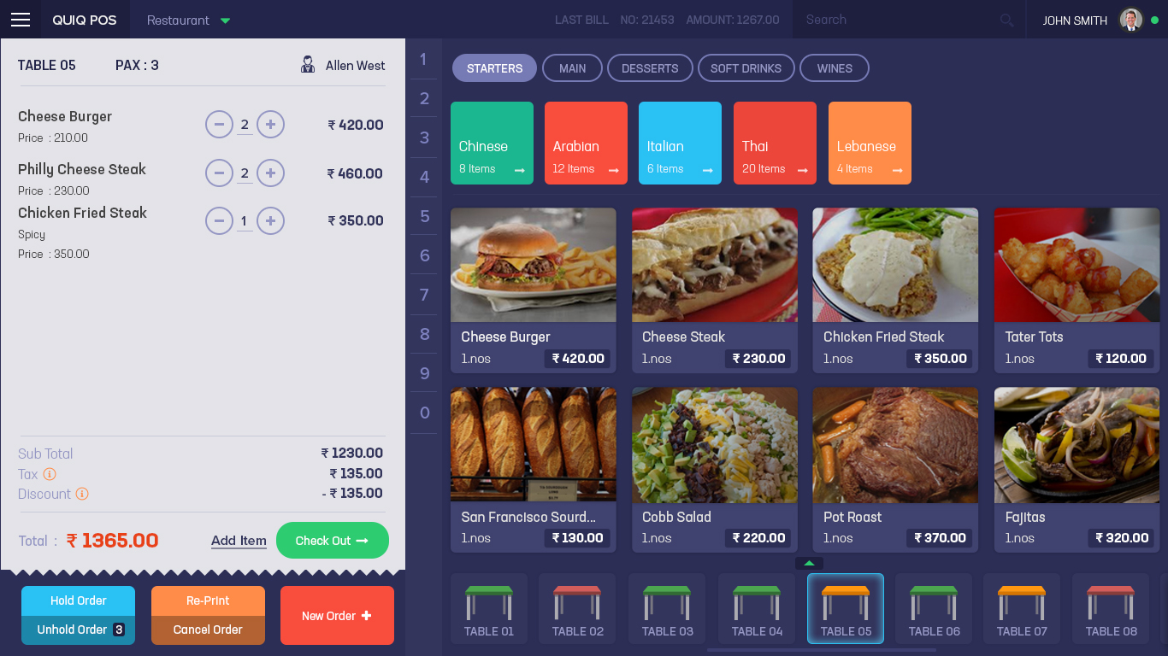
After Save Bill, add new items by clicking add item, it will return with editable PAX number and add items option
Once the bill is saved the button became “CHECK OUT”

Slide 6
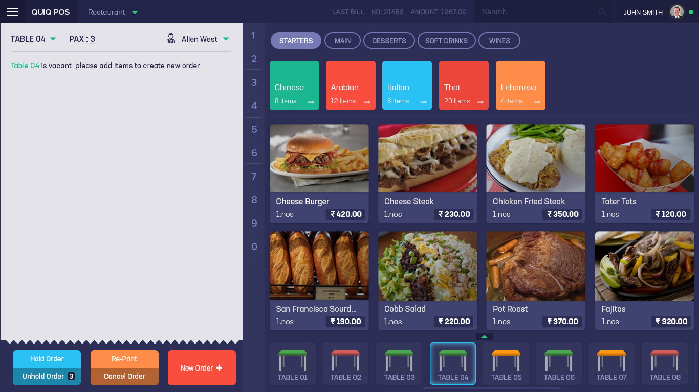
Create an Order by clicking a vacant table from the table section, will make the selection for table, waiter and PAX number

Slide 7
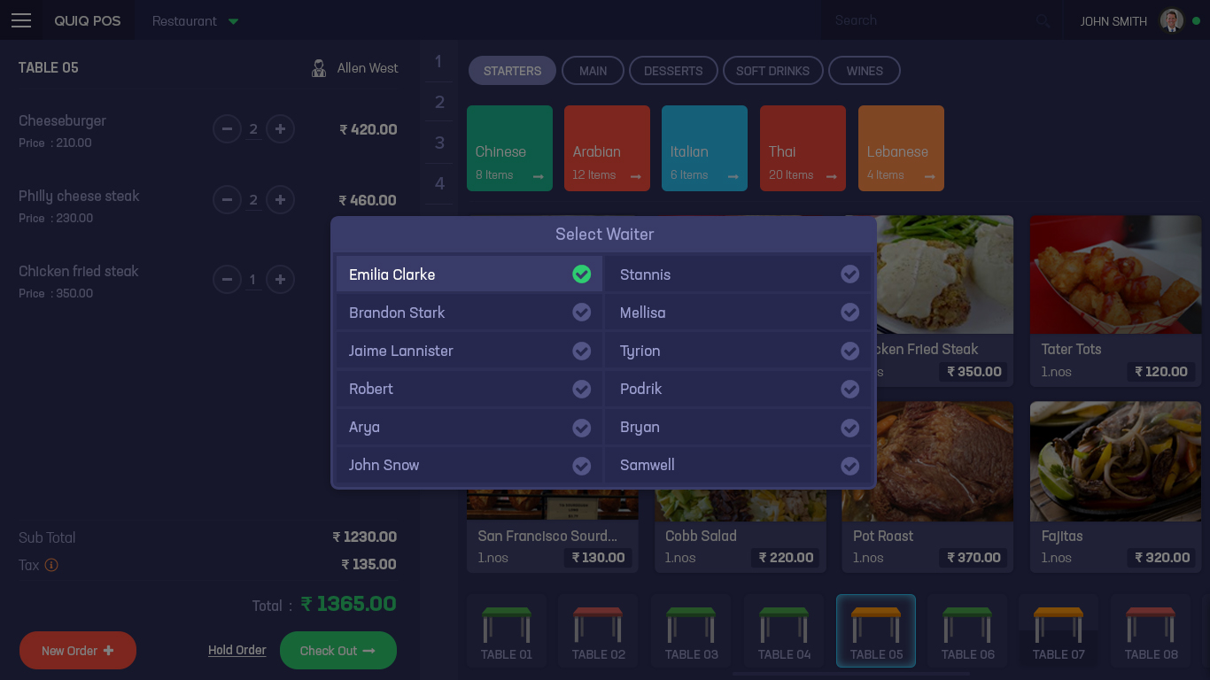
Waiter Selection Screen. Clicked one is showed as the first one.

Slide 8
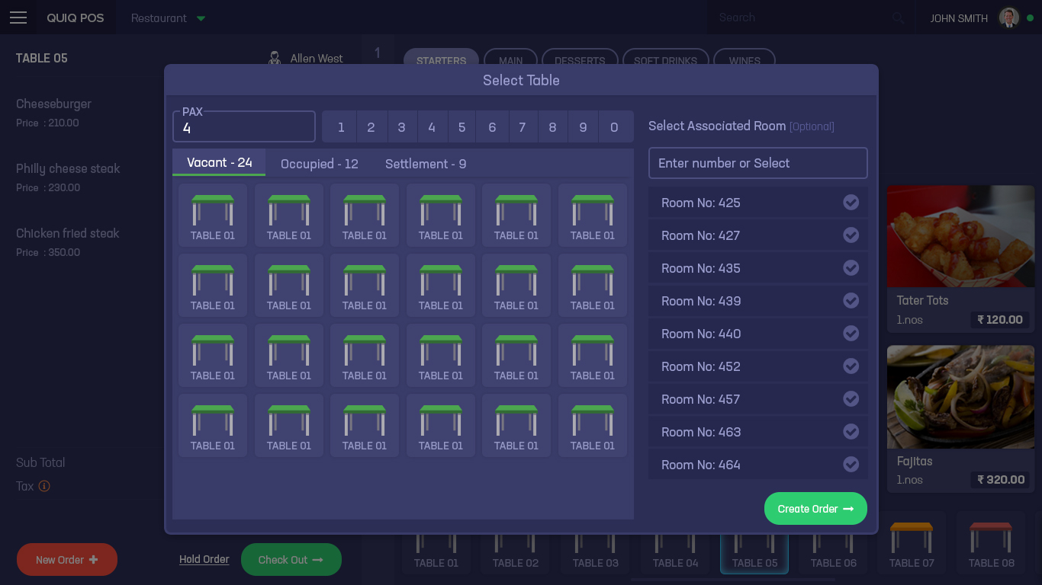
Table Selection and PAX, associated Room Number can be linked to the table.

Slide 9
Table Selection and PAX, associated Room Number can be linked to the table.

