Slide 1
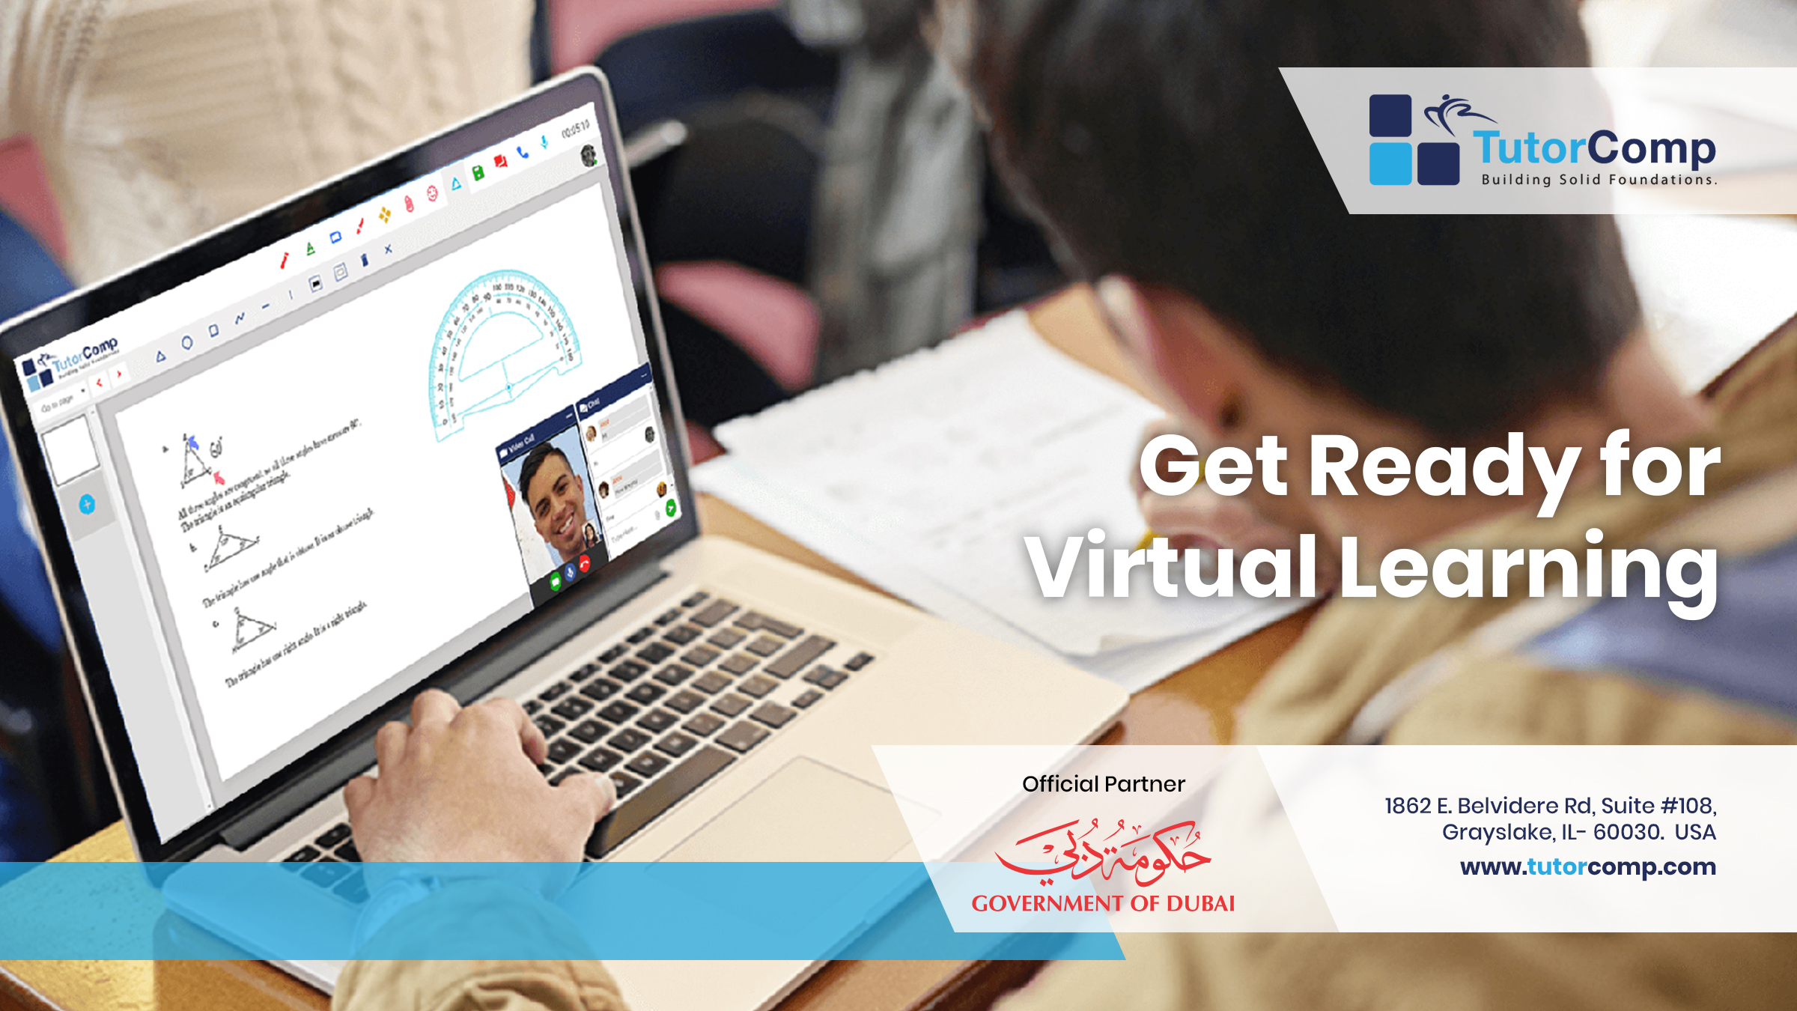
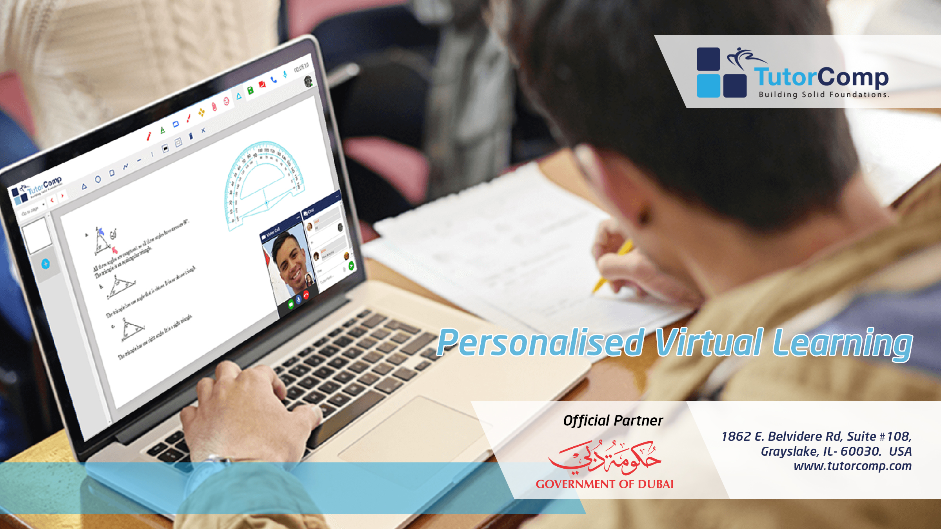


Personalised virtual learning

Slide 2
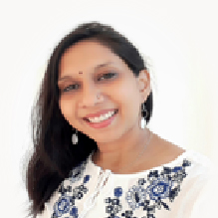

Dr. Sonali
Affiliated by Indian Dental Association, IAOMR , IAFO
Achievements
Achievements can be listed here
Profile
Education
Have been practicing Clinical Dentistry for past 13 years and have been teaching in a Dental college for over 6 years in Oral Medicine and Radiology department, a student counsellor involved in various social causes rendering school student personality development programs, mindful parenting and public health awareness programs on tobacco cessation, dental health, positive thinking, stress management
Master of Dental Surgery- Oral Medicine & Radiology
2010- 2013 Ragas Dental College& Hospital
Bachelor of Dental Surgery
2000- 2005 Ragas Dental College & Hospital
Expert Certified Forensic Odontologist
International Forensic Science- 2017
Post Graduate Diploma in Counselling and Spiritual Health
2018 Annamalai University

Slide 3


We Involve Students
TutorComp Inc.
Registered Office
1862 E. Belvidere Rd, Suite #108,
Grayslake, IL- 60030. USA
Official Partner
Office
Space No. 7, 2nd Floor,
Park Office, Athulya Building, Infopark, Kakkanad, Kerala INDIA – 682 042
info@tutorcomp.com
www.tutorcomp.com

