Slide 1

Key Metrics
US $ million | Year 1 | Year 2 | Year 3 | Year 4 | Year 5
Revenue | 3.54 | 15.41 | 37.01 | 67.08 | 107.43
Students nos. | 11,150 | 33,137 | 67,703 | 1,14,623 | 1,64,673
PAT | -1.10 | -0.97 | 3.21 | 8.73 | 16.50
Exclusive contract with Dubai
Product can be customised to offer training – For corporates etc
Contract to be extended to other GCC countries

Slide 2
Current Traction
Total revenue | Rs.3.14 crore
Total Hours served | 40,448
No of Countries (Students) | 45 Nos.
Total Students Enrolled in Application | 1306
Total Average Revenue per student | Rs.23,000.00
Year | 2015-16 | 2016-17 | 2017-18 | 2018-2019
No of Students | 167 | 200 | 274 | 348
Leads | 286 | 364 | 449 | 514
Enrolled | 80 | 112 | 160 | 237
Student Conversion | 27.97% | 30.77% | 35.63% | 46.11%
No. of Tutors Active | 68 | 85 | 90 | 99
Tutor Turnover | 11.76% | 16.47% | 16.67% | 7.07%

Slide 3
Current Equity Structure
Equity Holding | Equity percentage
Shery S kurian | 25%
Raju Kurian | 75%
Total Amount Invested | Rs.2.85 Crore
Total Revenue | Rs.3.03 crore
Revenue (2018 - 2019) | Rs 80 Lakh
Revenue (2017 - 2018) | Rs 67 Lakh
Revenue (2016 - 2017) | Rs 57 Lakh

Slide 4
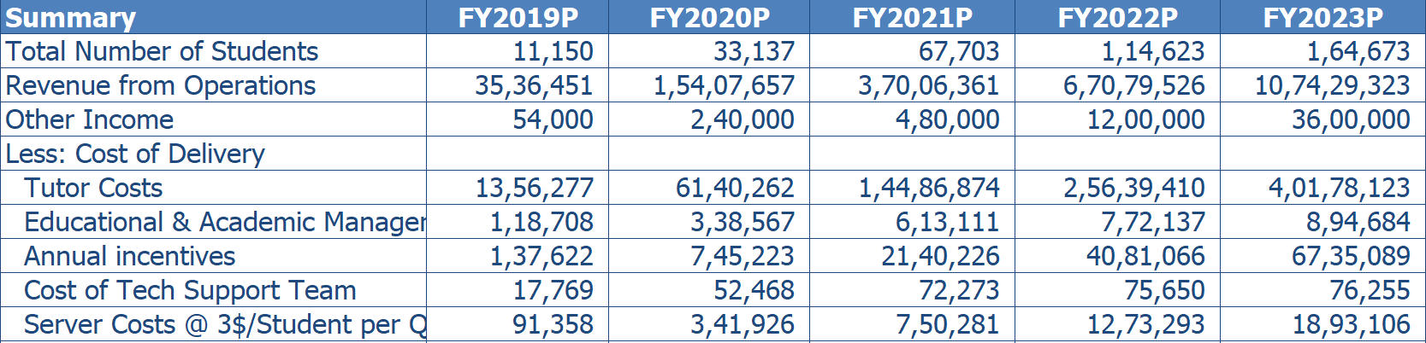
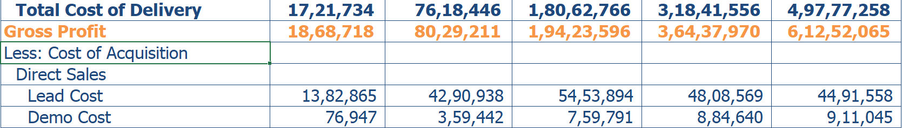
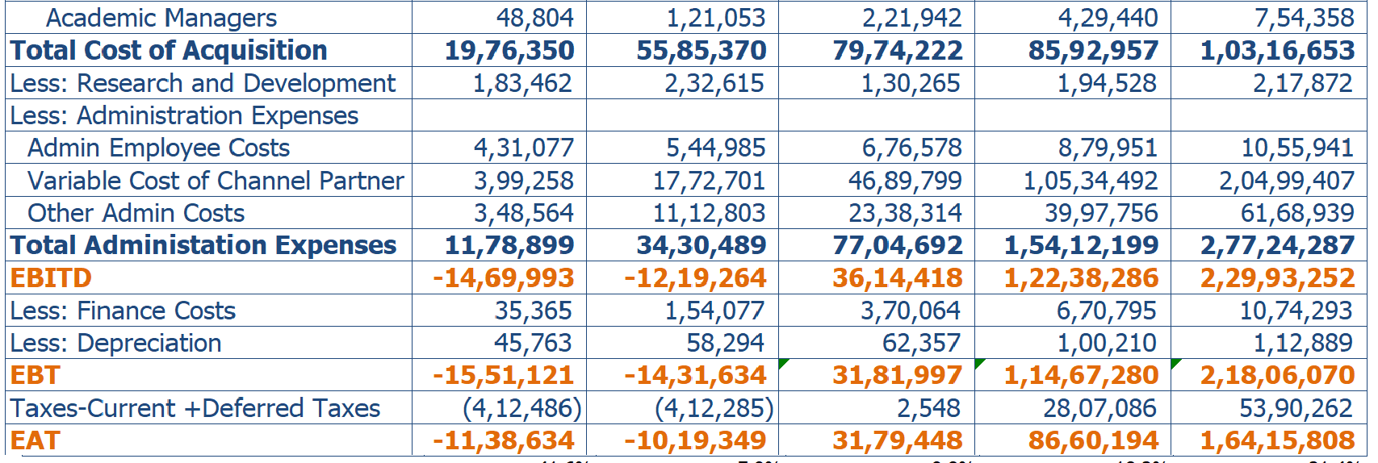
Revenue Projections

Slide 5
Financial Projections
Year | Year 1 | Year 2 | Year 3 | Year 4 | Year 5
Number of students | 11,150 | 33,137 | 67,703 | 1,14,623 | 1,64,673
Number of tutors | 711 | 1,957 | 3,366 | 4,995 | 6,945
Revenues USD Mn | 3.59 | 15.65 | 37.49 | 68.28 | 111.03
Delivery costs USD Mn | 1.72 | 7.62 | 18.06 | 31.84 | 49.78
Gross Margin USD mn | 1.87 | 8.03 | 19.43 | 36.44 | 61.25
Gross Margin % | 53% | 52% | 52% | 54% | 57%
Acquisition costs USD Mn | 1.98 | 5.59 | 7.97 | 8.59 | 10.32
Other expenses USD Mn | 1.12 | 3.36 | 7.62 | 15.32 | 27.61
EBITDA USD Mn | (1.41) | (1.15) | 3.69 | 12.33 | 23.11
PAT USD Mn | (1.10) | (0.97) | 3.21 | 8.73 | 16.50
PAT % | (30.64%) | (6.20%) | 8.56% | 12.79% | 14.86%

Slide 6
Traction Metrics
Summary | Data Value
Funding till date USD | 3,50,000
Revenues generated till date USD | 4,20,000
Number of students enrolled | 1,306
Number of hours billed | 40,448
Number of active tutors | 350
Annual student retention | 83%
Annual tutor turnover | 7%
Daily active users | 35
Monthly active users | 131
DAU/MAU% | 27%
Net cost of acquisition per student USD | 122
Gross margin per student USD | 322

Slide 7
Hostorical Business Acquisition Metrics
Year | 2015-16 | 2016-17 | 2017-18 | 2018-19
No of students | 167 | 200 | 274 | 348
Leads | 286 | 364 | 449 | 514
Number of students enrolled | 80 | 112 | 160 | 237
Number of hours billed | 27.97% | 30.77% | 35.63% | 46.11%
Number of active tutors | 68 | 85 | 90 | 99
Annual student retention | 11.76% | 16.47% | 16.67% | 7.07%
Revenues USD | 42,350 | 80,500 | 94,680 | 1,20,100

Slide 8
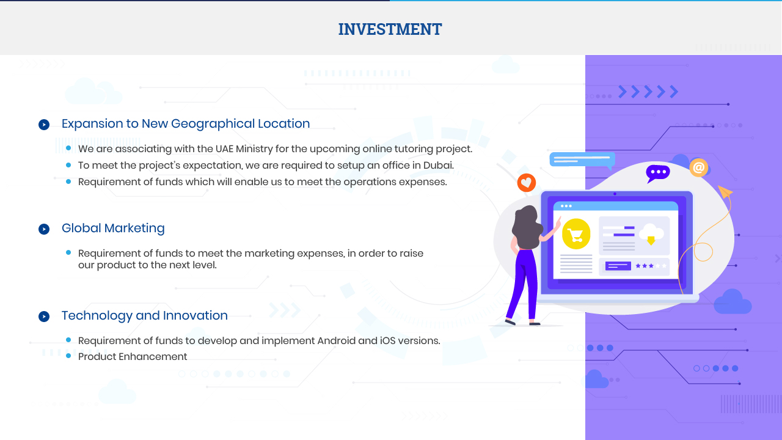
Investment

Slide 9



Corporate Office
Registered Office
Thank You...
Space # 7, 2nd Floor,
Park Office, Athulya Building,
Infopark, Kakkanad, Kerala
INDIA – 682 042
1862 E. Belvidere Rd, Suite #108,
Grayslake, IL- 60030.
USA
shery.kurian@tutorcomp.com
www.tutorcomp.com

