Slide 1
E-learning architecture on Responsive Web Design
By Prajita Chakraborty

Slide 2
Why do I need responsive website design?

Slide 3
Why do I need responsive website design?

Slide 4
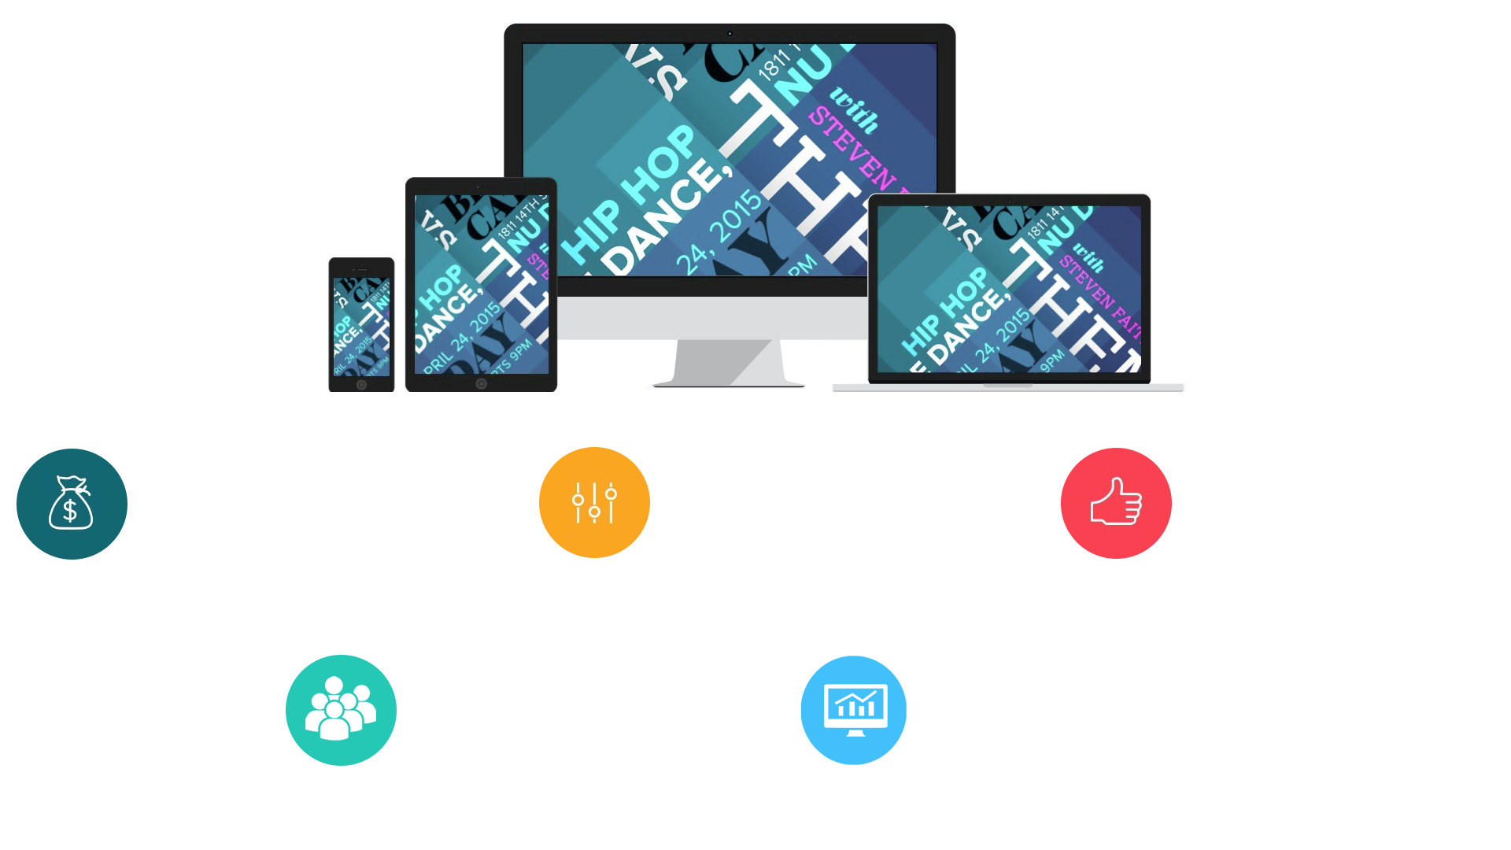
Stay Competitive
Stay Competitive
Saves Money
Good for SEO
More Customers

Slide 5
E-learning & Pervasive Learning
Understanding eLearning is simple. eLearning is learning utilizing electronic technologies to access educational curriculum outside of a traditional classroom. In most cases, it refers to a course, program or degree delivered completely online.
By Responsive E-learning architecture the E-learning will convert in pervasive learning-like learning anywhere and every where.

