Slide 1
Eagle Project Proposal AZ Community Science Alliance
- Prajith Praveenkumar

Slide 2
Overview
Arizona Community Science Alliance (AZCSA) is the Arizona Department of Environmental Quality’s (ADEQ) community science and environmental education program. It is driven by community scientists across Arizona who help monitor the health of the state’s air, water, and land, supporting informed actions to protect the environment for future generations.
As part of this Eagle Scout Service Project, I wanted to integrate Scouting America’s youth volunteer activities with AZCSA’s community science efforts by creating a structured, ADEQ-aligned method for collecting environmental data during routine Scout service activities. We have flyers to advertise this.
For example, when Scouts participate in activities such as campsite cleanups, park service projects, or “police line” trash collection events, the data related to the trash collected (type, quantity, and location) can be recorded in a standardized format and shared with AZCSA as community science data.
My project will also prove to be a form of water conservation
Project Beneficiary: Arizona Community Science Alliance (AZCSA)

Slide 3
My Project - Leadership & Execution
To demonstrate leadership and organize a group service activity for my Eagle Scout Service Project, I will select a cleanup location in coordination with the Arizona Community Science Alliance (AZCSA) team to ensure the activity supports both trash removal and community science data collection.
I will lead Scouts and volunteers in conducting a trash cleanup using appropriate tools such as trash bags and grabbers, following all safety guidelines. During the activity, participants will collect standardized data on the trash removed and submit it through the AZCSA-aligned data collection system.
I will also plan and conduct fundraising activities to provide lunch and snacks for volunteers, ensuring participant support and engagement throughout the project.
Through this project, I aim to measure the scale and environmental impact of trash accumulation at the selected location while analyzing the variation in types of waste collected, including plastics, glass, cardboard, bottles, and other materials. This data will help demonstrate both the immediate impact of the cleanup and the value of structured environmental data collection.

Slide 4

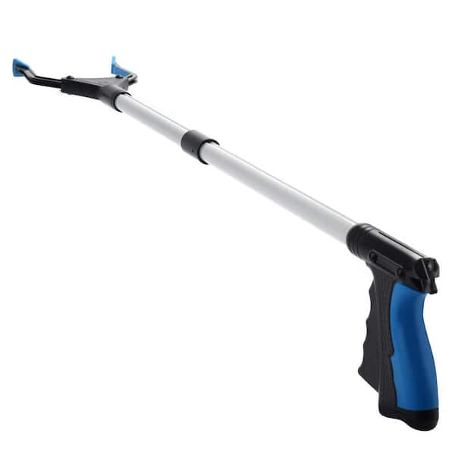
SAFETY
GLOVES FOR PICKING UP TRASH
Closed toed shoes due to rocks
Trash-pickers for getting trash from bushes
Snakes and other animals

Slide 5
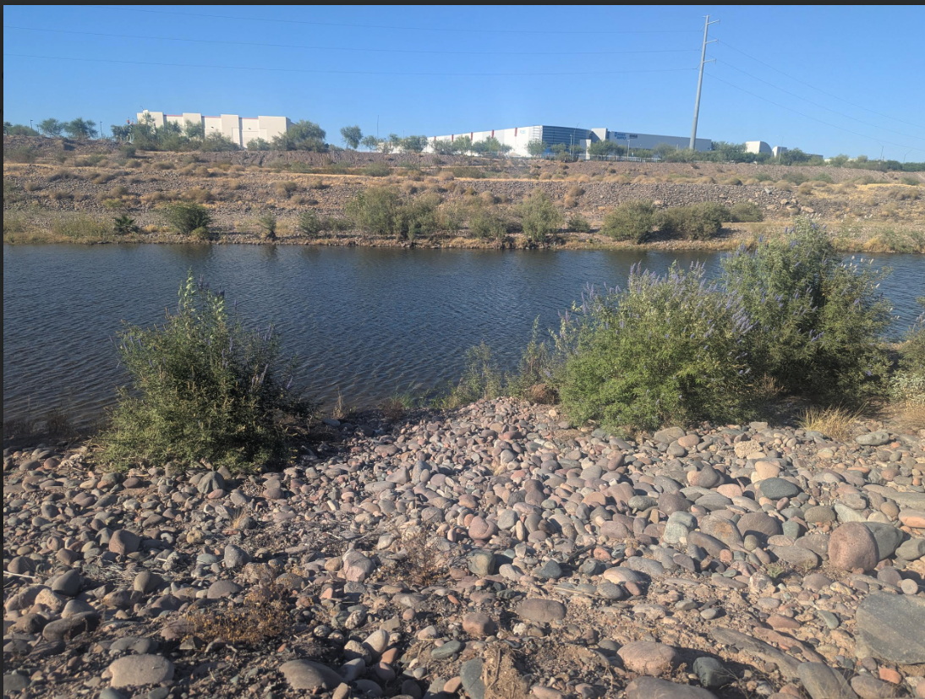
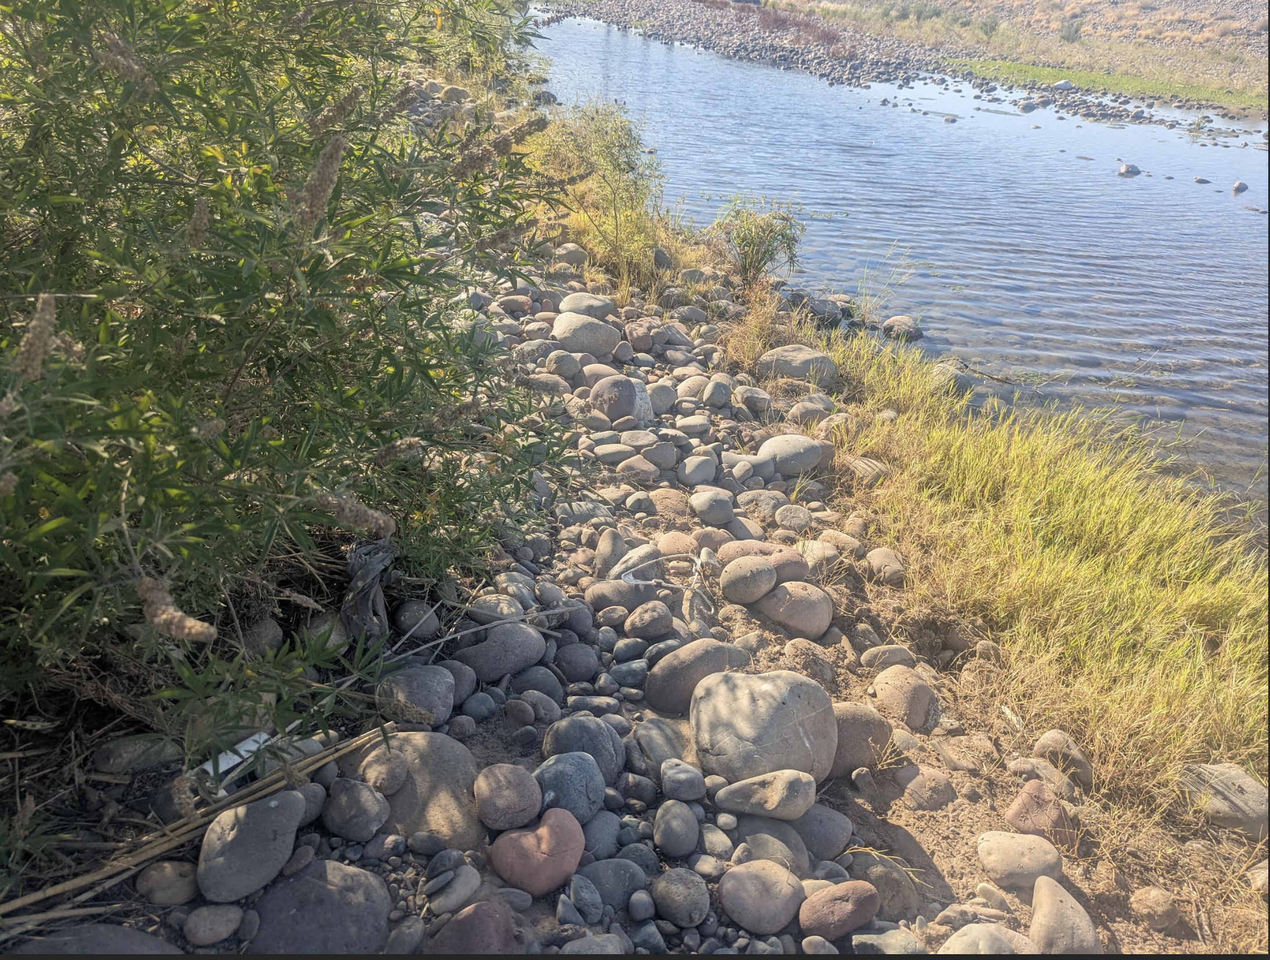
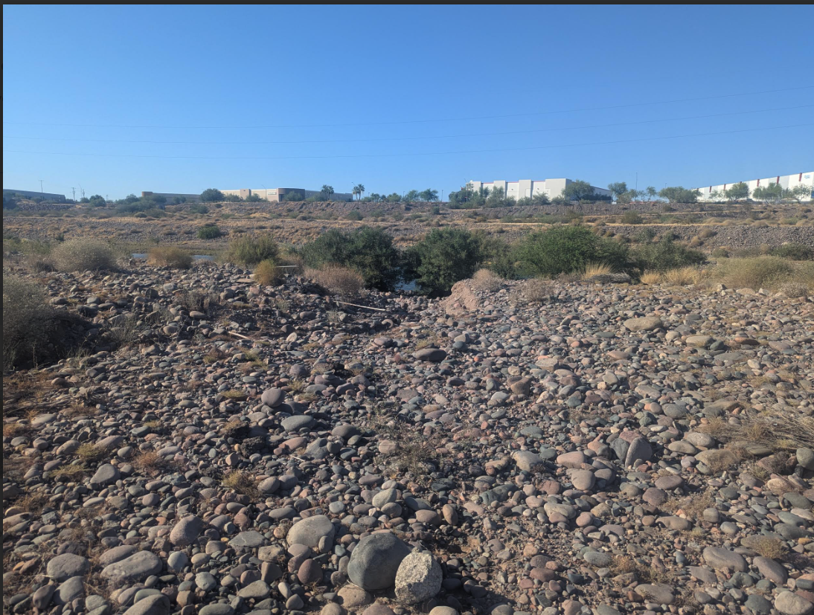
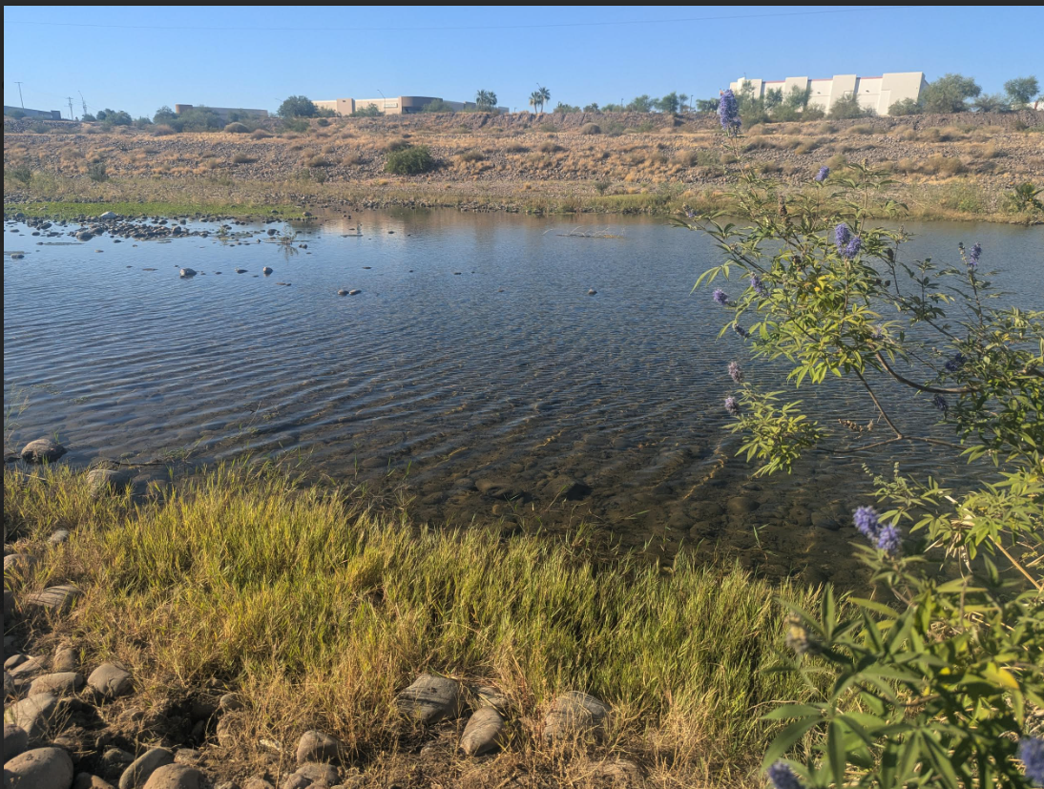
Pictures!!!!

Slide 6
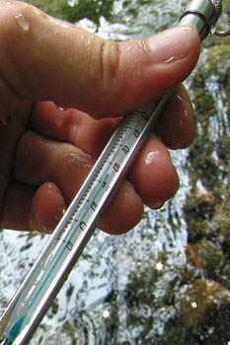
Links and the website for the beneficiary
Arizona Department of Environmental Quality
Science Alliance Trash Cleanup
Volunteer for Wet-Dry Mapping
Arizona Water Watch Mobile App
https://www.scoutingaz.org/volunteer/

Slide 7
The End Thank you for considering my proposal

