Slide 1
The Battle of Neighbourhoods

Slide 2
Problem Statement
This Project answers the three main questions for the Indians in New York
1. What is / are the best location(s) for Indian cuisine in New York City?
2. In what Neighborhood and/or borough should I open an Indian restaurant to have the best chance of being successful?
3. Where would I go in New York City to have the best Indian food?

Slide 3
Data
Data source : https://cocl.us/new_york_dataset
Description : To explore various neighborhoods of new york city.
Data source : Foursquare API
Description : By using this api we will get all the venues.
Data source : https://data.cityofnewyork.us/City-Government/Borough-Boundaries/tqmj-j8zm
Description : Get the New york Borough boundaries.

Slide 4
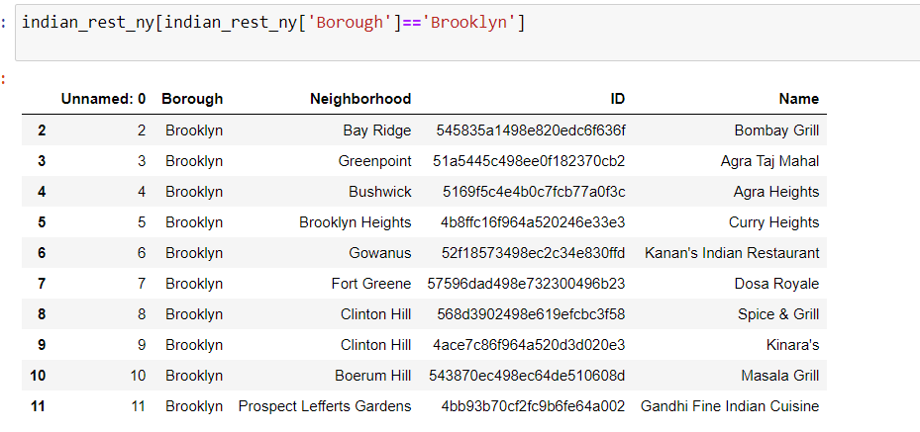
Analysis
Indian Restuarants in Brooklyn

Slide 5
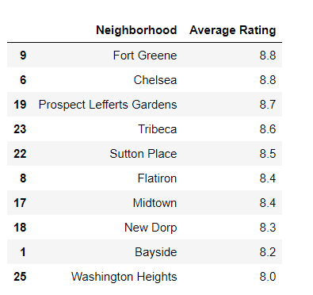
Average Rating of Indian Restaurants in Sorted Order

Slide 6
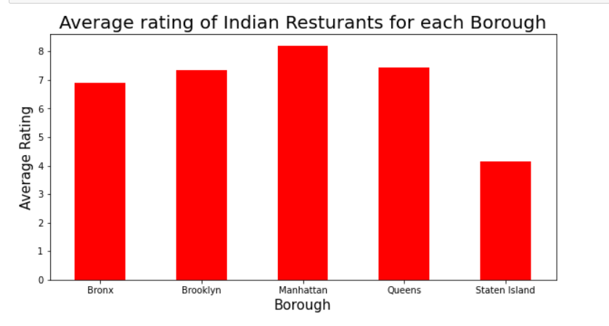
Rating Vs Borough

Slide 7
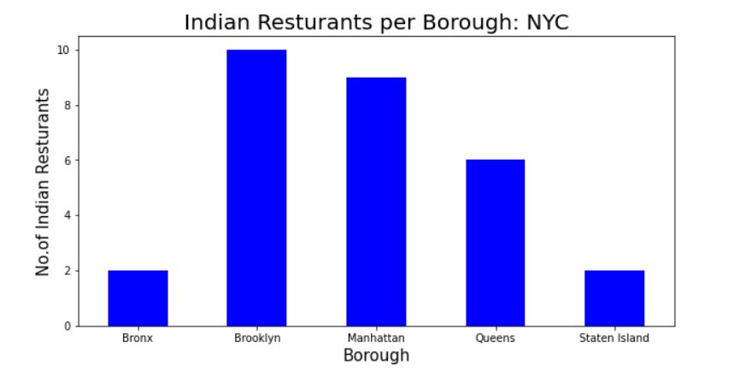
Restaurants Vs Borough

Slide 8
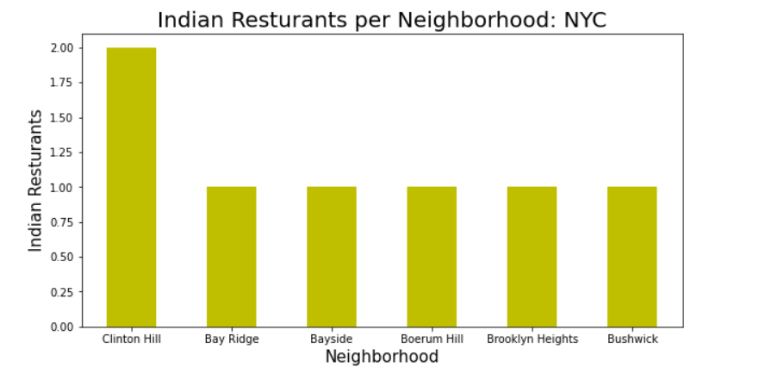
Restaurants Vs Neighborhoods

Slide 9
Result
Fort Greene and Chelsea have the best rated Indian restaurants on average.
Staten Island and The Bronx have the least amount of Indian restaurants per borough.
Clinton Hill is the neighborhood in all of NYC with the most Indian Restaurants.
Manhattan and Brooklyn are the best locations for Indian cuisine in NYC.
I would open an Indian restaurant in Bronx.
I would go to Midtown in Manhattan for the best Indian food based on 834 likes.

Slide 10
The End

