Slide 1
Autoregressive Integrated Moving Average models (ARIMA)

Slide 2
Overview
Introduction to Time Series
Categories and Terminologies
Time Series Analysis
ARIMA Models
AR Process MA
Process ARIMA
Models ARIMA
Models

Slide 3
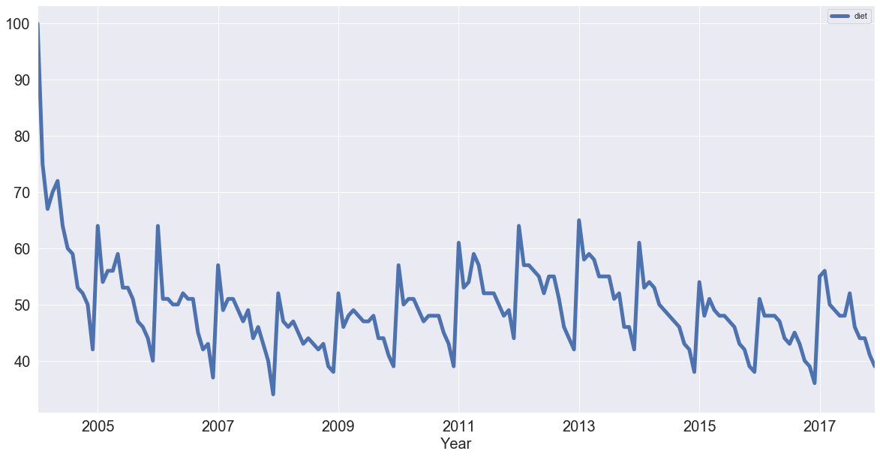
Time Series
A time series is a sequential set of data points, measured typically over successive times.
Time series analysis comprises methods for analyzing time series data in order to extract meaningful statistics and other characteristics of the data.

Slide 4

Categories and Terminologies
Time-domain vs. Frequency-domain
Univariate vs. Multivariate
Linear vs. Non-linear
Discrete vs. Continuous

Slide 5

Time-domain vs. Frequency-domain
Time-Domain
How Does what happened today affect what will happen tomorrow?
The approaches view the investigation of lagged relationships as most important, e.g. Autocorrelation analysis.
Frequency-Domain
What is the economic cycle through periods of expansion and recession?
These approach view the investigationa of cycle’s as most important, example spectral analysis and wavelet analysis.

Slide 6

Univariate vs. Multivariate
A time series containing records of a single variable is termed as univariate, but if records of more than one variable are considered then it is termed as multivariate.

Slide 7
Linear Vs. Non-linear
A time series model is said to be linear or non-linear depending on whether the current value of the series is a linear or non-linear function of past observations.

Slide 8
Discrete Vs. Continuous
In a continuous time series observations are measured at every instance of time, whereas a discrete time series contains observations measured at discrete points in time.

Slide 9
Components of a Time Series
In general, a time series is affected by four components
trend
seasonal
cyclical
irregular

Slide 10
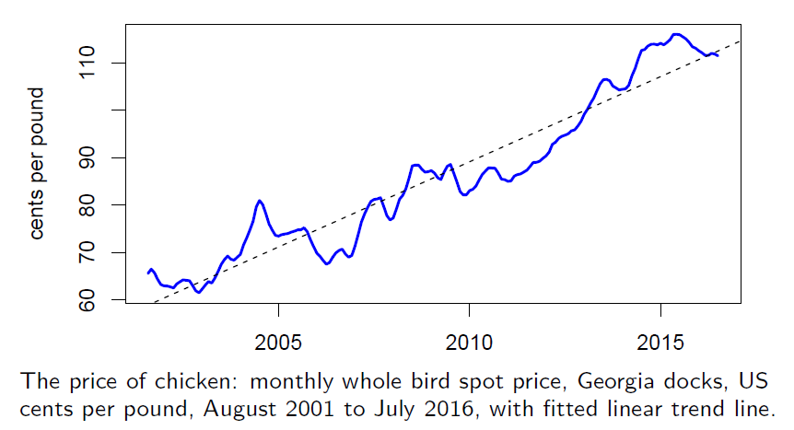
Trend
The general tendency of a time series to increase, decrease or stagnate over a long period of time.

Slide 11
Seasonal Variation
This component explains fluctuations within a year during the season, usually caused by climate and weather conditions, customs, traditional habits, etc.

Slide 12
Cyclical variation
This component describes the medium-term changes caused by circumstances, which repeat in cycles. The duration of a cycle extends over longer period of time.

Slide 13
Irregular variation
Irregular or random variations in a time series are caused by unpredictable influences, which are not regular and also do not repeat in a particular pattern.
These variations are caused by incidences such as war, strike,
earthquake, flood, revolution, etc.
There is no defined statistical technique for measuring random fluctuations in a time series.

Slide 14
Combination of Four Components
Considering the effects of these four components, two different types of models are generally used for a time series.
Additive Model
Multiplicative Model

Slide 15


Additive Model
y$\left(t\right)=\text{T}\left(t\right)+\text{S}\left(t\right)+\text{C}\left(t\right)+\text{I}\left(t\right)$
Assumption: These four components are independent of each other.

Slide 16

Multiplicative Model
Assumption: These four components of a time series are not necessarily independent and they can affect one another.
y$\left(t\right)=\text{T}\left(t\right)×\text{S}\left(t\right)×\text{C}\left(t\right)×\text{I}\left(t\right)$

Slide 17

Time Series Analysis
The procedure of using known data values to fit a time series with suitable model and estimating the corresponding parameters. It comprises methods that attempt to understand the nature of the time series and is often useful for future forecasting and simulation.
There are several ways to build time series forecasting models, but this lecture will focus on stochastic process.
We assume a time series can be defined as a collection of random variables indexed according to the order they are obtained in time, X1, X2, X3, . . . t will typically be discrete and vary over the integers t = 0, ±1, ±2, . . .
Note that the collection of random variables {X_{t}} is referred to as a stochastic process, while the observed values are referred to as a realization of the stochastic process.

Slide 18
Measures of Dependence
A complete description of a time series, observed as a collection of n random variables at arbitrary time points t1,t2, . . . , tn, for any positive integer n, is provided by the joint distribution function, evaluated as the probability that the values of the series are jointly less than the n constants, c1, c2, . . . , cn; i.e., Ft1,t2,...,tn (c1, c2, . . . , cn) = Pr (Xt1 ≤ c1, Xt2 ≤ c2, . . . , Xtn ≤ cn).
Unfortunately, these multidimensional distribution functions cannot usually be written easily.
Therefore some informative descriptive measures can be useful, such as mean function and more.

Slide 19
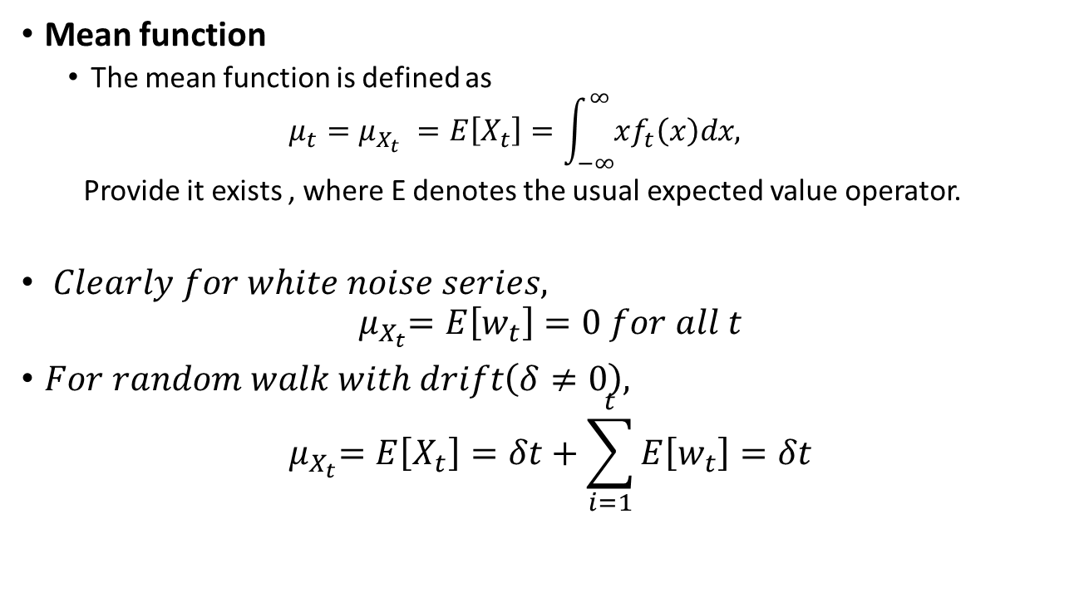
Measurement Functions
Mean function
The mean function is defined as
$$μ_{t}=μ_{X_{t}} =E\left[X_{t}\right]=\int_{−∞}^{∞}{xf_{t}\left(x\right)dx,}$$
Provide it exists , where E denotes the usual expected value operator.
$Clearly for white noise series,$
$${ μ}_{X_{t}}=E\left[w_{t}\right]=0 for all t$$
$For random walk with drift\left(δ≠0\right),$
$${ μ}_{X_{t}}=E\left[X_{t}\right]=δt+\sum_{i=1}^{t}{E\left[w_{t}\right]=δt}$$

Slide 20

Autocovariance for Time Series
Lack of independence between adjacent values in the time series$X_{t}$ $and X_{s}$can be numerically assessed.
Autocovariance Function
𝐴𝑠𝑠𝑢𝑚𝑖𝑛𝑔 𝑡ℎ𝑒 𝑣𝑎𝑟𝑖𝑎𝑛𝑐𝑒 𝑜𝑓 $X_{t}$ is finite, the autocovariance function is defined as the second moment product.
$$γ\left(s,t\right)=γx\left(s,t\right)=cov\left(X_{t},X_{s}\right)=E\left[\left(X_{s}−μ_{s}\right)\left(X_{t}−μ_{t}\right)\right]$$
$$for all s and t$$
Note that $γ\left(s,t\right)=γ\left(t,s\right)$for all time points s and t .
The autocovariance measures the linear dependence between two points on the same series observed at different times.
Very smooth series exhibit autocovariance functions that stay large even when the t and s are far apart, whereas choppy series tend to have autocovariance functions that are nearly zero for large separations.

Slide 21
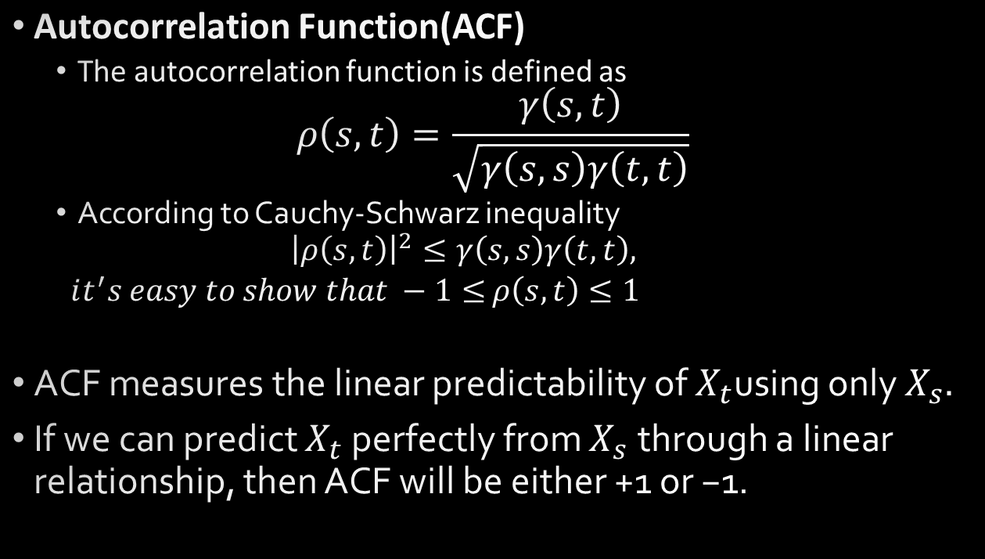
Autocorrelation for Time Series
Autocorrelation Function(ACF)
The autocorrelation function is defined as
$$ρ\left(s,t\right)=\frac{γ\left(s,t\right)}{\sqrt{γ\left(s,s\right)γ\left(t,t\right)}}$$
According to Cauchy-Schwarz inequality
$${\left|ρ\left(s,t\right)\right|}^{2}≤γ\left(s,s\right)γ\left(t,t\right),$$
$it^{′}s easy to show that −1≤$ $ρ\left(s,t\right)≤1$
ACF measures the linear predictability of $X_{t}$using only $X_{s}.$
If we can predict $X_{t}$ perfectly from $X_{s}$through a linear relationship, then ACF will be either +1 or −1.

