Slide 1
Title: Introduction to NREGA Power BI Project Creation
Key Point: Creating a Power BI project based on NREGA CSV data involves several steps, including data preparation, creating a data model, designing reports, publishing and sharing, and maintaining and updating the project.

Slide 2
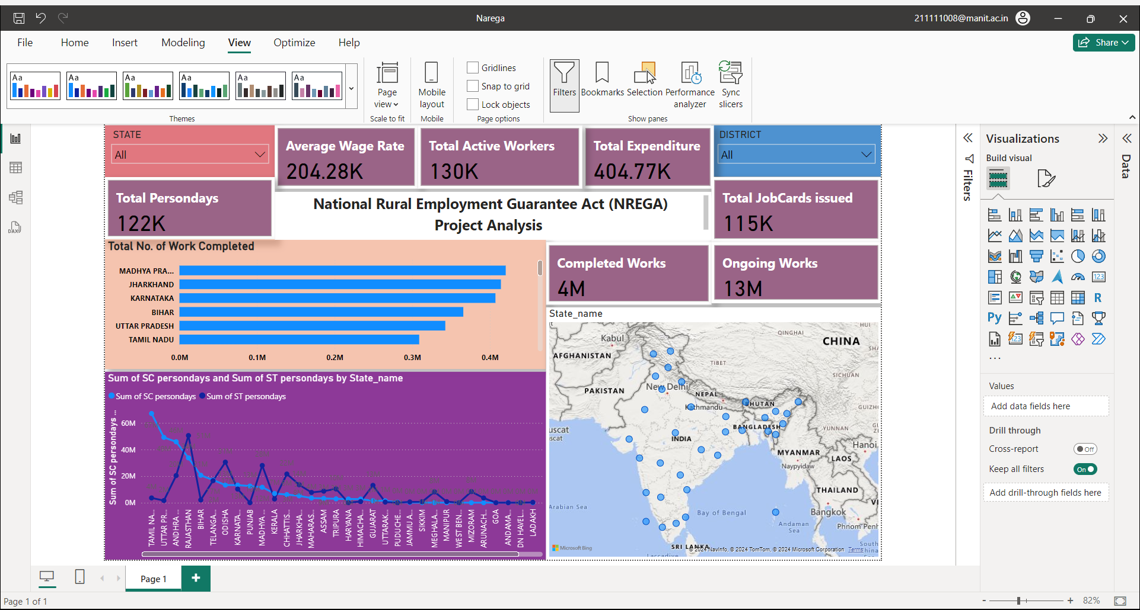

Slide 3
Title: Step 1: Prepare the Data Key Point: In this step, the data from the provided NREGA CSV file is loaded into Power BI Desktop and then cleaned using the Power Query Editor. Cleaning may involve removing null values and correcting data types.

Slide 4
Title: Step 2: Create a Data Model Key Point: In this step, relationships are established between tables based on common keys, such as State_name and District_name. Additionally, calculated columns and measures are defined to calculate key metrics, like Total Persondays, Average Wage Rate, and Total Expenditure.

Slide 5
Title: Step 3: Design the Reports Key Point: Visuals such as bar charts, line charts, pie charts, and tables are used to visualize key metrics. Examples of visuals include Total No. of Job Cards Issued, Active Workers and SC/ST Workers, Approved Labour Budget vs. Actual Expenditure, Persondays of Employment, and Average Wage Rate.

Slide 6
Title: Step 3 (Continued): Design the Reports Key Point: Additionally, filters and slicers for State_name, District_name, and Year (if applicable) are added to allow users to filter the data. All the visuals are then arranged into a cohesive dashboard that tells a clear story and highlights key insights.

Slide 7
Title: Step 4: Publish and Share Key Point: Once the report is ready, it is published to the Power BI Service by following the prompts in Power BI Desktop. The dashboard is then shared with stakeholders, and appropriate permissions and access levels are set up.

Slide 8
Title: Step 5: Maintain and Update Key Point: A schedule is set up for data refresh if the data source is updated regularly. Additionally, the performance of the reports and dashboards is monitored, and visuals and queries are optimized if necessary.

Slide 9
Title: Example Metrics to Highlight Key Point: Some example metrics to highlight in the NREGA CSV data Power BI project include Total Job Cards Issued, breakdown by state and district, Active Job Cards and Workers, comparison of total and active job cards and workers, SC/ST Workers proportion among active workers, Labour Budget and Expenditure comparison of approved budget vs. actual expenditure, and Persondays of Employment - the total number of persondays.

Slide 10
Title: Conclusion Key Point: Creating a Power BI project based on NREGA CSV data involves several steps, including data preparation, creating a data model, designing reports, publishing and sharing, and maintaining and updating the project. By following these steps and highlighting relevant metrics, stakeholders can gain valuable insights and make informed decisions.

Slide 11


