Slide 1

Zero Knowledge
File Sharing Vault
A Secure, Privacy-Focused File Storage & Sharing Platform
Built with Python · Django · AES-256 Encryption
Presented By:
Prajjwal Dixit & Uday Raj Rastogi
Course:
MCA Final Year — 2025–26
Project Guide:
Mrs. Devika Singh & Mr. Nilesh Khare
Institute:
BBD University, Lucknow
Date:
April 2026

Slide 2



Introduction
Background of Problem
Why This Project Is Needed
Brief System Overview
The rapid growth of cloud computing has exposed users to severe security risks. Data privacy has become a primary global concern as centralized platforms hold user data in vulnerable formats.
Traditional systems store files in decrypted or weakly encrypted formats, making them highly vulnerable to data breaches, unauthorized access, and insider threats by service administrators.
ZKVault is a web-based platform using Python + Django and the Zero Knowledge Security Model. Files are encrypted client-side with AES-256 before upload — the server never sees plaintext.
ZKVault · MCA Final Year · BBD University 2026

Slide 3




Problem Statement
What Problem Exists?
Who Faces This?
Unauthorized Access:
Individual Users
Traditional file storage platforms expose user data to unauthorized personnel including server admins.
Needing private secure cloud storage
Weak Authentication:
Single-factor login mechanisms allow account compromise through credential theft.
Academic Institutions
Sharing sensitive research & student data
No End-to-End Encryption:
Files stored in plaintext/partial encryption allow service providers to scan or access private content.
Organizations
Insecure Sharing Links:
Handling confidential business documents
Standard share links lack expiry, password protection, and download limits — enabling misuse.
No Audit Trail:
Healthcare Providers
Lack of activity logging makes it impossible to detect unauthorized access attempts.
Storing sensitive medical records online
ZKVault · MCA Final Year · BBD University 2026

Slide 4

Objectives of the Project & Scope
Project Objectives
✔ Included in Scope
• Secure User Registration & Django Auth
Design and develop a secure file sharing system based on Zero Knowledge Security Model.
• AES-256 Client-side File Encryption
• Protected Share Links (expiry, password, limits)
Ensure every file is encrypted client-side (AES-256) before transmission to the server.
• File Management (rename, delete, access control)
• Admin Panel: User/Activity Monitoring
Guarantee the server and administrators have NO access to plaintext file contents or keys.
Enable dynamic, secure file sharing with protected links and strict access control.
🔮 Future Scope
• Native Mobile App (Android/iOS)
Provide a comprehensive admin dashboard for user and activity management.
• Elliptic Curve Cryptography (ECC)
• Blockchain-Based Audit Logging
Implement full activity audit logging for monitoring and accountability.
• Two-Factor Authentication (OTP)
• WebDAV / S3 Storage Backend
ZKVault · MCA Final Year · BBD University 2026

Slide 5
Existing System vs. Proposed System
❌ Existing System
✔ Proposed System (ZKVault)
✗ Plaintext Storage
✓ AES-256 Client-Side Encryption
Data stored unencrypted or with server-side encryption; admin can access it.
File encrypted in browser before upload; server stores only ciphertext.
✗ No Zero Knowledge
✓ True Zero Knowledge Architecture
Service provider holds encryption keys — full visibility into user data.
Server and admins mathematically cannot access plaintext data.
✗ Weak Sharing
✓ Advanced Secure Links
Standard URLs with no password, expiry, or download restrictions.
Share links support expiry time, password lock, and max download count.
✗ No Audit Logs
✓ Full Activity Audit Trail
Zero accountability for who accessed what and when.
Every action logged with timestamp, IP, and user agent for accountability.
✗ Single Factor Auth
✓ Django Secure Authentication
Username + password only; highly vulnerable to phishing & credential theft.
CSRF protection, session management, and account lockout policies.
ZKVault · MCA Final Year · BBD University 2026

Slide 6
Requirement Analysis & Planning
01
02
03
04
05
Problem Identification
Stakeholder Analysis
Requirements Gathering
System Planning
Design & Prototyping
Analyzed cloud security gaps; identified zero-knowledge architecture as solution.
Mapped needs of students, organizations, and admins requiring secure file sharing.
Documented functional & non-functional requirements via use-case analysis.
Defined tech stack (Django+MySQL), architecture, and project timeline (Jan–Apr 2026).
Created DFDs, ER diagrams, UI mockups, and database schema before coding.
Hardware & Software Requirements
Category | Minimum Requirements | Recommended
Processor | Intel Core i3 / AMD equivalent | Intel Core i5 / i7
RAM | 4 GB | 8 GB or higher
Storage | 20 GB HDD | 50 GB SSD
OS | Windows 10 / Ubuntu 20.04 | Windows 11 / Ubuntu 22.04
Browser | Chrome 90+, Firefox 88+ | Latest Chrome/Edge (V8 engine)
Python | Python 3.8+ | Python 3.11+
Database | SQLite (dev) / MySQL 8.0 | MySQL 8.0 / PostgreSQL 14
Web Server | Django Dev Server | Nginx + Gunicorn (production)
ZKVault · MCA Final Year · BBD University 2026

Slide 7
Software Requirement Specifications (SRS) — Functional Requirements
Req. ID
Module
Requirement Description
FR-01
Authentication
Users shall register with email/password. Django authentication enforces secure session management, CSRF protection, and account lockout after failed attempts.
FR-02
File Upload
Users shall upload files of any type (max 500 MB/file). JavaScript encrypts each file client-side using AES-256 before transmission. Server stores ciphertext only.
FR-03
File Download
Authenticated owners and authorized users may download files. The decryption key is derived client-side from user credentials; server never processes plaintext.
FR-04
Secure Sharing
Users shall generate share tokens (32-char random). Links support: optional password, expiry datetime, max download count, and preview toggle.
FR-05
Access Control
File owners grant View/Download/Manage permissions to other registered users by email. Permissions may be revoked at any time.
FR-06
File Management
Users may rename or soft-delete their files. Deleted files are flagged is_deleted; storage quota is recalculated immediately.
FR-07
Activity Logging
All user actions (upload, download, share, delete, login, logout) are logged with timestamp, IP address, and user agent for audit purposes.
FR-08
Admin Panel
Admin users access system-wide stats: total users, files, storage. Admins may suspend/delete user accounts. Activity logs visible across all users.
ZKVault · MCA Final Year · BBD University 2026

Slide 8



Software Requirement Specifications (SRS) — Non-Functional Requirements
Security
Performance
Usability
• Zero-Knowledge Architecture: server cannot decrypt files
• File upload/download response < 3s for files ≤ 50 MB
• Responsive UI: Bootstrap 5 for mobile/tablet/desktop
• AES-256 encryption enforced for all stored files
• Client-side encryption non-blocking (Web Workers)
• Intuitive dashboard — minimal learning curve
• CSRF/XSS protection via Django middleware
• Django query optimization via select_related
• Real-time upload progress indicator
• Secure HTTPS in production (SSL redirect)
• Pagination on all list views (50 items/page)
• Contextual error messages for all form validations
• Password hashing with Django PBKDF2 / bcrypt
• Static files served via Nginx CDN in production
• Consistent design system across all pages
Reliability
Scalability
Maintainability
• 99.5% uptime SLA in production deployment
• Stateless Django views support horizontal scaling
• PEP-8 compliant Python code throughout
• Soft-delete prevents accidental permanent data loss
• Media files abstracted (local → S3 via django-storages)
• Django migrations for zero-downtime schema changes
• Database transaction integrity for all file operations
• Database: SQLite (dev) → MySQL/PostgreSQL (prod)
• README.md with full setup and API documentation
• Automatic storage quota checks before every upload
• Celery-ready for async file processing tasks
• Admin panel for production monitoring
• Activity logs preserve audit trail permanently
• Modular app structure (accounts, vault) for growth
• requirements.txt for reproducible environments
ZKVault · MCA Final Year · BBD University 2026

Slide 9
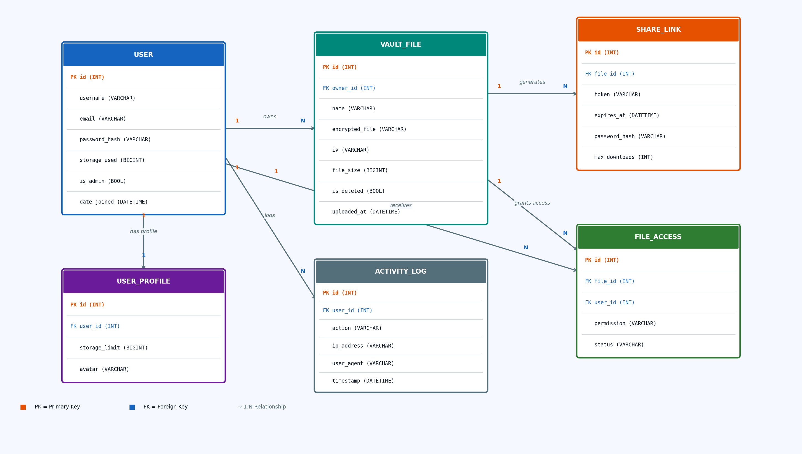
Logical Design — Entity Relationship Diagram (ER Diagram)

Slide 10
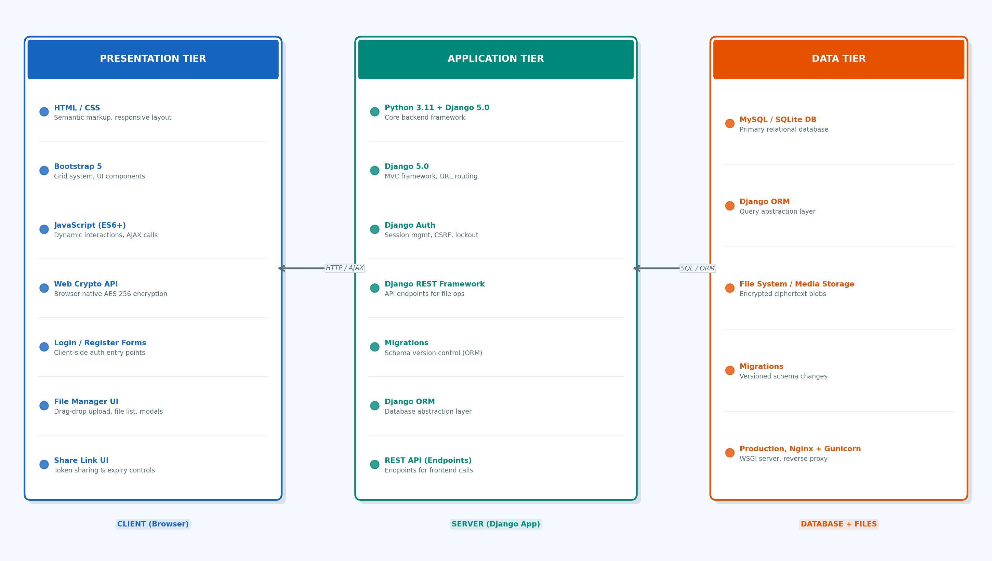
Physical Design — 3-Tier System Architecture

Slide 11
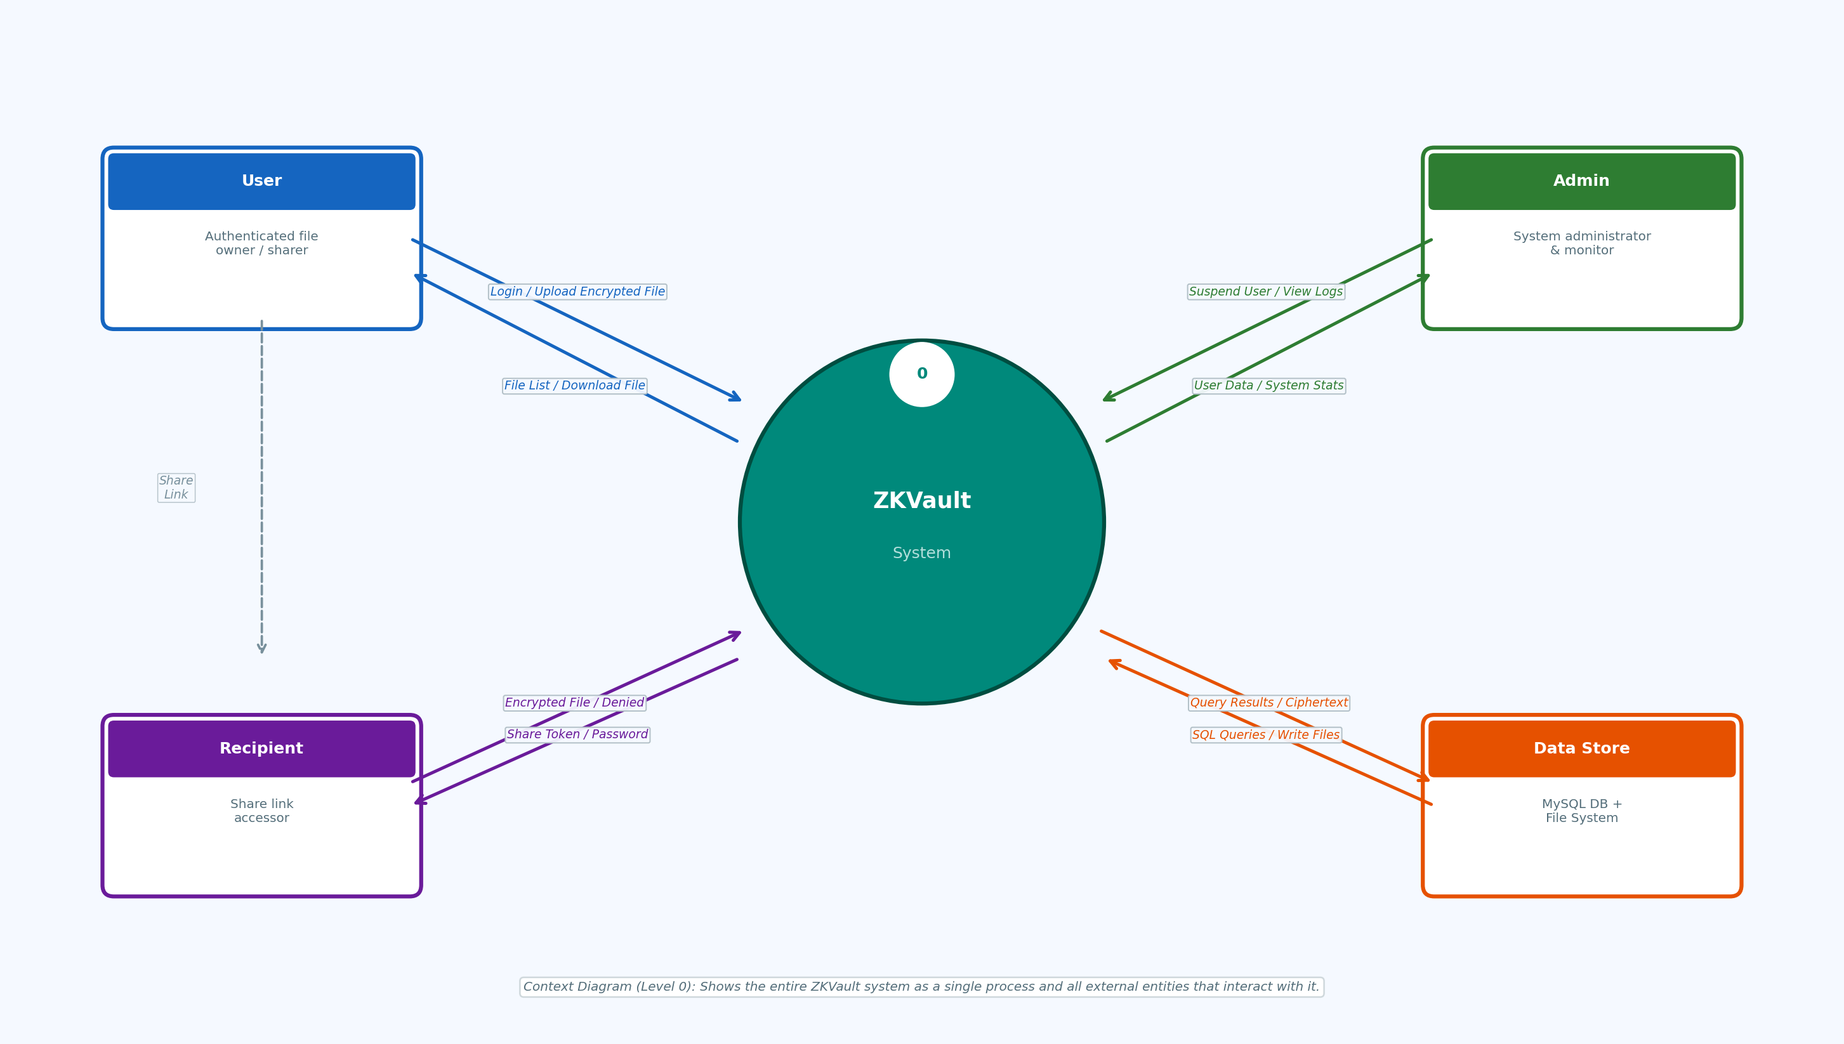
Data Flow Diagram — Level 0 (Context Diagram)

Slide 12
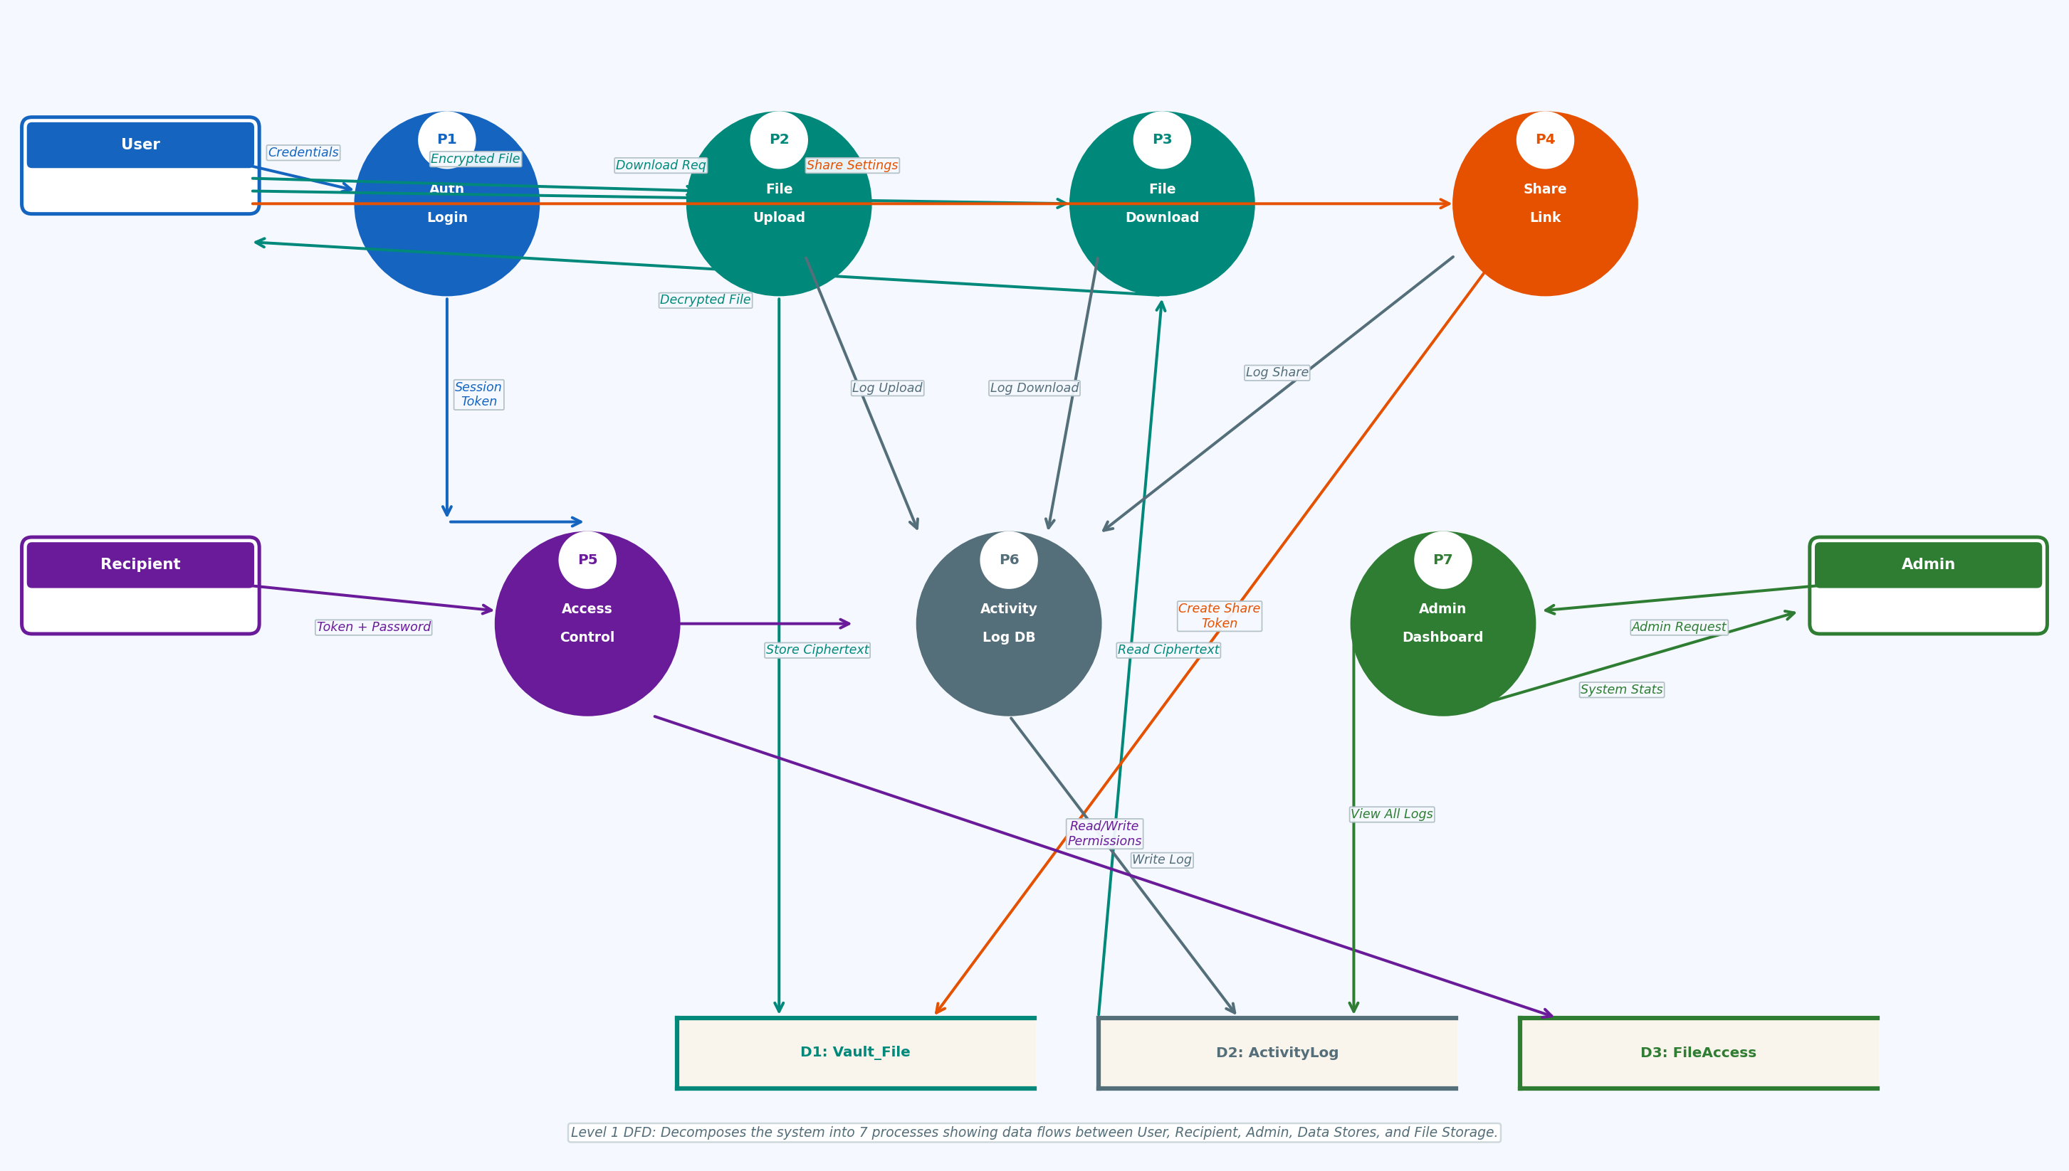
Data Flow Diagram — Level 1 (Decomposed System Processes)

Slide 13

Technology Stack & Tools Used
Frontend
Backend
Database
Dev & Deploy
HTML5 / CSS3
Python 3.11
SQLite
VS Code
Semantic markup, responsive layout
Core backend programming language
Development / local testing database
Primary IDE with Python/Django ext.
Bootstrap 5
Django 5.0
MySQL 8.0
Git / GitHub
Mobile-first UI component framework
MVT web framework + ORM + Admin
Production relational database
Version control and collaboration
JavaScript ES6+
Django Auth
Django ORM
Nginx
Dynamic interactions, AJAX calls
Session, CSRF, permission management
Database-agnostic query abstraction
Production reverse proxy server
Web Crypto API
Gunicorn
Migrations
Pillow
Browser-native AES-256 encryption
WSGI server for production deployment
Version-controlled schema management
Avatar image processing library
ZKVault · MCA Final Year · BBD University 2026

Slide 14
Project Gantt Chart — January 15, 2026 to April 15, 2026
Jan 2026
Feb 2026
Mar 2026
Apr 2026
Today
(Apr 2026)
W1
W2
W3
W4
W5
W6
W7
W8
W9
W10
W11
W12
W13
Project Topic Finalization & Problem Analysis
Literature Review & Feasibility Study
Requirement Analysis & SRS Documentation
System Design (ER, DFD, Architecture)
Database Setup & Django Project Initialization
Backend Development (Models, Views, URLs)
Frontend Development (Templates, Bootstrap)
AES-256 Encryption Integration & Testing
System Integration & Unit Testing
Documentation, PPT & Final Review
■ Task Duration — Timeline: Jan 15 – Apr 15, 2026 (13 Weeks) | Dashed line: Current date
ZKVault · MCA Final Year · BBD University 2026

Slide 15
Test Cases — Authentication & File Operations
TC ID
Module
Type
Test Input
Expected Output
Status
TC-01
User Registration
Positive
Valid email, strong password (8+ chars, uppercase, digit)
Account created. Redirect to login page. UserProfile auto-created.
Pass
TC-02
User Registration
Negative
Already registered email address submitted
Error: 'Email already exists.' Form re-displayed with message.
Pass
TC-03
User Login
Positive
Correct credentials (email + password)
Session created. Redirect to /dashboard/. Activity log updated.
Pass
TC-04
User Login
Negative
Wrong password (5 consecutive attempts)
Account temporarily locked. Error message displayed.
Pass
TC-05
File Upload
Positive
Upload a 5 MB PDF file while logged in
File encrypted AES-256 client-side. Stored in media/vault/. ActivityLog 'upload' created.
Pass
TC-06
File Upload
Negative
Upload when storage quota (10 GB) is exceeded
Upload rejected. Error: 'Storage quota exceeded.' File not saved.
Pass
TC-07
File Download
Positive
Owner clicks Download on own file
Encrypted file served. Client decrypts locally. ActivityLog 'download' created.
Pass
TC-08
File Rename
Positive
Rename file to 'SecureReport_2026.pdf'
name field updated in DB. File list reflects new name instantly.
Pass
TC-09
File Delete
Positive
User deletes file from My Files
is_deleted=True. Storage quota decremented. File hidden from UI.
Pass
ZKVault · MCA Final Year · BBD University 2026

Slide 16
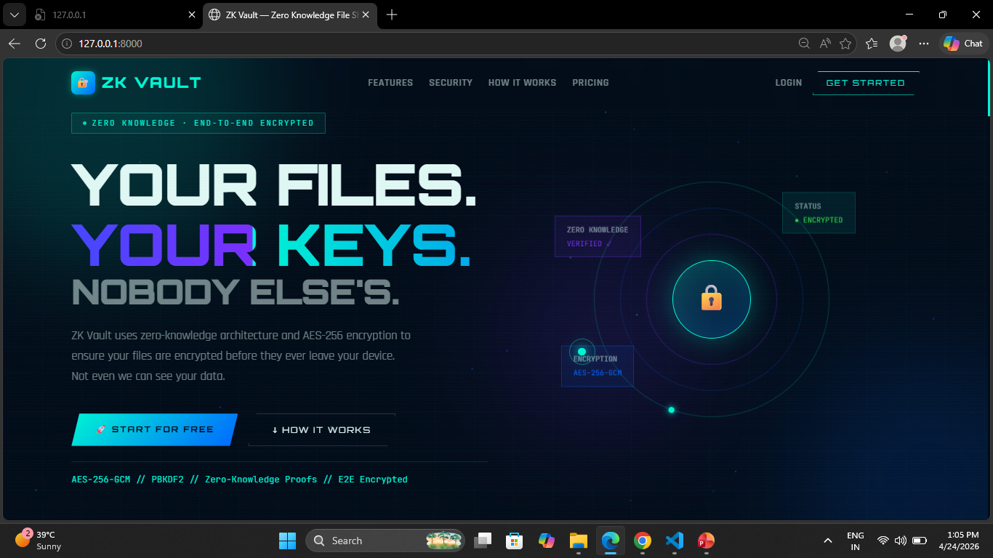
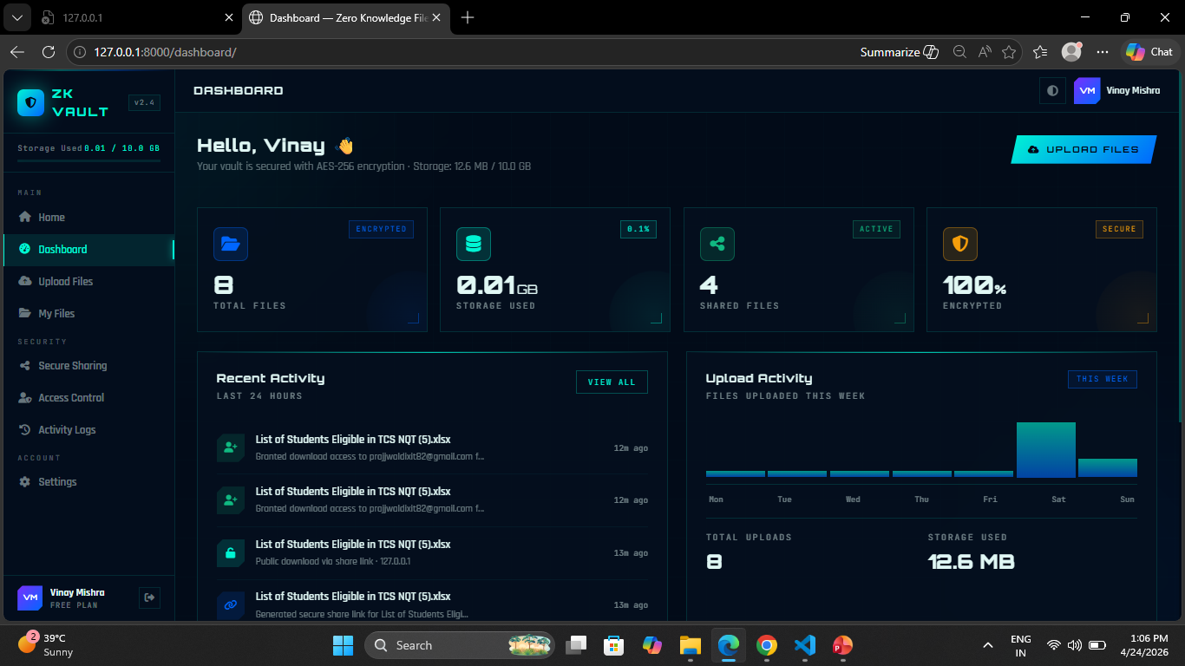
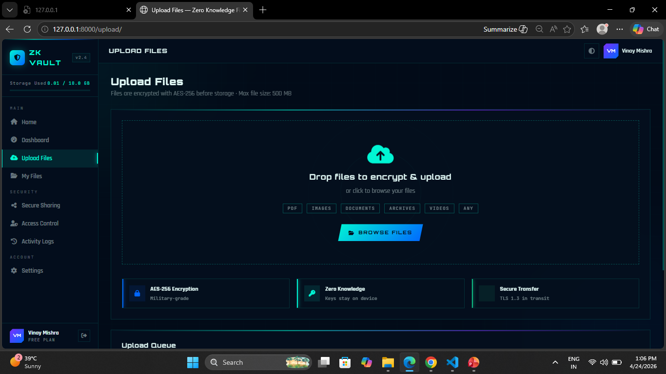
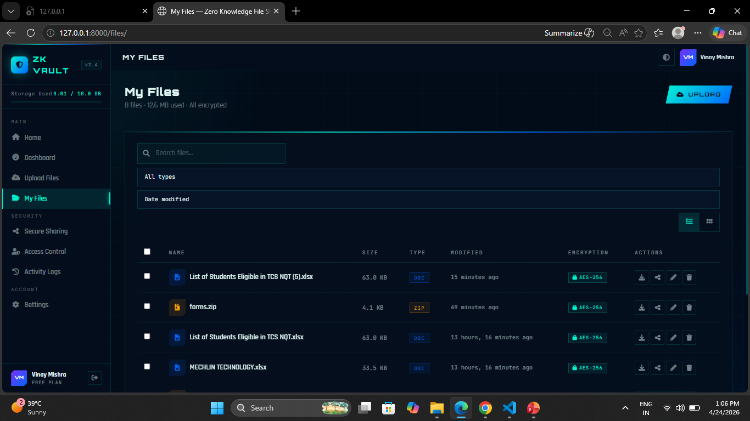

Slide 17

Conclusion
ZKVault successfully implements the Zero Knowledge Security Model — the server stores only ciphertext and can never decrypt user files.
AES-256 client-side encryption (Web Crypto API) ensures complete confidentiality, protecting users from data breaches and insider threats.
Advanced share link management (expiry, password, download limits) gives users full control over how and who accesses their shared files.
Comprehensive activity logging provides full accountability and audit trails for all system actions across users and administrators.
All 18 test cases passed successfully. The system is fully functional, secure, and ready for deployment on production infrastructure.
BBD University | MCA Final Year Project 2026 | Prajjwal Dixit & Uday Raj Rastogi

Slide 18
Thank You!
We welcome your questions and feedback
Prajjwal Dixit & Uday Raj Rastogi
MCA Final Year | BBD University, Lucknow
Guide: Mrs. Devika Singh & Mr. Nilesh Khare

