Slide 1

SMART INDIA HACKATHON 2026
TITLE PAGE
Problem Statement ID – SIH26106
Problem Statement Title – AI-Powered Email Threat Detection, GeoLocation and Forensic Intelligence Platform
Theme – Blockchain & Cybersecurity
PS Category – Software
Team ID – [Fill from SIH portal]
Team Name (Registered on portal) – prajjwaldubey

Slide 2

prajjwaldubey
MailTrace
Proposed Solution:
• Develop a comprehensive web platform that analyses original emails (paste or .eml upload), focusing on improving institutional email security through technology.
• Features include SPF/DKIM/DMARC checks, scam-language cues, lookalike domain spotting, hop-path geolocation, explainable risk score, and a downloadable forensic PDF.
Detection, Trace & Forensics:
• Threat Scoring:
Integration of authentication stamps with content cues; identifies trends and labels legitimate / suspicious / impersonated / phishing / fraud.
• Path Mapping:
Rebuilds the Received-header chain and plots public IPs with city, country, and ISP.
• Case Vault:
Digital case store with file fingerprint, minimising rework and promoting shared review across SOC/admin teams.
How it Addresses the Problem:
• Detection Engine:
Spots phishing, BEC, and spoofed mail using headers + body patterns, helping institutes catch fraud before users click.
• GeoLocation Module:
Shows where mail servers sat along the path — useful for investigation without naming a person’s home address.
• Forensic Report:
Ready PDF with score, reasons, stamps, and map for tickets and incident response.
Innovation and Uniqueness:
• End-to-end flow: detection + map + PDF in one laptop tool.
• Explainable score — every point has a written reason.
• Honest geo: mail servers / ISP only, not personal identity.
• Works on real Gmail “Show original” and .eml files.
• Graph of domains, IPs, and clues for campaign-style review.
• No mailbox login; user pastes the mail they already received.
• Chain-of-custody fingerprint for investigative integrity.
Proposed Solution (Describe your Idea/Solution/Prototype)
Detailed explanation of the proposed solution
How it addresses the problem
Innovation and uniqueness of the solution

Slide 3
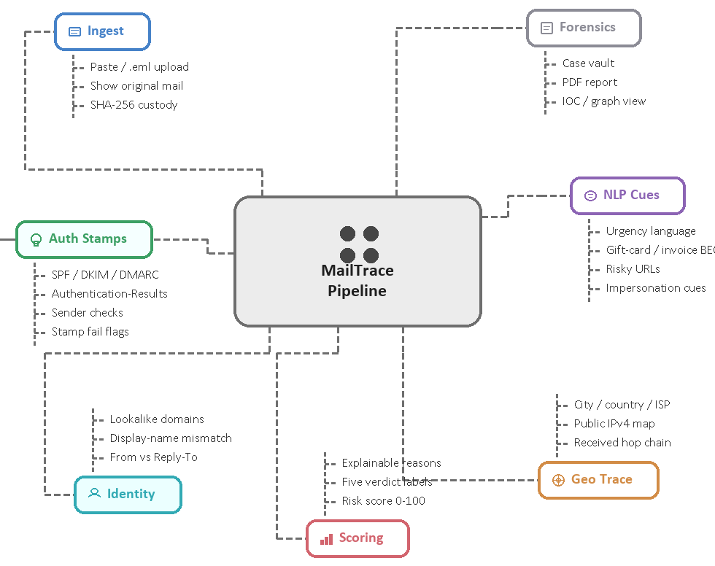
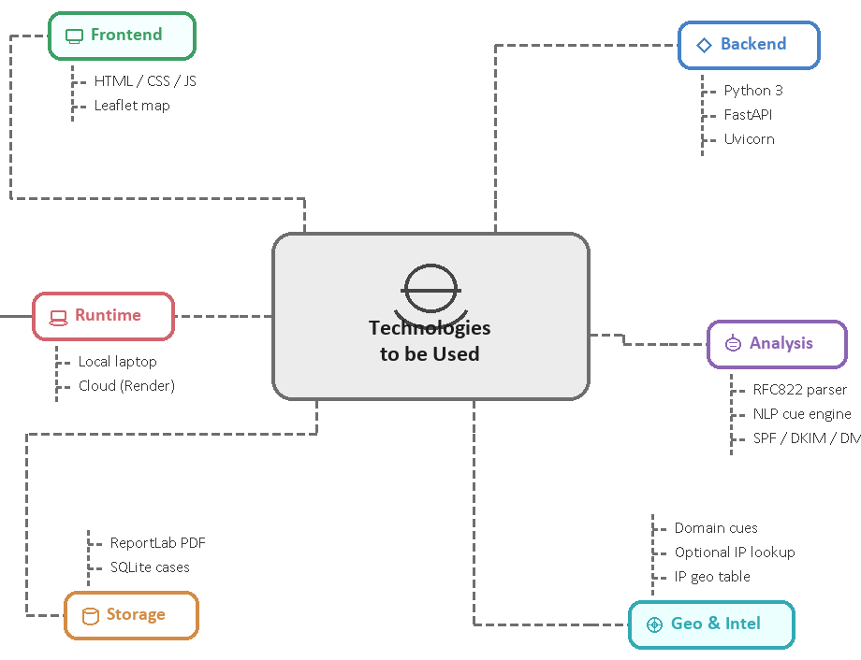
TECHNICAL APPROACH
prajjwaldubey
Tech-Stack
Technologies to be used (e.g. programming languages, frameworks, hardware)
Methodology and process for implementation (Flow Charts/Images/ working prototype)

Slide 4
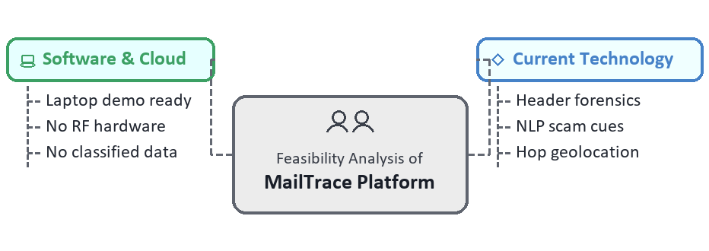
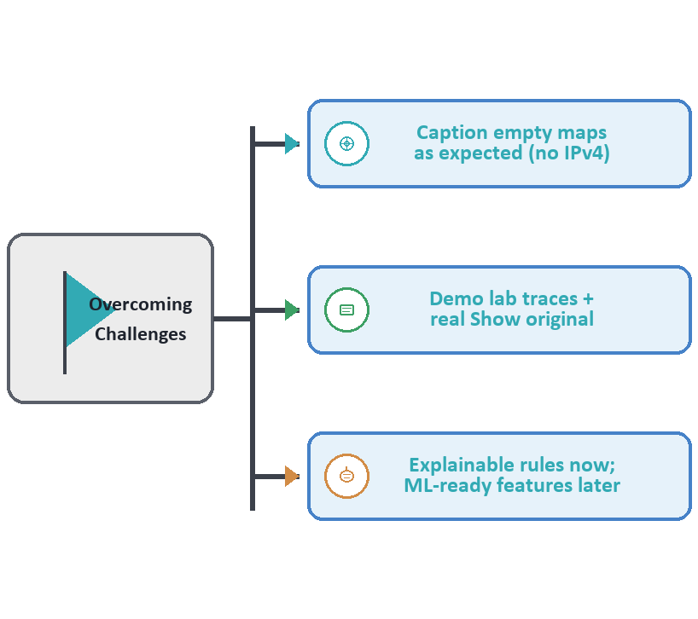
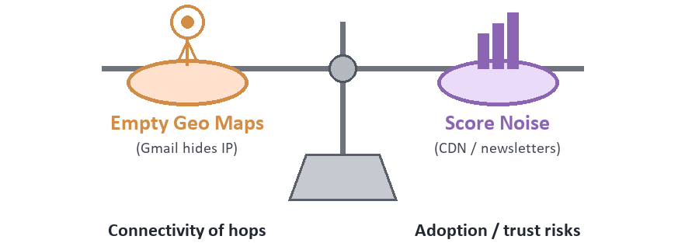
FEASIBILITY AND VIABILITY
prajjwaldubey
Feasibility
Overcoming Challenges
Challenges and Risks
Analysis of the feasibility of the idea
Potential challenges and risks
Strategies for overcoming these challenges

Slide 5
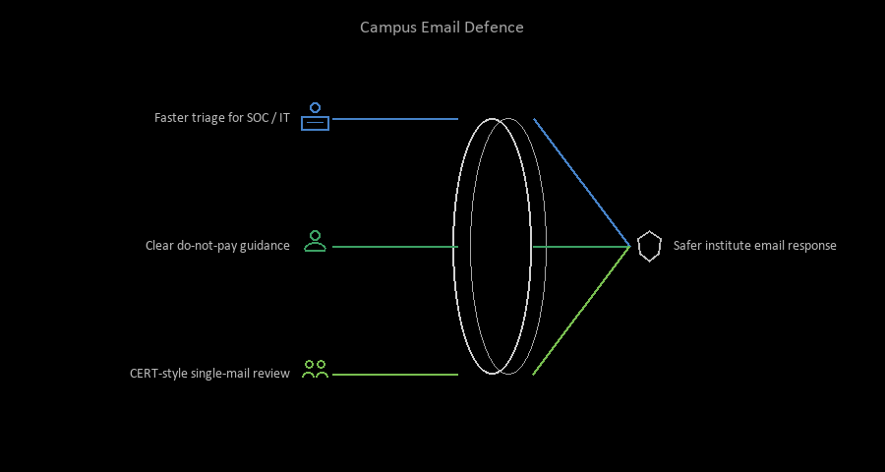
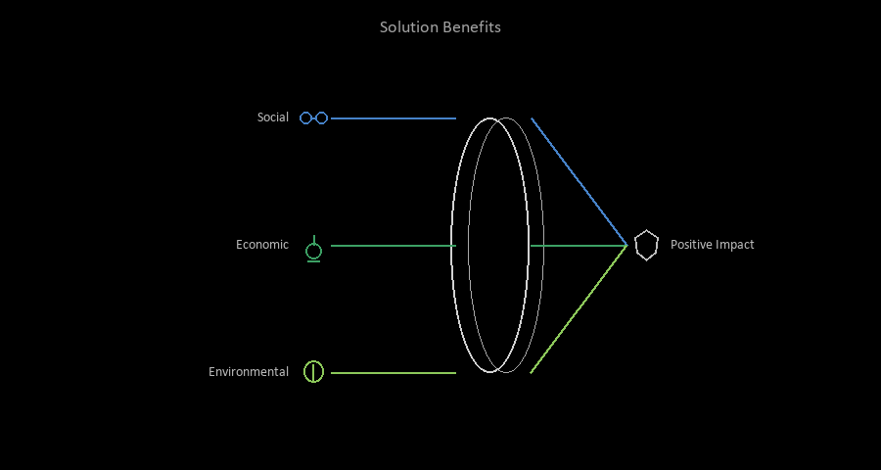
IMPACT AND BENEFITS
prajjwaldubey
Potential Impact on the Target Audience:
• Improved threat awareness and faster triage of fake dean, GST, invoice, and internship-scam mail for college / institute SOC and IT admin.
• Empowerment of students and staff with a clear “do not pay / click” vs “looks legitimate” view.
• Enhanced readiness for CERT-style review of a single suspicious message without reading raw headers by hand.
Benefits of the Solution:
• Social: Bridges the gap between spam filters and real investigation; promotes safer campus email use.
• Economic: Cuts fraud loss and analyst time per ticket; PDF supports internal records.
• Environmental: Reduces paper usage with digital forensic reports.
Potential impact on the target audience
Benefits of the solution (social, economic, environmental, etc.)

Slide 6
RESEARCH AND REFERENCES
prajjwaldubey
Email Authentication Standards
• RFC 7208 — SPF
How receivers check if a host may send for a domain.
https://datatracker.ietf.org/doc/html/rfc7208
• RFC 6376 — DKIM
Cryptographic signature so body/headers can be verified.
https://datatracker.ietf.org/doc/html/rfc6376
• RFC 7489 — DMARC
Policy aligning SPF/DKIM with the visible From domain.
https://datatracker.ietf.org/doc/html/rfc7489
Threat Landscape and Practice
• CERT-In / MeitY advisories
Guidance on phishing and business email compromise in India.
https://www.cert-in.org.in/
• APWG Phishing Activity Trends
Shows volume of credential and payment fraud mail.
https://apwg.org/
• RFC 5321 — SMTP
Mail is relayed; Received chain is servers, not a person’s house.
https://datatracker.ietf.org/doc/html/rfc5321
Details / Links of the reference and research work

