Slide 1
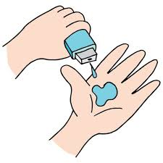
Project Title - Seasonal Agriculture Performance Analysis
[Student Name- PRAJJWAL KATIYAR
College Name-DELHI TECHNICAL CAMPUS , GURU GOIND SINGH INDRAPRASTHA UNIVERSITY]
AICTE STU ID : (STU6a3034a4bae891781544100)

Slide 2

PROBLEM STATEMENT
(Agricultural activities are influenced by seasonal variations in environmental conditions, farming practices, resource availability and market conditions. As a result, agricultural performance may differ from one season to another. However, raw agricultural data does not clearly explain how agricultural performance changes across seasons or what patterns can be observed in different seasonal conditions. The problem is to analyze the given agricultural dataset and investigate seasonal differences in agricultural performance by identifying meaningful patterns, trends, relationships and variations within the available data. )

Slide 3
Project Description
This project is about understanding how agricultural performance changes across different seasons. We analyzed farming data from Kharif, Rabi, and Zaid seasons and looked at factors such as crop yield, production, revenue, profit, water usage, weather conditions, irrigation, and resource usage.
The data was cleaned and analyzed using Python, statistical methods, and visualizations. We compared different seasons, crops, and states to find useful patterns and understand which conditions and practices are associated with better agricultural performance.
The main aim of the project is to use these findings to understand seasonal differences and provide practical insights for better crop planning, efficient use of resources, and improved agricultural decision-making.

Slide 4

WHO ARE THE END USERS?
Farmers – For better seasonal and crop planning.
Agriculture Department and Govt. Organization – Agriculture planning and for more crop production efficiency.
Researchers and Students – For analyzing on agriculture data and to find out important insights.
Agriculture Experts – For seasonal trends and regional performance.

Slide 5

Technology Used
Python – Data analysis and preprocessing.
Pandas – Data cleaning , manipulation and analysis.
Numpy - Numerical calculations and data operations.
Matplotlib - Creating charts and data visualizations.
Google Colab Notebooks – Project Development and documentation.

Slide 6
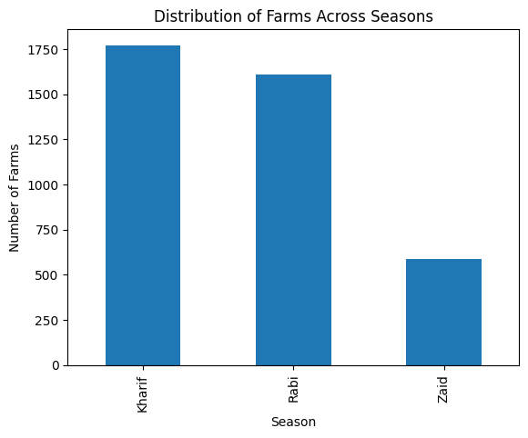
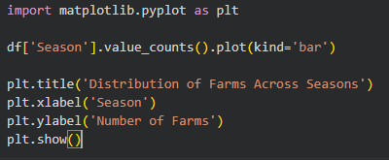
RESULTS

Slide 7
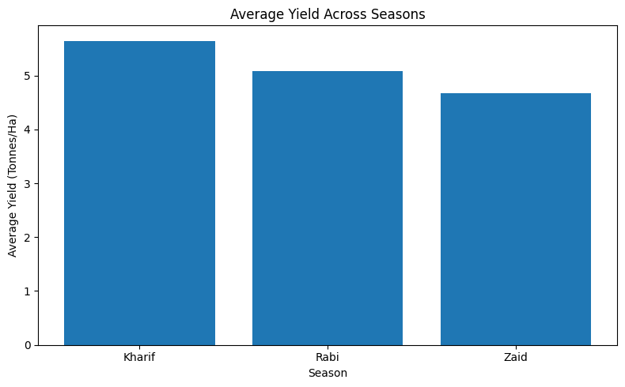
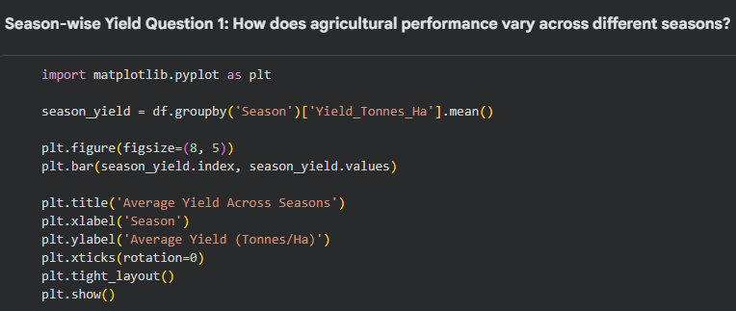
RESULTS

Slide 8
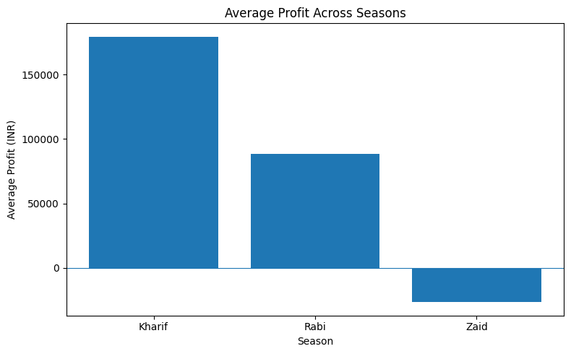
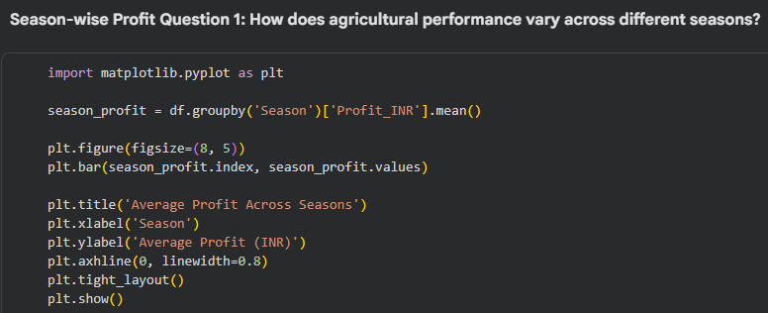
RESULTS

Slide 9
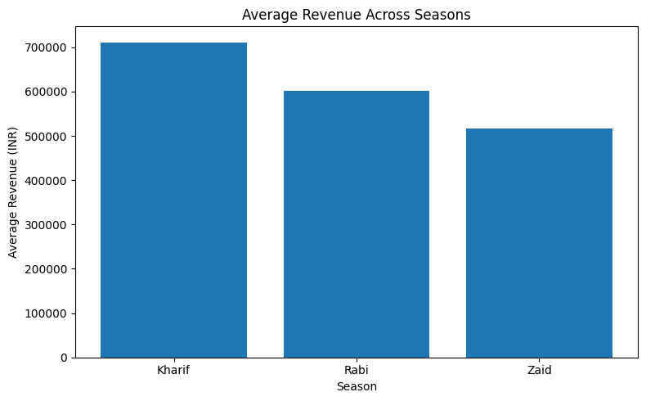
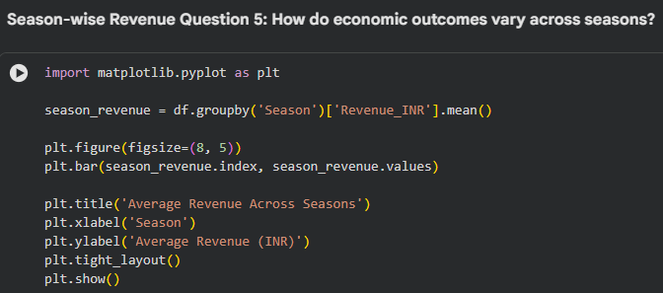
RESULTS

Slide 10
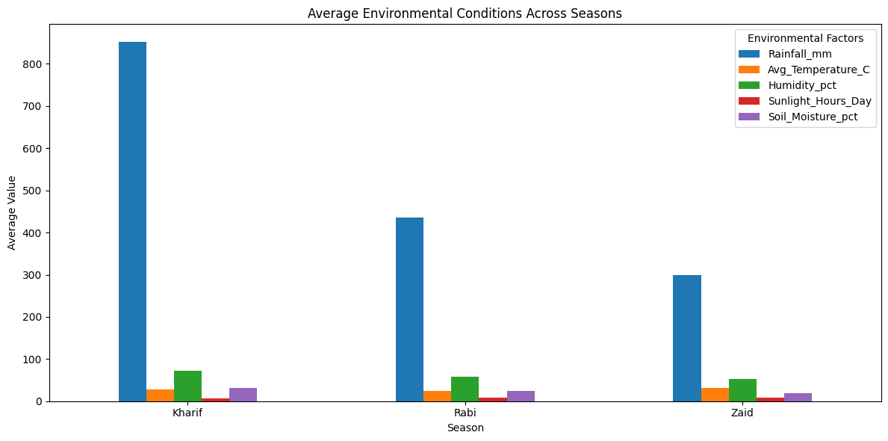
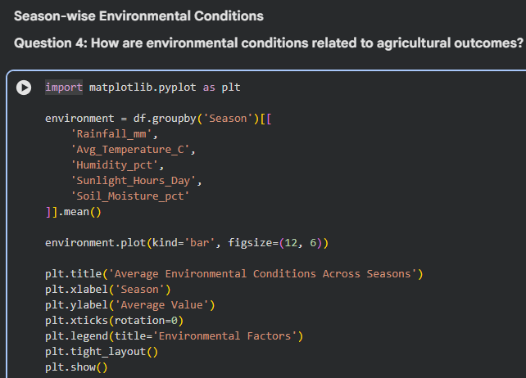
RESULTS

Slide 11
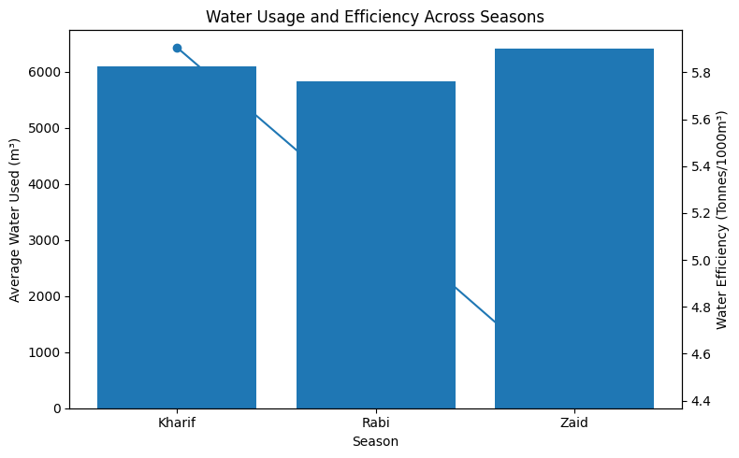
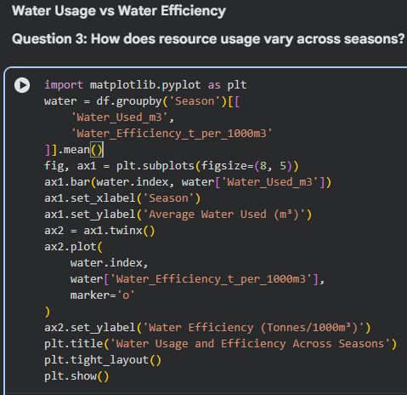
RESULTS

Slide 12
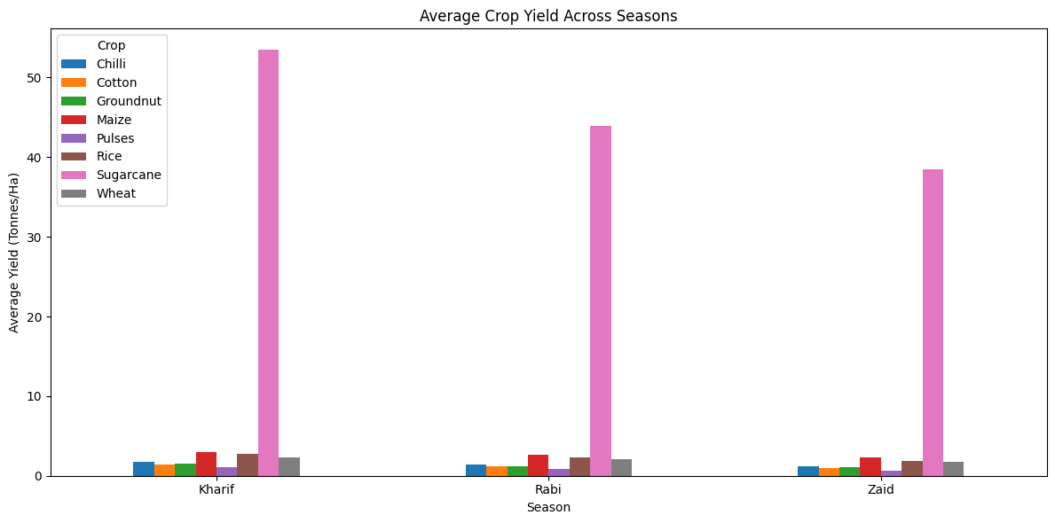
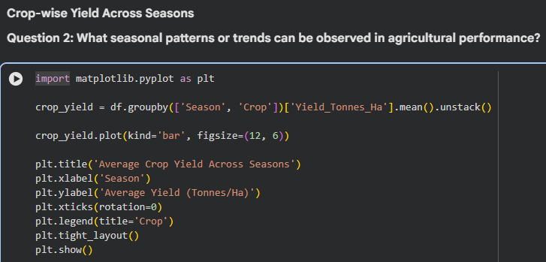
RESULTS

Slide 13
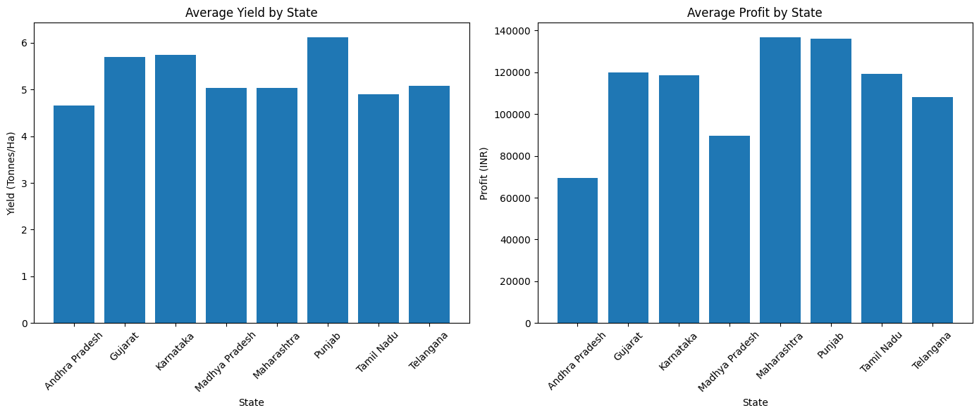
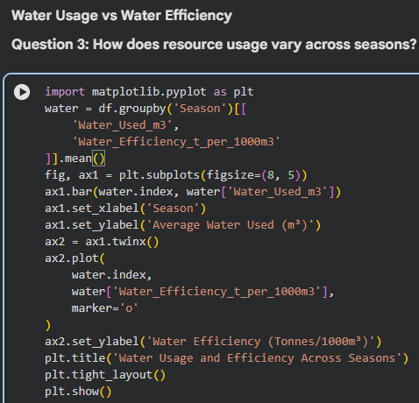
RESULTS

Slide 14
Future scope
Crop Recommendation System – By suggesting suitable crops on the basis of soil , weather and seasonal conditions.
Real Time Data Integration – It can enhance the analysis by including market prices , live weather and agricultural data.
Weather Forecasting Integration – By including future weather data we can enhance the farming decisions.
Predictive Analysis – We can use machine learning models to predict future crop yields , production and can easily predict future profits or losses.

Slide 15
GitHub Link
https://github.com/prajjwalk-3016/seasonal-agriculture-performance-analysis

Slide 16

VOIS Course completion certificate - Course name- Data Visualization

Slide 17
Thank you
.
.

