Slide 1
Zomato Business Intelligence
& Delivery Prediction
Cleaning, SQL, EDA, machine learning and Power BI on two years of food-delivery orders (Jan 2023 - Dec 2024)
Prajna Dottakavi | 25 September 2026
Notes:
Replace the placeholder line with your name, course and date.

Slide 2
Business problem
A food-delivery business needs to know where money is made, where it leaks, and what can be predicted.
Where does revenue come from?
Why do orders fail?
City, cuisine, restaurant and time of day.
Cancelled, never delivered or delivered late.
Can delivery time be predicted?
Can churn be predicted?
Traffic, weather, basket and partner data.
Who will not order in the next 60 days.
2
Notes:
Four questions drive the whole project. Each later slide answers one of them.

Slide 3
Data architecture
EDA
30 charts
Raw data
12 messy CSVs
Cleaned data
12 clean CSVs
src/clean.py
Analytical layer
3 tables
src/features.py
Machine learning
Delivery + churn
Power BI
6 pages
One trusted analytical layer feeds everything downstream
Code is split into small, readable modules: ingest, clean, features, models
Notebooks call the modules and show the results
3
Notes:
Data is prepared once in the analytical layer and reused by EDA, ML and Power BI, so all three always agree.

Slide 4
Data quality and cleaning
205
180
230
12 / 12
duplicate orders removed
duplicate customers removed
conflicting feedback rows dropped
quality checks pass on analytical tables
Mixed date formats parsed only when unambiguous; 1,737 order dates recovered from payment dates
City names standardised to 25 canonical cities; negative amounts fixed only when cross-checked
Missing values left blank, not invented (weather and traffic readings are missing for about 46% of orders)
4
Notes:
Rule followed everywhere: fix what is clearly wrong, never guess what is missing. Every decision is logged in cleaning_decisions_Profiling.csv.

Slide 5
Analytical dataset
Orders
Customers
Restaurants
20,475 rows x 74 columns
One row per order: customer, restaurant, partner, weather, traffic and delivery details.
9,254 rows x 24 columns
Time-aware churn label: features before 2024-11-01, outcome in the next 60 days.
1,200 rows x 20 columns
Revenue, cancellation, late rate and a documented PerformanceScore.
25+ engineered features: peak hour, tenure, lifetime value, delivery efficiency, rain impact, basket size
Limitation stated openly: restaurant-to-customer distance is unavailable
5
Notes:
Three tables at three grains. Distance was not fabricated: customers have no coordinates, so SameCity is used as a documented proxy.

Slide 6
SQL insights: headline business metrics
Rs 5.31M
20,475
Rs 392
Revenue (delivered orders)
Orders placed
Average order value
22.3%
15.9%
38.4 min
Cancellation rate
Late deliveries (of delivered)
Average delivery time
Revenue counts Delivered and Delivered Late orders only. Total order value placed is Rs 8.02M.
6
Notes:
Figures below were computed in Pandas from order_analytics.csv. Replace or add your top SQL query results here (20+ queries, 2+ views, 1 index) and confirm they match these numbers.

Slide 7
EDA insights: demand is steady, failures are high
A third of order value (Rs 2.7M of 8.0M) is lost to cancelled or undelivered orders
Revenue is evenly spread across cities, months and cuisines; membership tiers look identical
Late orders average 64 min vs 34 min on time, but traffic, rain and vehicle explain little
7
Notes:
Orders peak at lunch and dinner, but cancellation and late rates are the same in peak and off-peak hours (22.3% cancellation in both).

Slide 8
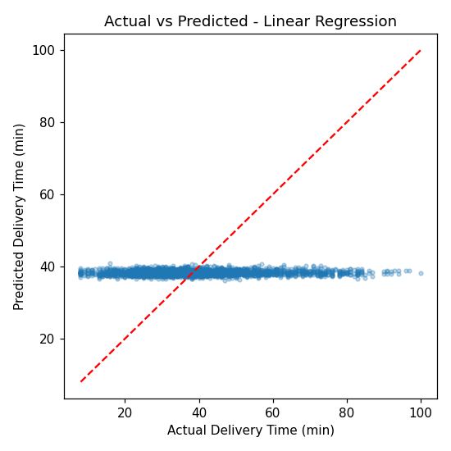
Delivery-time model: no usable signal
Model (tuned) | MAE (min) | RMSE | R-squared
Linear Regression | 11.64 | 15.38 | 0.001
Random Forest | 11.66 | 15.41 | -0.003
15 pre-delivery features: traffic, rain, basket, partner rating, hour and more
R-squared of about 0: the features explain almost none of the variation
Next step: capture customer location, preparation time and partner GPS
8
Notes:
Four regression models were compared and the top two tuned. Predicting the average alone gives an MAE of about 11.5 minutes, the same as the models. Distance, the likely main driver, is not in the data.

Slide 9
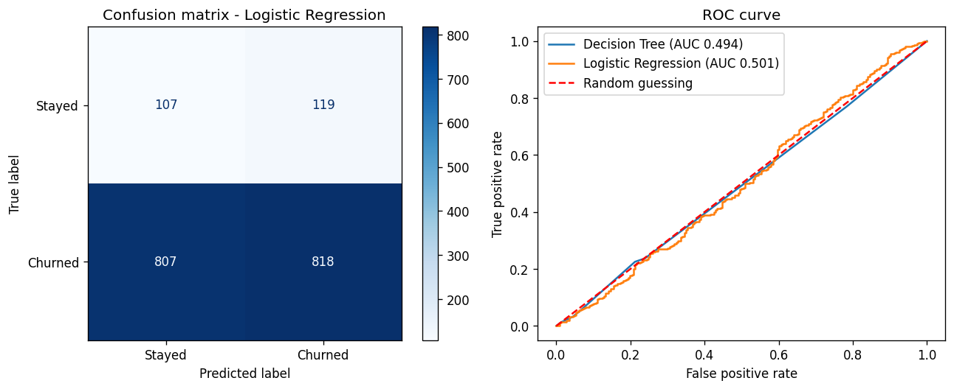
Churn model: no better than guessing
Model | Accuracy | F1 | ROC-AUC
Everyone churns (baseline) | 0.878 | 0.935 | 0.500
Logistic Regression | 0.499 | 0.637 | 0.501
Decision Tree | 0.619 | 0.752 | 0.507
Random Forest | 0.820 | 0.900 | 0.494
Gradient Boosting | 0.579 | 0.717 | 0.487
Confusion matrix and ROC curve: the curve sits on the diagonal.
Time-aware design: features before 2024-11-01, churn = no order in the next 60 days
Class imbalance handled with class weights; top 2 models tuned
Probabilities and Low / Medium / High risk segments are exported for Power BI
9
Notes:
Churn is about 88% in every recency and order-count group. The naive rule "everyone churns" scores higher on accuracy and F1 than any model, so ROC-AUC is the fair metric, and it is about 0.5.

Slide 10
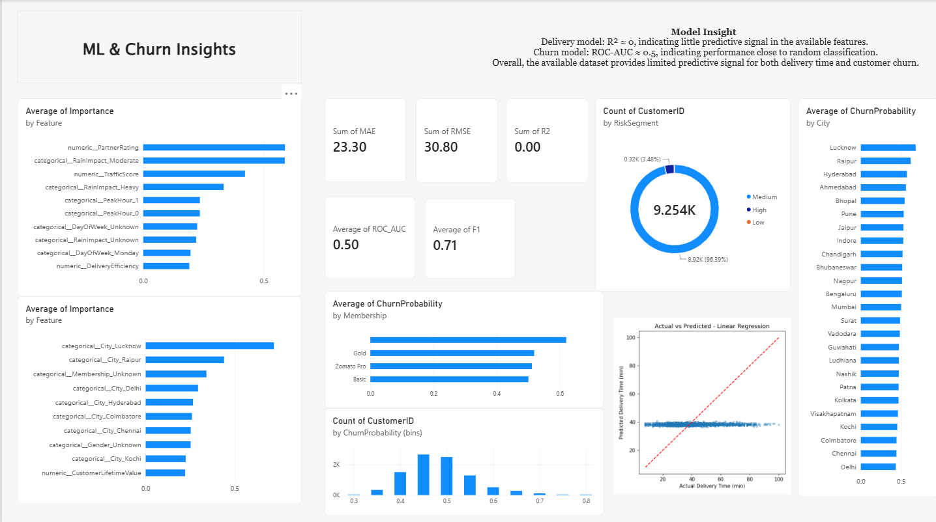
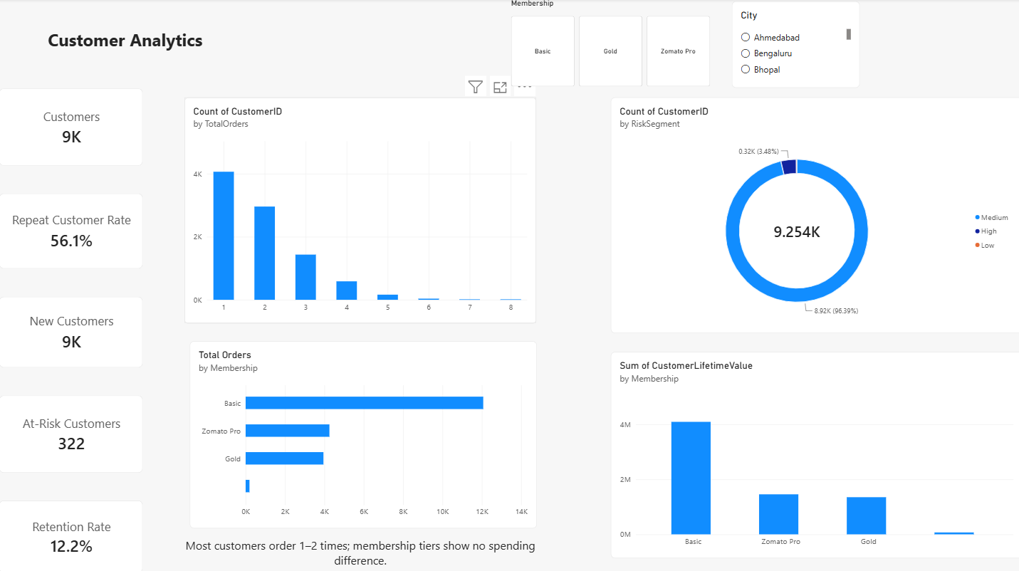
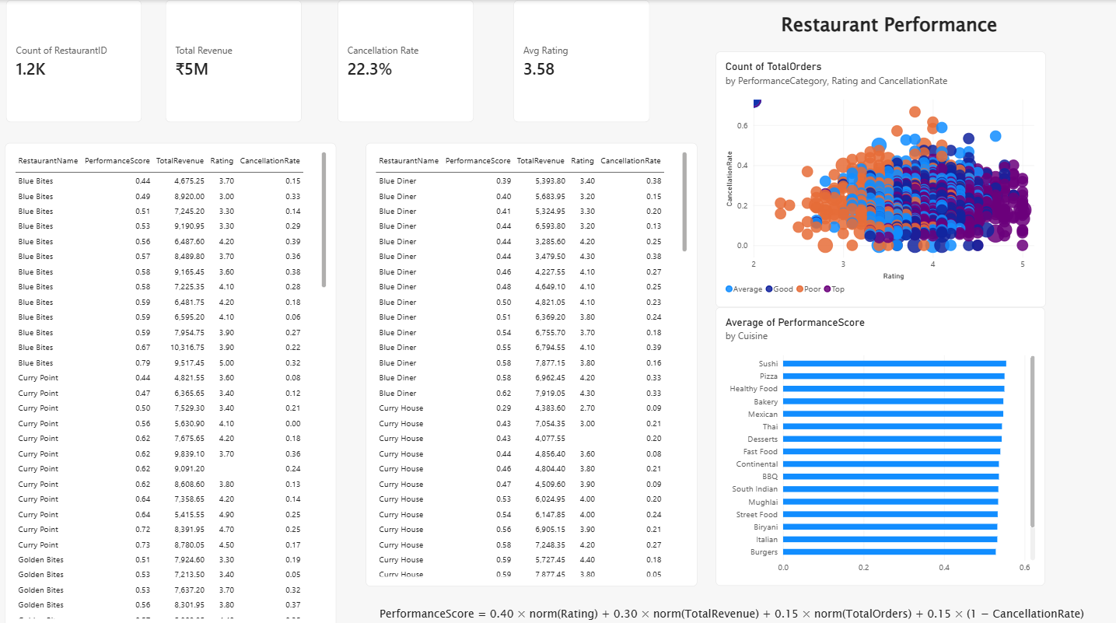
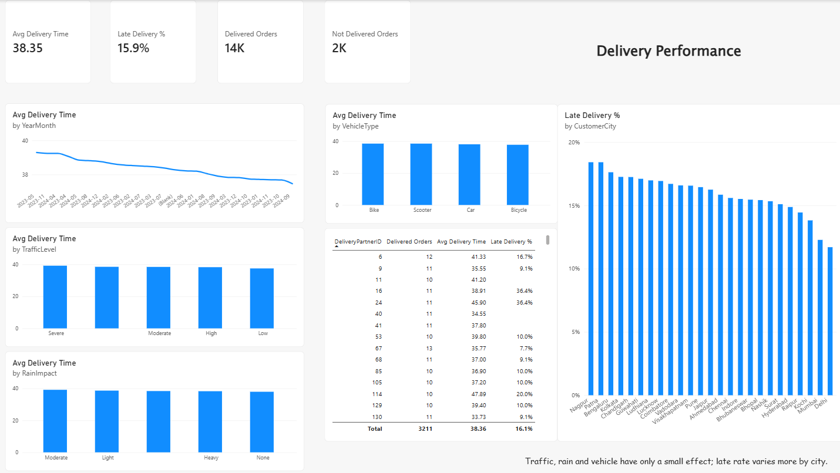
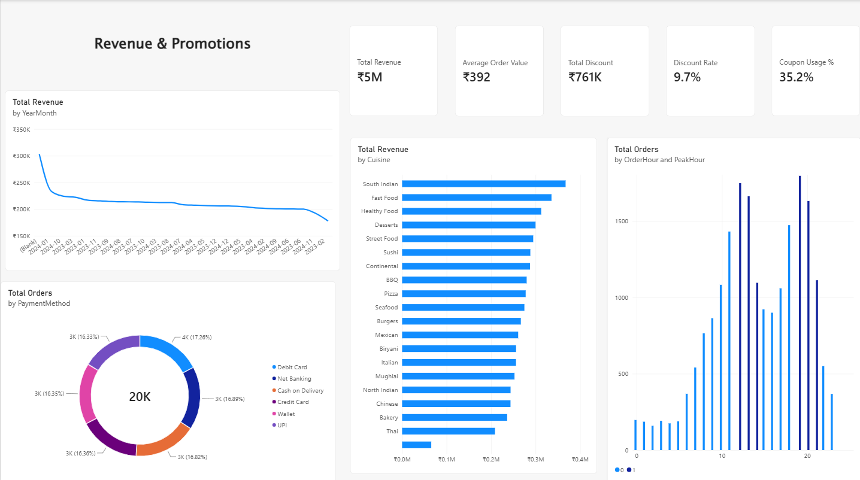
Power BI dashboard: 6 pages
1 Executive
Revenue, orders, delivery time, late %, city and date slicers
All pages use the same measures, validated against SQL and Pandas.
10
Notes:
Replace the tiles with screenshots from images/powerbi/ once the dashboard is built. See documentation/powerbi_build_guide.md for the full build steps.

Slide 11
Business recommendations
1
Cut order failures
Each 1 point of cancellation avoided is worth about Rs 80k; capture cancellation reasons first
2
Look beyond peak capacity
Failure rates are the same at peak and off-peak; check acceptance, dispatch, payments
3
Fix late deliveries by city
Late rate ranges from about 12% to 18% across cities
4
Test before spending
Run holdout tests on coupons (Rs 0.76M) and membership benefits
5
Win the second order
Most customers order once or twice; target first-time customers
11
Notes:
Each recommendation follows from an insight in the Business Insights Report.

Slide 12
Limitations and future work
Limitations
Future work
No customer coordinates, so no distance (not fabricated)
About 46% of orders have no weather or traffic reading
1,173 orders have no valid date
Both ML models perform near chance
Restaurant-level rates rest on about 17 orders each
Capture customer location, preparation time and partner GPS, then retrain
Add behavioural signals for churn: app activity, complaints, refunds
Record cancellation reasons
Automate the pipeline with one run script
12
Notes:
Being open about limits is part of the method. Both ML models reflect the dataset, not the code.

