Slide 1


Localized Voice Assistant for Senior Citizens
Hey
Lumi !!
Presented by:
24B91A0457 – G.P.S. Lakshmi
24B91A0462 – G. Pavani

Slide 2
Problem Statement
Identifying the key difficulties affecting elderly independence and safety:
Missed medicines & appointments
Digital Complexity
Smartphones are difficult to operate
Health & Safety Risks
No immediate emergency response
Frequent updates confuse elderly users
Smart assistants stop without Wi-Fi
Connectivity Dependency
Power cuts reduce reliability
Language & Emotional Gap
Limited regional language support
Lack of daily interaction & companionship

Slide 3
Need for the Proposed System
🚨 Safety Need
Faster emergency response
Reliable alerts during power interruptions
💊 Health Support
Timely medicine and appointment reminders
Automated daily assistance
🌐 Accessibility Need
Simple voice-based interaction
Regional language support
❤️ Emotional Support
Improves confidence and independence
A reliable voice-based assistive system is essential.

Slide 4
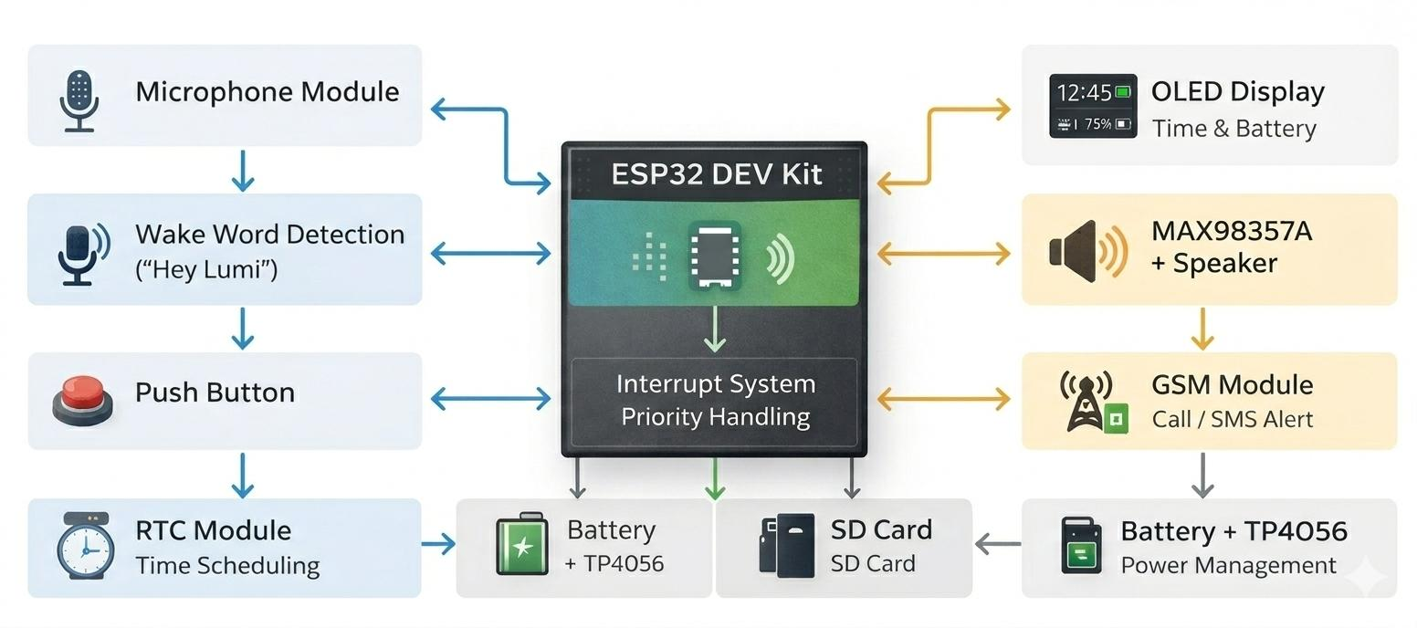
System Architecture Diagram
ESP32 acts as the central processing and control unit
Voice, button, and scheduled inputs are handled using a priority-based system
Emergency can be triggered by voice command or long-press button
System operates using a standalone embedded architecture with rechargeable battery backup.

Slide 5
Task Priority & Interrupt System
Emergency
Companion interaction
Medicine & Appointment Reminders
Smart Home Control
Safety Alerts
Interrupt System
Higher-priority tasks override lower-priority tasks
Emergency stops all ongoing functions instantly
Button Control
Long Press → Emergency Mode
Short Press → Active Listening Mode

Slide 6
Safety & Security Features
Long-press button activation
Immediate task interruption
GSM-based alert notification system
Priority override mechanism
Voice trigger command: “Help”

Slide 7
Conclusion
Safe & Offline - Telugu voice assistant for seniors
Medicine & Appointment Reminders – Automated alerts
Emergency Alerts – GSM calls & SMS to caregivers
Smart Home Control & Companionship – Voice based interaction
Portable & Privacy-Friendly – Expandable design for future sensors
Rumi is a reliable, language-friendly, and safety-focused voice assistant designed to enhance independence and confidence among senior citizens.
Thank YOU

