Slide 1

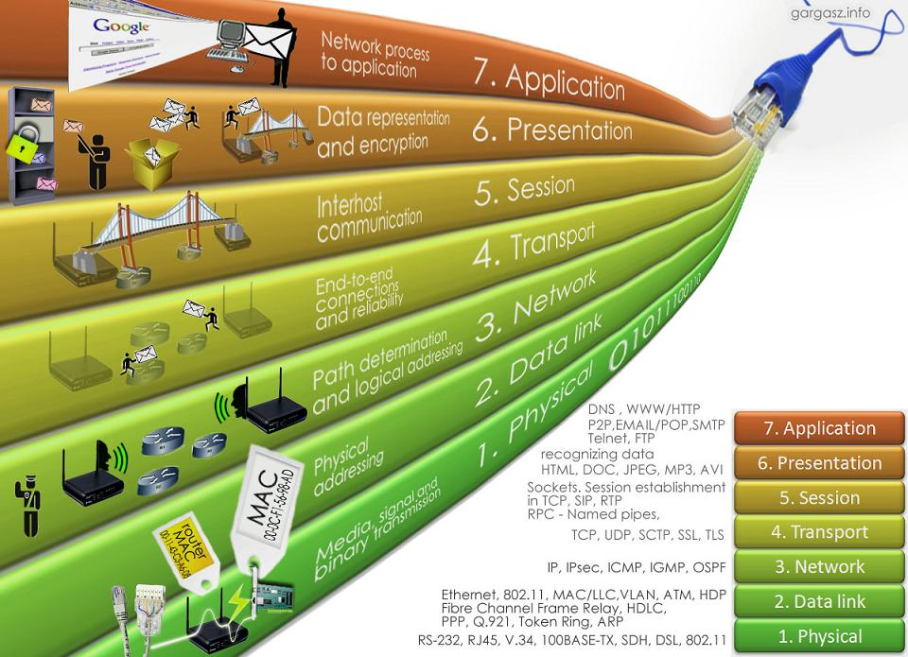

CSE-307
INTERNETWORKING
ESSENTIALS
Lecture #0

Slide 2
Course details
L T P – 0 0 2
(Lecture/Tutorial/Practical)
Credit - 1

Slide 3

Revised Bloom’s Taxonomy

Slide 4
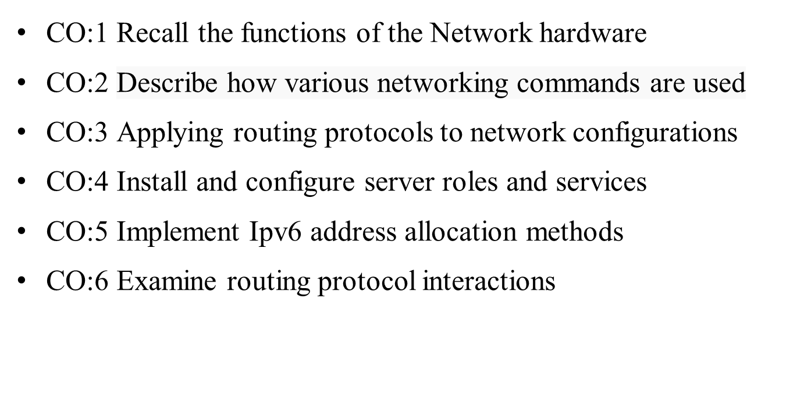
Course Outcomes

Slide 5
Program Outcomes
PO1::Apply the knowledge of mathematics, science, engineering fundamentals, and engineering specialization to the solution of complex engineering problems.
PO2::Identify, formulate, review research literature, and analyze complex engineering problems reaching substantiated conclusions using first principles of mathematics, natural sciences and engineering sciences.
PO3::Design solutions for complex engineering problems and design system components or processes that meet the specified needs with appropriate consideration for public health and safety, and cultural, societal, and environmental considerations.
PO4::Use research-based knowledge and research methods including design of experiments, analysis and interpretation of data, and synthesis of the information to provide valid conclusions.

Slide 6
Program Outcomes
PO5::Create, select and apply appropriate techniques, resources, and modern engineering and IT tools including prediction and modeling to complex engineering activities with an understanding of the limitations.
PO6::Apply reasoning informed by the contextual knowledge to assess societal, health, safety, legal and cultural issues and the consequent responsibilities relevant to the professional engineering practice.
PO7::Understand the impact of professional engineering solutions in societal and environmental contexts, and demonstrate the knowledge of, and need for sustainable development.
PO8::Apply ethical principles and commit to professional ethics and responsibilities and norms of the engineering practice.
PO9::Function effectively as an individual, and as a member or leader in diverse teams, and in multidisciplinary settings.

Slide 7
Program Outcomes
PO10::Communicate effectively on complex engineering activities with the engineering community and with society at large, such as, being able to comprehend and write effective reports and design documentation, make effective presentations, and give and receive clear instructions.
PO11::Demonstrate knowledge and understanding of the engineering and management principles and apply these to one’s own work, as a member and leader in a team, to manage projects and in multidisciplinary environments.
PO12::Recognize the need for, and have the preparation and ability to engage in independent and lifelong learning in the broadest context of technological change.
© LPU :: INT243 – INFORMATION SYSTEM SECURITY

Slide 8
Course content
Network hardware and basics of IP addressing concept:
  Familiar with the usage of cisco packet tracer
  Basic working of hub, switch and router
  Adding of interfaces (ports) in the devices
  Creation of cross and straight cables
  IP addressing basics
  Implementation and configuration of different topologies such as bus, star, ring, mesh, tree and hybrid
  Configuration of devices using command line interface (CLI)
Network commands:
  ipconfig, ping, tracert, arp, netstat, nslookup, switch commands, router commands (use DOS and scenario based commands)

Slide 9
Course content
Network layer routing protocols:
Implementation of static routing using classfull addressing
Implementation of dynamic routing using classfull addressing by configuring routing information protocol (RIP)
Implementation of static routing using classless addressing (FLSM and VLSM)
Implementation of dynamic routing using classless addressing (FLSM and VLSM) by configuring routing information protocol (RIP, RIP version 2 for VLSM)

Slide 10
Course content
Server configuration and LAN setup:
Implementation of LAN with DHCP configuration
Implementation of DNS, FTP, HTTP and Email server configuration
IPv6 addressing and routing:
Implementation of IPv6 static routing
Implementation of IPv6 dynamic routing

Slide 11

Course Assessment Model
Marks break up*
Attendance 5
CA (Three best out of four tasks) 45
ETE 50
Total 100

Slide 12
Detail of Academic Tasks
AT1 (Conduct during 3rd week) | Practical 1 | 30 Marks –Performance-15, Viva-15
AT2 (Conduct during 6th week) | Practical 2 | 30 Marks –Performance-15, Viva-15
AT3 (Conduct during 10th week) | Practical 3 | 30 Marks –Performance-15, Viva-15
AT4 (Conduct during 13th week) | Practical 4 | 30 Marks –Performance-15, Viva-15

Slide 13
Benefits of the course
Provide handson practice in a simulated environment
Accessible to the institution with limited budget
Enhance concepts via interactive learning.
Prepare for practical professional challenges
© LPU :: INT243 – INFORMATION SYSTEM SECURITY

Slide 14


Text Book
Reference Book

Slide 15
MOOCs/Certifications
Type | Name of Certification/Test/Online Course | Syllabus Mapped (%age) | Exemption
Industry Certification | Juniper Networks Certified Internet Associate | 100 | Full Course
Link
https://www.juniper.net/us/en/training/certification/tracks/junos/jncia-junos.html

Slide 16
OPEN EDUCATIONAL RESOURCE
Basic working of hub, switch and router
https://business.amazon.in/en/discover-more/blog/networking-devices-buying-guide-2021
Creation of cross and straight cables
https://www.firewall.cx/networking/network-cabling/network-cabling-utp-xover.html
© LPU ::CSE 307

Slide 17
IP addressing basics
https://learn.microsoft.com/en-us/troubleshoot/windows-client/networking/tcpip-addressing-and-subnetting
topologies such as bus, star, ring, mesh, tree and hybrid
https://ipcisco.com/lesson/network-topologies/
© LPU ::CSE 307

Slide 18
Configuration of devices using command line interface (CLI)
https://www.cisco.com/c/en/us/td/docs/ios-xml/ios/fundamentals/configuration/15mt/fundamentals-15-mt-book/cf-cli-basics.html
© LPU ::CSE 307

Slide 19
ipconfig, ping, tracert, arp, netstat, nslookup
https://www.simplilearn.com/tutorials/cyber-security-tutorial/understanding-the-networking-commands
switch command
https://www.cisco.com/c/en/us/td/docs/switches/lan/catalyst3850/software/release/3se/consolidated_guide/b_consolidated_3850_3se_cg_chapter_01.html
© LPU ::CSE 307

Slide 20
router commands
https://www.cisco.com/E-Learning/bulk/public/tac/cim/cib/using_cisco_ios_software/07_basic_commands_tasks.htm
Implementation of static routing using classfull addressing
https://www.ciscopress.com/articles/article.asp?p=2180209&seqNum=4
© LPU ::CSE 307

Slide 21
Implementation of dynamic routing using classfull addressing by configuring routing information protocol (RIP)
https://www.cisco.com/c/en/us/td/docs/ios-xml/ios/iproute_rip/configuration/15-mt/irr-15-mt-book/irr-cfg-info-prot.html
VLSM
https://www.cisco.com/c/en/us/support/docs/ip/routing-information-protocol-rip/13788-3.html
© LPU ::CSE 307

Slide 22
DHCP
https://learn.microsoft.com/en-us/windows-server/networking/technologies/dhcp/dhcp-top
DNS
https://aws.amazon.com/route53/what-is-dns/#:~:text=The%20Internet's%20DNS%20system%20works,These%20requests%20are%20called%20queries.
© LPU ::CSE 307

Slide 23
FTP
https://www.ibm.com/docs/en/zos/2.3.0?topic=commands-file-transfer-protocol-ftp
Implementation of IPv6 static routing
https://www.cisco.com/c/en/us/support/docs/ip/ip-version-6-ipv6/113361-ipv6-static-routes.html
© LPU ::CSE 307

Slide 24
Implementation of IPv6 dynamic routing
https://www.cisco.com/c/en/us/td/docs/ios-xml/ios/iproute_rip/configuration/xe-3s/asr1000/ip6-rip-xe.html
© LPU ::CSE 307

Slide 25

Any Questions..?
Thank you.

