Slide 1

Basic Details of the Team and Problem Statement
Ministry/Organization Name: Ministry of Home Affairs
PS Code: SIH1439 Problem Statement Title:
Robotics Device for Borewell Rescue Operation Team Name: daabChingri( ) Team Leader Name: Shubhangi Dutta Institute Code (AISHE): U-0356 Institute Name: Kalinga Institute of Industrial Technology
Theme Name: Disaster Management

Slide 2
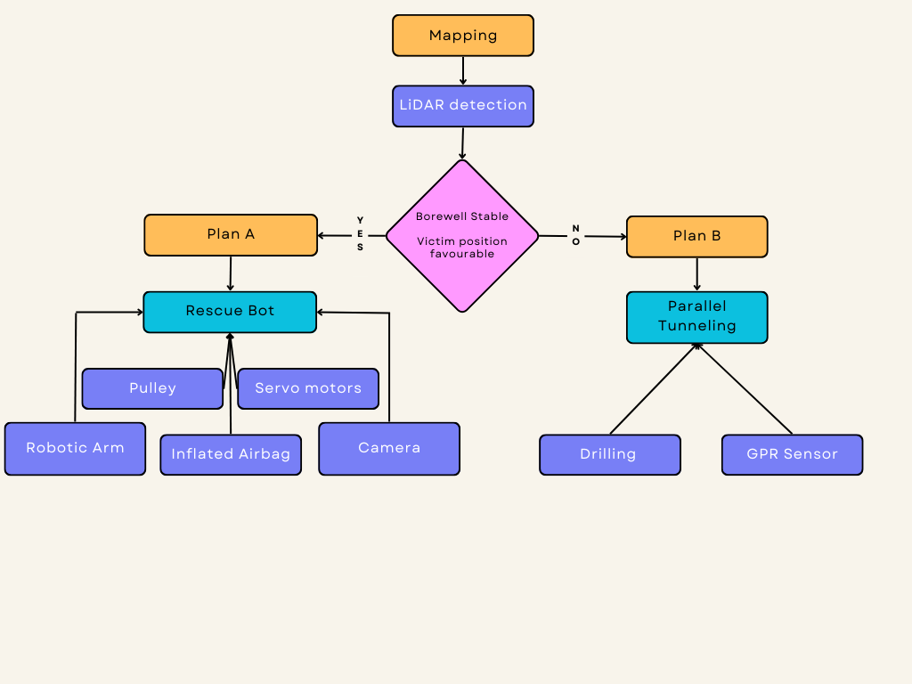
Idea/Approach Details
Describe your idea/Solution/Prototype here:
We propose an advanced disaster management device optimized for time-sensitive situations. Our solution employs LiDAR sensors for tunnel mapping and victim location. If feasible, robots are deployed with an airbag system for swift rescue. If not, Ground Penetrating Radar (GPR) helps identify alternate tunneling routes.
Throughout the operation, our integrated system ensures victim safety:
Oxygen Regulation: Monitors and automatically deploys oxygen canisters if levels drop below 21%, maintaining it at 25%.
Communication: Equipped with a microphone and camera for two-way communication with the victim.
Vitals Monitoring: Utilizes a Pulse Oximeter to track the victim's vital signs.
This streamlined approach maximizes efficiency in disaster response.
Describe your Technology stack here:
Our model consists of two parts:
Mapping:
LiDAR for 3D borewell mapping and victim location, GPR for finding alternative routes.
Machine Learning for path prediction.
Rescue:
Robot with air balloon support, camera, and remote-controlled gripper (LoRaWAN).

Slide 3
Idea/Approach Details
Describe your Use Cases here
Describe your Dependencies / Show stopper here
When a child or an adult falls into a borewell, the local authorities contact the NDRF through official channels. NDRF responds by sending a rescue team. There they will be able to use our proposed solution to improve upon their existing approach. Our improvement will cut down time required for the rescue by a large margin.
Application of LiDAR : The LiDAR will be lowered down the tunnel at the start of the operation and it will be mapping the tunnel as well as the position of the victim.
GPR :GPR (Ground Penetrating Radar) is a technology that uses electromagnetic pulses to create subsurface images, helping to detect and visualize objects, structures, or anomalies buried underground or within solid materials.
Machine Learning

Slide 4
Team Member Details
Team Leader Name: Shubhangi Dutta
Branch: BTech Stream (ECE, CSE etc): CSE Year (I,II,III,IV): 3rd Year
Team Member 1 Name: Prajukta Dey
Branch: BTech Stream (ECE, CSE etc): CSE Year (I,II,III,IV): 3rd Year
Team Member 2 Name: Diya Das
Branch: BTech Stream (ECE, CSE etc): IT Year (I,II,III,IV): 3rd Year
Team Member 3 Name: Saptaporni Karmakar
Branch: BTech Stream (ECE, CSE etc): ETC Year (I,II,III,IV): 3rd Year
Team Member 4 Name: Adwaita Basu Bal
Branch: BTech Stream (ECE, CSE etc): CSE Year (I,II,III,IV): 3rd Year
Team Member 5 Name: Madhura Chakraborty
Branch: BTech Stream (ECE, CSE etc): ECS Year (I,II,III,IV): 3rd Year
Team Mentor 1 Name: Dr. Saritha Nanda
Category: Academic Expertise : Machine Learning Domain Experience (in years):

Slide 5
Important Pointers
Please ensure below pointers are met while
Kindly keep the maximum slides limit to 4 pages
All the topics should be utilized for description of your idea
Try to avoid paragraphs and post your idea in points
Keep your explanation precisely and easy to understand
Idea should be unique and novel. If it has a business potential more weightage will be given.
Apart from this PPT abstract of your idea will be asked separately while submitting
You need to save the file in PDF and upload the same on portal. No PPT, Word Doc or any other format will be supported
You can delete this slide (Important Pointers) when you upload the details of your idea on SIH portal.

