Slide 1

CIFAR - 100

Slide 2

CIFAR-100 Dataset Overview
Total Images: 60,000 RGB Images
  50,000 Training Images
  10,000 Test Images
Each Image Is 32x32 Pixels, 3 Channels (RGB)
Each Pixel’s RGB Value Ranges From 0 To 255
The Images Are Stored As Uint8 Type
Labels:
  100 Fine-grained Classes (E.G., Apple, Keyboard, Lion)
  20 Coarse-grained Superclasses (E.G., Fruit And Vegetables, Electronic Devices)
✅We Are Only Using The Fine Labels For Classification.

Slide 3
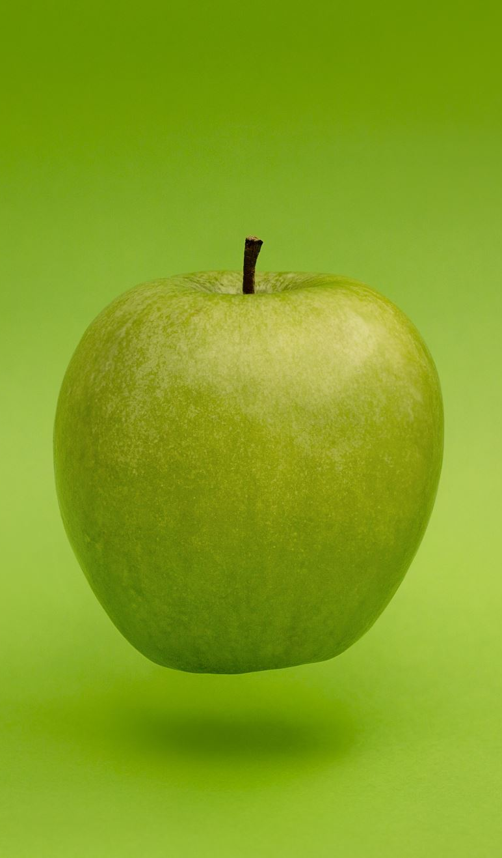
Label Types in CIFAR-100
Fine Labels: Specific Category (E.G., Leopard, Apple, Keyboard)
Coarse Labels: General Category (E.G., Mammals, Fruit And Vegetables, Electronic Devices)
Example:
  Fine Label: Apple
  20 Coarse-grained Superclasses (E.G., Fruit And Vegetables, Electronic Devices)
🔍 This Project Focuses Only On The 100 Fine-grained Labels.

Slide 4
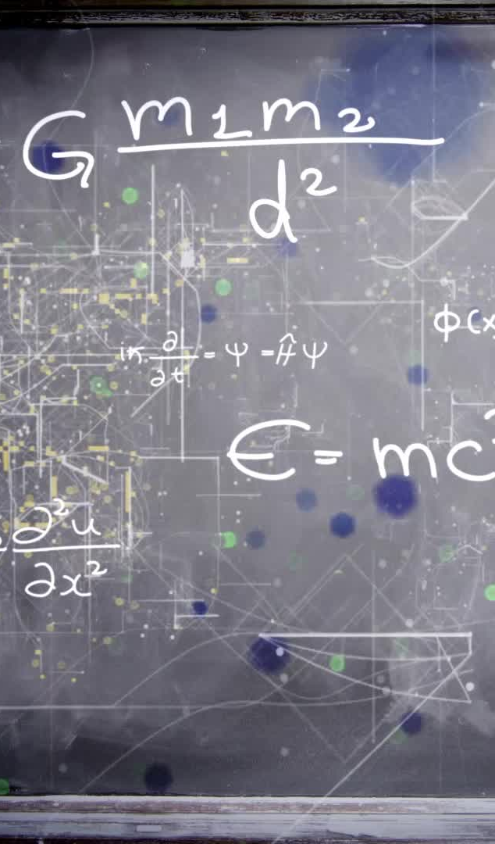
Loading the Data
Loaded directly using tf.keras.datasets.cifar100
Splits into:
  X_train, Y_train
  X_test, Y_test
Labels are integers from 0 to 99

Slide 5
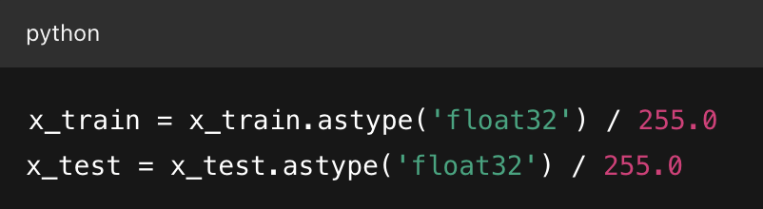
Normalization
Images Are Stored As Uint8, Meaning Pixel Values Range From 0 To 255.
Dividing By 255 Rescales Pixel Values Into The Range [0.0, 1.0].
Labels Remain Unchanged (Integers)
Normalization Ensures All Features (Pixels) Are On A Similar Scale, Helping Models Converge Faster And More Stably.

Slide 6
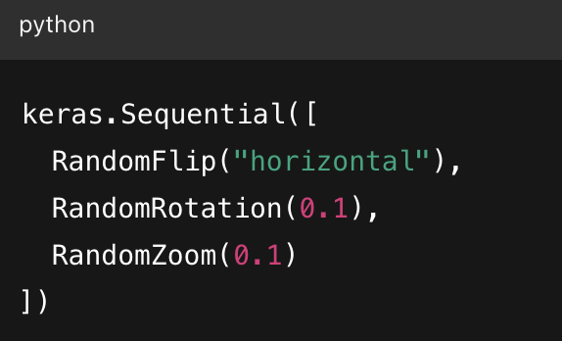
Data Augmentation
Applied only to training data to increase diversity
Helps model generalize better
Reduces overfitting

Slide 7
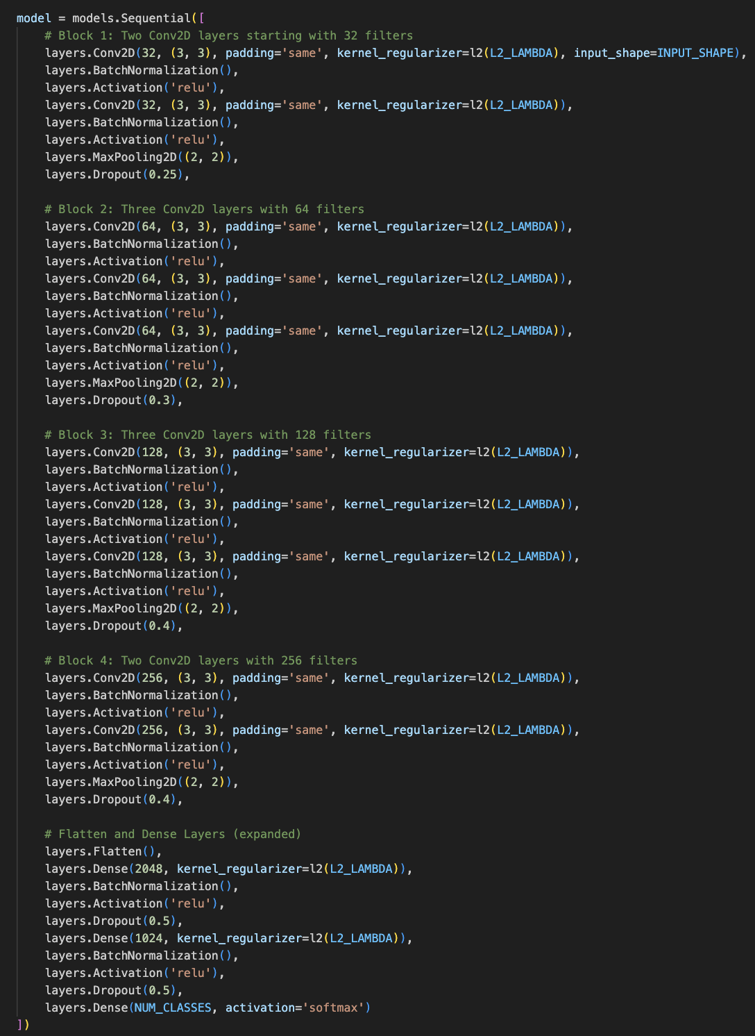
Model Structure
Breakdown
The model uses tf.keras.Sequential to stack layers one after the other.
✅ Regularization Techniques Used
  l2(L2_LAMBDA) in all Conv & Dense layers → discourages large weights.
  Dropout in every block → reduces overfitting.
  Batch Normalization → stabilizes training, allows higher learning rate.
🧠 Optimizer and Loss
  Adam optimizer with learning_rate = 0.001.
  SparseCategoricalCrossentropy → used for integer-labeled classification.
  Metrics: Accuracy.
📉 Callbacks
  EarlyStopping: Stops training if val_loss doesn’t improve after 10 epochs.
  ReduceLROnPlateau: Reduces learning rate if val_loss plateaus.

Slide 8
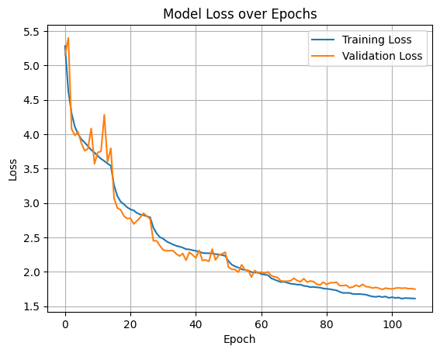
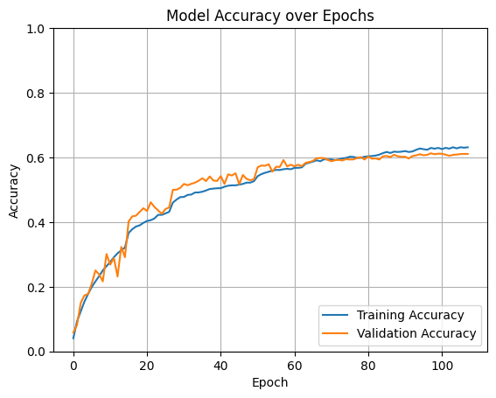
RESULTS - CNN
We got an accuracy of 61.28 % by using the CNN.

Slide 9
Efficient Net B0
What is EfficientNetB0?
  Part of the EfficientNet family, developed by Google Research (2019).
  Designed via Neural Architecture Search (NAS) to optimize CNN architecture.
  B0 is the baseline model, scaled up to B1–B7 for larger tasks.
Core Innovation: Compound Scaling
  Balances network depth, width, and resolution using a single scaling factor.
  Achieves better accuracy vs. compute trade-off compared to traditional scaling methods.
Why EfficientNetB0?
  Pretrained features generalize well to CIFAR-100’s fine-grained classes.
  Efficient architecture reduces training time on resource-constrained setups.

Slide 10
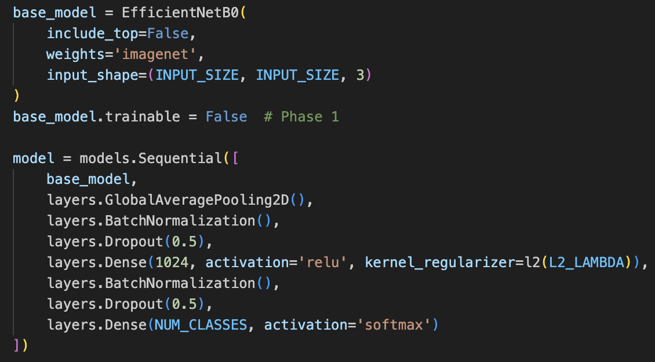
Model Structure Breakdown
1. Pretrained Backbone
  EfficientNetB0 (input 224×224×3, include_top=False, ImageNet weights)
2. Custom Classification Head
  GlobalAveragePooling2D → spatial H×W → 1D feature vector
  BatchNormalization → stabilize & accelerate training
  Dropout(0.5) → regularization
  Dense(1024, ReLU, L2=2e-4) → learn deeper task-specific features
  BatchNormalization + Dropout(0.5)
  Dense(NUM_CLASSES, softmax) → final 100-way prediction
3. Training Strategy
  Data Augmentation: random flip, rotate, zoom (on resized 224×224 CIFAR-100)
  Two-Phase LR Schedule:
    Head: 1e-3 for 50 epochs
    Fine-tune: 1e-5 for 50 epochs
  Callbacks: EarlyStopping (patience 10) + ReduceLROnPlateau (patience 5)

Slide 11
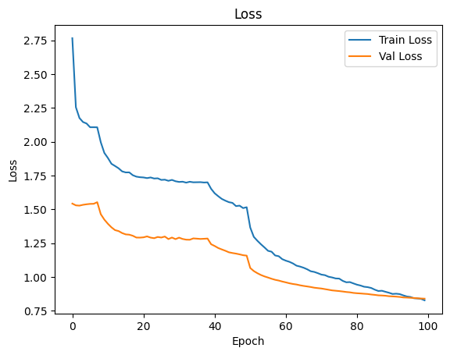
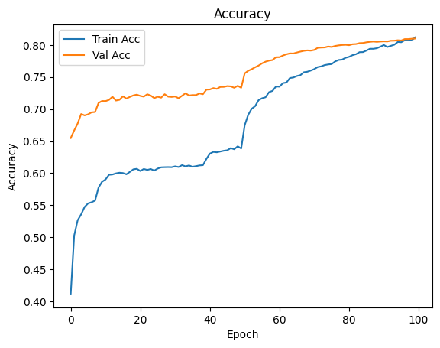
RESULTS – EFFICIENT NET B0
We got an accuracy of 81%. Also based on the above graph we can see that the model might be slightly under-fitting at the beginning. We can consider reducing the strength of our regularizes.

Slide 12
Result Comparison
Model | Test Accuracy | Observations
Custom CNN | 61.28% | Reasonable performance but prone to overfitting, as validation accuracy plateaus.
EfficientNetB0 | 81% | Significant improvement, better generalization, slight underfitting observed at the beginning.

Slide 13
Conclusion
Project Goal Achieved: Built a custom CNN to classify CIFAR-100 images into 100 classes
Baseline Performance: Original 4-block CNN reached 61% test accuracy
Extended Beyond Proposal: Incorporated EfficientNetB0 backbone via transfer learning
Accuracy Gain: EfficientNetB0 fine-tuned → 81% vs. custom CNN → 61% (+20 pts)
Key Insight: Pretrained, compound-scaled architectures dramatically improve multi-class image classification performance

