Slide 1
Design and Implementation of a Database Management System for E-Commerce Order, Return and Refund Management
Undergraduate project review
DATABASE MANAGEMENT SYSTEM · E-COMMERCE OPERATIONS
A structured data model for controlling the complete post-purchase lifecycle: order placement, fulfilment, returns, inspection, refunds, inventory impact, and audit history.
Kakaraparthi Komal Prajvesh
25WU0102114

Slide 2
One connected system can make post-purchase operations traceable
01
A relational DBMS links customers, orders, payments, returns, refunds, inventory, and audit history in one consistent model.
Project aim. Replace fragmented order and after-sales records with a structured, queryable system.
Core outcome. Track reliable status from order placement to refund completion.
Design lens: data integrity, process visibility, and controlled access.
2

Slide 3
Manual after-sales handling creates avoidable gaps
Order, return, and refund information is often scattered across tools or spreadsheets.
Status changes can be delayed, duplicated, or difficult to audit.
Customers and support staff lack one dependable view of the transaction history.
The proposed system centralizes records and enforces valid state transitions.
PROBLEM STATEMENT
One lifecycle needs one source of truth.
Design a DBMS that manages the full order-to-refund lifecycle accurately and efficiently.
3

Slide 4
SRS: requirements define what the system must control
01
Customer and order management creates accounts, places orders, stores addresses, and tracks order status.
02
Return management records requests, reasons, eligibility decisions, and item-level return status.
03
Refund management calculates refundable amounts, records approval, initiates refunds, and confirms completion.
04
Inventory and payment linkage connects order items, stock impact, payment records, and refund transactions.
05
Auditability retains timestamps, actors, status history, and exception notes.
4

Slide 5

Actors, boundaries, and quality requirements
RESPONSIBILITY MAP
Customer
Support agent
Warehouse operator
Administrator
View orders, request returns, and track refund status.
Review requests, communicate decisions, and resolve exceptions.
Inspect returned items and record condition.
Manage rules, roles, reports, and audit access.
Non-functional requirements: data consistency, role-based access, responsive queries, recoverability, input validation, and secure payment references without storing sensitive card data.
5

Slide 6
System architecture separates channels from the data core
CLIENT LAYER
Customer Portal
Orders · returns · refund status
Operations Dashboard
Review · inspection · reporting
SERVICE LAYER
Authentication
Order service
Return service
Refund service
Notifications and reporting consume controlled service outputs.
DATA LAYER
Relational DBMS
Constraints · transactions · indexes · audit log · backups
Payment Gateway connects only through the Payment and Refund services; channels never bypass the data core.
6

Slide 7
The relational schema keeps every business event anchored to an order
Entity | Key attributes
Customer | customer_id, name, email, phone, created_at
Order | order_id, customer_id, order_date, total_amount, order_status
OrderItem | order_item_id, order_id, product_id, quantity, unit_price
Payment | payment_id, order_id, provider_reference, amount, payment_status
ReturnRequest | return_id, order_id, customer_id, reason, return_status, requested_at
Refund | refund_id, return_id, payment_id, amount, refund_status, processed_at
Primary keys, foreign keys, unique constraints, status domains, and indexes on customer_id, order_id, return_status, and refund_status preserve integrity and queryability. Normalize repeated data into related tables and preserve historical events instead of overwriting them.
7

Slide 8
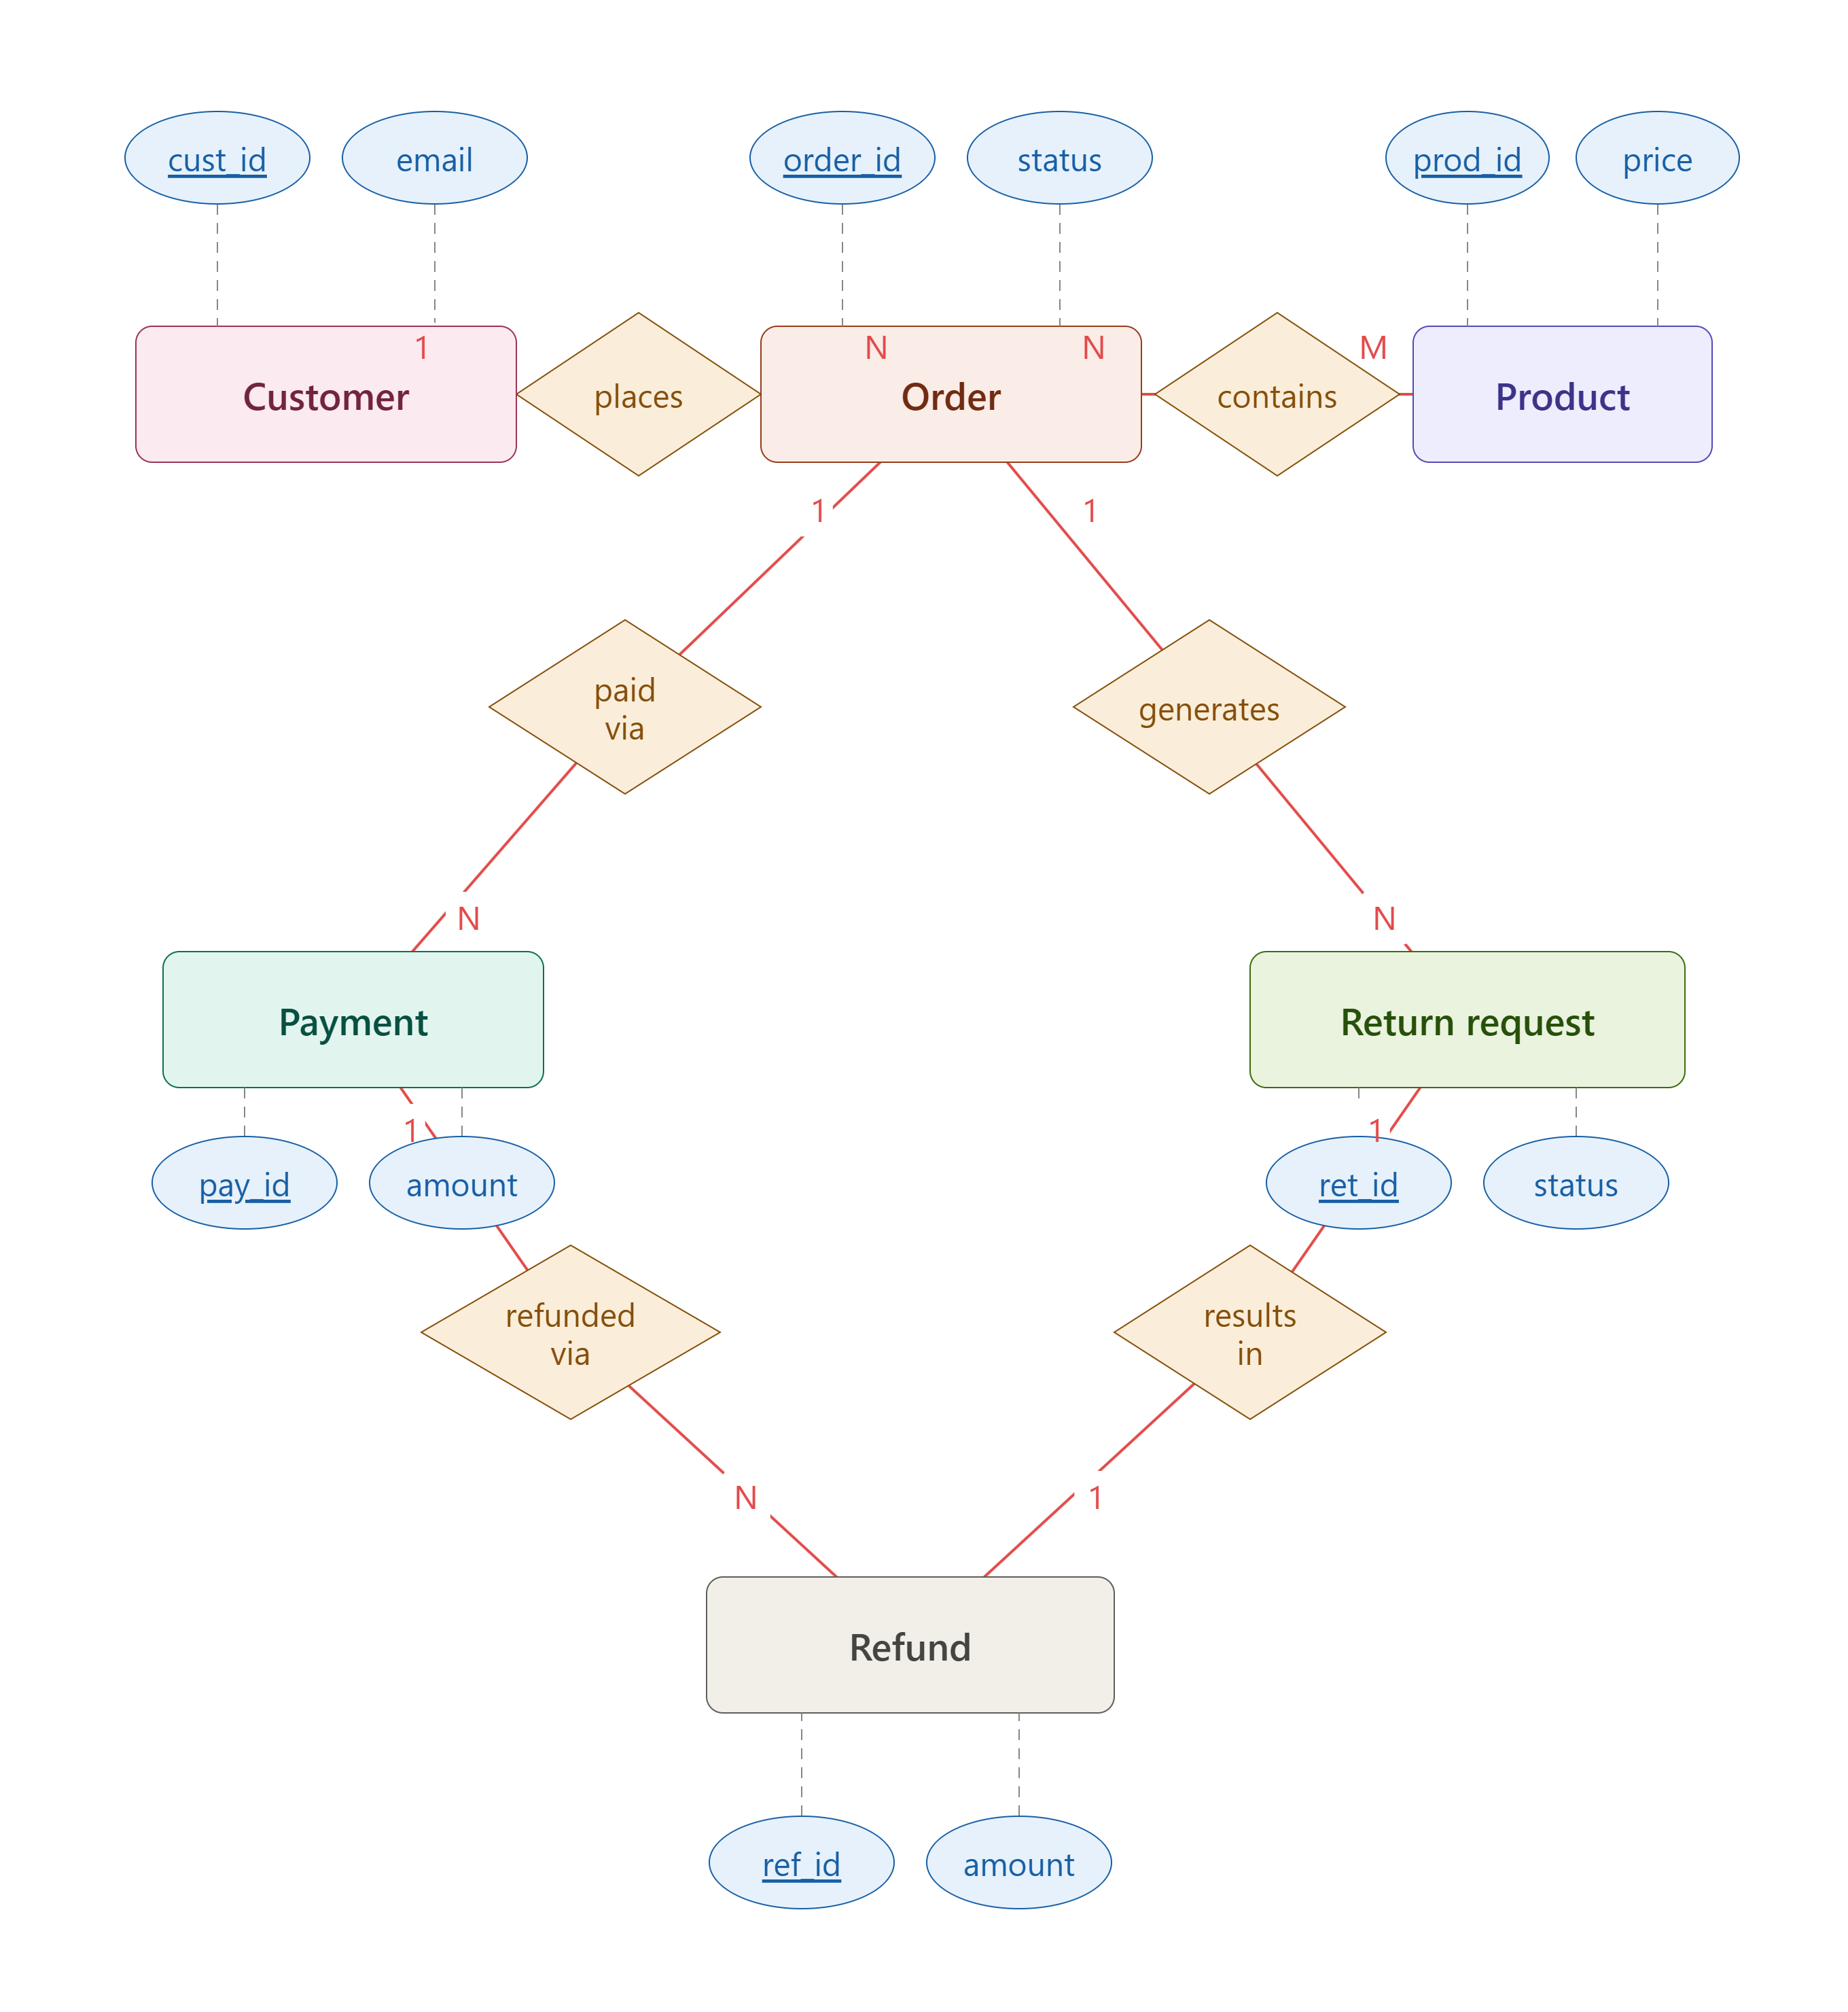
The ER model makes ownership and cardinality explicit
Why the model matters
Returns are item-aware rather than order-only.
Refunds are traceable to both a return and a payment.
Every child record carries a foreign key back to its parent.
8

Slide 9
The lifecycle turns one purchase into a controlled sequence
Place order
Request return
Approve refund
Validate cart, create order and items, reserve stock, record payment result.
Select item, reason, quantity, and supporting note.
Calculate amount, call the provider, confirm outcome.
Fulfil and deliver
Inspect and decide
Close the loop
Update fulfilment and delivery status with timestamps.
Verify eligibility and received condition.
Update inventory, notify the customer, retain the audit trail.
Each transition produces a timestamped, queryable state change rather than an undocumented manual update.
9

Slide 10
Implementation success means trustworthy state, not just stored data
Implementation
Testing
Future scope
Relational schema, REST endpoints, validation rules, role-based access, transactions, and indexed queries.
Unit tests for rules, integration tests for order-to-refund flows, constraint tests, and failure-recovery tests.
Analytics dashboard, automated return eligibility, fraud signals, and event-driven notifications.
A well-designed DBMS gives e-commerce teams one reliable source of truth for every post-purchase decision.
STUDY RECORD
10

Slide 11
THANK YOU

