Slide 1
REVIEW 2 · DATABASE SYSTEMS
Design and Implementation of a Database Management System for E-Commerce Order, Return and Refund Management
Detailed Design and Implementation Progress
Kakaraparthi Komal Prajvesh · Roll No. 25WU0102114
B.Tech AI & ML project review

Slide 2
Review 2 moves the project from design into implementation
REVIEW 1 · DESIGN
REVIEW 2 · IMPLEMENTATION
Review 1 covered the problem statement, SRS, three-layer architecture, core entities, and the order-to-refund lifecycle.
Review 2 focuses on the normalized schema, SQL implementation, database-enforced business rules, core queries and APIs, and first-round testing.
1
2
3
Review 1
Review 2
Review 3
Design
Implementation
Validation and Demo
STUDY RECORD
2

Slide 3
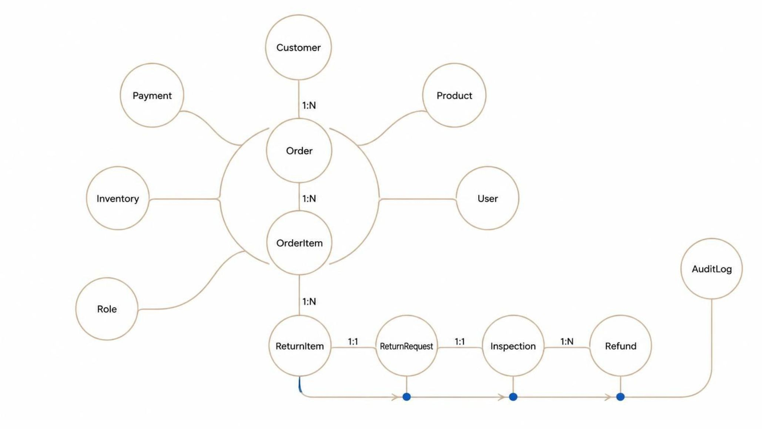
DATA MODEL · ER VIEW
Item-level returns make partial refunds possible
Returns are attached to purchased items rather than only to an order. That structure supports partial returns, item-specific inspection, and one or more refunds against a return request.
Core cardinalities: Customer 1:N Order · Order 1:N OrderItem · OrderItem 1:N ReturnItem · ReturnRequest 1:1 Inspection · ReturnRequest 1:N Refund
STUDY RECORD
3

Slide 4
SCHEMA DESIGN · NORMALIZATION
Normalization separates reusable product data from purchase facts
01
02
03
04
UNF
1NF
2NF
3NF
Repeating order and return details are mixed together.
Atomic values and one row per item.
Remove partial dependencies.
Separate reusable product data from purchase facts.
BEFORE
AFTER · 3NF
OrderItem stores product name and current price alongside each purchase row.
OrderItem retains product_id and unit_price_at_purchase; reusable product data remains in Product.
Safeguards: primary and foreign keys with ON DELETE RESTRICT · CHECK quantity > 0 and amount >= 0 · UNIQUE provider_reference · controlled status domains.
STUDY RECORD
4

Slide 5
SQL IMPLEMENTATION
The database schema is implemented with enforceable safeguards
Tables — PLACEHOLDER
CREATE TABLE ReturnRequest (
return_id BIGINT PRIMARY KEY,
order_id BIGINT NOT NULL,
return_status VARCHAR(24) NOT NULL,
requested_at TIMESTAMP NOT NULL,
inspected_at TIMESTAMP,
reason VARCHAR(120),
CONSTRAINT fk_return_order
FOREIGN KEY (order_id) REFERENCES Orders(order_id)
ON DELETE RESTRICT,
CONSTRAINT chk_return_status CHECK (
return_status IN ('Requested','Approved','Received',
'Inspected','Rejected','Refunded')
)
);
Constraints — PLACEHOLDER
Indexes — PLACEHOLDER
Values remain placeholders until measured from the implementation.
Indexes: customer_id, order_id, return_status, refund_status
Seeded sample data supports first-round query and API testing.
STUDY RECORD
5

Slide 6
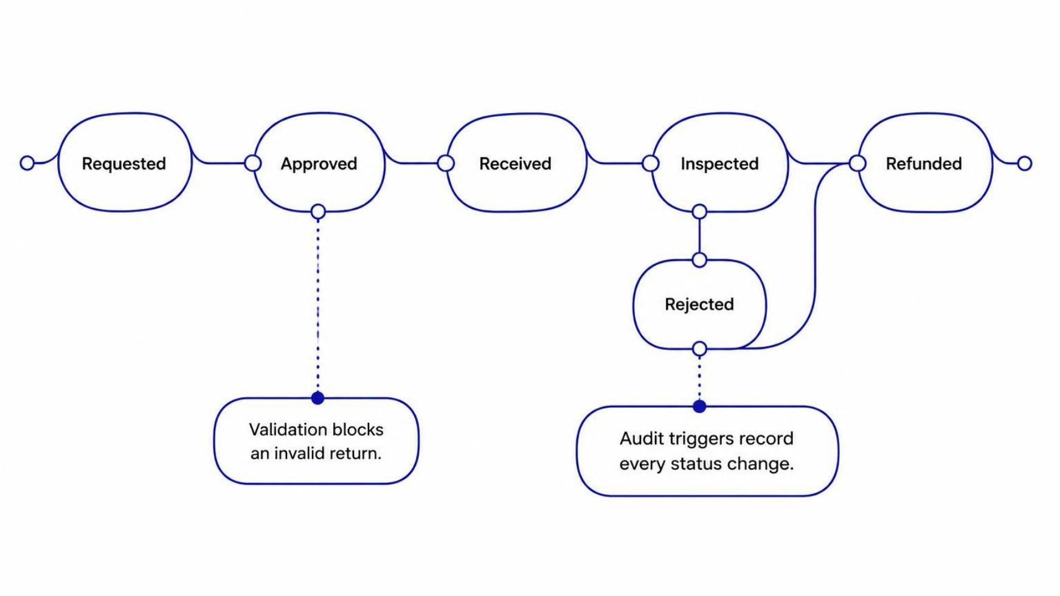
DATABASE-ENFORCED LOGIC
Business rules live close to the data
Audit trigger records every return or refund status change.
Validation trigger blocks returns outside the return window or above purchased quantity.
Stored procedure sp_process_refund coordinates refund processing.
Transaction safety uses ACID transactions with COMMIT and ROLLBACK.
STUDY RECORD
6

Slide 7
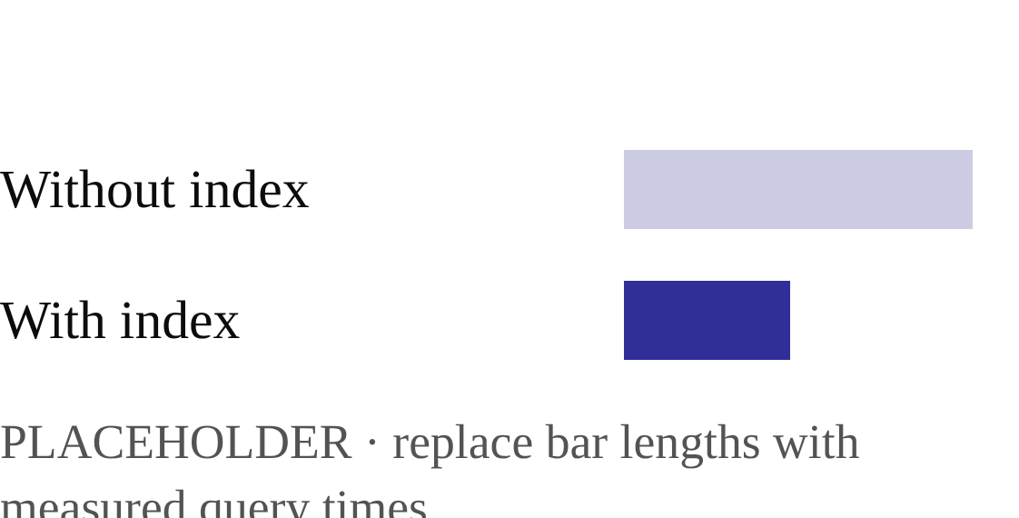
QUERY LAYER
Queries connect operations with product-level insight
Type | Query catalog | Purpose
Operational | Order history with returns via JOIN | Trace activity
Operational | Pending returns awaiting inspection | Prioritize work
Operational | Refund status by order | Resolve cases
Analytical | Return rate per product | Product insight
Analytical | Monthly refund totals; top return reasons | Trend review
Index effect
Before / after query time
STUDY RECORD
7

Slide 8
APPLICATION LAYER · ROLE CONTROL
The application layer exposes controlled actions by role
REST endpoints
APPLICATION / API FLOW
POST /orders · POST /returns · PUT /returns/{id}/inspect · POST /refunds/{id}/approve · GET /orders/{id}/status
SCREENSHOT
PLACEHOLDER
Role | Primary permission
Customer | Create orders and returns; view order status
Support agent | Review returns and approve eligible actions
Warehouse operator | Receive and inspect returned items
Admin | Manage roles, refunds, and audit access
Reserve this frame for the application or API flow capture.
Security: parameterized queries and no card data stored.
STUDY RECORD
8

Slide 9
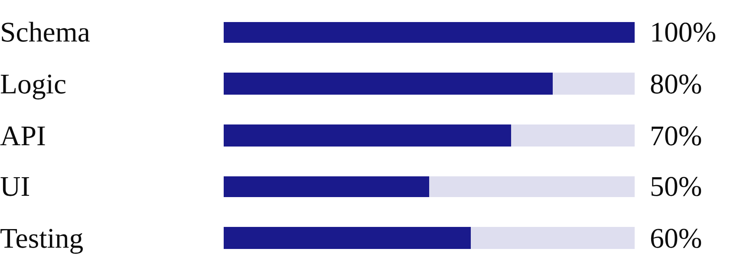
VALIDATION READINESS
Core schema work is complete; validation is the next risk
Test type | Example | Result
Constraint | Quantity above purchased amount | Blocked
Unit | Refund procedure validation | Pending
Integration | Return to refund API path | Pending
Failure-rollback | Refund error during transaction | Pending
Implementation progress by workstream.
Challenges and fixes: constraints protect invalid values, triggers protect workflow state, indexes support lookup paths, and transaction handling protects consistency during failure.
STUDY RECORD
9

Slide 10
NEXT REVIEW
Review 3 will prove the system end to end
From a designed model to a working, trustworthy system.
03
REMAINING WORK
REVIEW 3 DELIVERABLES
Complete UI · performance and load testing · backup and recovery test · analytics dashboard
Live end-to-end demo · full test report · performance comparison · conclusion and future scope
Q&A

