Slide 1
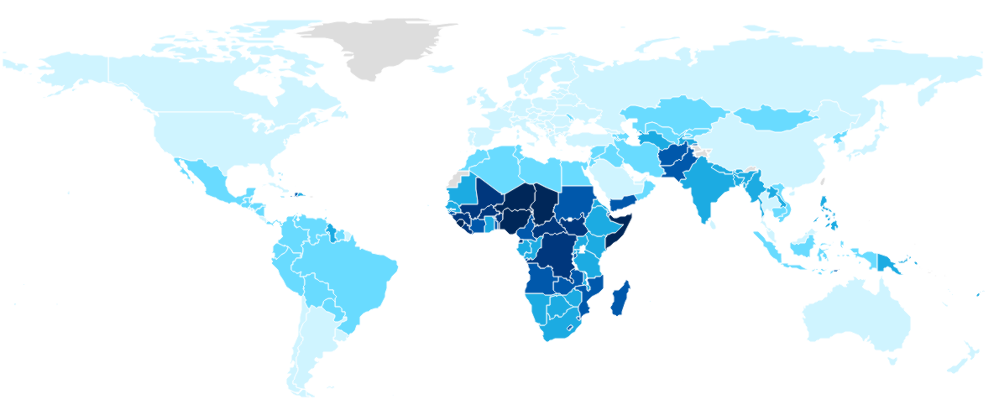
HELP International Dataset
multivariate analysis

Slide 2
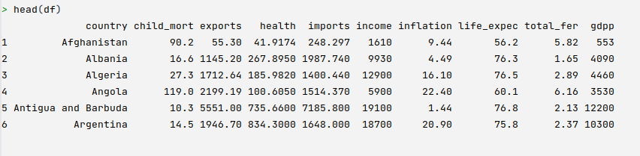
Data We Used
You can find the data we worked on here. It consists of a countries which are under poverty
The dimensions of data: 167 rows & 10 columns. You can find the head of data below.
The attributes are: country, child mortality, exports, health, imports, income, inflation, life expectancy, total fertility and gdpp

Slide 3
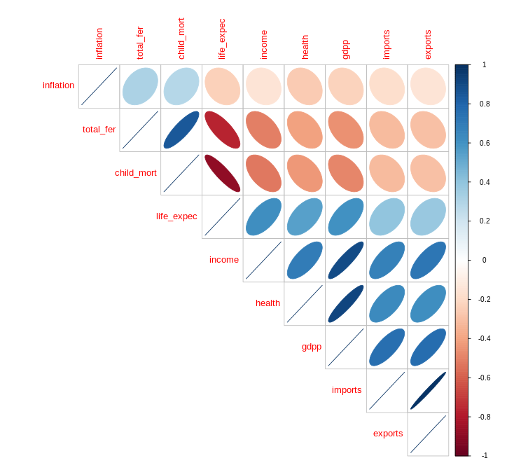
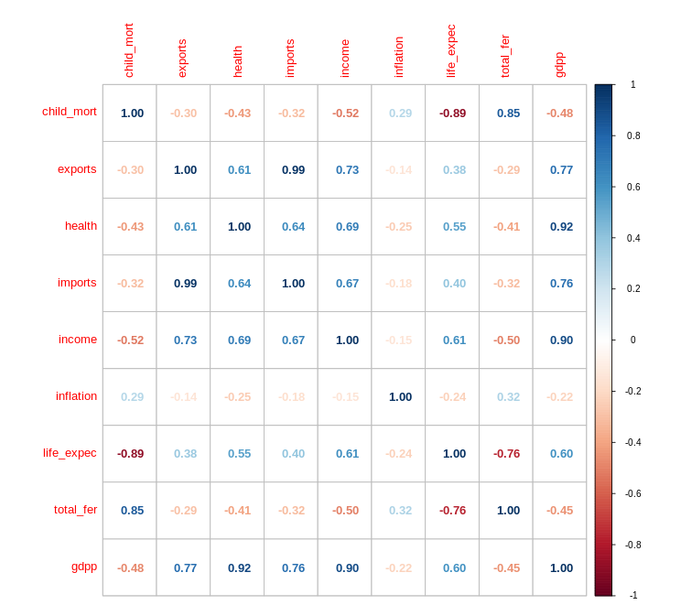
Correlation Heatmap

Slide 4
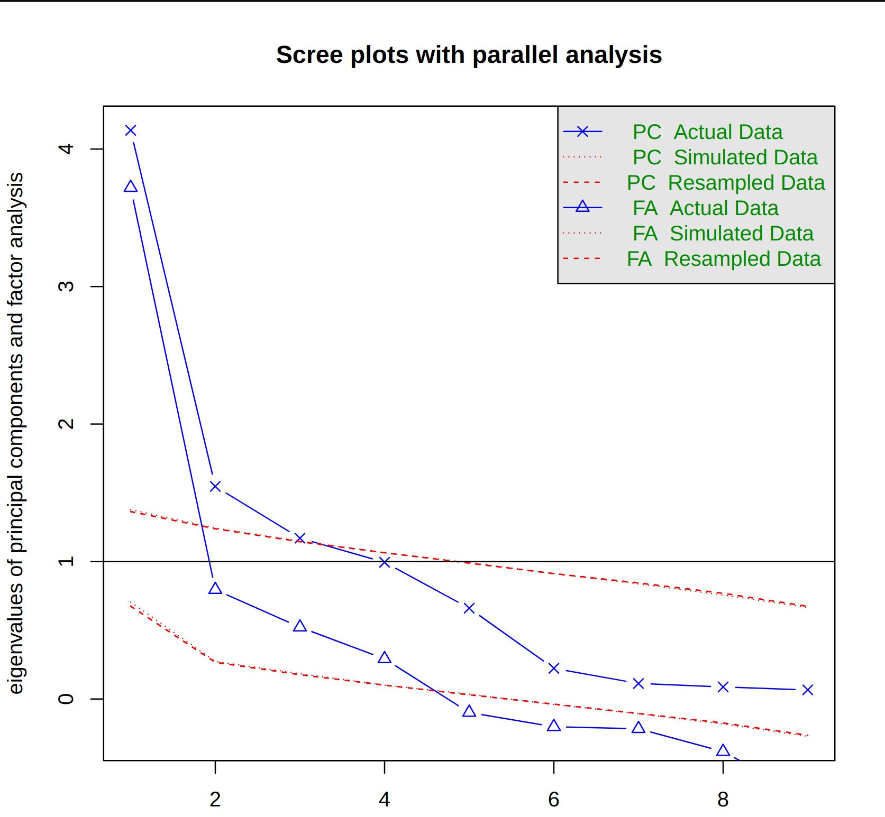
Scree plot after 1000 iterations Parallel analysis suggests that number of factors = 4 and number of components = 2.

Slide 5
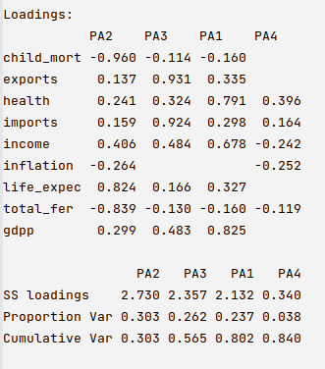
Factor analysis

Slide 6
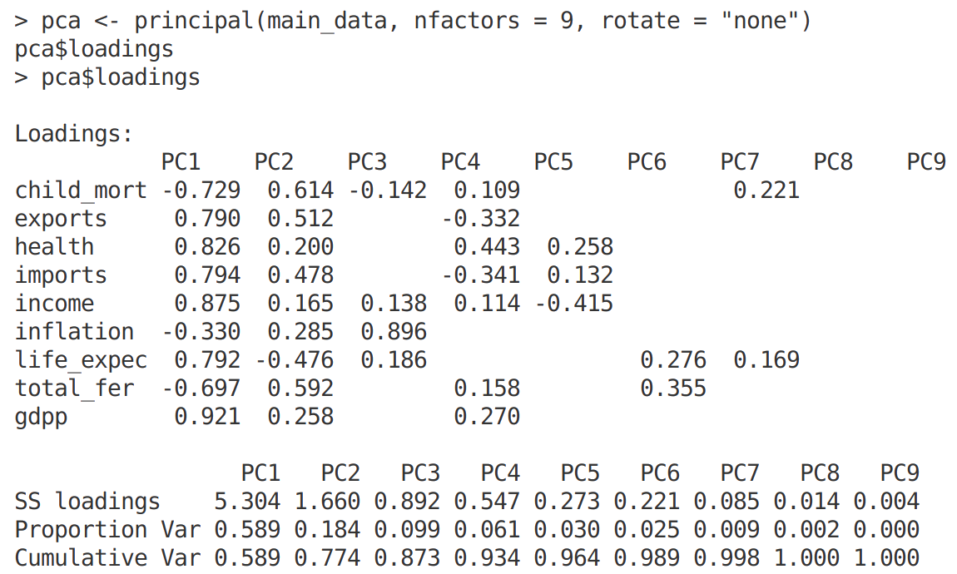
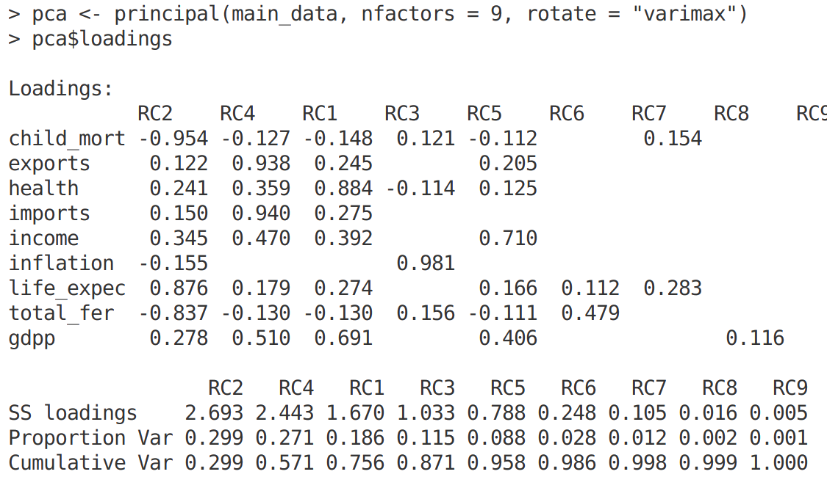
PCA

Slide 7
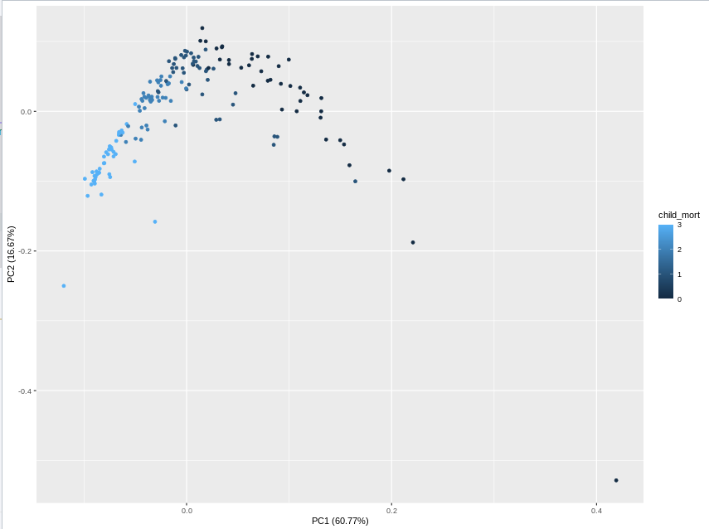
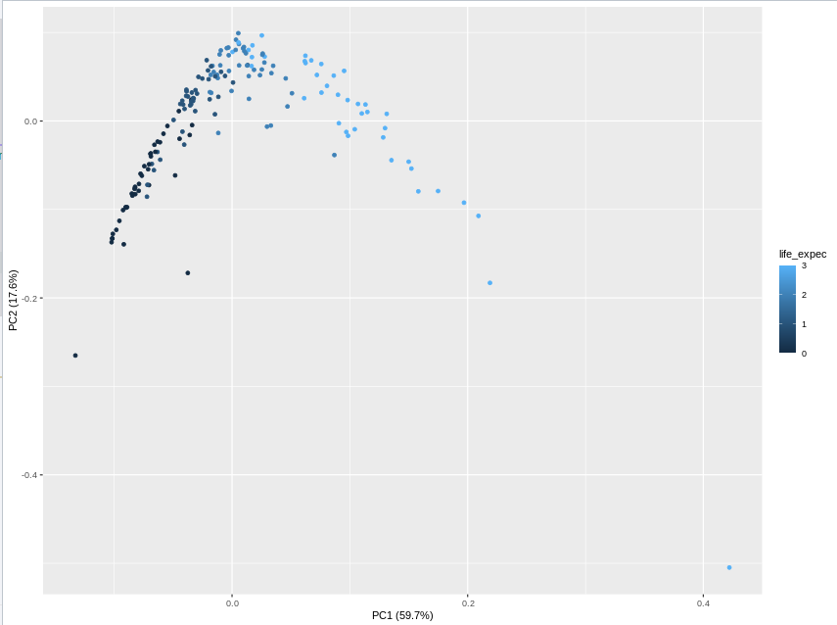
PCA plots
Scatter plots of child mortality and life expectancy with respect to the Principle components

Slide 8
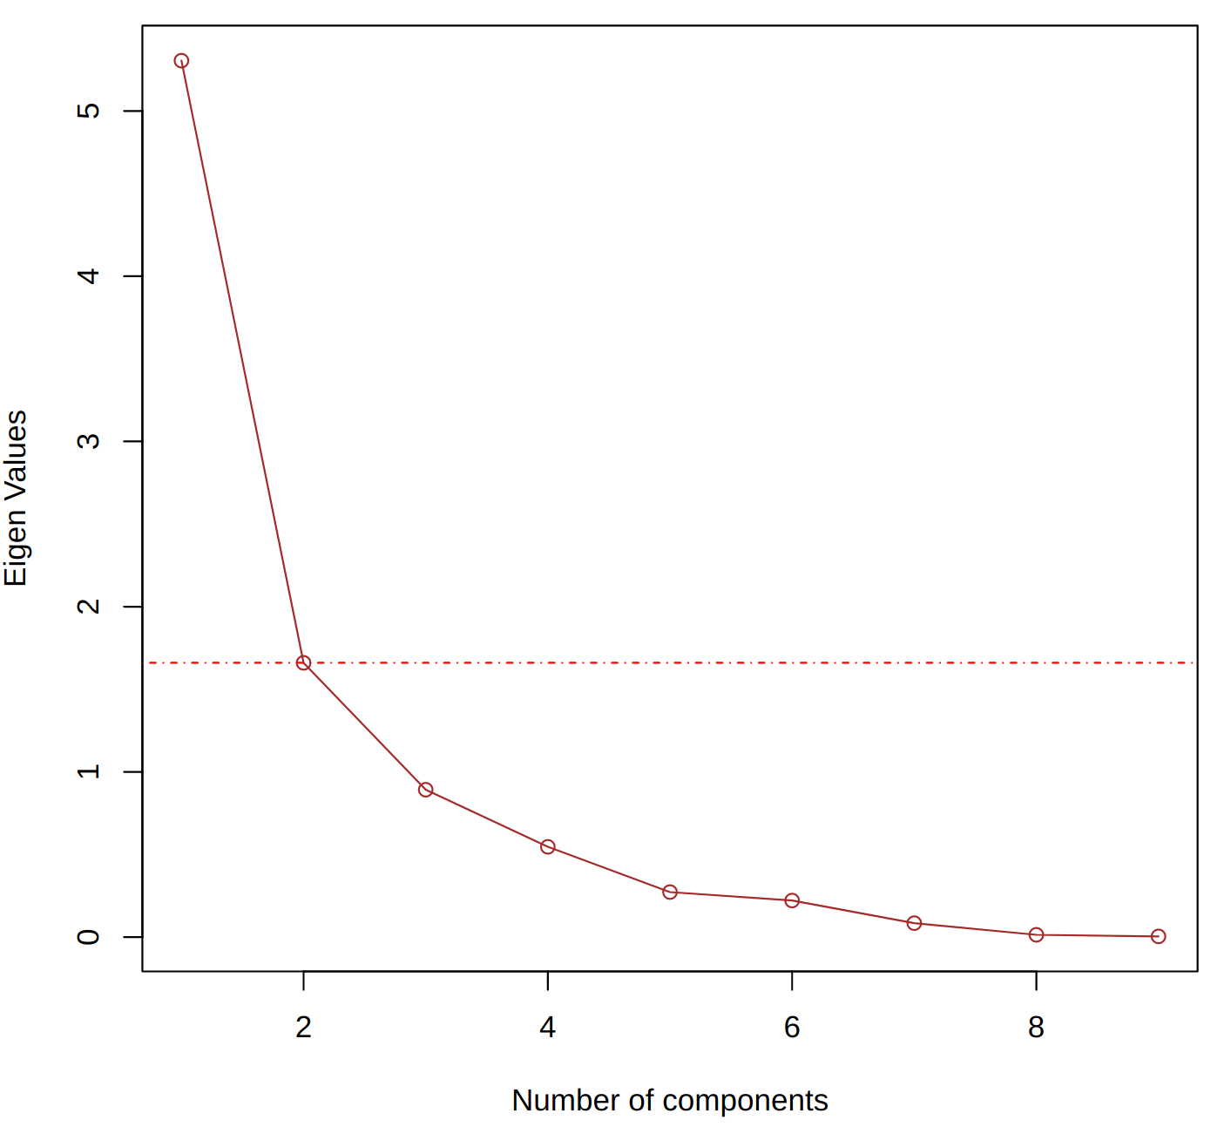
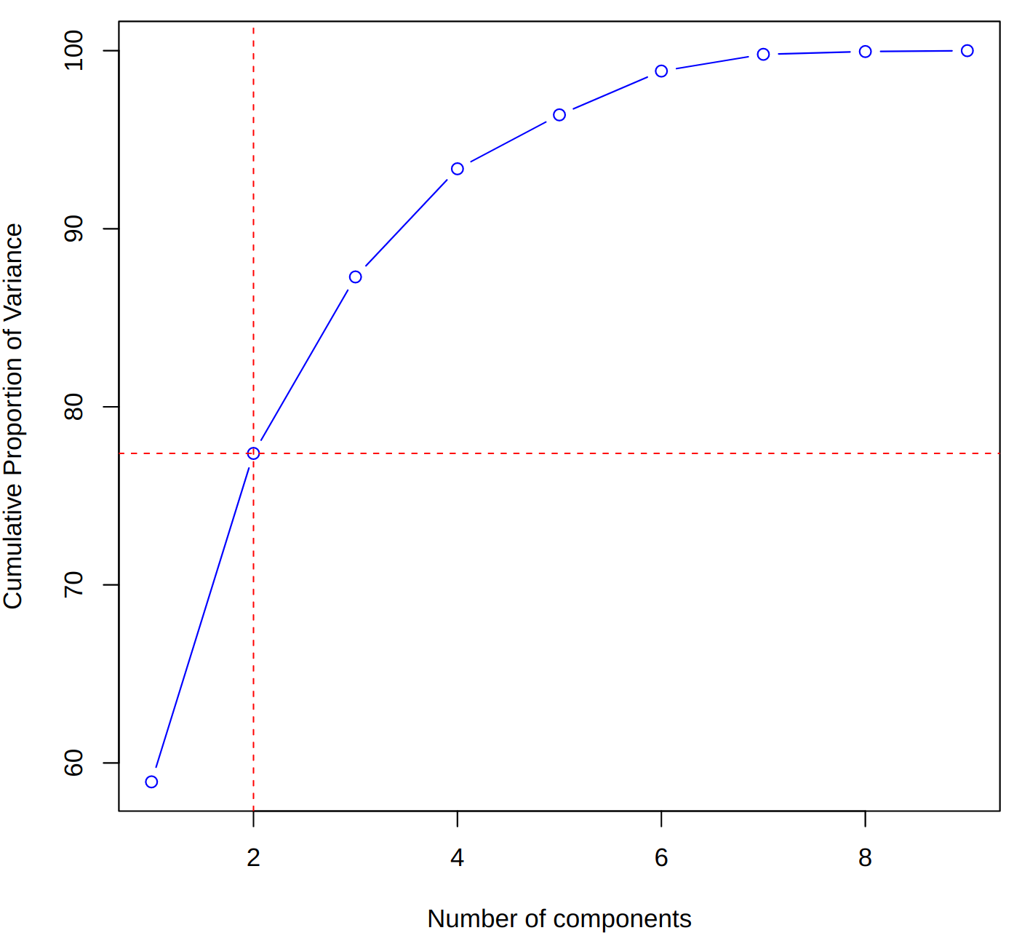
Scree plot of PCA

Slide 9
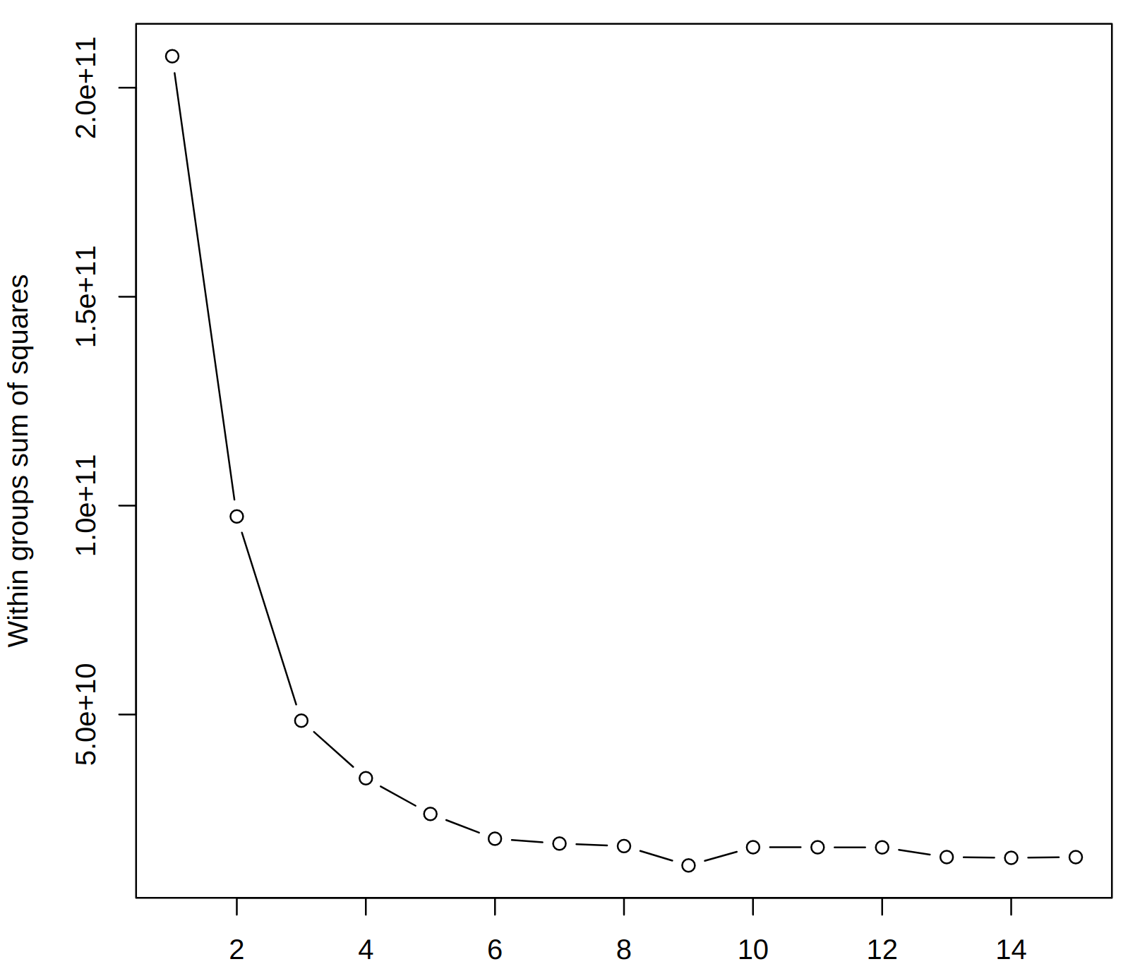
WSS Plot for k-means clustering
From elbow method we can tell that optimum number of clusters that should be taken is 3.

Slide 10
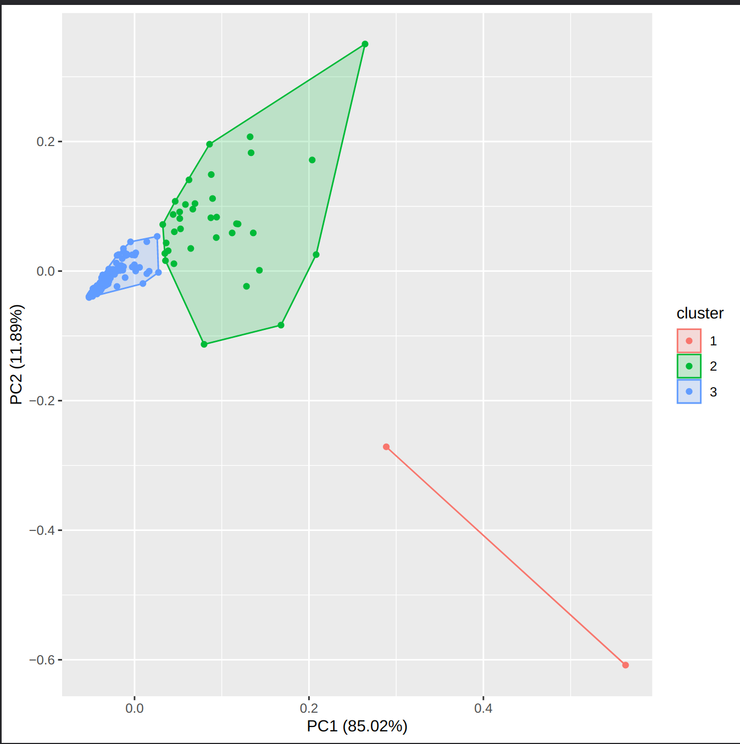
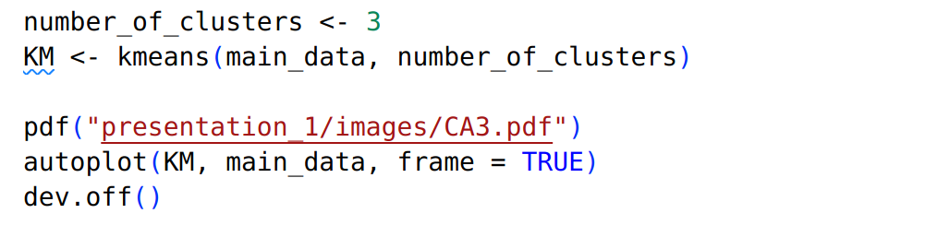
K-means clustering

Slide 11
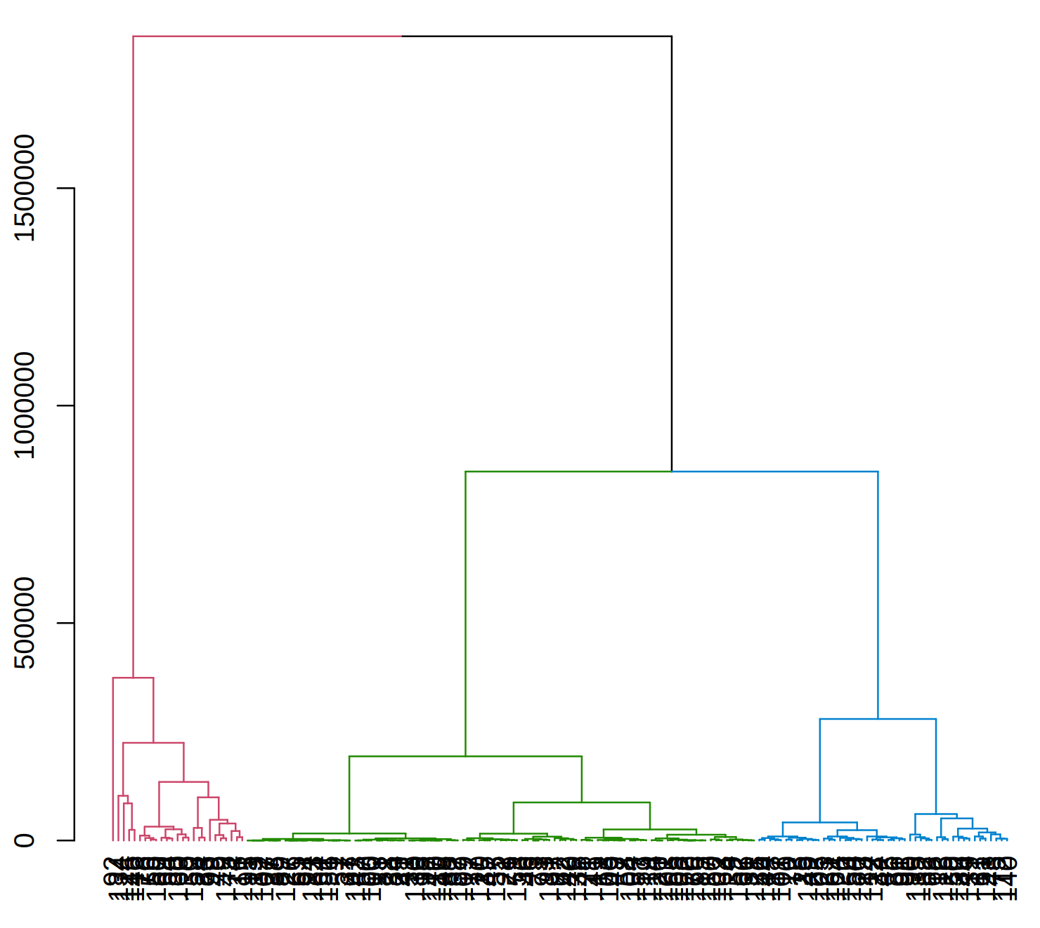
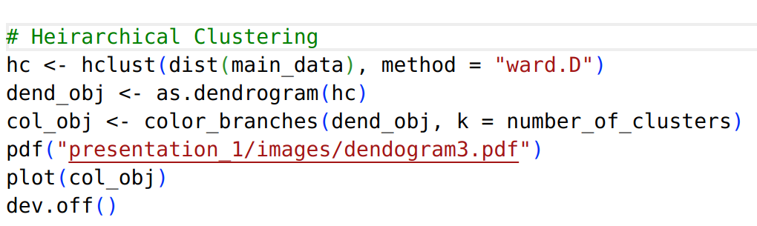
Hierarchical Clustering

Slide 12
MULTIPLE LINEAR REGRESSION
We are doing multiple linear Regression on the Help International dataset
We are taking Life Expectancy (life_expec) as the dependent variable
While the dependent Variables are:
Gdpp
Income
Child Mortality
Total Fertility
Health

Slide 13
Steps
Split the data randomly in Train and Test (80-20 split).
Fitting the Regression model.
Verifying and working over the Assumptions of Linear Regression:
Linear Relationship between input and output
No Multicollinearity
Normality of Residuals
Homoscedasticity
No Autocorrelation
Final Model after making necessary changes
Verifying the Accuracy of the Model over test data

Slide 14
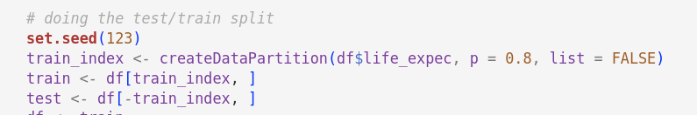
Splitting the data using the 'caret' library
Random (seed-123) 80-20 data split

Slide 15
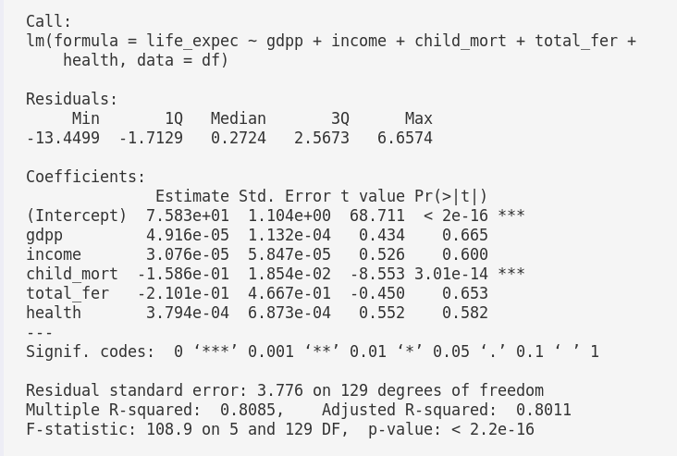
Fitting the Model (Initial Model)

Slide 16
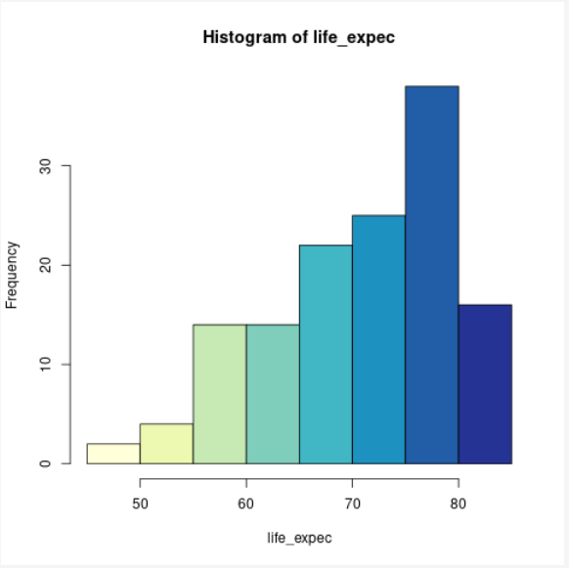
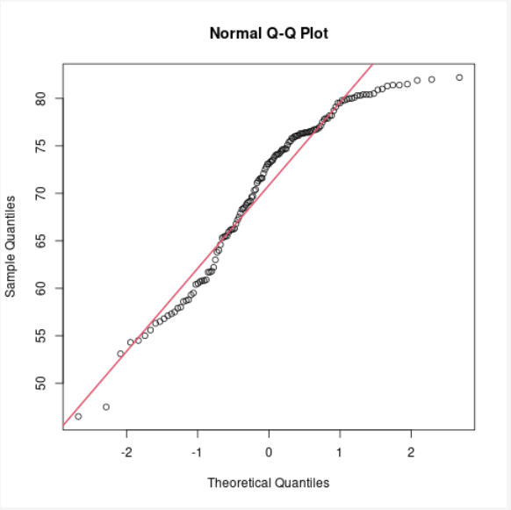
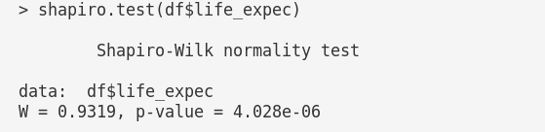
Normality of the dependent variable (Not Normal)

Slide 17
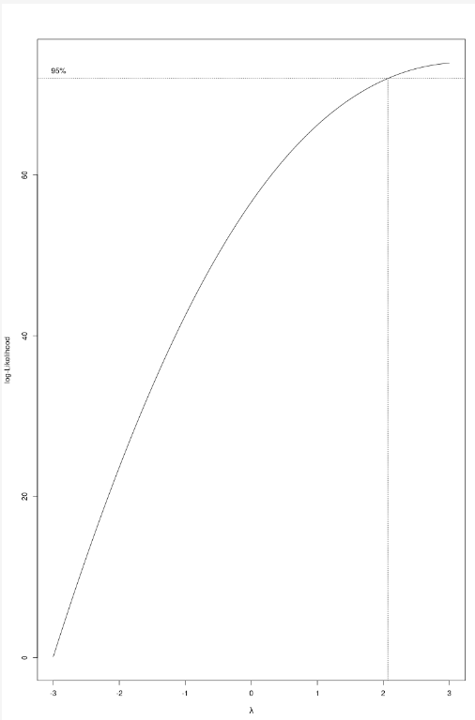
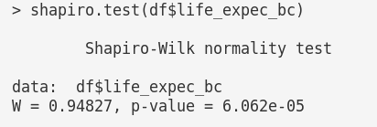
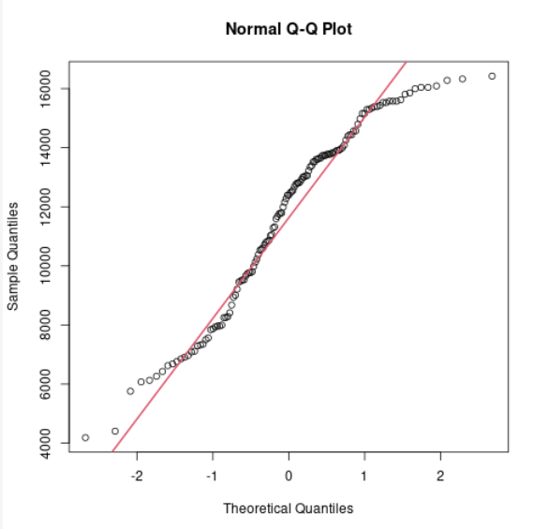
Box Cox Transform
For around Lambda = 2.4 we get ideal Box Cox Transform
The Data is comparatively more normal now

Slide 18
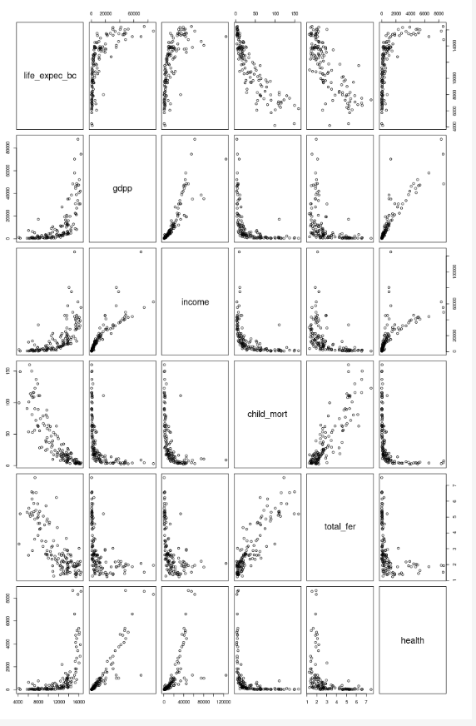
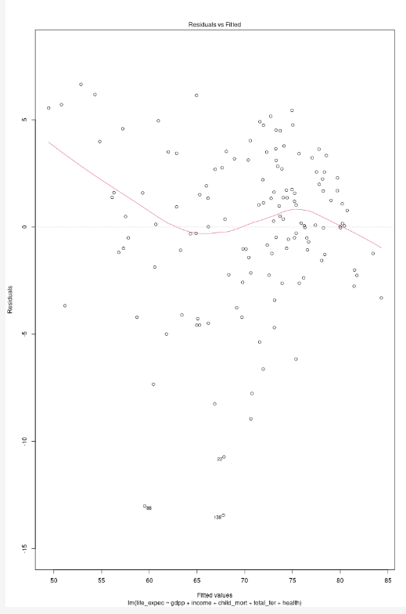
Linearity of the Variables

Slide 19

Multicollinearity
We Do VIF test if the scores are more than (5-10 points) if we get high multicollinearity of the Variables.
We remove the gdpp Cloumn as its score is highest

Slide 20
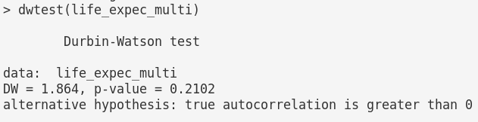
Autocorrelation
(No significant autocorrelation)

Slide 21
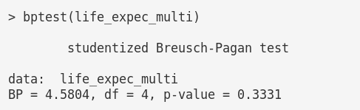
Homoscedasticity (We fail to confirm Heteroscedasticity) hence Homoscedastic

Slide 22
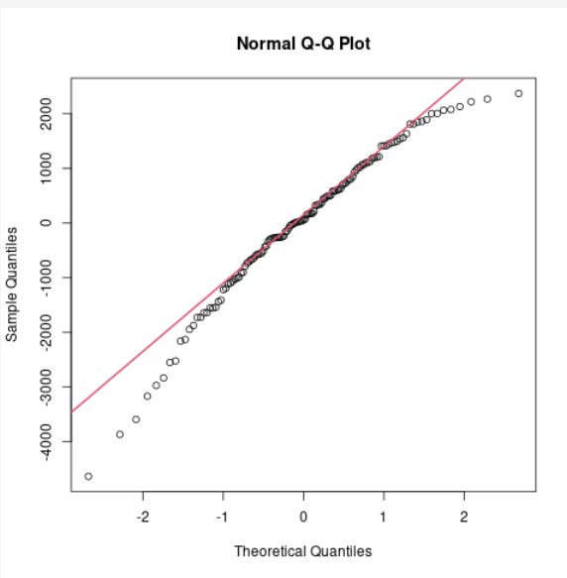
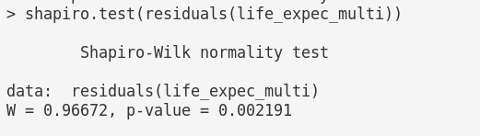
Normality of the residuals

Slide 23
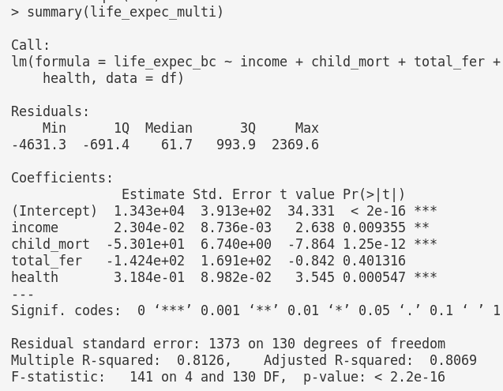
Final Model
Changes made
Removed gdpp for high multicolinearity
Did Box Cox transform
Used OLS as less heteroskedasticity it’s easier to visualize
Key point: Model fits for 81.26 percent of data

Slide 24
Verifying the Model on the Test Data
The Mean Square Error: 11.7
The Root Mean Square Error: 3.42
The mean of the test Values: 70.5

Slide 25
Thank you
Contributors
Prajwaldeep – MA20BTECH11013
Vishwanath – MA20BTECH11010
Submitted to :-
Sayantee Jana
Code for the project: https://github.com/Vishwanath-123/Intro-to-regression/tree/main/presentation_1

