Slide 1


ACS College of Engineering
Department of Cyber Security
ZERO TRUST | HYBRID ENCRYPTION | ORBIT-AWARE KEYS | AI DEFENSE
Evolving Encryption and AI Driven Cyber Defense for Satellite Communication Networks
Final Year Project Presentation
Secure Satellite TT&C Simulation Prototype
Team Members
Prajval Raj K - 1AH23CY037
Mohammad Taha Shariff - 11AH23CY031
Shrikar S - 1AH23CY052
Anil Kumar Pancha - 1AH24CY400
Project Guide
Mrs Majida Vettil Chettiyam
Domain
Satellite Cybersecurity | Zero Trust | AI Defense
MID-TERM REVIEW DECK | 50% COMPLETION STATUS

Slide 2

Presentation Roadmap
Structured for academic review and technical discussion
Introduction and project abstract
Literature survey, problem statement, and objectives
Existing system limitations and proposed system overview
Core architecture: evolving encryption, AI anomaly detection, and autonomous cyber defense
Implementation progress achieved so far (50% completion status)
Current results, remaining roadmap, and expected impact
ACS College of Engineering | Department of Cyber Security | Final Year Project Review

Slide 3
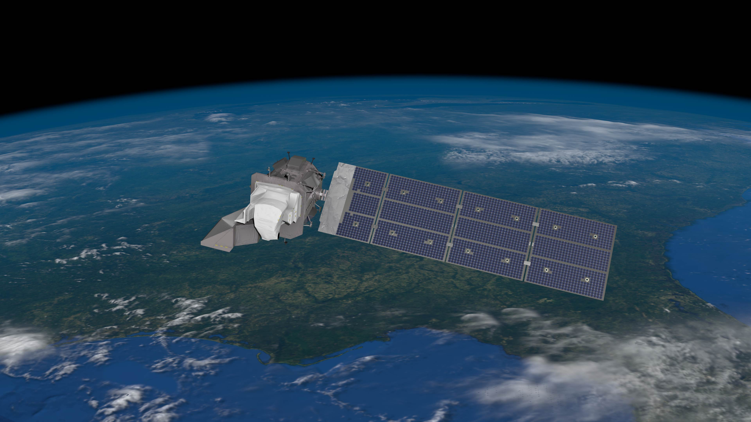
Introduction
Why satellite communication security now demands adaptive defense
Context
Project Motivation
Modern satellite communication networks carry high-value telemetry, control, and mission data.
These links are exposed to spoofing, replay, command injection, signal interception, and identity misuse.
Traditional perimeter-centric security is not enough for distributed space-ground systems.
The project explores a Zero Trust security framework tailored for satellite networks.
It combines evolving hybrid encryption, AI-based anomaly detection, trust scoring, and autonomous containment.
The goal is to move from static protection to adaptive cyber defense.
ACS College of Engineering | Department of Cyber Security | Final Year Project Review

Slide 4
Abstract
Proposed final-year project concept and current prototype direction
This project proposes a simulation-driven cybersecurity framework for satellite communication networks where multiple satellites and a ground station exchange secure packet-based commands and telemetry.
The proposed model uses hybrid cryptography with AES-256 for payload protection and ECC-based key exchange to derive evolving orbit-aware packet keys using timestamp, packet ID, and satellite position.
On top of cryptographic protection, the system includes AI-driven anomaly detection, dynamic trust scoring, replay protection, digital signatures, and autonomous cyber defense actions such as monitoring, throttling, quarantine, and isolation.
The project is currently at a partial implementation stage, with core simulation, dashboarding, and defense logic developed while deeper validation, deployment refinement, and full academic evaluation remain in progress.
ACS College of Engineering | Department of Cyber Security | Final Year Project Review

Slide 5
Literature Survey
Selected references guiding the architecture
NIST SP 800-207 (Rose et al., 2020): established the Zero Trust principle of verifying every access request regardless of network location.
CCSDS security guidance and space data link security standards: highlighted the need for authenticated and integrity-protected space-ground communication.
Recent satellite communication security surveys: identified replay, spoofing, jamming, eavesdropping, and command injection as dominant threat classes.
Recent ML-based satellite security research: showed anomaly detection can improve response to evolving threats, but often lacks deep integration with cryptographic trust enforcement.
Gap Identified
Most related work studies either cryptography, anomaly detection, or network resilience in isolation. Our project focuses on combining evolving encryption, orbital context, trust-aware control, and autonomous cyber defense in one unified framework.
ACS College of Engineering | Department of Cyber Security | Final Year Project Review

Slide 6
Problem Statement
What challenge this project addresses
THREATS: SPOOFING | REPLAY | COMMAND INJECTION | CONTEXT-AWARE ATTACKS
Statement
Satellite communication networks are vulnerable to identity spoofing, replay attacks, unauthorized command injection, and stealthy behavioral anomalies.
Existing approaches often rely on static cryptographic arrangements, limited contextual verification, and delayed human-driven response.
There is a need for a more adaptive satellite security model that continuously validates communication, derives stronger context-aware keys, detects anomalies early, and autonomously contains malicious behavior.
Research Need
Target Outcome
How can we combine evolving encryption with AI-driven cyber defense to secure packet-level satellite communication?
A secure and demonstrable Zero Trust framework suitable for academic validation and future real-world extension.
ACS College of Engineering | Department of Cyber Security | Final Year Project Review

Slide 7
Objectives
Technical and academic goals
Design a simulation environment for secure communication between multiple satellites and a ground station.
Implement hybrid encryption using AES-256 and ECC-based key exchange with evolving orbit-aware key derivation.
Integrate digital signatures, HMAC verification, packet freshness checks, and replay protection.
Develop AI-based anomaly detection and a dynamic trust score for each satellite node.
Create an autonomous cyber defense mechanism that can monitor, throttle, quarantine, and isolate malicious devices.
Build a professional dashboard for mission monitoring, alerts, and trust visualization.
Prepare the project for final-year review with a credible roadmap toward completion.
ACS College of Engineering | Department of Cyber Security | Final Year Project Review

Slide 8
Existing System Overview
Current limitations in conventional approaches
STATIC SECURITY POSTURE | LIMITED ADAPTATION | HUMAN-IN-THE-LOOP RESPONSE
Traditional Model
Major Weaknesses
Why It Falls Short
Static keys
Perimeter-focused trust
Reactive monitoring
Manual incident response
Limited contextual awareness
Single key compromise exposes larger traffic windows.
Weak protection against replay or identity spoofing.
Low visibility into behavioral anomalies.
Slow operator response during active attacks.
Satellite environments are distributed, delayed, and high-value.
Security must adapt to changing state, timing, and mission context.
Conventional models struggle to deliver resilient zero-trust enforcement.
ACS College of Engineering | Department of Cyber Security | Final Year Project Review

Slide 9
Proposed System Overview
High-level solution architecture
Zero Trust packet validation between satellites and ground station.
Hybrid encryption with evolving orbit-aware per-packet keys.
AI anomaly scoring plus trust-driven autonomous defense.
Mission control dashboard for live visibility and response.
Satellites
Hybrid Crypto Layer
AI + Trust Engine
Autonomous Defense
ACS College of Engineering | Department of Cyber Security | Final Year Project Review

Slide 10
System Architecture
Layered view of the proposed platform
MISSION NODES -> HYBRID CRYPTO -> AI TRUST ENGINE -> AUTONOMOUS DEFENSE
Layer 1
Mission Nodes
Layer 2
Security
Layer 3
Intelligence
Layer 4
Defense
LEO satellites
Ground station
Packetized telemetry
Command exchange
ECC key exchange
AES-256-GCM
Ed25519 signatures
HMAC integrity
Nonce + timestamp freshness
AI anomaly detector
Behavioral baselines
Trust scoring
Alert generation
Monitor
Throttle
Quarantine
Isolate
Audit KPIs
ACS College of Engineering | Department of Cyber Security | Final Year Project Review

Slide 11
Key Innovations
What differentiates the project
Evolving encryption keys instead of static session protection.
Orbit-aware key derivation that binds cryptographic context to packet identity, time, and satellite position.
Integration of cryptographic verification and AI-driven anomaly detection in one pipeline.
Dynamic trust scoring to represent live node health rather than binary trusted/untrusted state.
Autonomous cyber defense actions to contain threats without waiting for manual intervention.
Mission-control style visualization designed for operational clarity and academic demonstration.
ACS College of Engineering | Department of Cyber Security | Final Year Project Review

Slide 12
Work Done Till Now
Current status: approximately 50% completed
Completed in Current Phase
Not Yet Claimed as Complete
Core simulation of satellites and ground station
Zero Trust communication workflow
AI anomaly detection prototype
Autonomous defense logic
Interactive dashboard UI
Initial deployment and demo pathway
Rigorous validation against broader test cases
Formal performance benchmarking
Full real-data integration
Publication-grade results and comparative study
Final documentation and viva-ready refinements
50%
ACS College of Engineering | Department of Cyber Security | Final Year Project Review

Slide 13
Current Results and Demonstration Status
What can already be shown during review
LIVE DASHBOARD | SECURE PACKET FLOW | ATTACK RESPONSE VISIBILITY
Secure packet flow with hybrid encryption and packet-level validation is operational in simulation.
Replay, spoofing, and injection scenarios can trigger alerts and trust degradation.
The dashboard shows trust stage, AI risk, alerts, KPIs, and blocked nodes in real time.
The system can already support a guided demonstration for review, while deeper evaluation is still pending.
Important Review Positioning
This is a progressing final-year project. The current presentation reflects a credible mid-stage prototype, not a falsely claimed finished product.
ACS College of Engineering | Department of Cyber Security | Final Year Project Review

Slide 14
Remaining 50% Roadmap
Planned work before final completion
Strengthen experimental evaluation and collect comparative metrics.
Add more realistic orbital/network scenarios and attack diversity.
Refine crypto inspection and evidence reporting for presentation and review.
Integrate cleaner real-time ingestion and optional external telemetry feed.
Complete academic report, diagrams, test cases, and final documentation.
Prepare final demonstration script, viva responses, and conclusion chapter.
ACS College of Engineering | Department of Cyber Security | Final Year Project Review

Slide 15
Conclusion
Academic significance of the project
Conclusion
The project addresses a relevant and technically meaningful problem at the intersection of satellite systems and cybersecurity.
Its contribution lies in combining evolving hybrid encryption, orbit-aware context, AI-based anomaly detection, trust-aware control, and autonomous cyber defense in one unified prototype.
At the current stage, the project demonstrates strong architectural direction and a functional prototype foundation, with the remaining effort focused on validation, completion, and academic polishing.
ACS College of Engineering | Department of Cyber Security | Final Year Project Review

Slide 16
References
Key sources used for conceptual grounding
NIST | CCSDS | SATELLITE SECURITY SURVEYS | AI ANOMALY DETECTION RESEARCH
Rose, S., Borchert, O., Mitchell, S., Connelly, S. Zero Trust Architecture. NIST SP 800-207, 2020.
CCSDS security guidance and space data link security publications for protected space-ground communications.
A Survey on Satellite Communication System Security, Sensors/MDPI, 2024.
Satellite Navigation Signal Authentication in GNSS: A Survey on Technology Evolution, Status, and Perspective, Remote Sensing/MDPI, 2023.
Recent research on AI-based anomaly detection and cyber resilience in satellite communication environments.
ACS College of Engineering | Department of Cyber Security | Final Year Project Review

