Slide 1



ACS College of Engineering
(Approved by AICTE, New Delhi, Govt. of Karnataka, Affiliated to Visvesvaraya Technological University, Belagavi)
#207, Kambipura, Mysore Road, Bengaluru – 560074
COSMIC SEA
Evolving Encryption and AI-Driven Cyber Defense for Satellite Communication Networks
Under the Guidance:
PRAJVAL RAJ K (1AH23CY037)
MOHAMMAD TAHA SHARIFF (1AH23CY031)
SHRIKAR S (1AH23CY052)
ANIL KUMAR PANCHAL (IAH24CY400)
MR. SHRIDHAR SHETTY
(Asst.Professor, CSE-CY, ACSCE)

Slide 2
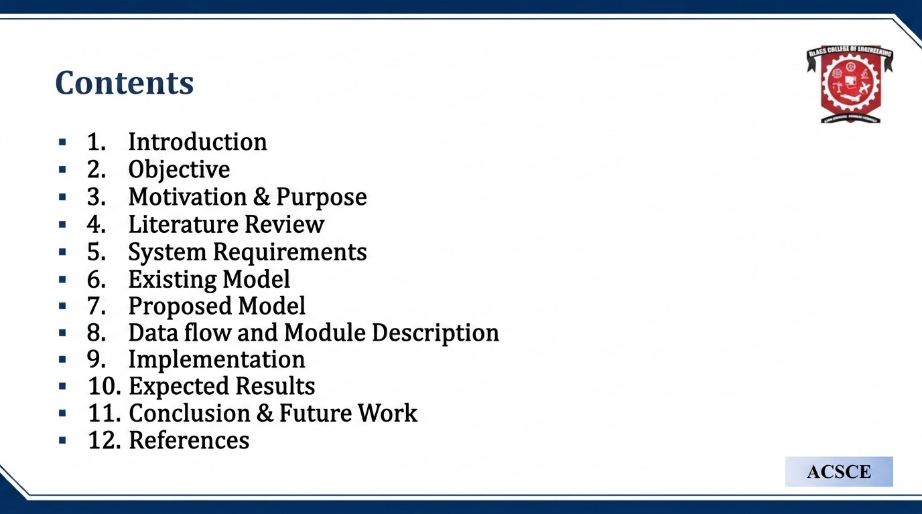

Contents
1. Introduction and Motivation
2. Problem Statement and Objectives
3. Existing vs Proposed System
4. System Architecture and Modules
5. Cryptography, AI and Trust-Based Defense
6. Implementation, Results and Demo
7. Conclusion and Future Scope
ACSCE

Slide 3
Introduction
â€¢ Cosmic Sea is a simulation-based Zero Trust cybersecurity framework for satellite TT&C communication.
â€¢ It protects command and telemetry exchange between LEO satellites and ground stations.
â€¢ Satellite links are high-value, remote, intermittent, and vulnerable to spoofing, replay, packet tampering, and command injection.
â€¢ The project combines hybrid cryptography, online anomaly detection, dynamic trust scoring, and autonomous containment.
ACSCE

Slide 4
Objectives
â€¢ Simulate secure packet communication between multiple satellites and rotating ground stations.
â€¢ Verify every packet using Zero Trust principles: identity, integrity, freshness, replay prevention, and confidentiality.
â€¢ Derive evolving orbit-aware packet keys using ECC, packet ID, timestamp, position, and key epoch.
â€¢ Detect anomalous behavior and apply monitor, throttle, quarantine, or isolation automatically.
ACSCE

Slide 5
Motivation and Purpose
Motivation (The Problem)
Reactive Legacy Systems
Traditional firewalls rely on static signatures and miss unknown threats.
Alert Fatigue
High false positives overwhelm security teams and delay critical response times.
Need for Proactive Defense
Security must stop threats before they breach the core network assets.
Purpose (The Solution)
Automate Detection
Use Machine Learning algorithms to identify and block emerging threats in real-time.
Misdirect Attackers
Deploy intelligent honeypots and decoys to safely divert and analyze malicious traffic.
Self-Learn & Adapt
Establish an adaptive security posture that dynamically updates firewall rulesets.
Satellite command and telemetry links support navigation, remote sensing, defense, weather, and scientific missions.
A successful replayed command, forged identity, or tampered packet can affect mission continuity and safety.
Traditional perimeter-based trust and long-lived/static keys are not sufficient for distributed satellite networks.
Cosmic Sea explores an adaptive, continuously verified cyber-defense model.
ACSCE

Slide 6
Literature Review
YEAR | AUTHOR | PUBLICATION | METHODOLOGY | ADVANTAGES | LIMITATIONS
2022 | M.R. Amal,P. Venkadesh | 10.14704/WEB/V19I1/WEB19370 Webology, Volume 19 | Review of Cyber Attack Detection: | Honeypoot- used of deception system in SOC | Reactive technology used.
2024 | Amir Javadpour, Forough Ja'fari, Tarik Taleb, | Volume 140, 103792,ISSN 0167-4048 | comprehensive survey on cyber deception techniques | modern architecture | lacks in interconnectivity
2025 | Taimoor Ahmad | arXiv preprint arXiv:2506.05356, 2025 | Ai-driven dynamic firewalloptimizatinusingreinforcemen | next-gen firewall powered by AI | lacks deception system
AI anomaly detection
NIST SP 800-207
CCSDS guidance
Satellite security surveys
Key finding: Existing work often treats cryptography, anomaly detection, and response separately. Cosmic Sea integrates all three into one Zero Trust pipeline.
ACSCE

Slide 7
Problem Statement
Satellite communication networks are exposed to identity spoofing, replay attacks, unauthorized command injection, packet tampering, and stealthy behavioral abuse.
There is a need for a framework that continuously verifies every packet, learns abnormal behavior, and autonomously contains threats.
ACSCE

Slide 8
System Requirements
Hardware Requirements
Software Requirements
developer_board
Intel i3 or above
computer
Operating System
Windows / Linux
4 GB RAM or above
Python 3.11, Flask, Cryptography, HTML/CSS/JavaScript
memory
code
storage
20 GB free space
dns
In-memory state (prototype); persistence is future scope
ACSCE

Slide 9
Existing System
Conventional approaches commonly use:
â€¢ Perimeter-based or one-time trust
â€¢ Static or long-lived session keys
â€¢ Limited packet freshness and contextual validation
â€¢ Reactive logging with manual incident response
â€¢ Little visibility into changing node behavior
These limitations are risky for delayed, intermittent, mission-critical space-ground links.
ACSCE

Slide 10
Proposed System
SATELLITES / GROUND STATIONS
DOWN
ZERO TRUST SECURITY LAYER
Identity | Signature | HMAC | Timestamp | Nonce | AES-GCM
DOWN
AI ANOMALY DETECTION + TRUST ENGINE
DOWN
AUTONOMOUS DEFENSE: Monitor -> Throttle -> Quarantine -> Isolate
DOWN
MISSION CONTROL DASHBOARD
ACSCE

Slide 11
System Architecture
1. Communication layer: satellite nodes, ground stations, telemetry and commands.
2. Security layer: X25519, AES-256-GCM, Ed25519, HMAC-SHA256, HKDF, nonce and timestamp checks.
3. Intelligence layer: online per-node anomaly detection and frequency checks.
4. Response layer: dynamic trust policy and autonomous incident containment.
5. Visualization layer: Flask API, SSE stream, and live dashboard.
ACSCE

Slide 12
Data Flow and Module Description
Telemetry/command -> packet issue -> encrypt/sign/HMAC -> simulated network -> verify/decrypt -> AI observe -> trust update -> defense action -> dashboard
Main modules:
- simulator.py: orchestrates traffic, attacks, link impairments and handover
- security.py: key lifecycle and Zero Trust packet verification
- anomaly_ai.py: online z-score anomaly model
- trust.py and defense_policy.py: staged containment and KPIs
- app.py: REST API, SSE stream and dashboard
ACSCE

Slide 13
Implementation
- Flask-based Mission Control dashboard with real-time Server-Sent Events.
- Six simulated satellites and two ground stations with handover and visibility windows.
- Hybrid packet security: X25519 + HKDF + AES-256-GCM + Ed25519 + HMAC-SHA256.
- Replay, impersonation, command injection, packet corruption, loss, latency and clock-drift simulations.
- AI anomaly detector, trust-score engine, incident records, containment actions and KPIs.
Implemented So Far
ACSCE

Slide 14
Expected Results
â€¢ Every accepted packet has passed identity, signature, HMAC, timestamp, nonce, and decryption checks.
â€¢ Replay, forged identity, and tampering attempts are rejected and reflected in the trust score.
â€¢ The dashboard presents AI risk, trust stage, alerts, blocked nodes, and containment KPIs in real time.
â€¢ The prototype demonstrates measurable defense behavior; formal benchmarking is future work.
ACSCE

Slide 15
Conclusion and Future Work
â€¢ Cosmic Sea demonstrates a complete Zero Trust security pipeline for simulated satellite communication.
â€¢ Its key contribution is combining evolving orbit-aware cryptography, behavior intelligence, trust scoring, and autonomous defense.
â€¢ Future work: persistent storage, richer orbital realism, real telemetry adapters, broader attack datasets, benchmarking, and advanced ML models.
ACSCE

Slide 16
References
1. Rose, S., Borchert, O., Mitchell, S., and Connelly, S. NIST SP 800-207: Zero Trust Architecture, 2020.
2. CCSDS security guidance and space data-link security recommendations.
3. Satellite communication security surveys covering spoofing, replay, and command injection.
4. Research on AI-based anomaly detection in communication and cyber-physical systems.
5. Python Cryptography documentation: Ed25519, X25519, AES-GCM and HKDF.
ACSCE

Slide 17

Thank You
COSMIC SEA
Evolving Encryption and AI-Driven Cyber Defense for Satellite Communication Networks
Presented by: PRAJVAL RAJ K | MOHAMMAD TAHA SHARIFF | SHRIKAR S | ANIL KUMAR PANCHAL
ACSCE

Slide 18
Live Demonstration
Dashboard demonstration:
â€¢ Valid telemetry flow
â€¢ Simulated replay, injection and impersonation attacks
â€¢ Trust-score degradation and autonomous containment
â€¢ Live alerts, blocked identities and defense KPIs
ACSCE

