Slide 1

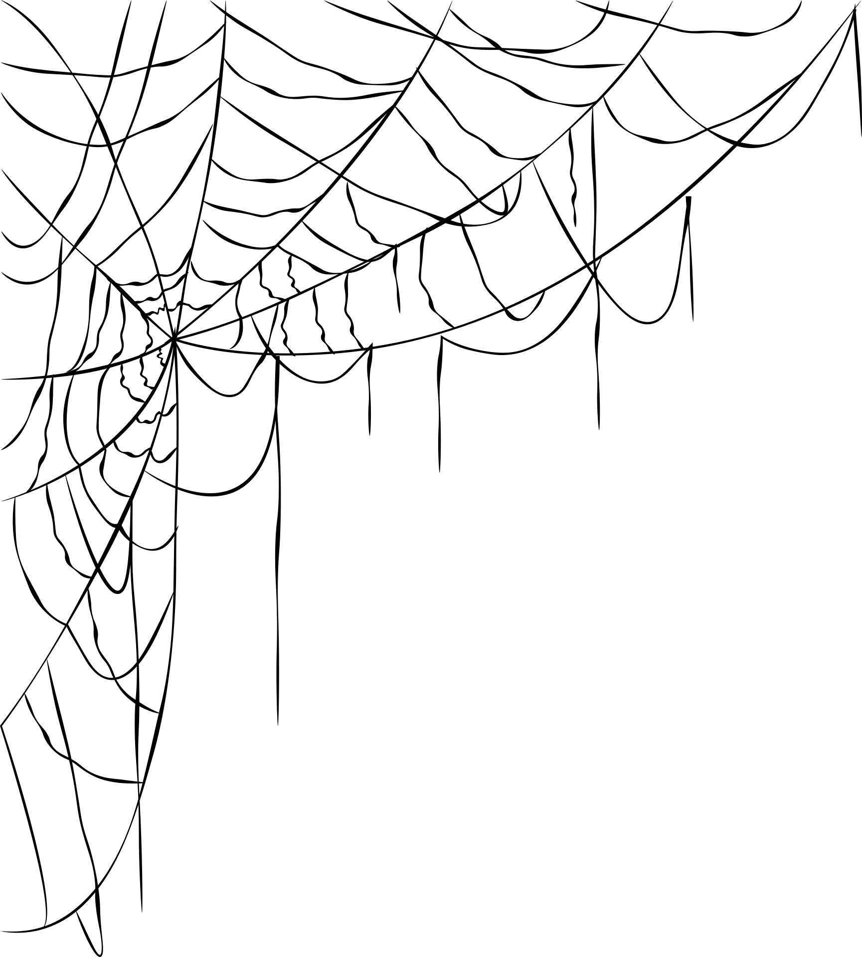
maynards
Prajwal Gunnala
Yuva Raj Ambati
MESH AI
IQOO Hackathon 2026

Slide 2
maynards
NO API BILL
ON YOUR PHONES
30B CODER
REVIEWS YOUR CODE
OFFLINE
ON A BUDGET LAPTOP
WHAT IF YOU COULD ACTUALLY RUN IT?
IQOO HACKATHON 2026

Slide 3
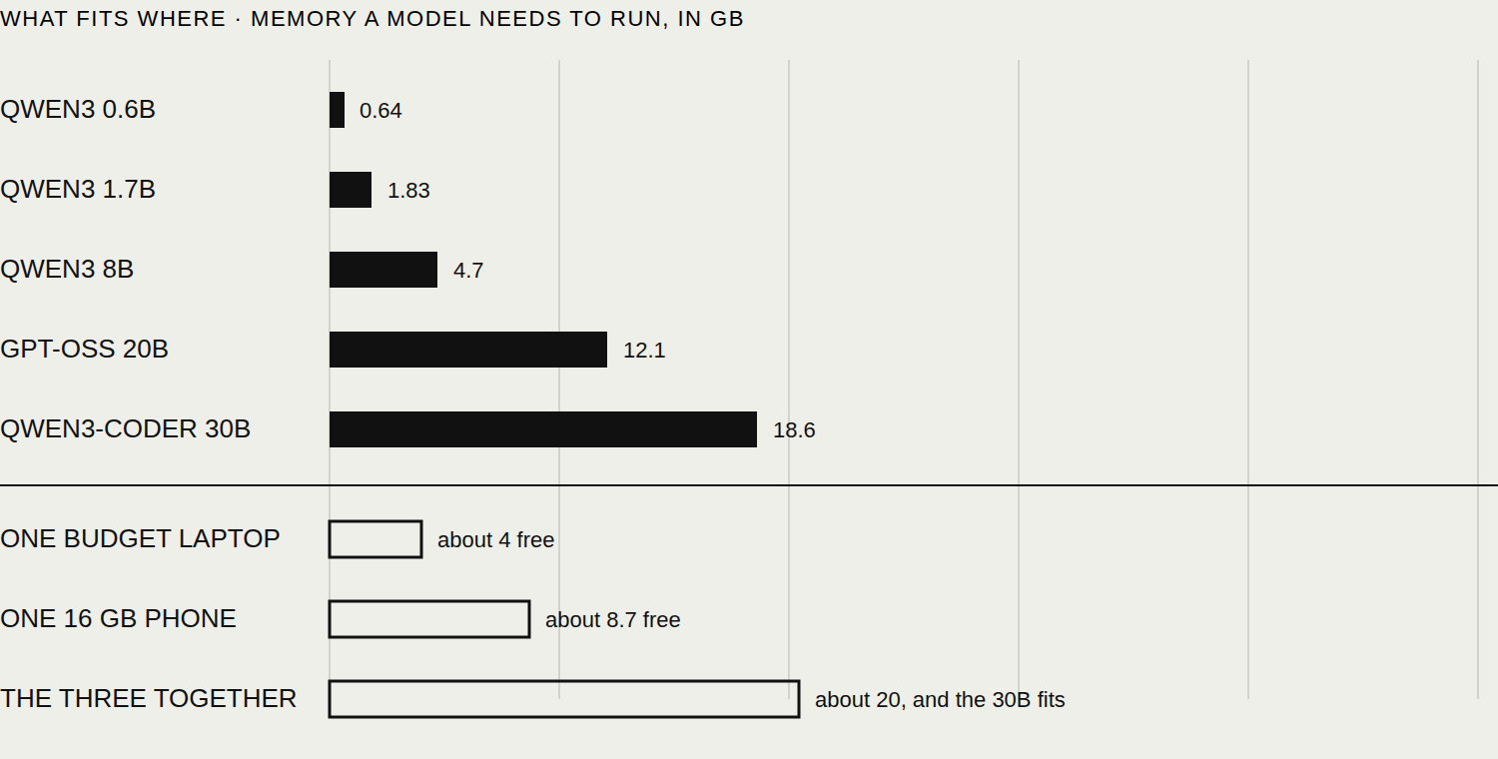



MESH AI
IQOO HACKATHON 2026 · DEVELOPER TOOLS
PROBLEM
The model decides the answer, and memory decides the model. A 30B coding model needs about 18.6 GB of memory to run. A budget laptop has around 4 GB free once a browser and an editor are open. A phone has 2 to 10 GB. Neither can hold it, so you run a small model instead and you get answers you cannot use.
We measured exactly what that costs. The same 15 coding problems, asked of each setup, scored by running every answer against its own tests. laptop alone, 0.6B passed 2 of 15; laptop alone, 1.7B passed 7 of 15; laptop + laptop helper, 1.7B (split) passed 7 of 15.
Buying a machine that can hold the big model costs more than the laptop. The devices that could hold it together are already on the table.
TEAM MAYNARDS
PRAJWAL GUNNALA · YUVA RAJ AMBATI

Slide 4
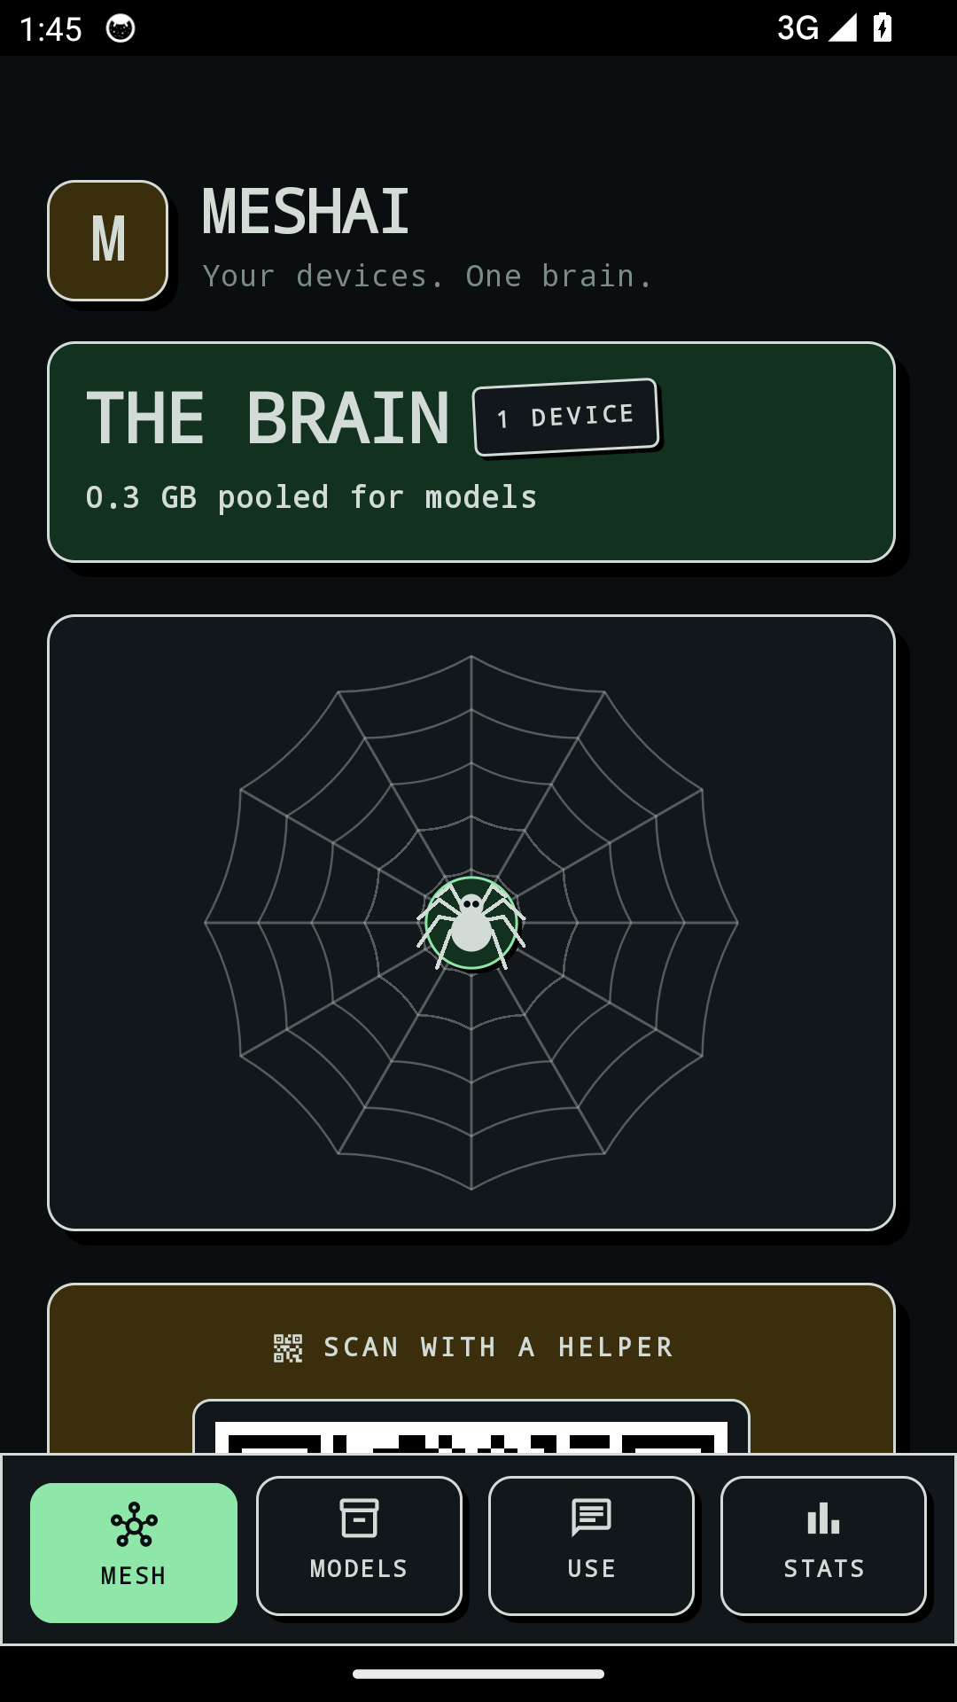


MESH AI
IQOO HACKATHON 2026 · DEVELOPER TOOLS
THE MESH
MeshAI pools the free memory of the devices you already own. Phones and laptop join over a USB cable, one device plans which layers sit where, and the model runs across all of them behind a single OpenAI compatible endpoint, so the tools you already use do not change.
Only a few kilobytes cross the link for each word, because the embeddings and the output head stay on the host.
On top of it sits the developer tool: mesh review for a file, mesh tests to write tests for one, mesh diff for what you are about to commit, and a git hook that reviews every commit before it lands. All of it against your own devices.
ONE ENDPOINT
NOTHING LEAVES
MESH REVIEW · TESTS · DIFF
PLANS THE SPLIT
REFUSES BAD DEVICES
GIT PRE-COMMIT HOOK
TEAM MAYNARDS
PRAJWAL GUNNALA · YUVA RAJ AMBATI

Slide 5
MESH AI
IQOO HACKATHON 2026 · DEVELOPER TOOLS
WHY NOT BEFORE?
Splitting a model across machines is not new. Doing it across phones is, and the reasons are physical rather than clever.
Generating a word reads the whole model out of memory, so a device that holds part of the model is asked for it once per word. That makes the link, not the chip, the thing that decides whether a split is usable. Venue Wi-Fi measured 266 to 483 ms round trip and the planner refuses it. A USB cable measures 2 to 3 ms and it works.
Loading was the second wall. The first 30B split took 517 seconds, because the engine read the file in scattered pieces while pushing layers out. Reading it once, front to back, brought that to 70.
The research agrees on where the line falls. Petals, the only peer reviewed system to do this at scale, measured 0.83 tokens per second across two continents. A split is worth it on a link you own and worthless on one you do not, which is exactly where we drew it.
TEAM MAYNARDS
PRAJWAL GUNNALA · YUVA RAJ AMBATI

Slide 6
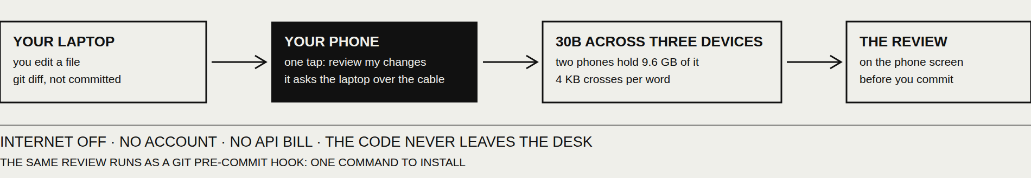
MESH AI
IQOO HACKATHON 2026 · DEVELOPER TOOLS
WHAT YOU DO WITH IT
You are about to commit. You tap one button on your phone.
The phone asks your laptop what you have changed and not committed. The laptop answers over the cable with the diff. A 30B coding model running across the two phones and the laptop reviews it, and the review appears on the phone. No internet, no account, no API bill, and the code never left the desk.
The same review runs as a git pre-commit hook, so every commit is read before it lands, and as mesh review on a file, or mesh tests to write the tests for one. One command to install, and it costs nothing on the ten thousandth run.
TEAM MAYNARDS
PRAJWAL GUNNALA · YUVA RAJ AMBATI

Slide 7
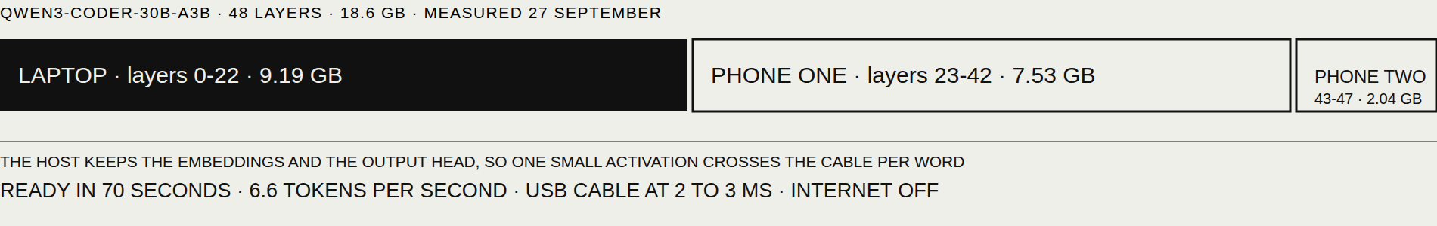
MESH AI
IQOO HACKATHON 2026 · DEVELOPER TOOLS
HOW IT WORKS
One device is the host. It reads every device's free memory, heat, battery and round trip time, then gives each one an unbroken run of layers it can actually hold, largest first. The embeddings and the output head stay on the host.
Measured on our own hardware: laptop layers 0 to 22, one phone 23 to 42, the other 43 to 47. The phones hold 9.6 GB of the 18.6. What crosses the cable is one hidden state per word, about 4 KB, read from the model's own header. The 18.6 GB of weights never move, and the app draws that traffic live while it answers.
TEAM MAYNARDS
PRAJWAL GUNNALA · YUVA RAJ AMBATI

Slide 8
MESH AI
IQOO HACKATHON 2026 · DEVELOPER TOOLS
WHAT MADE IT WORK
Read the file once, front to back: load 517 s to 70 s.
Every phone keeps its own layers on its own storage, so a split it has never used before is ready in 70 s instead of 437.
One conversation slot, so a long chat stops falling out of the cache.
The median of ten round trips, not the average, so one Wi-Fi spike does not evict a healthy phone.
And it refuses. Too slow to reach, too hot, nearly flat, or the model already fits one device: it says which, in a sentence you can read.
TEAM MAYNARDS
PRAJWAL GUNNALA · YUVA RAJ AMBATI

Slide 9


MESH AI
IQOO HACKATHON 2026 · DEVELOPER TOOLS
Any GGUF model
Kotlin, Compose
Rust agent
llama.cpp, ggml RPC
USB tethering
TECH STACK
OpenAI-style API
Android NDK arm64
CLI and git hook
No cloud at all
TEAM MAYNARDS
PRAJWAL GUNNALA · YUVA RAJ AMBATI

Slide 10

MESH AI
IQOO HACKATHON 2026 · DEVELOPER TOOLS
FEASIBILITY
READY IN 70 SECONDS, 6.6 TOKENS PER SECOND
IT RUNS TODAY: 30B ACROSS A LAPTOP AND TWO PHONES
BUILT AND MEASURED INSIDE THE EVENT WINDOW
TEAM MAYNARDS
PRAJWAL GUNNALA · YUVA RAJ AMBATI

Slide 11
MESH AI
IQOO HACKATHON 2026 · DEVELOPER TOOLS
LIMITS
NOT FASTER. IT BUYS MEMORY, NOT SPEED
Every word crosses the link once, so a split is slower than one device that can already hold the model. Our own planner will tell you so and refuse to involve your phone. We split only when the model fits nowhere else.
PRIVATE ACROSS YOUR OWN DEVICES ONLY
Nothing leaves the devices you own, and the demo runs with the internet off. We do not claim that activations sent to someone else's phone are private, because published work turns them back into text.
TEAM MAYNARDS
PRAJWAL GUNNALA · YUVA RAJ AMBATI

Slide 12
MESH AI
IQOO HACKATHON 2026 · DEVELOPER TOOLS
IMPACT
THE CEILING MOVES
The quality of AI you can run on your own hardware is set by memory. Pool the memory and the ceiling moves: the same devices that could only hold a small model now hold a 30B coding model, and the answers change accordingly.
PHONE FIRST IS NOT A GIMMICK HERE
In rural India 94.2% of households have a phone and 4.2% have a computer (MoSPI, 2022-23). That is not our first user and we will not pretend it is. It is why the phone has to be the device that works rather than the accessory: for most people it is the only computer in the house, and as open models improve at a given size, what it can hold matters more every year.
TEAM MAYNARDS
PRAJWAL GUNNALA · YUVA RAJ AMBATI

Slide 13

MESH AI
IQOO HACKATHON 2026 · DEVELOPER TOOLS
DEVELOPERS ON A WEAK LAPTOP
TWO PERSON TEAMS
NO-CLOUD WORKPLACES
STUDENTS WITH A GOOD PHONE
ANY CAPABLE ANDROID
FIELD WORK WITH NO SIGNAL
WHO IT IS FOR
TEAM MAYNARDS
PRAJWAL GUNNALA · YUVA RAJ AMBATI

Slide 14
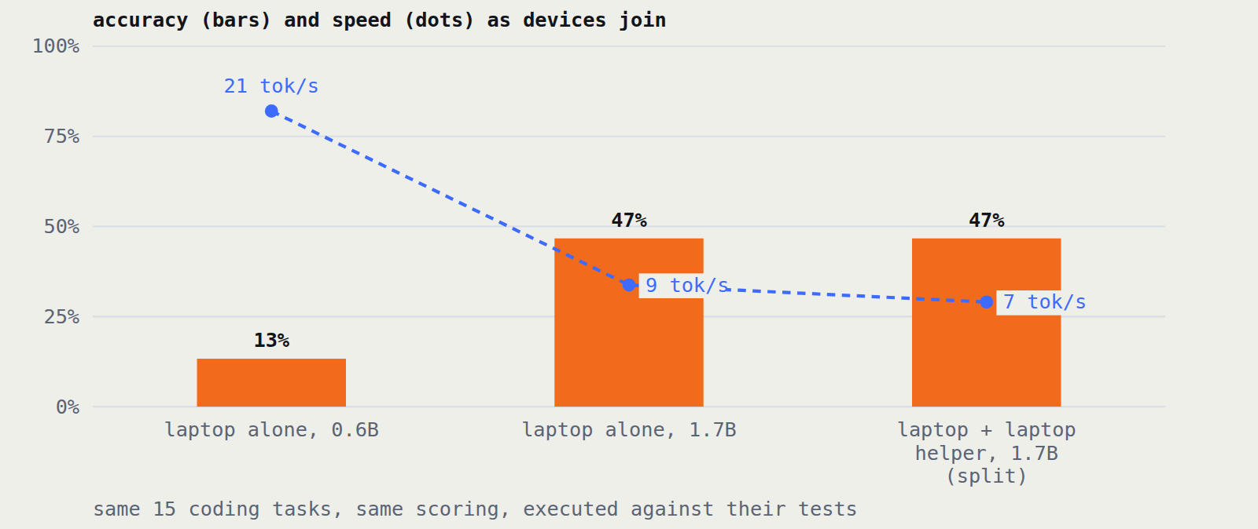




MESH AI
IQOO HACKATHON 2026 · DEVELOPER TOOLS
THE EVIDENCE
TEAM MAYNARDS
PRAJWAL GUNNALA · YUVA RAJ AMBATI

Slide 15
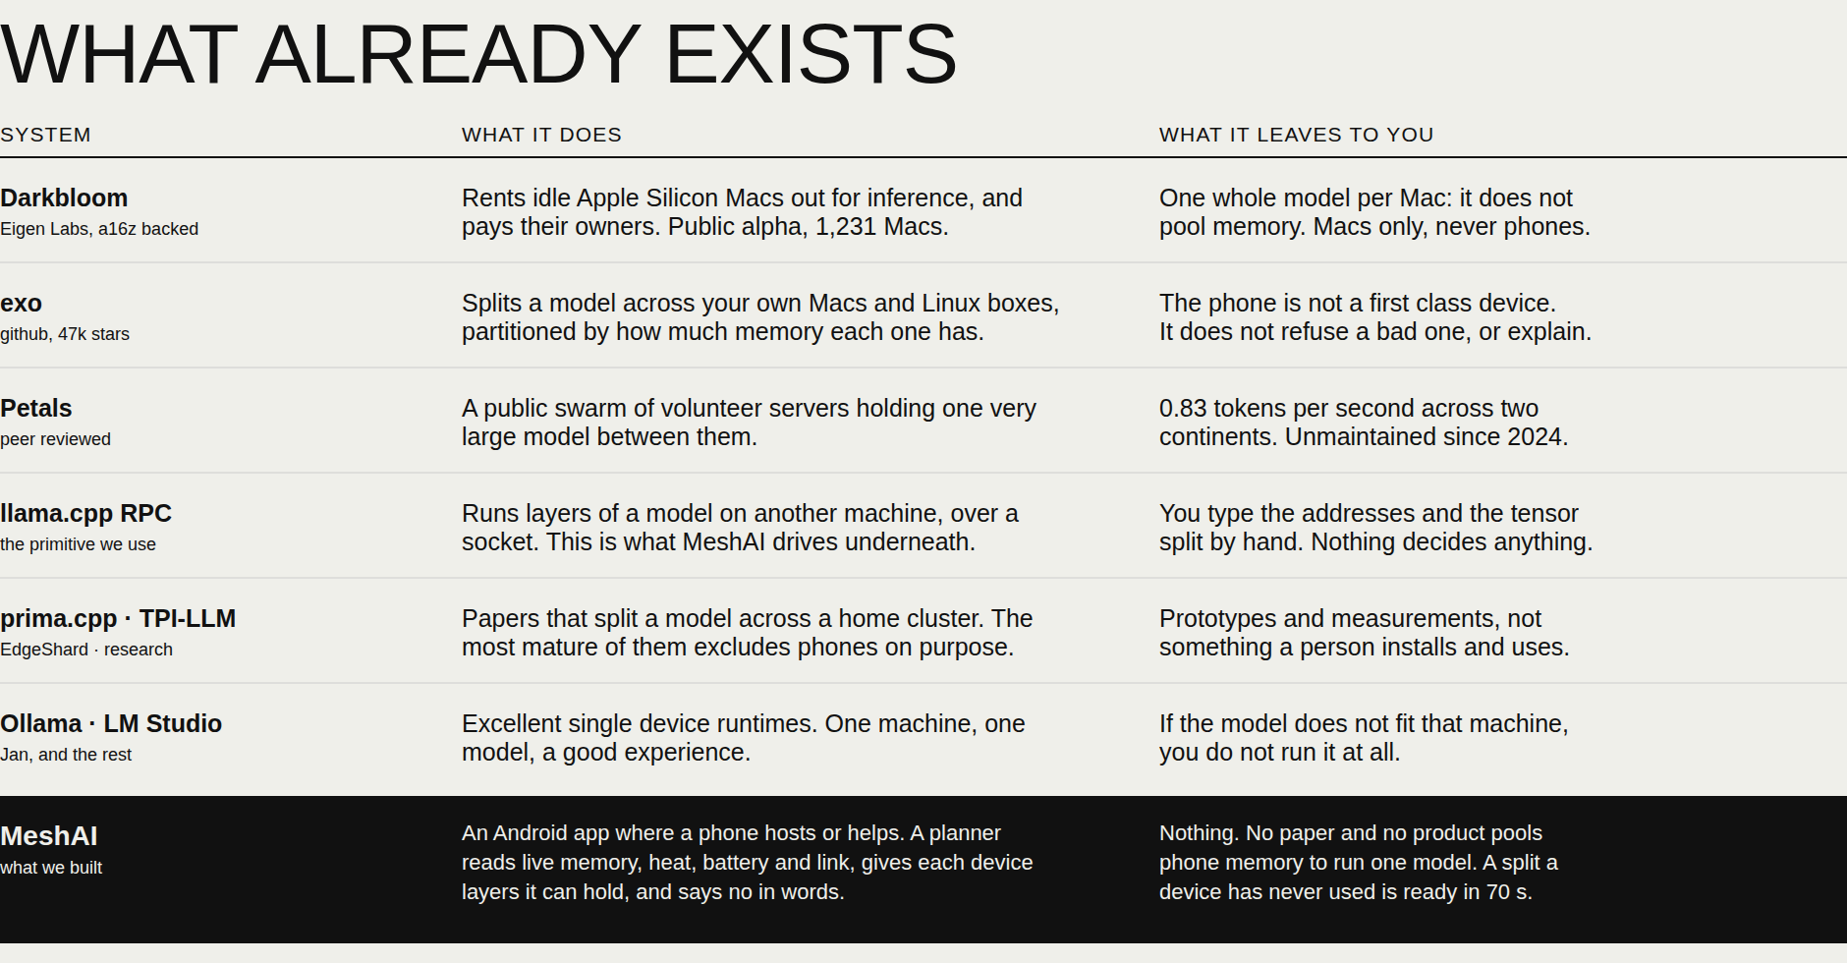
MESH AI
IQOO HACKATHON 2026 · DEVELOPER TOOLS
TEAM MAYNARDS
PRAJWAL GUNNALA · YUVA RAJ AMBATI

Slide 16
MESH AI
IQOO HACKATHON 2026 · DEVELOPER TOOLS
THE NUMBERS
30B RUNNING ACROSS THREE DEVICES, 18.6 GB POOLED
PHONES HOLD 9.6 GB OF IT, THE LAPTOP HOLDS THE HEAD
READY IN 70 SECONDS, 6.6 TOKENS PER SECOND
4 KB CROSSES PER WORD, 18.6 GB NEVER MOVES
TEAM MAYNARDS
PRAJWAL GUNNALA · YUVA RAJ AMBATI

Slide 17
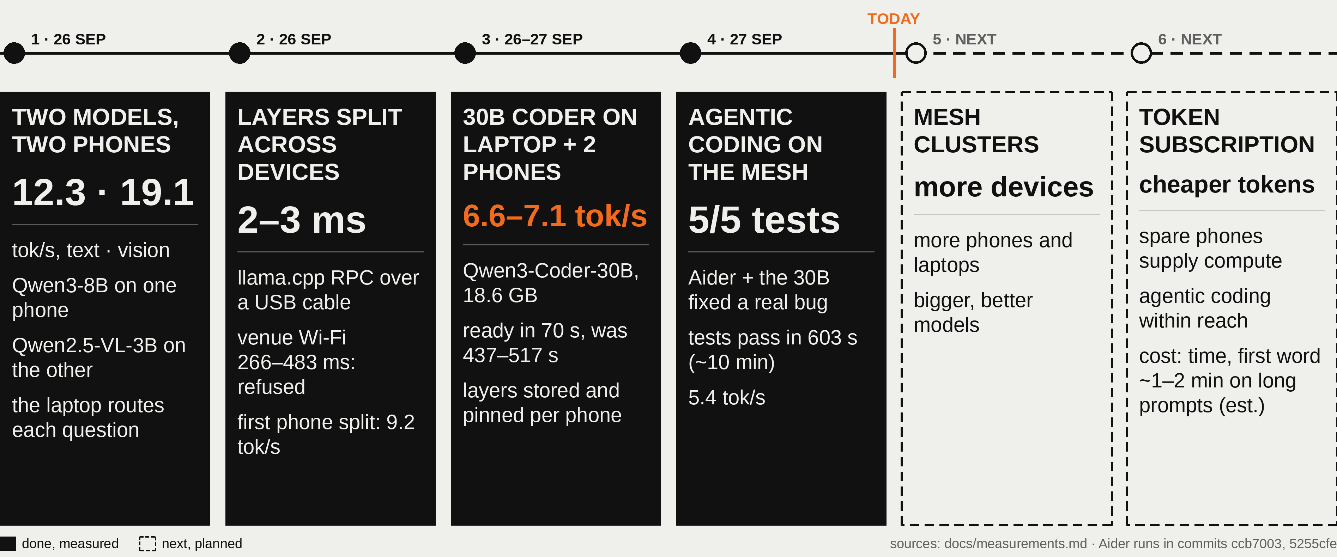
MESH AI
IQOO HACKATHON 2026 · DEVELOPER TOOLS
MILESTONES
TEAM MAYNARDS
PRAJWAL GUNNALA · YUVA RAJ AMBATI

Slide 18
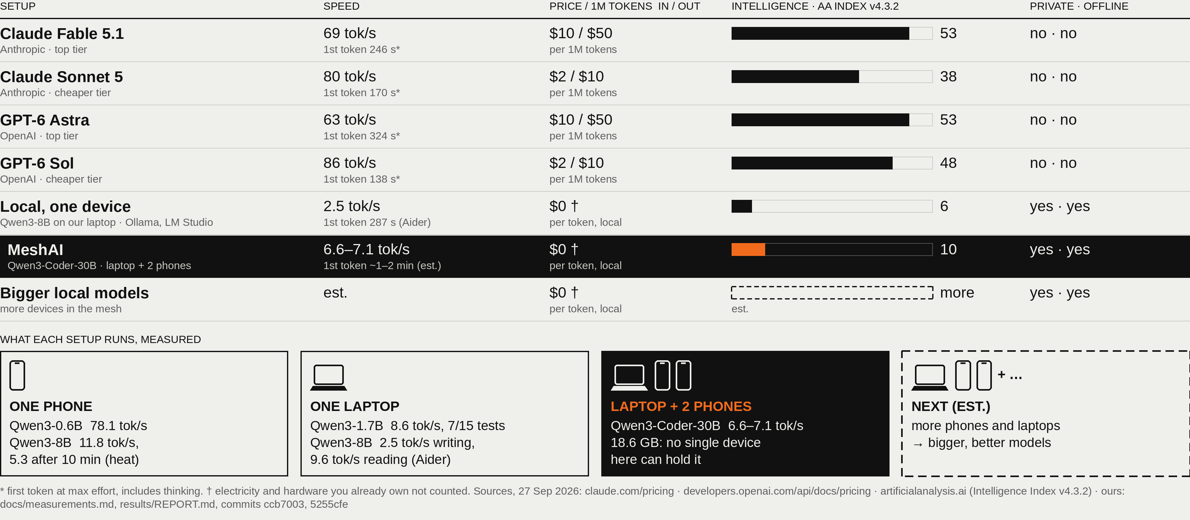
MESH AI
IQOO HACKATHON 2026 · DEVELOPER TOOLS
WHERE WE STAND
TEAM MAYNARDS
PRAJWAL GUNNALA · YUVA RAJ AMBATI

Slide 19



MESH AI
IQOO HACKATHON 2026 · DEVELOPER TOOLS
TEAM MAYNARDS
THANK
YOU
Prajwal Gunnala
github.com/prajwal-gunnala/maynards
Yuva Raj Ambati
every number in this deck is in that repository
TEAM MAYNARDS
PRAJWAL GUNNALA · YUVA RAJ AMBATI

