Slide 1
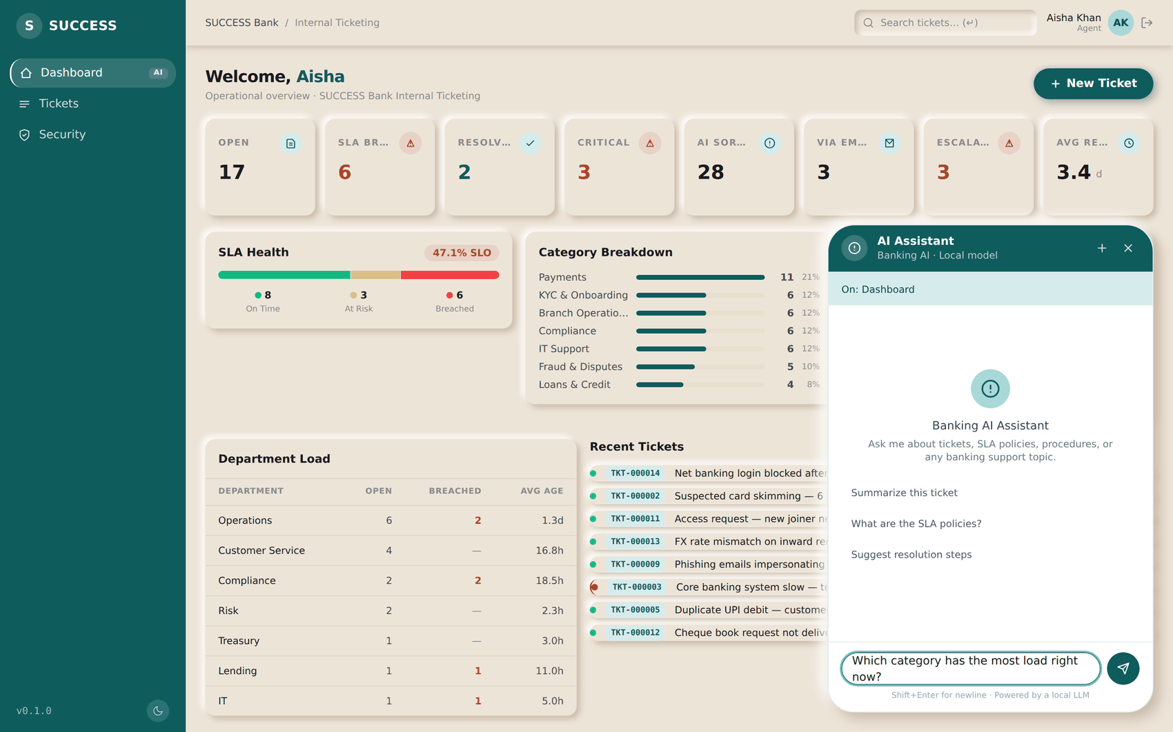
THE AI ASSISTANT
Asking it a question
EVERY ROLE
ON THIS SCREEN
1
The context it is working from
2
Start a fresh conversation
3
Starter prompts — click one to fill the box
4
Ask in plain English; Enter sends
2
1
ASK IT LIKE THIS
“Summarise this ticket for the customer”
“Which category has the most load right now?”
“What is breaching today?”
“What are the SLA policies for critical tickets?”
“Suggest next steps on this one”
3
IT WILL NOT
Change a status, assign a ticket or post a comment. Everything it produces is for you to act on.
4
It answers only from what your role can already open — ask about a hidden ticket and it says so.
SUCCESS Bank — Internal Ticketing · Standard Operating Procedure
AI Assistant

