Slide 1
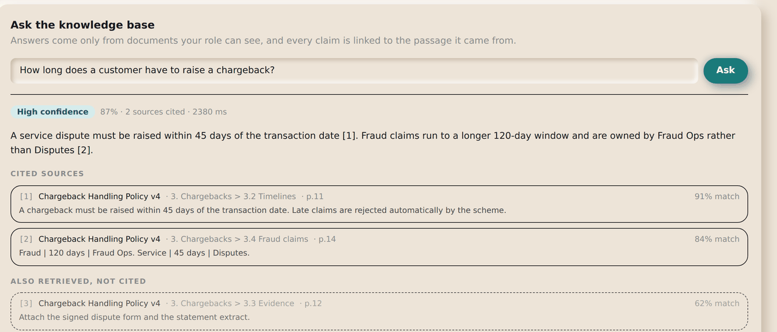
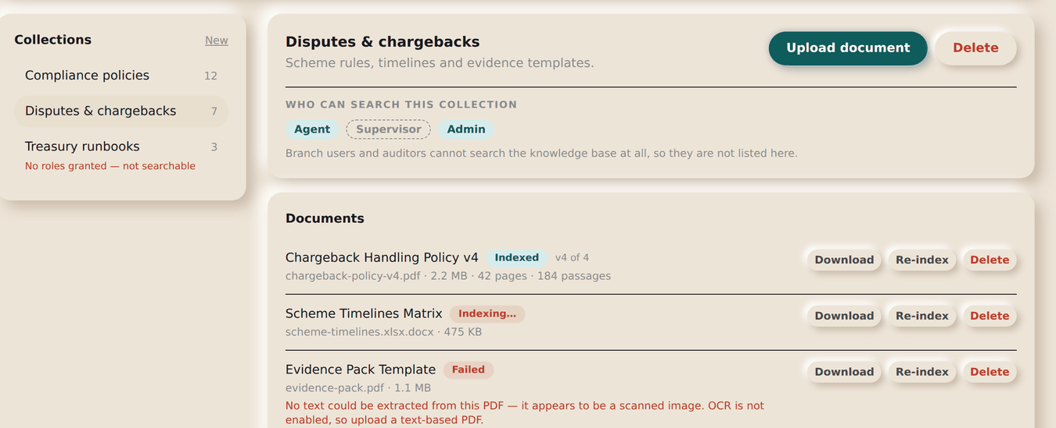
THE KNOWLEDGE BASE
Asking it a question, and keeping it stocked
ASK: AGENT & ABOVE · UPLOAD: ADMIN
ON THIS SCREEN
1
Ask in plain words — no query syntax
1
2
Confidence band, computed from the evidence
rather than claimed by the model
2
3
3
Every factual sentence carries its source [n]
4
Cited sources: document, section and page
4
5
Also retrieved but not cited — shown so you
can see what was weighed
6
Admins upload PDF, Word, Markdown, text or CSV
7
Which roles may search this collection
5
8
A collection nobody can read is flagged,
not left to fail silently
9
A document that failed to index says why
6
WHY YOU CAN TRUST THE ANSWER
Retrieval is filtered by your role before the model sees anything, so it cannot quote a document you could not open yourself. Every citation is checked against what was actually retrieved — an invented one is removed along with the sentence it supported.
8
7
WHEN IT HAS NOTHING
It says so and stops, rather than guessing. That is the correct answer, not a failure.
9
SUCCESS Bank — Internal Ticketing · Standard Operating Procedure
Knowledge Base

