Slide 1
STANDARD OPERATING PROCEDURE
SUCCESS Bank
Internal Ticketing
A role-by-role operational guide.
Every screen in this deck was captured from the running application.
Branch User
Agent
Supervisor
Admin
Auditor
raises the ticket
works and resolves it
watches SLA and escalations
configures the system
reads everything, changes nothing
Version 1.0 · Built at commit 37f71d3

Slide 2
How to use this deck
Read it in order the first time; use Section 14 as a desk reference after that
WHAT THIS IS
A step-by-step operational guide. Each role is taken from signing in to a finished ticket, using screens captured from the running application.
Every workflow slide follows the same shape: what you do, what the system does back, and who picks it up next.
FIND YOUR ROLE
Branch User
Section 6
You raise tickets and follow them
Agent
Section 7
You work and resolve them
Supervisor
Section 8
WHAT IT IS NOT
You watch SLA and escalations
Not a feature tour, and not a specification. Where the system does not do something people often expect — approvals, in-app notifications, ticket merging — this deck says so rather than staying silent.
Admin
Section 9
You configure the system
Auditor
Section 10
You review; you change nothing
SUCCESS Bank — Internal Ticketing · Standard Operating Procedure
Overview

Slide 3
SECTION 02
What the system is for
One record for every operational problem, from the moment it is raised to the moment it is closed.
SUCCESS Bank — Internal Ticketing · Standard Operating Procedure
Section 02

Slide 4
The problem it replaces
Why a shared record beats a shared inbox
Without it
With it
A blocked card is reported by phone. A duplicated debit goes to somebody's inbox. Nobody can say how long either has been open, who owns it, or what was decided.
Every problem gets a number, an owner, a deadline and a history. Months later an auditor can answer who changed what, and when.
HOW A TICKET ARRIVES
Portal
Email
A branch user fills in the form and attaches evidence
A message to the support mailbox becomes a ticket automatically
Email intake is implemented but off by default (IMAP_ENABLED=false) and needs a real mailbox. Everything else in this deck works out of the box.
SUCCESS Bank — Internal Ticketing · Standard Operating Procedure
Overview

Slide 5
SECTION 03
Roles and permissions
Five roles, one per user. This is the whole model — there are no per-user overrides.
SUCCESS Bank — Internal Ticketing · Standard Operating Procedure
Section 03

Slide 6
Who can do what
Enforced server-side in core/authz.py — the interface only hides what the API would refuse anyway
Role | Tickets | Assignment | Users & org | Audit | Escalations
Branch User | Own only — raise, comment, attach | — | — | — | —
Agent | Any in scope — progress, resolve | Assign to a person | — | — | —
Supervisor | As agent | Also auto-assign, rules, leave | Read directory | — | Yes
Admin | As agent | As supervisor, plus the delay | Full control | Yes | Yes
Auditor | Read only — no writes at all | — | — | Yes | —
Super admin is a second tier on top of Admin, not a sixth role. Only a super admin can create another super admin or change one's password — otherwise any admin could take over the account.
The auditor is read-only everywhere. It can open any ticket, dashboard and report, and every attempt to write is refused with a 403 — including comments and attachments.
SUCCESS Bank — Internal Ticketing · Standard Operating Procedure
Roles

Slide 7
SECTION 04
The ticket lifecycle
Nine statuses. The API enforces which moves are legal — an illegal jump is refused, not merely discouraged.
SUCCESS Bank — Internal Ticketing · Standard Operating Procedure
Section 04

Slide 8
Status flow
Reproduced from VALID_TRANSITIONS in ticket_service.py — these are the only legal moves
new
acknowledged
assigned
in_progress
resolved
closed
Both pause the ticket and
both return to in_progress.
on_hold
escalated
closed can be reopened; it
returns to assigned.
reopened
TWO RULES PEOPLE GET WRONG
closed is reachable from any open state
Closing early is a withdrawal — the problem went away, or it was raised in error.
resolved is NOT reachable from assigned
The ticket must have been worked first, so 'resolved' means something.
SUCCESS Bank — Internal Ticketing · Standard Operating Procedure
Lifecycle

Slide 9
SECTION 05
End to end, across the roles
The seams matter more than the steps. This is where a ticket changes hands.
SUCCESS Bank — Internal Ticketing · Standard Operating Procedure
Section 05

Slide 10
Who holds the ticket, and when
Left to right in time; each band is one role
Raise ticket
+ attach evidence
See resolution,
close or reopen
BRANCH USER
Take it,
investigate
Reply
+ attach fix
Resolve
AGENT
Assign, or
auto-assign
Review,
reassign
SUPERVISOR
Number it,
stamp SLA
SLA breach?
escalate
SYSTEM
The connectors are the handoffs. Two of them are a person deciding: the supervisor choosing an owner, and the branch user closing or reopening. The rest happen because the system moved the ticket, or because the next role was already watching. Note what the system does not do — it numbers the ticket and starts the clock, but it does not choose who works it.
SUCCESS Bank — Internal Ticketing · Standard Operating Procedure
End to end

Slide 11
SECTION 06
Branch user workflow
You raise the problem, supply the evidence, answer questions, and see the resolution.
SUCCESS Bank — Internal Ticketing · Standard Operating Procedure
Section 06

Slide 12
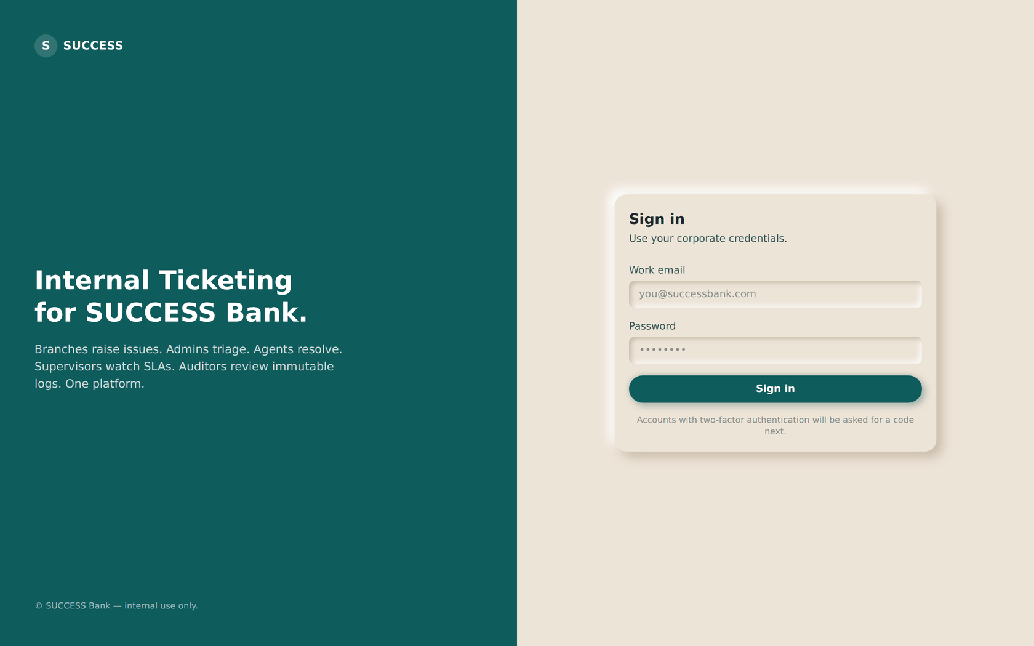
STEP 01
Sign in
BRANCH USER
ON THIS SCREEN
1
Your bank email address
2
Your password
3
Sign in
ACTION
Enter your bank email and password, then select Sign in.
RESULT
1
You land on your dashboard. If your account has a second factor enabled, you are asked for a 6-digit code first.
2
3
NEXT
Step 02 — read your dashboard.
SUCCESS Bank — Internal Ticketing · Standard Operating Procedure
Step 01

Slide 13
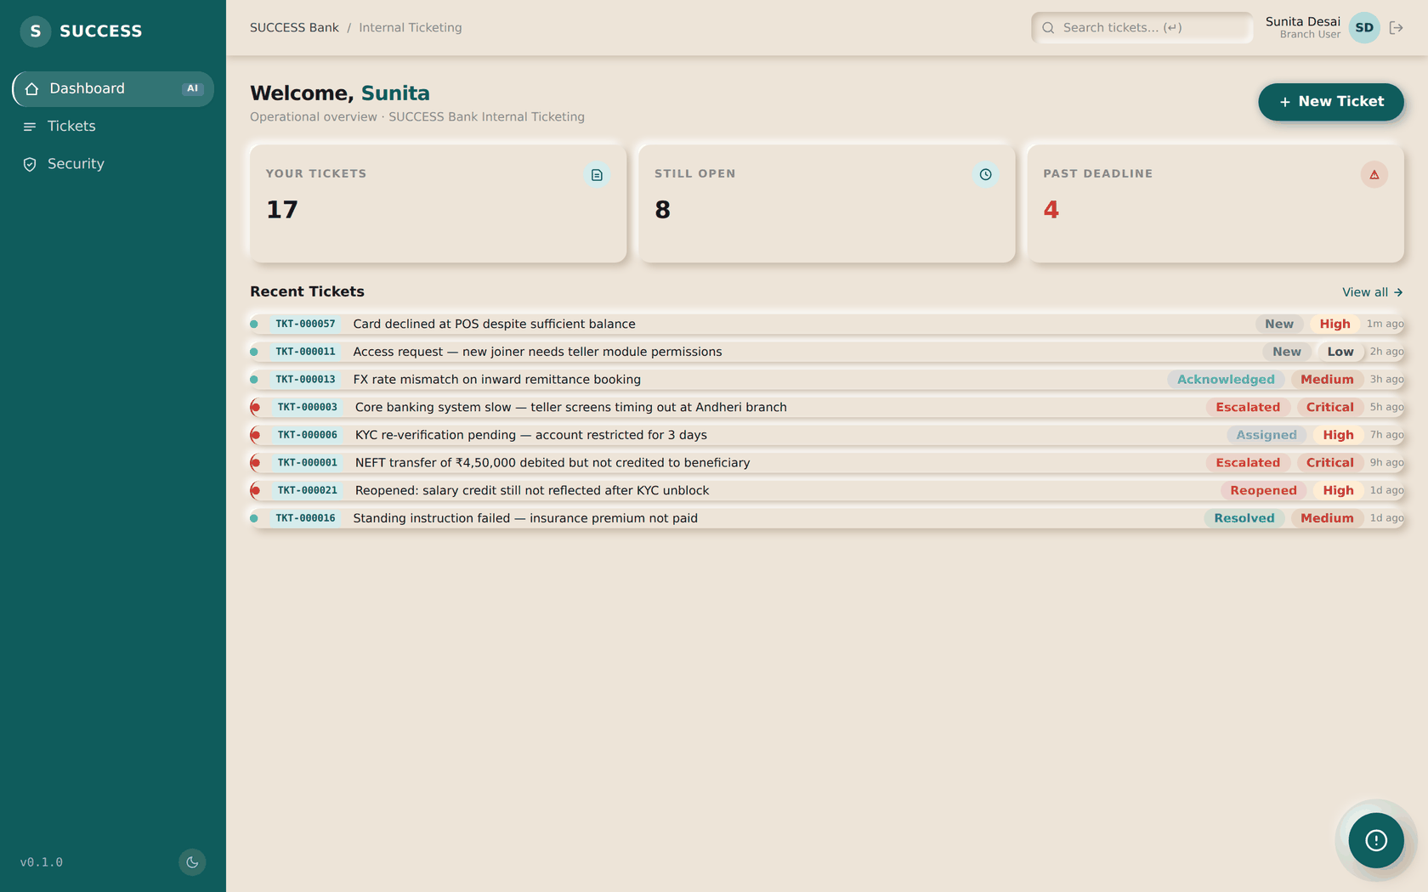
STEP 02
Read your dashboard
BRANCH USER
1
ON THIS SCREEN
1
Dashboard, Tickets and Security — the whole menu for this role
ACTION
Check the tiles for anything of yours that is breaching or still open.
RESULT
Each tile opens the exact list it counts — a tile reading 3 opens three tickets.
NEXT
Step 03 — open the ticket list.
SUCCESS Bank — Internal Ticketing · Standard Operating Procedure
Step 02

Slide 14
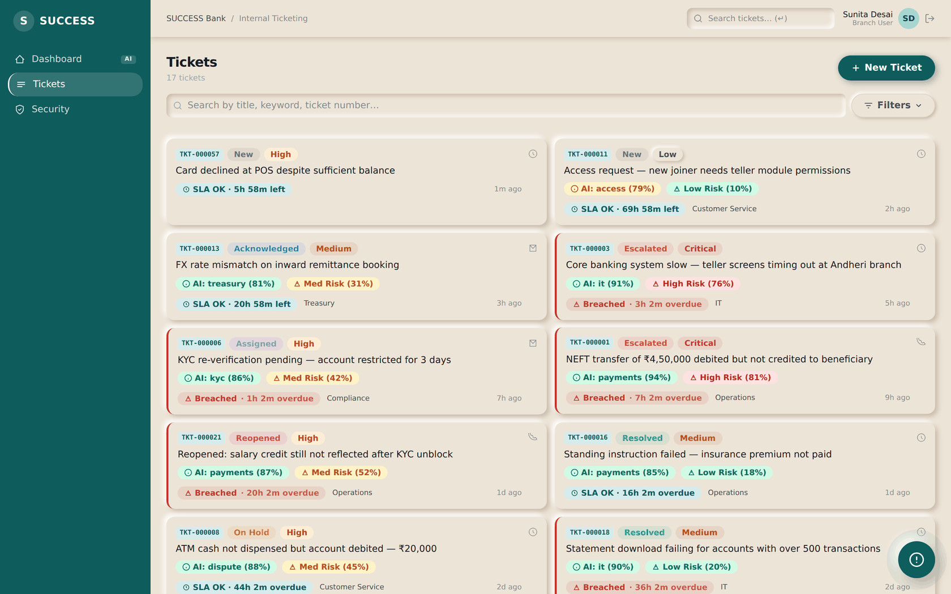
STEP 03
See only your own tickets
BRANCH USER
ON THIS SCREEN
1
Search and filters
2
2
New Ticket
1
ACTION
Scan the list, or filter to what you are looking for.
RESULT
You see only tickets you raised. This is enforced by the server, not hidden by the page.
NEXT
Step 04 — raise a new ticket.
SUCCESS Bank — Internal Ticketing · Standard Operating Procedure
Step 03

Slide 15
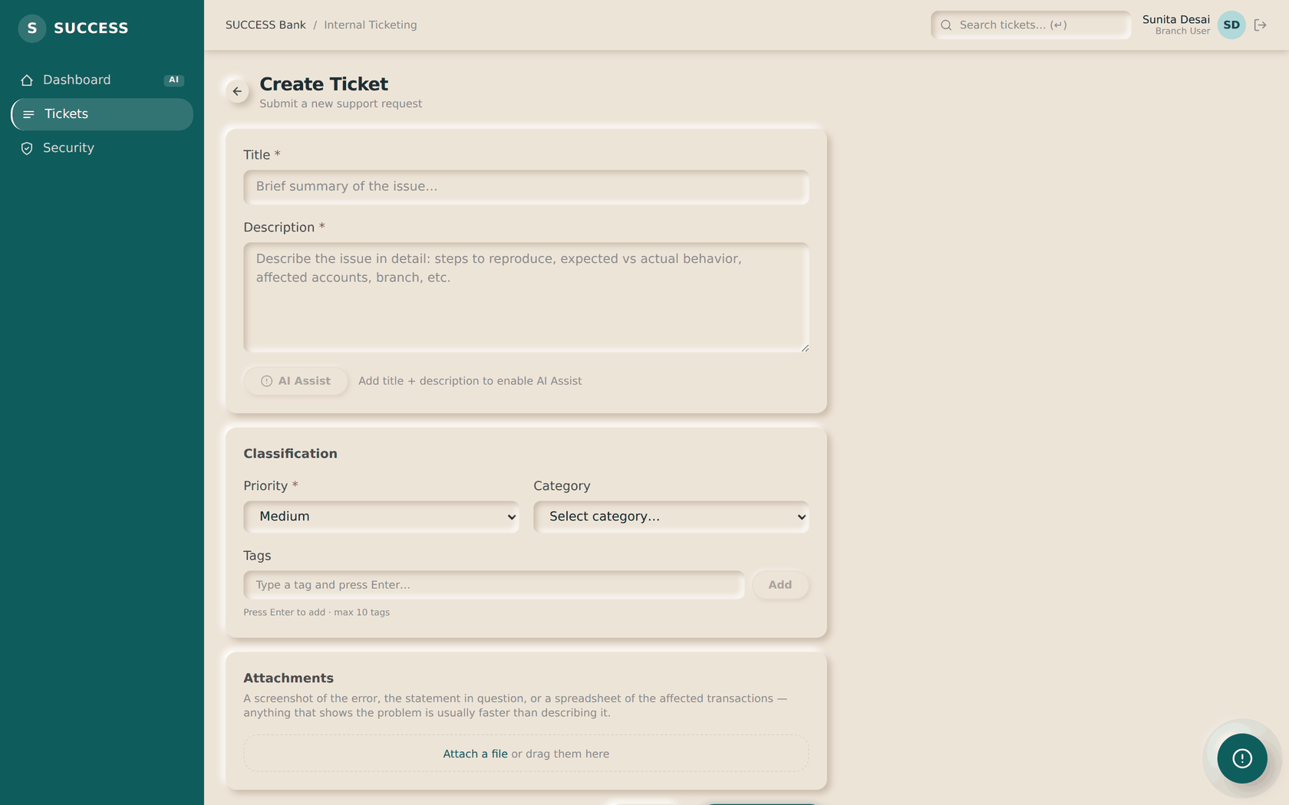
STEP 04
Open the new ticket form
BRANCH USER
ON THIS SCREEN
1
Title — one line naming the problem
2
Description — what happened, and for whom
1
3
Priority
ACTION
2
Select New Ticket from the ticket list.
RESULT
An empty form opens. Nothing is submitted until you choose Create Ticket.
NEXT
3
Step 05 — fill it in and attach evidence.
SUCCESS Bank — Internal Ticketing · Standard Operating Procedure
Step 04

Slide 16
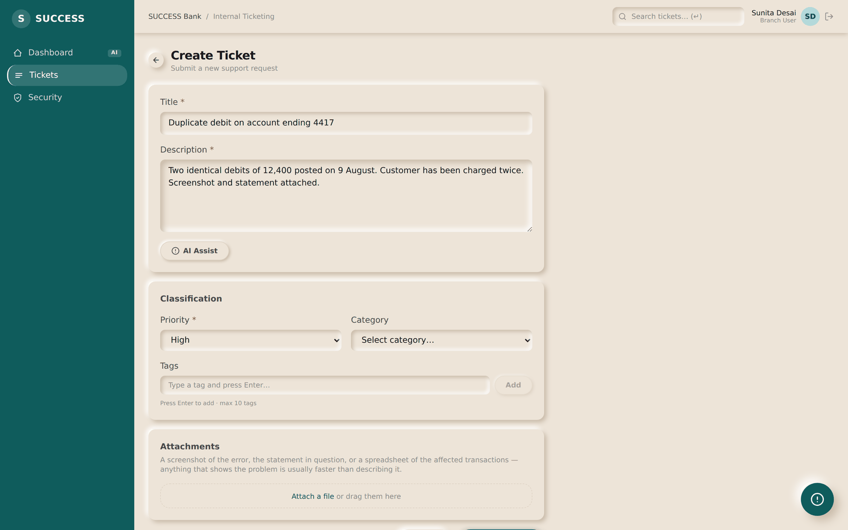
STEP 05
Describe it, and attach the evidence
BRANCH USER
ON THIS SCREEN
1
Be specific: account, amount, date
2
What happened, and what the customer expects
1
3
Priority and category
4
Attach evidence — drag files here, or choose them
2
ACTION
Complete the form and attach a screenshot, statement or spreadsheet. Up to 15 MB per file; images, PDF, Word, Excel, text and CSV.
3
RESULT
Files are held in the browser and uploaded the moment the ticket is created — so evidence arrives with the report, not after it.
4
NEXT
Step 06 — submit and follow it.
SUCCESS Bank — Internal Ticketing · Standard Operating Procedure
Step 05

Slide 17
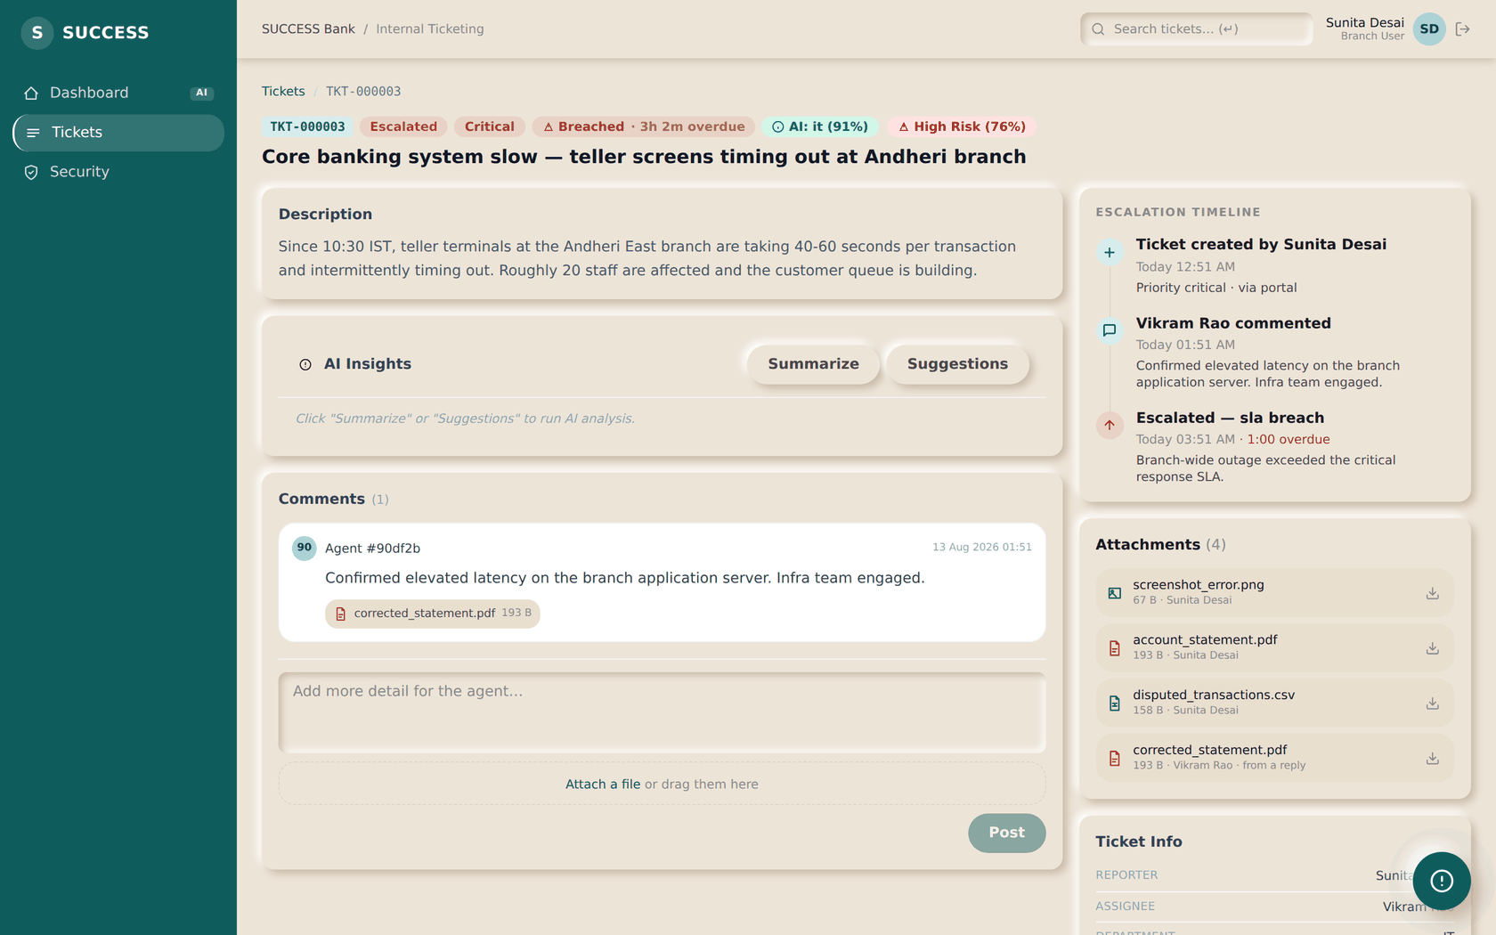
STEP 06
Follow your ticket
BRANCH USER
ON THIS SCREEN
1
Number, status and SLA countdown
2
Your attachments
3
Add more detail for the agent
4
Who owns it now
ACTION
Open the ticket from your list to see where it stands.
1
RESULT
The ticket was numbered, given SLA deadlines and assigned automatically — no one had to triage it by hand.
2
NEXT
Step 07 — answer questions and read the resolution.
3
4
SUCCESS Bank — Internal Ticketing · Standard Operating Procedure
Step 06

Slide 18
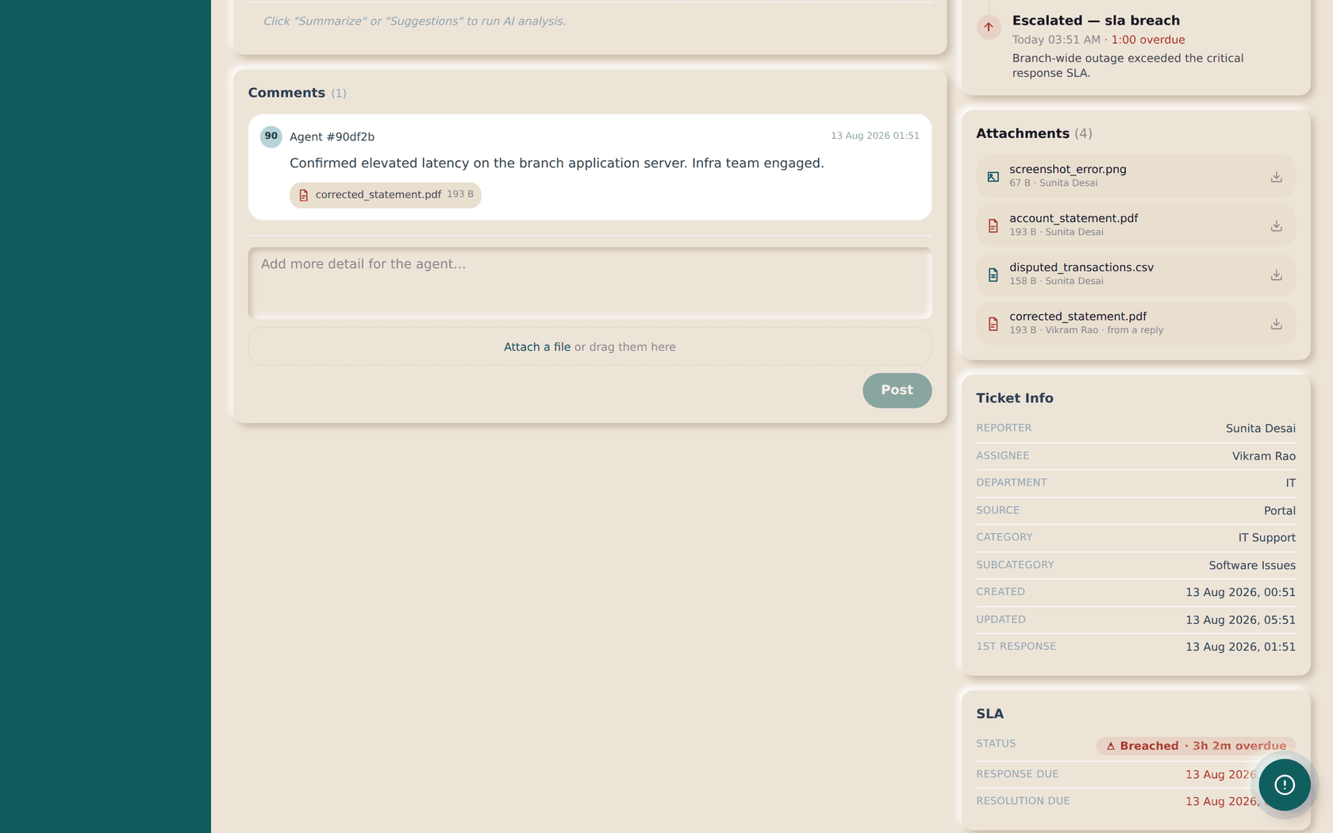
STEP 07
Reply, and read the resolution
BRANCH USER
ON THIS SCREEN
1
1
Replies appear here
2
Attach a file to your reply
ACTION
Answer any question the agent asks, attaching more evidence if needed.
RESULT
2
When the agent resolves it, their explanation and any file they attached appear here together.
NEXT
If it is fixed, the ticket is closed. If not, it can be reopened.
SUCCESS Bank — Internal Ticketing · Standard Operating Procedure
Step 07

Slide 19
What a branch user cannot see
Three rules worth knowing before you ask where something went
Internal notes — and their attachments
Agents can mark a note internal. You will not see the note, and you will not see any file attached to it. It is not hidden in the page; the server refuses to send it.
Other people's tickets
You see only tickets you raised. Opening someone else's by its link returns nothing.
Team-wide numbers
SLA health, category and department breakdowns and AI metrics are for agents and above. Your dashboard shows your own three counts instead.
If you believe a ticket of yours is missing, it is far more likely that it was raised by a colleague than that it was deleted — tickets are never deleted, and every change is recorded in the audit trail.
SUCCESS Bank — Internal Ticketing · Standard Operating Procedure
Branch User

Slide 20
SECTION 07
Agent workflow
You pick the ticket up, investigate, keep the requester informed, and resolve it.
SUCCESS Bank — Internal Ticketing · Standard Operating Procedure
Section 07

Slide 21
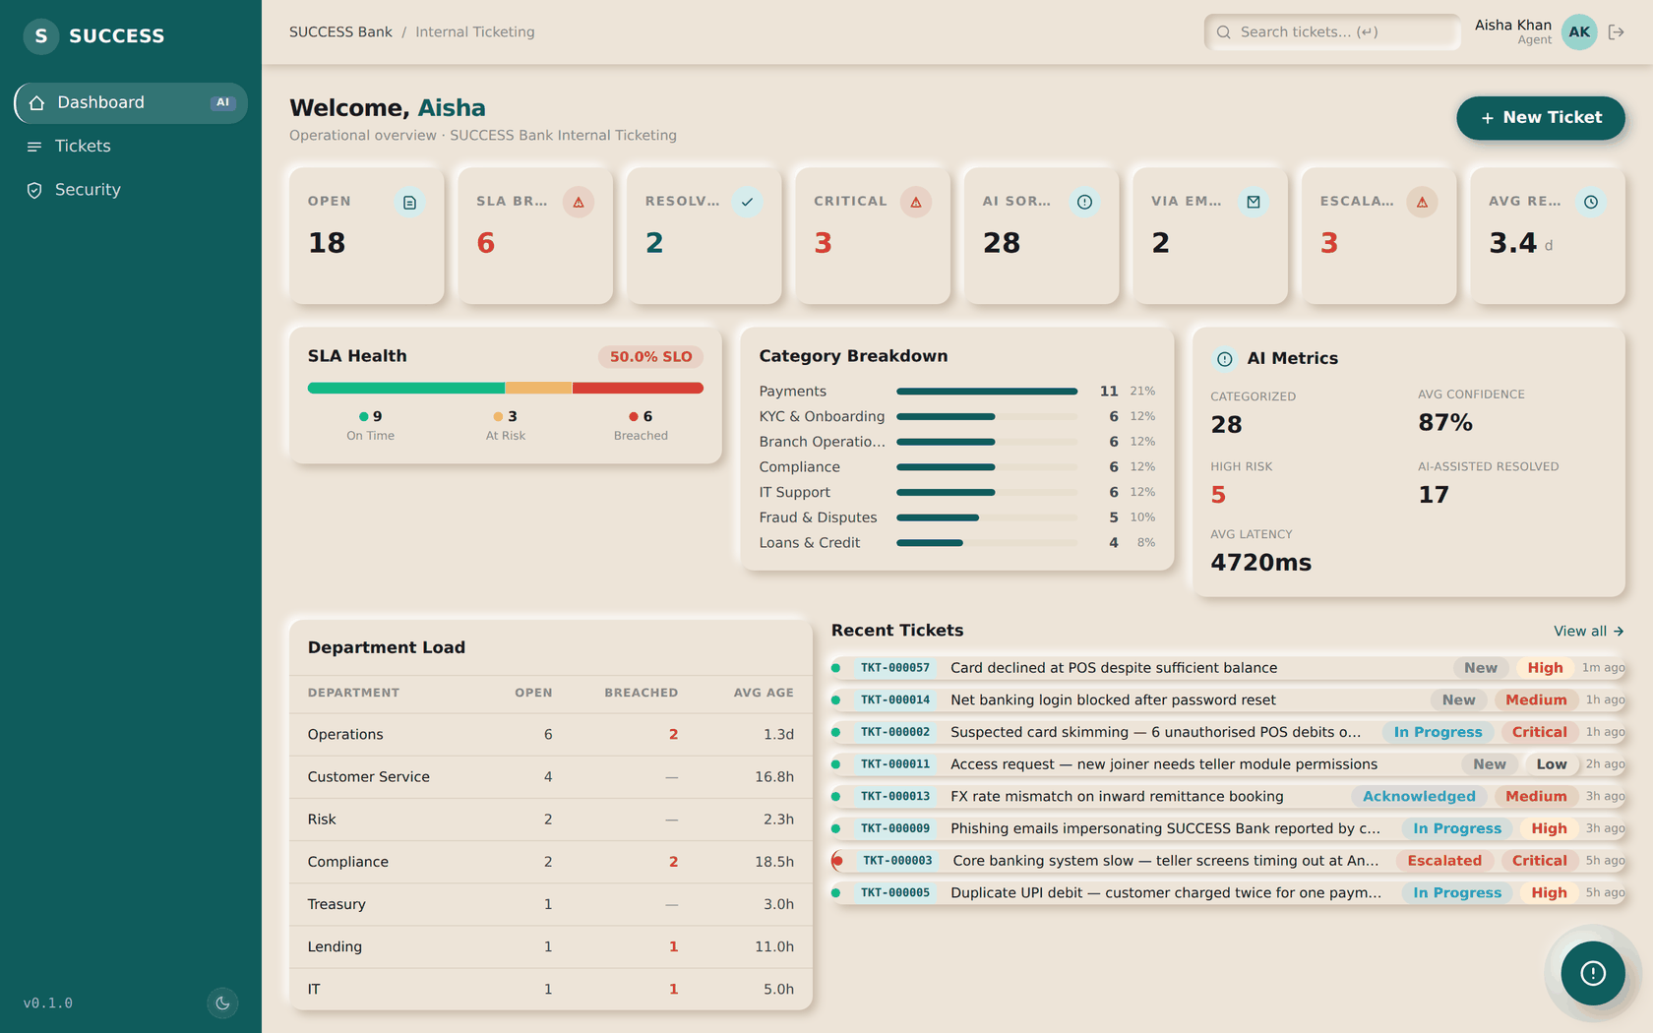
STEP 08
Start from the dashboard
AGENT
ON THIS SCREEN
1
SLA Breached — deal with these first
2
Critical open
1
2
3
AI panel
ACTION
Sign in and read the KPI strip before opening anything.
3
RESULT
Every tile is a live count and opens the exact list behind it.
NEXT
Step 09 — open the queue.
SUCCESS Bank — Internal Ticketing · Standard Operating Procedure
Step 08

Slide 22
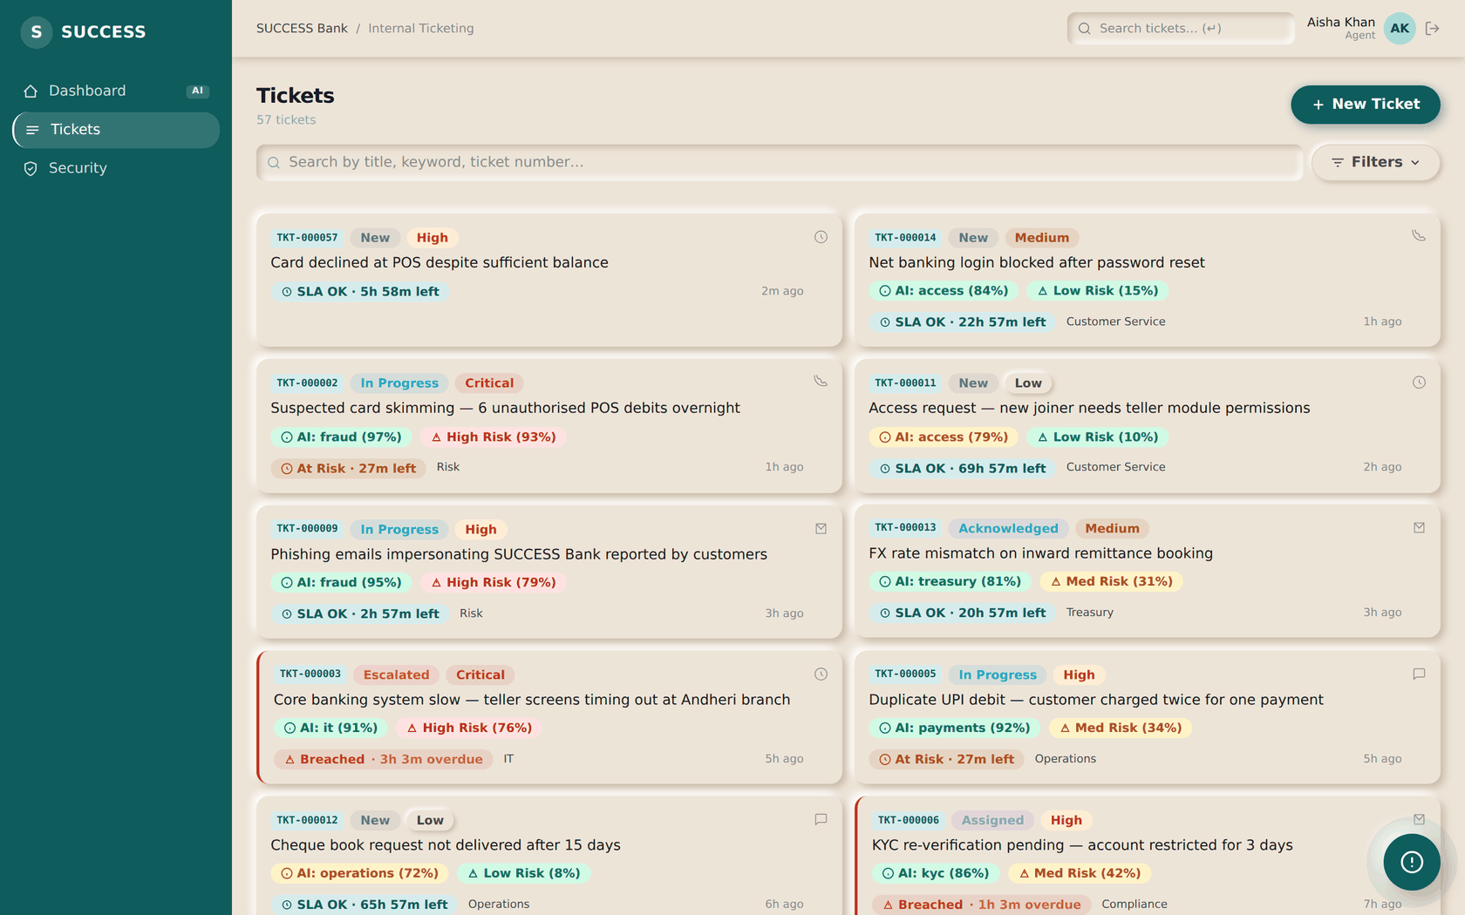
STEP 09
Work the queue
AGENT
ON THIS SCREEN
1
Filter by status, priority or owner
1
ACTION
Filter to unassigned or to your own, and choose what to work on.
RESULT
Agents see every ticket in their org scope, not just their own.
NEXT
Step 10 — start with what is breaching.
SUCCESS Bank — Internal Ticketing · Standard Operating Procedure
Step 09

Slide 23
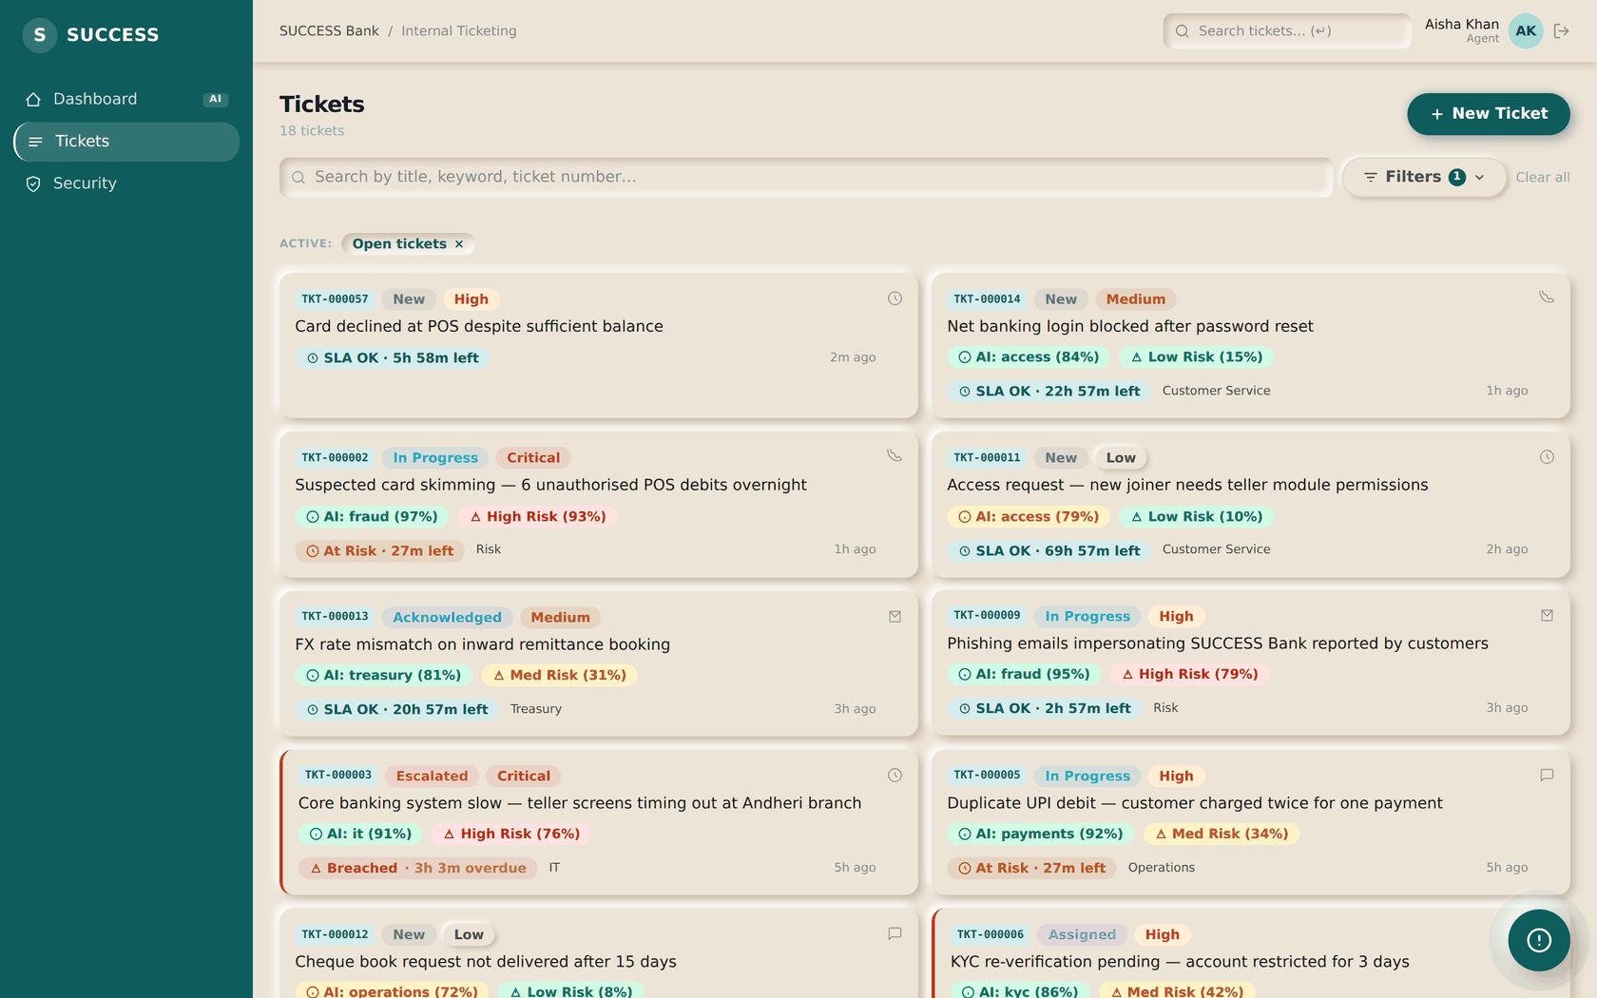
STEP 10
Deal with breaches first
AGENT
ON THIS SCREEN
1
The filter the tile applied
1
ACTION
Select the SLA Breached tile on the dashboard.
RESULT
The list is filtered to exactly the tickets the tile counted — the number on the card and the length of this list always agree.
NEXT
Step 11 — open one and investigate.
SUCCESS Bank — Internal Ticketing · Standard Operating Procedure
Step 10

Slide 24
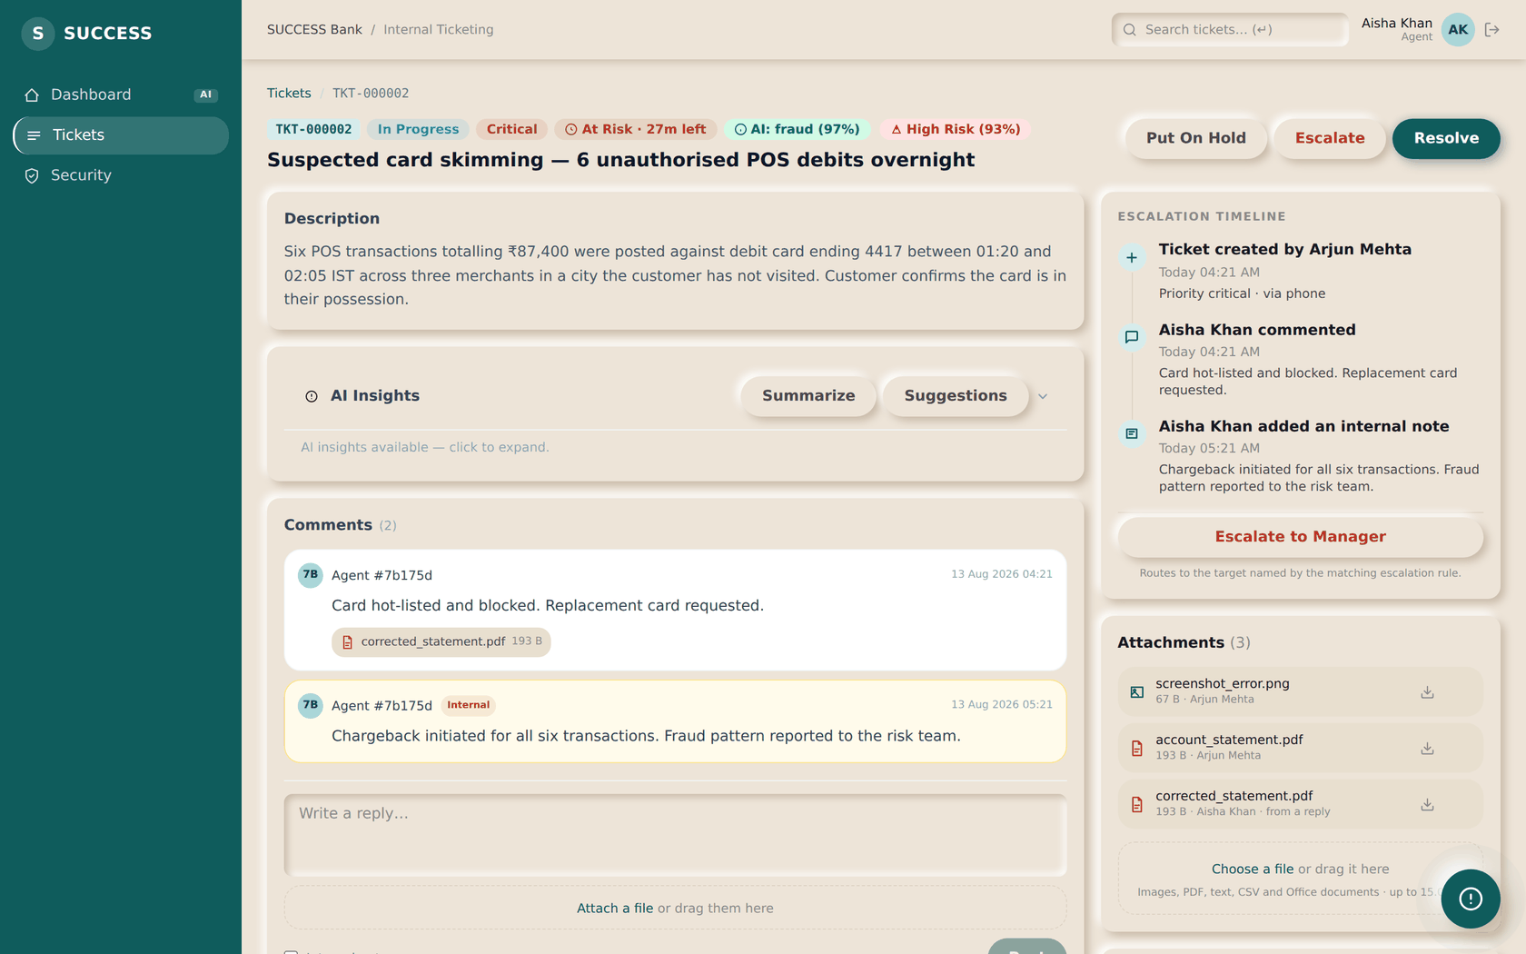
STEP 11
Investigate the ticket
AGENT
ON THIS SCREEN
1
The problem as reported
2
Status, SLA countdown, AI category and risk
1
2
3
AI Insights — summarise or suggest
4
Evidence the requester attached
ACTION
3
Read the description and the attached evidence, then move the ticket to In Progress.
RESULT
The status change is recorded in the audit trail with your name, and the first-response clock stops.
4
NEXT
Step 12 — reply, and attach the fix.
SUCCESS Bank — Internal Ticketing · Standard Operating Procedure
Step 11

Slide 25
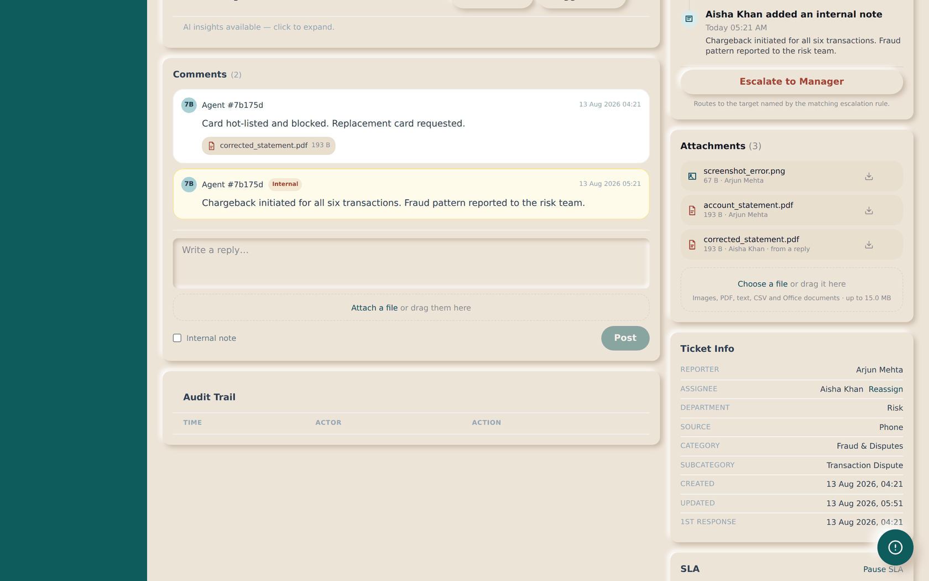
STEP 12
Reply — and attach the fix to your reply
AGENT
ON THIS SCREEN
1
Your reply
2
Attach files to this reply
ACTION
Write what you found and attach the corrected statement or screenshot.
RESULT
Files attached here belong to this reply, so the requester sees your fix beside the answer that explains it.
1
2
NEXT
Step 13 — resolve, or escalate.
SUCCESS Bank — Internal Ticketing · Standard Operating Procedure
Step 12

Slide 26
Resolve, or escalate — and what each means
Both are one action on the ticket page
Resolve
Use when the problem is fixed. Only available once the ticket has been worked — you cannot jump straight from Assigned to Resolved, which is what makes 'resolved' mean something.
Escalate
Use when it needs someone else. The ticket moves to Escalated, is reassigned to the least-loaded holder of the target role, and an escalation event is recorded. Escalating twice for the same reason does nothing — the second is suppressed.
Put on hold
Use when you are waiting on someone outside the team. The ticket stays open and keeps counting toward your queue.
Closing is always available, from any open state — it means the problem went away or the ticket was raised in error, not that it was solved.
SUCCESS Bank — Internal Ticketing · Standard Operating Procedure
Agent

Slide 27
SECTION 08
Supervisor workflow
You watch the deadlines and the escalations, and step in before a breach becomes a complaint.
SUCCESS Bank — Internal Ticketing · Standard Operating Procedure
Section 08

Slide 28
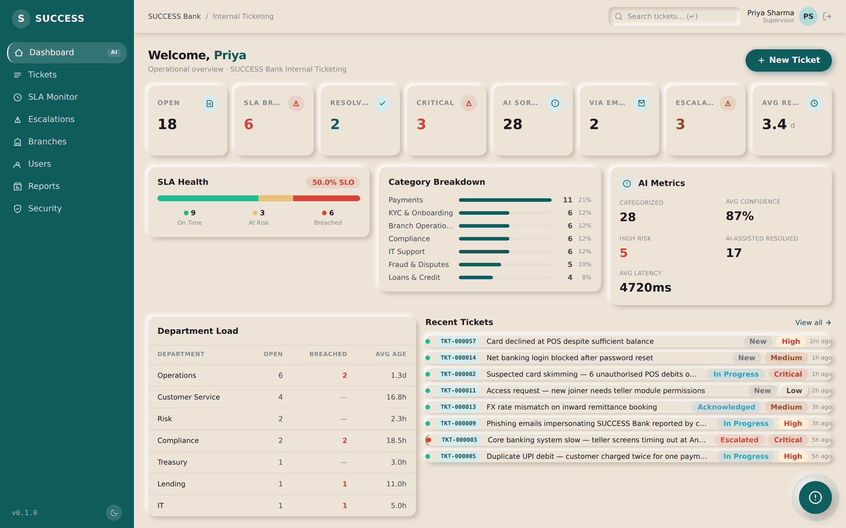
STEP 13
Watch the team's position
SUPERVISOR
1
ON THIS SCREEN
1
SLA Monitor and Escalations in the menu
2
Breached — the number that matters most
2
ACTION
Read the strip; anything breaching needs an owner today.
RESULT
Supervisors see the same tiles as agents, plus the SLA monitor and escalation queue in the menu.
NEXT
Step 14 — open the SLA monitor.
SUCCESS Bank — Internal Ticketing · Standard Operating Procedure
Step 13

Slide 29
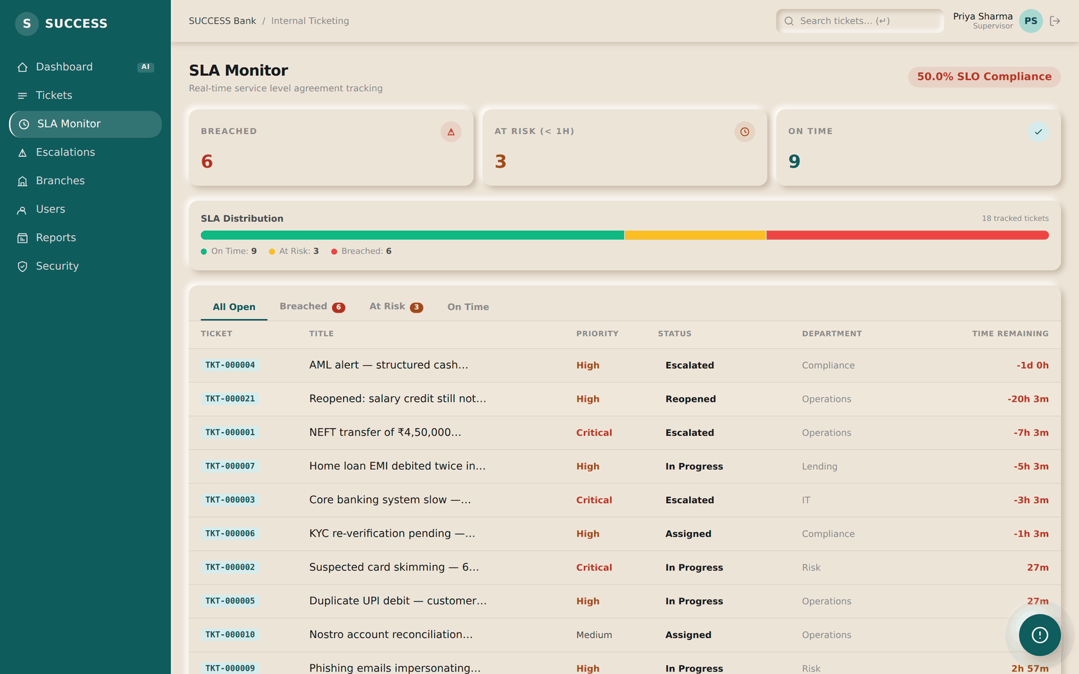
STEP 14
Read the SLA monitor
SUPERVISOR
ACTION
Work down from the tickets nearest their deadline.
RESULT
At risk means due within the hour. Breached means the deadline has already passed and, if a rule matched, escalation has already fired.
NEXT
Step 15 — review escalations.
SUCCESS Bank — Internal Ticketing · Standard Operating Procedure
Step 14

Slide 30
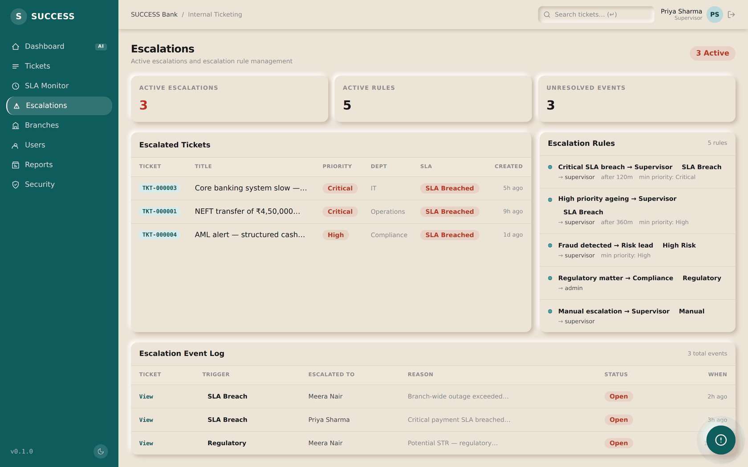
STEP 15
Review the escalation queue
SUPERVISOR
ACTION
Check what escalated and whether the target is acting on it.
RESULT
Escalations arrive here whether raised by hand or fired automatically by the SLA worker — both run the same engine, so the evidence is identical.
NEXT
Reassign if the target is wrong; otherwise the agent resolves it.
SUCCESS Bank — Internal Ticketing · Standard Operating Procedure
Step 15

Slide 31
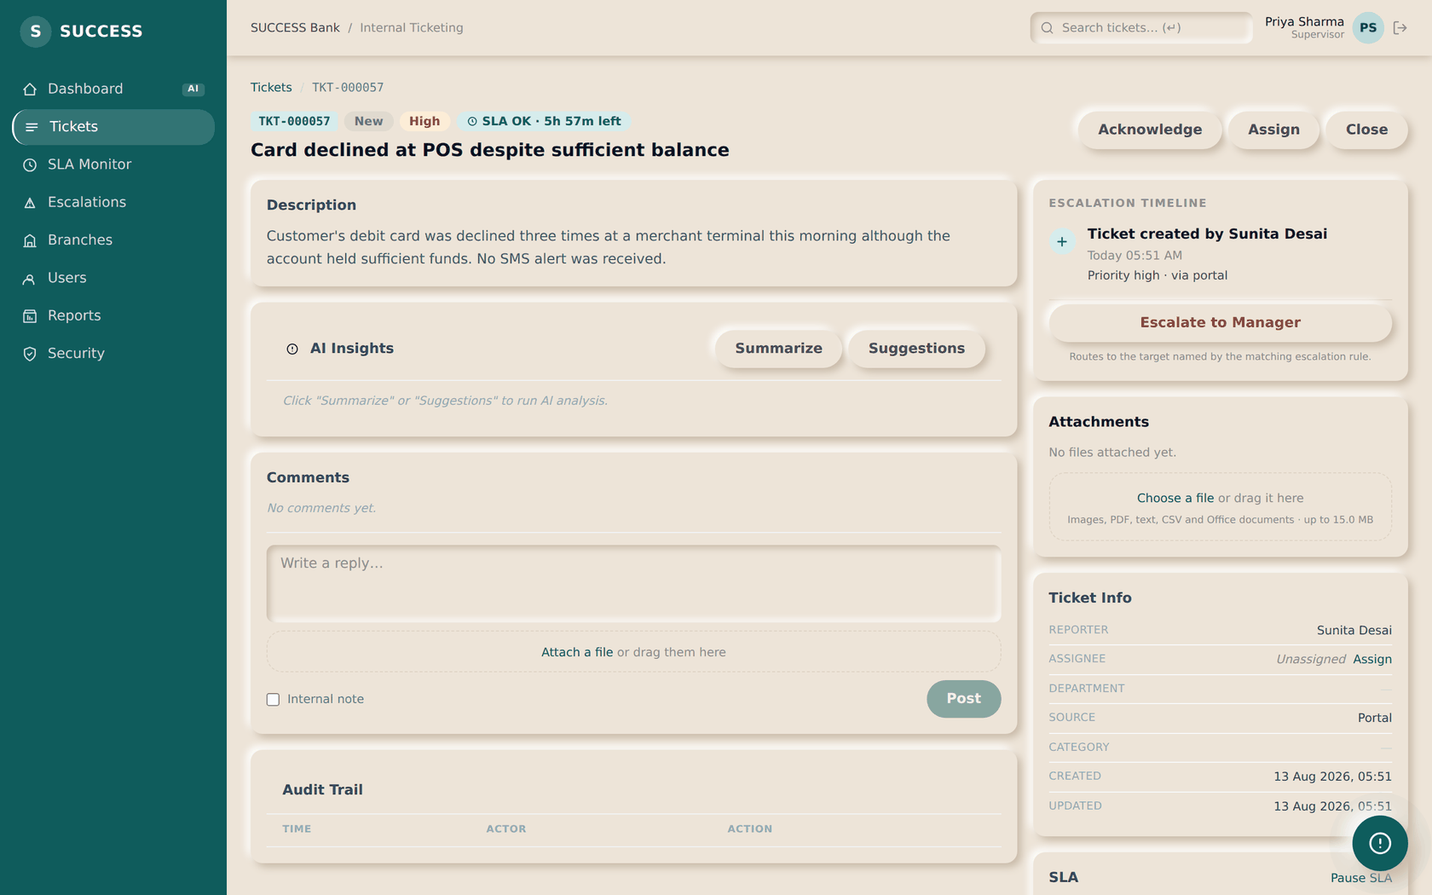
STEP 16
Decide who works it
SUPERVISOR
ON THIS SCREEN
1
No owner yet — raising a ticket does not choose one
2
Open the assign list
ACTION
Open a ticket with no owner and select Assign.
RESULT
Raising a ticket stamps its SLA deadlines but does not choose an owner. That is deliberate: who carries the work is a shift decision, and a machine making it at 2am is how tickets end up with whoever happens to be idlest rather than whoever should have them.
1
2
NEXT
Step 17 — pick a person, or let the router pick.
SUCCESS Bank — Internal Ticketing · Standard Operating Procedure
Step 16

Slide 32
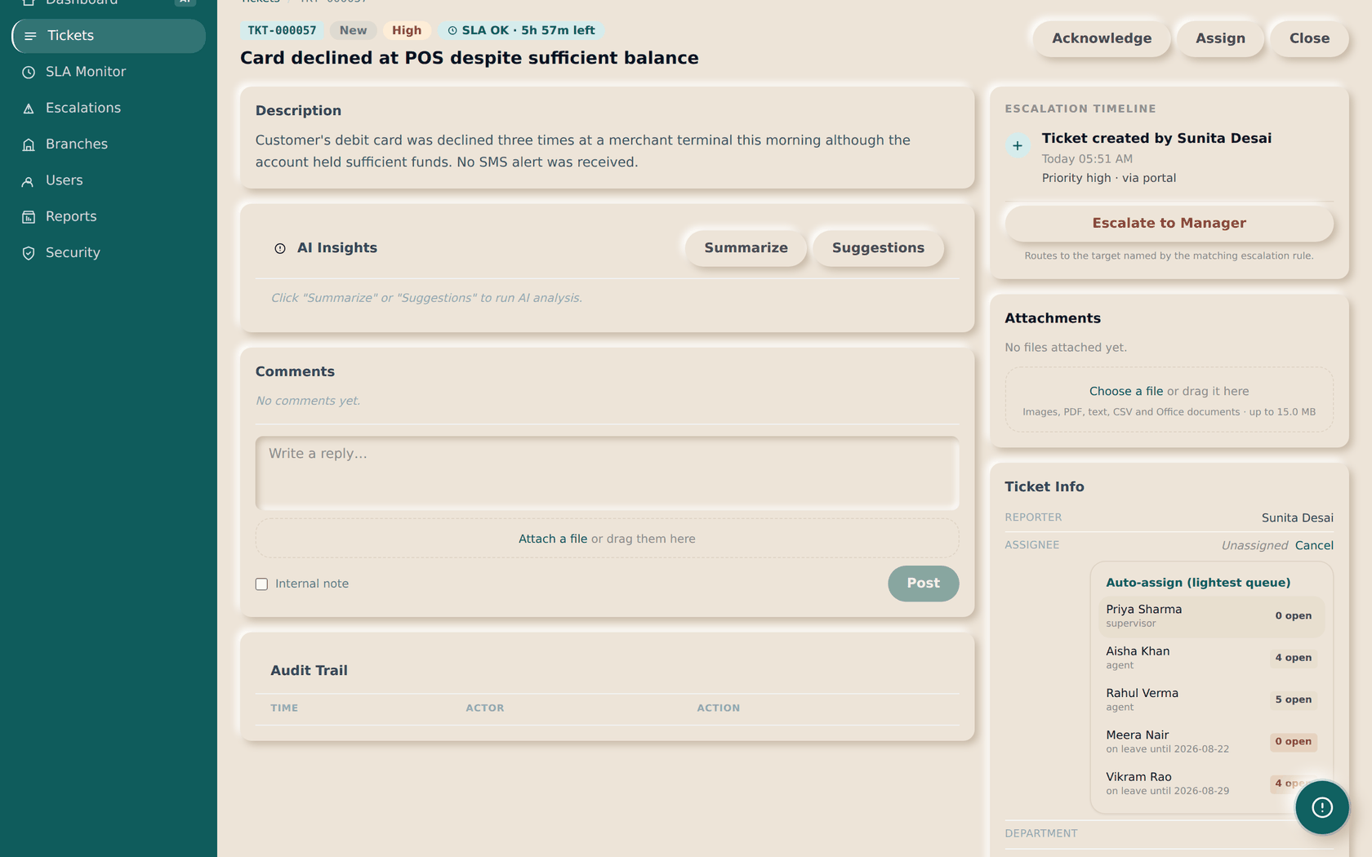
STEP 17
Pick a person, or let the router pick
SUPERVISOR
ON THIS SCREEN
1
Hand the choice to the router
2
Each candidate's open queue — what the router ranks on
3
Anyone on leave is marked, and sorted to the bottom
ACTION
Choose a name, or select Auto-assign to take the lightest queue.
RESULT
Each name shows the number of open tickets that person is already carrying — the same number the router ranks on, so you can see what you are overriding. Anyone on leave is labelled with their return date and sorted to the bottom. You can still assign to them knowingly; auto-assign will not.
1
2
NEXT
3
The agent picks it up from their queue.
Auto-assign is supervisor and above; an agent may assign a specific ticket.
SUCCESS Bank — Internal Ticketing · Standard Operating Procedure
Step 17

Slide 33
What the router actually does
Three steps, and it stops at the first that yields somebody
Auto-assign is not a black box. It runs the same search every time, and each step falls through to the next rather than failing.
1 — A category rule
If a rule names an owner for this category, they get it. Optional: most categories have none.
2 — Someone in the ticket's branch
Of the people left, whoever in that branch is carrying the fewest open tickets.
3 — Anyone assignable
Failing both, the lightest open queue anywhere.
TWO RULES THAT HOLD AT EVERY STEP
Agents before supervisors
Ranking on workload alone sends everything to whoever is idlest, which is reliably a supervisor — they carry no queue of their own — and frontline work would skip the agents entirely.
Nobody on leave, ever
A category rule naming someone who is away is skipped rather than obeyed. Parking tickets on an absent person is worse than having no rule.
SUCCESS Bank — Internal Ticketing · Standard Operating Procedure
Supervisor

Slide 34
The ticket nobody picked up
Why moving assignment to a person does not risk the SLA
SLA deadlines are stamped when the ticket is raised, and the clock runs from that moment. If assignment waited for a person and nobody was on shift, a ticket raised overnight could breach — and then escalate — without ever having had an owner.
The safety net
A background worker assigns anything still unassigned after a set delay, using the same router.
You set the delay
An admin sets it while the system is running — two hours by default, anywhere from fifteen minutes to a week.
It never overrides you
It only touches tickets with no owner. It never reassigns one somebody has already given out.
So the window is yours to triage in, not a gap. Shorten it if tickets sit too long; lengthen it if the system is assigning work your supervisors wanted to place themselves.
SUCCESS Bank — Internal Ticketing · Standard Operating Procedure
Supervisor

Slide 35
How escalation actually fires
Nobody has to be watching for this to happen
Every 5 minutes a background worker looks for tickets past their resolution deadline. For each one it finds, it marks the breach and evaluates the escalation rules.
1 — Rule matched
The most specific rule wins. A category-specific rule beats a catch-all, and priority_threshold is read as a minimum, so a 'high' rule also covers critical.
2 — Ticket moved
Status becomes Escalated and it is reassigned to the least-loaded holder of the target role.
3 — Evidence written
An escalation_events row records the trigger, the rule and the target.
4 — People told
The target and the manager list are emailed after the change commits — a failed email never rolls back the escalation.
A ticket will not escalate twice for the same trigger — otherwise the worker would raise a new event every five minutes until somebody resolved it.
SUCCESS Bank — Internal Ticketing · Standard Operating Procedure
Supervisor

Slide 36
SECTION 09
Admin workflow
You decide who exists, what they may do, and how the organisation is shaped.
SUCCESS Bank — Internal Ticketing · Standard Operating Procedure
Section 09

Slide 37
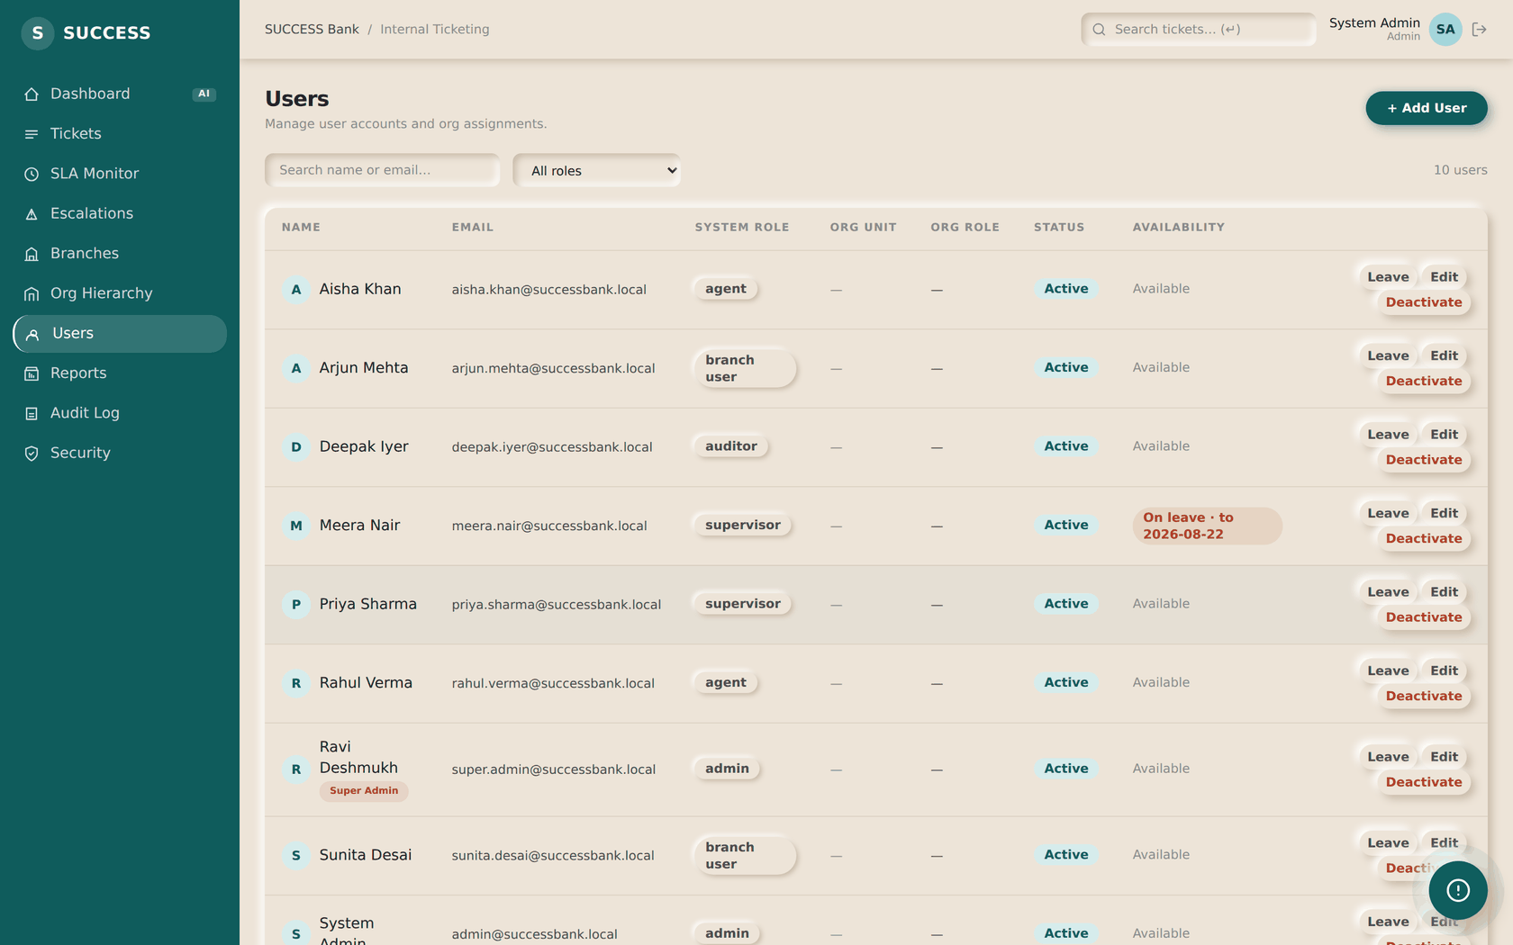
STEP 18
Manage users
ADMIN
ON THIS SCREEN
1
Add a user
1
ACTION
Create a user, set their role, and place them in an org unit.
RESULT
The role decides what they may do. There are no per-user permission overrides.
NEXT
Step 19 — shape the organisation.
SUCCESS Bank — Internal Ticketing · Standard Operating Procedure
Step 18

Slide 38

STEP 19
See who is available
ADMIN
ON THIS SCREEN
1
Availability is separate from Active — one gates login, the other routing
2
Record a leave window
1
ACTION
2
Read the Availability column before wondering why work is not reaching someone.
RESULT
Availability and Active are different columns because they mean different things. Active is whether the account works at all; availability is whether the router sends new tickets there. Someone on leave can still sign in and finish what they already hold.
NEXT
Record a leave window with the Leave button.
SUCCESS Bank — Internal Ticketing · Standard Operating Procedure
Step 19

Slide 39
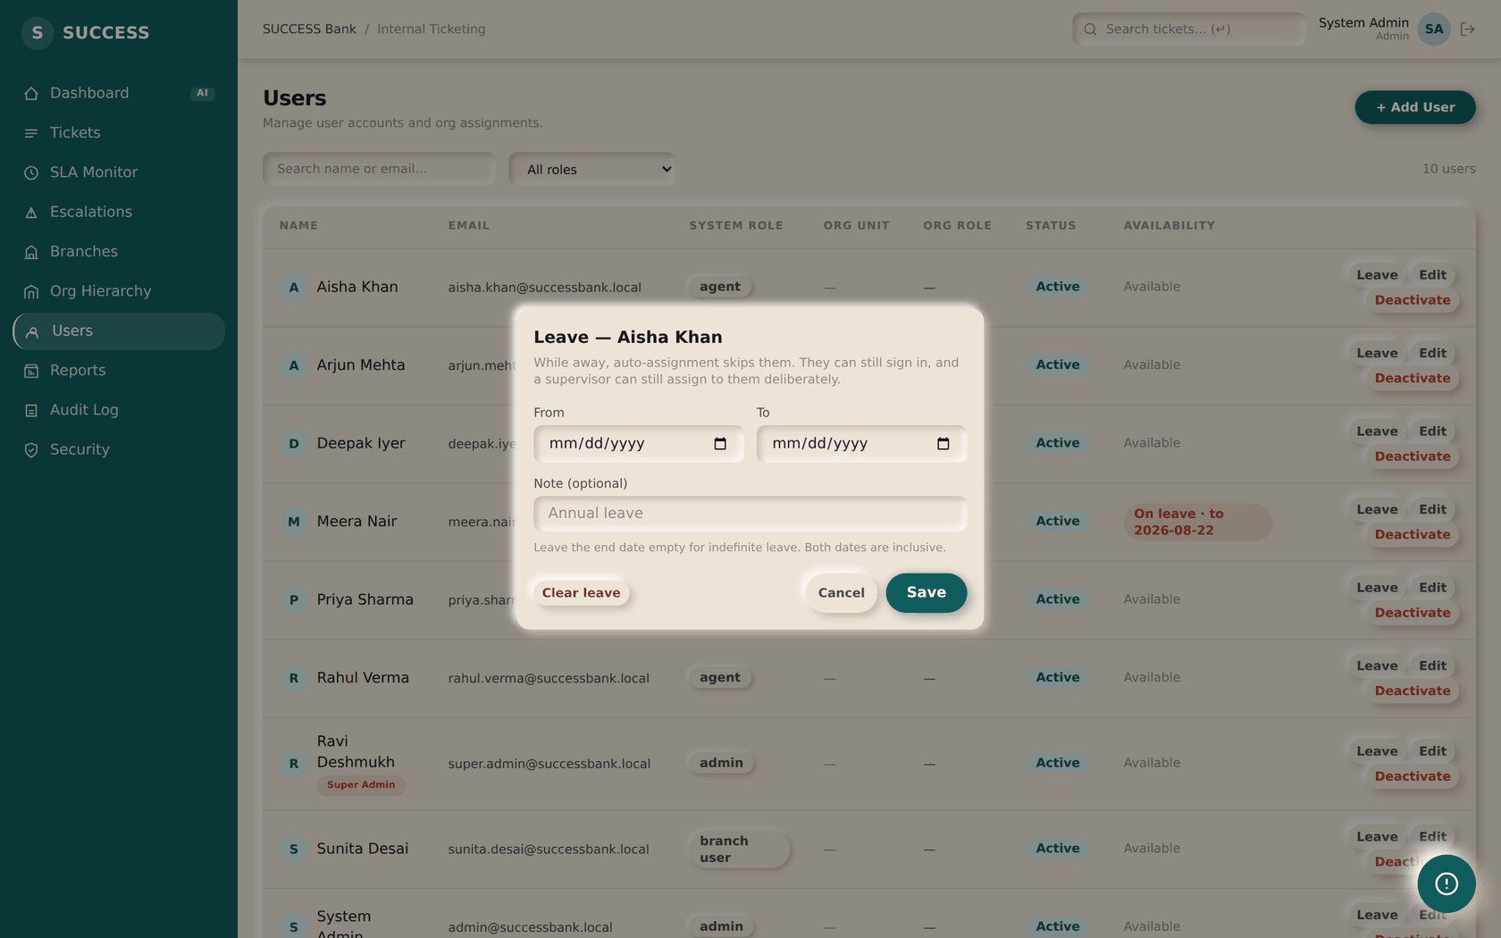
STEP 20
Record a leave window
ADMIN
ON THIS SCREEN
1
First and last day, both inclusive
2
Leave the end date empty for indefinite leave
3
Clears the window and makes them available again
ACTION
Enter the first and last day away, then save.
1
2
RESULT
Auto-assign skips them for that window and starts including them again the day after it ends — nobody has to remember to switch them back on. A supervisor can still assign to them deliberately, which is why they stay in the list rather than disappearing from it.
3
NEXT
Step 21 — shape the organisation.
Supervisors can set leave too — rota changes should not wait for an admin.
SUCCESS Bank — Internal Ticketing · Standard Operating Procedure
Step 20

Slide 40
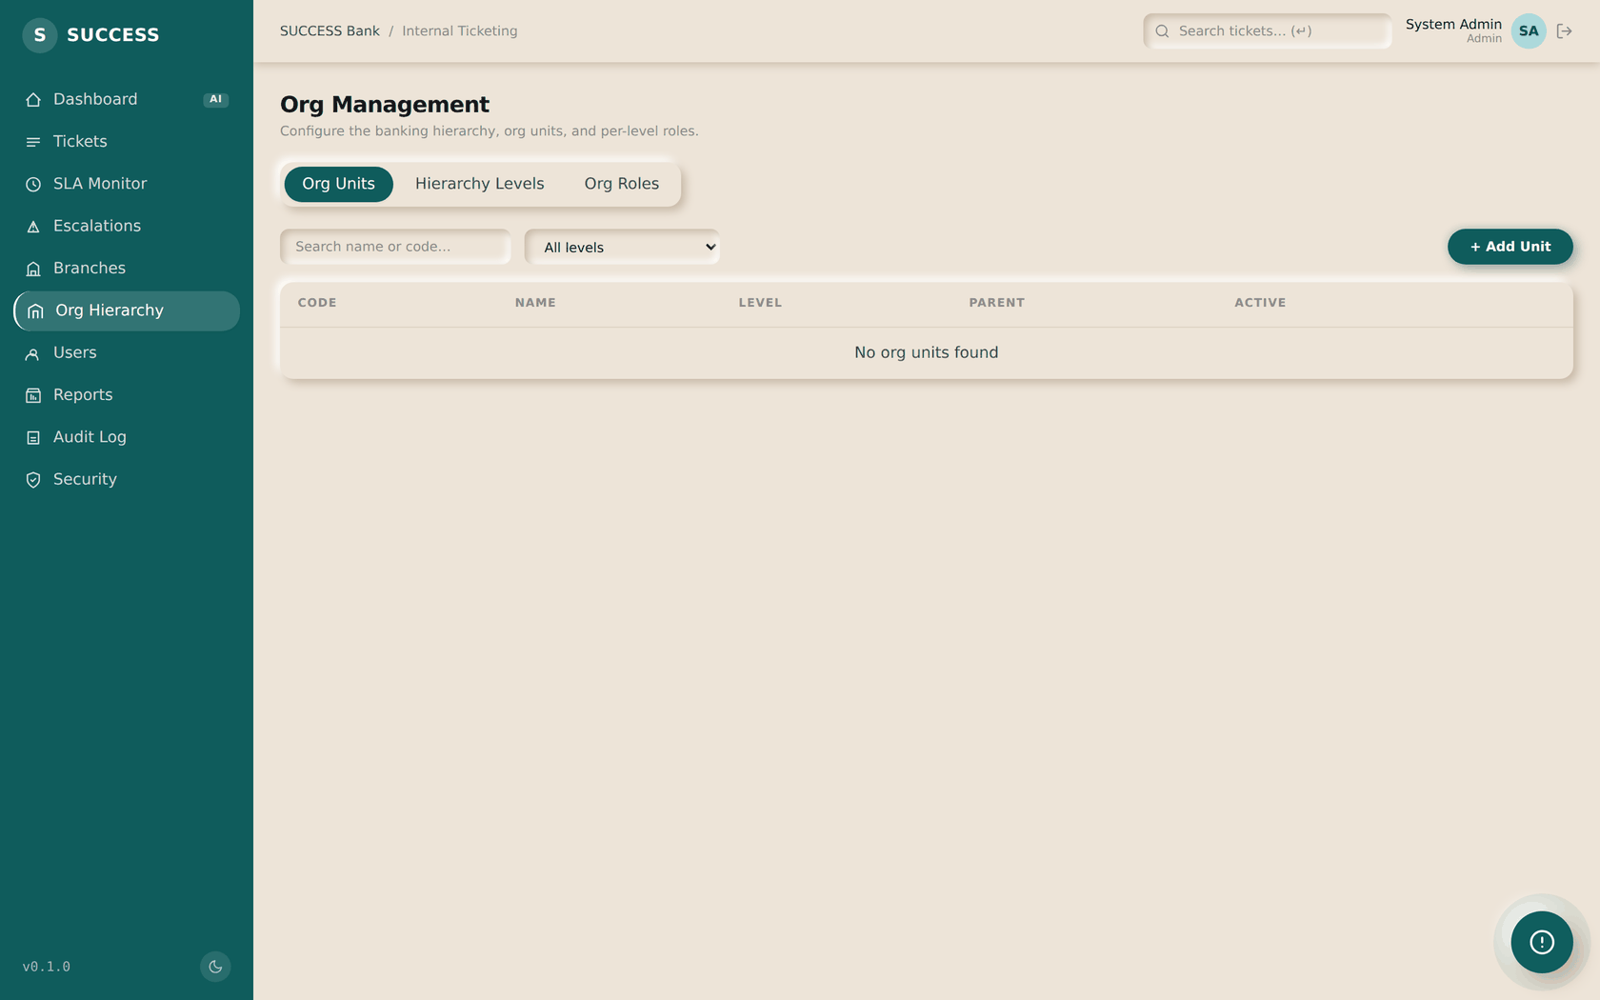
STEP 21
Shape the organisation
ADMIN
ACTION
Define hierarchy levels, then units within them.
RESULT
The org tree drives ticket visibility: a user sees their unit's subtree, plus anything assigned to them personally.
NEXT
Step 22 — maintain the branch network.
SUCCESS Bank — Internal Ticketing · Standard Operating Procedure
Step 21

Slide 41
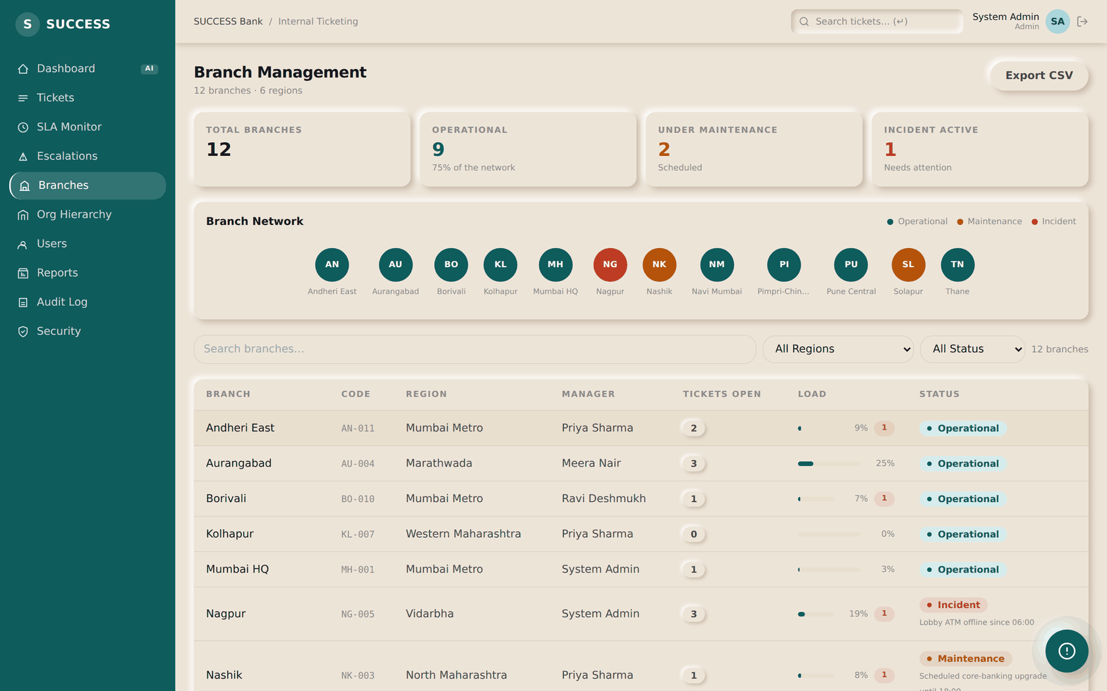
STEP 22
Maintain the branch network
ADMIN
ACTION
Add branches, set managers and capacity, and mark degraded ones.
RESULT
Ticket counts are computed per request, never stored — a counter that drifts is wrong forever with nothing to reveal it.
NEXT
Step 23 — pull reports.
SUCCESS Bank — Internal Ticketing · Standard Operating Procedure
Step 22

Slide 42
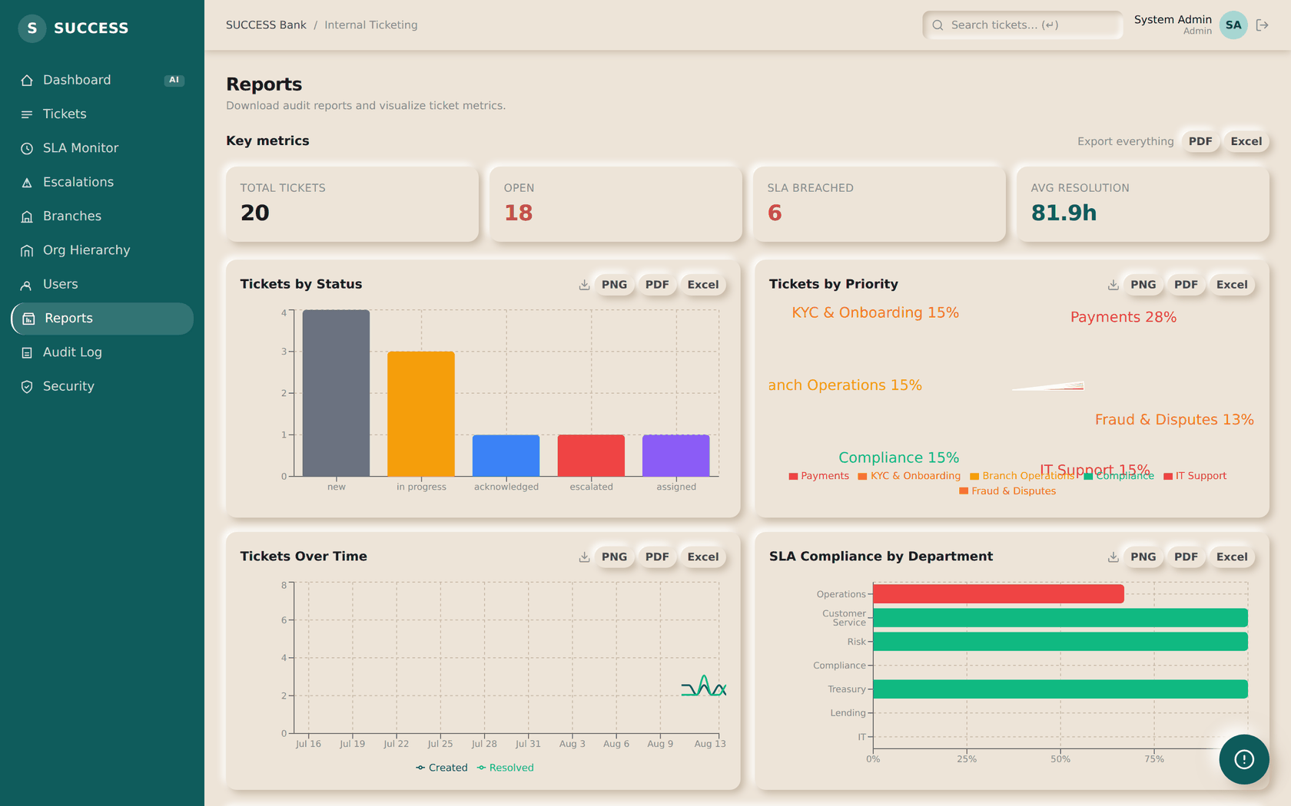
STEP 23
Pull reports
ADMIN
ACTION
Choose a period, then export.
RESULT
The export is generated from what is on screen, so it matches the filters you applied rather than silently re-running an unfiltered query.
NEXT
Step 24 — protect your own account.
SUCCESS Bank — Internal Ticketing · Standard Operating Procedure
Step 23

Slide 43
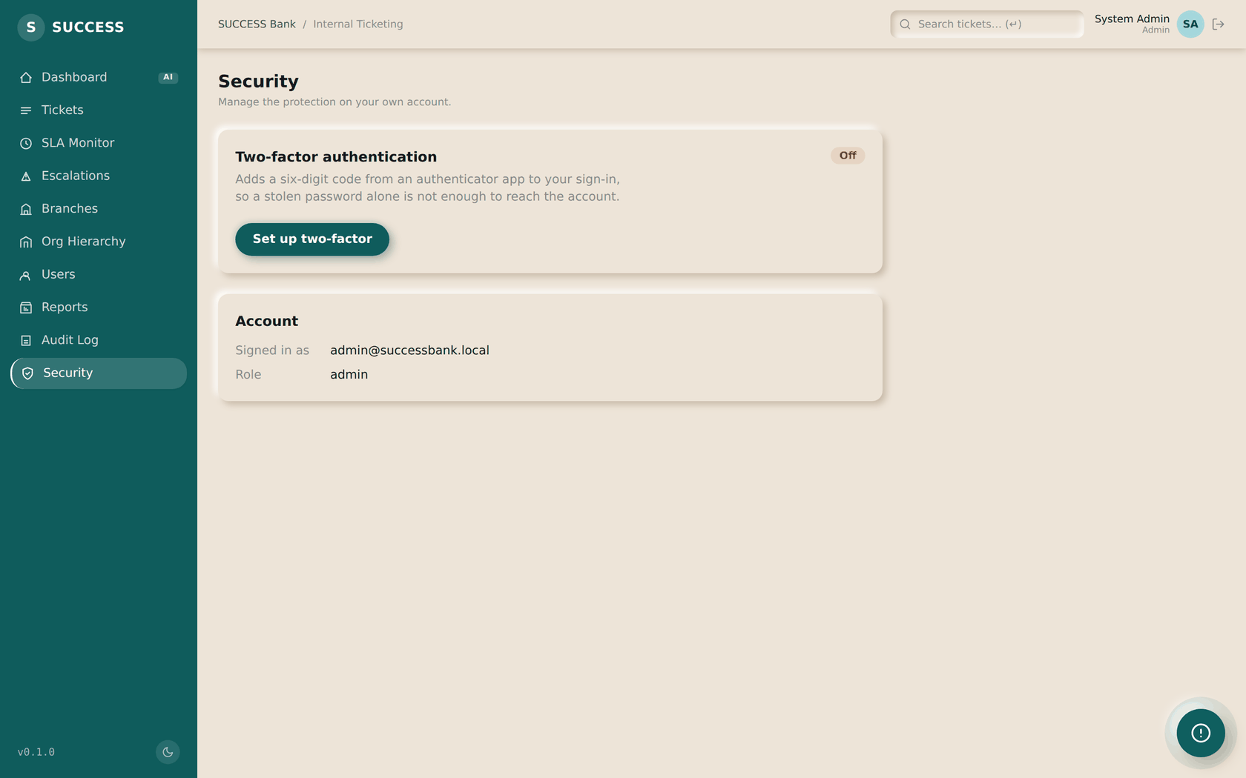
STEP 24
Turn on your second factor
ADMIN
ACTION
Open Security, scan the QR code, and enter one code to confirm.
RESULT
MFA is only switched on once a correct code proves the app is working — so a failed scan cannot lock you out. Ten single-use recovery codes are shown once, and never again.
NEXT
Save the recovery codes somewhere safe before leaving this screen.
SUCCESS Bank — Internal Ticketing · Standard Operating Procedure
Step 24

Slide 44
Save the recovery codes
This is the one screen you cannot go back to
Ten recovery codes are shown once, when you switch MFA on. Only their hashes are stored, so nobody — including an administrator — can show them to you again. Each works once, in place of a code from your app.
Lost your phone, still have codes
Use any unused recovery code at sign-in. It works once, then it is spent.
Lost both
An administrator clears your enrolment, and you set it up again from scratch.
Lost the only super admin
There is no route through the interface, by design. The flag has to be set on the database row.
SUCCESS Bank — Internal Ticketing · Standard Operating Procedure
Admin

Slide 45
SECTION 10
Auditor workflow
You can open everything and change nothing. Every write is refused by the server.
SUCCESS Bank — Internal Ticketing · Standard Operating Procedure
Section 10

Slide 46
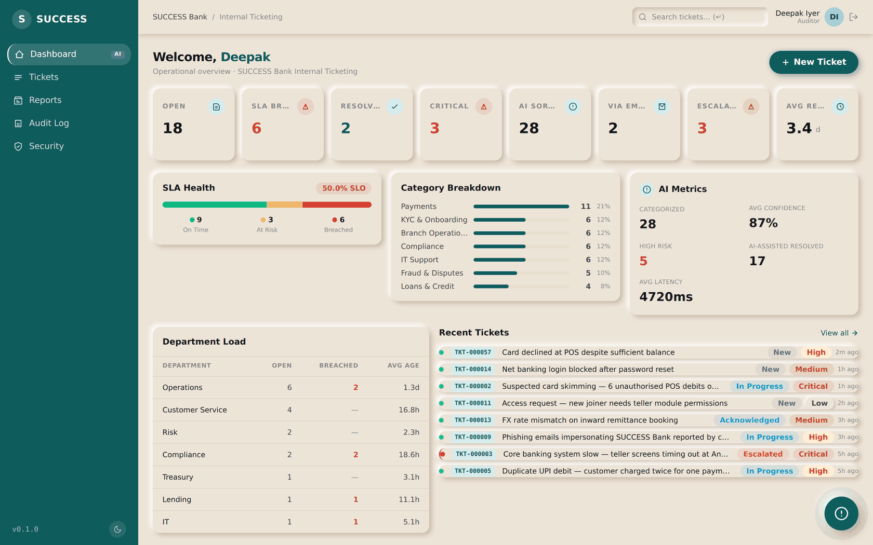
STEP 25
See the whole picture
AUDITOR
ACTION
Sign in and read the dashboard.
RESULT
Auditors have full visibility. What they do not have is any way to change what they are looking at.
NEXT
Step 26 — open the audit trail.
SUCCESS Bank — Internal Ticketing · Standard Operating Procedure
Step 25

Slide 47
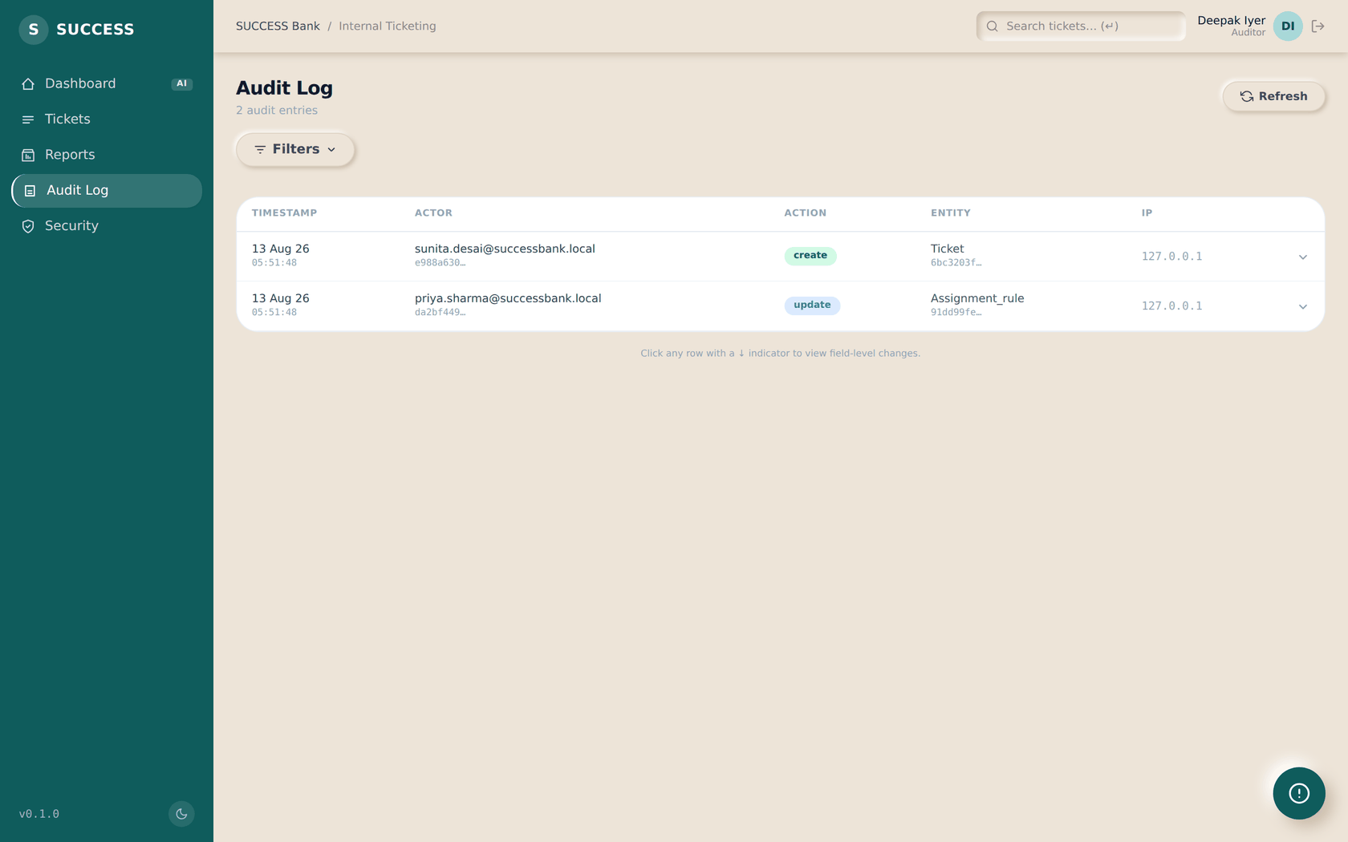
STEP 26
Read the audit trail
AUDITOR
ACTION
Filter to the entity or person you are reviewing.
RESULT
Every state change writes a row: actor, role, IP, request id, and the values before and after.
NEXT
Step 27 — inspect any ticket.
SUCCESS Bank — Internal Ticketing · Standard Operating Procedure
Step 26

Slide 48
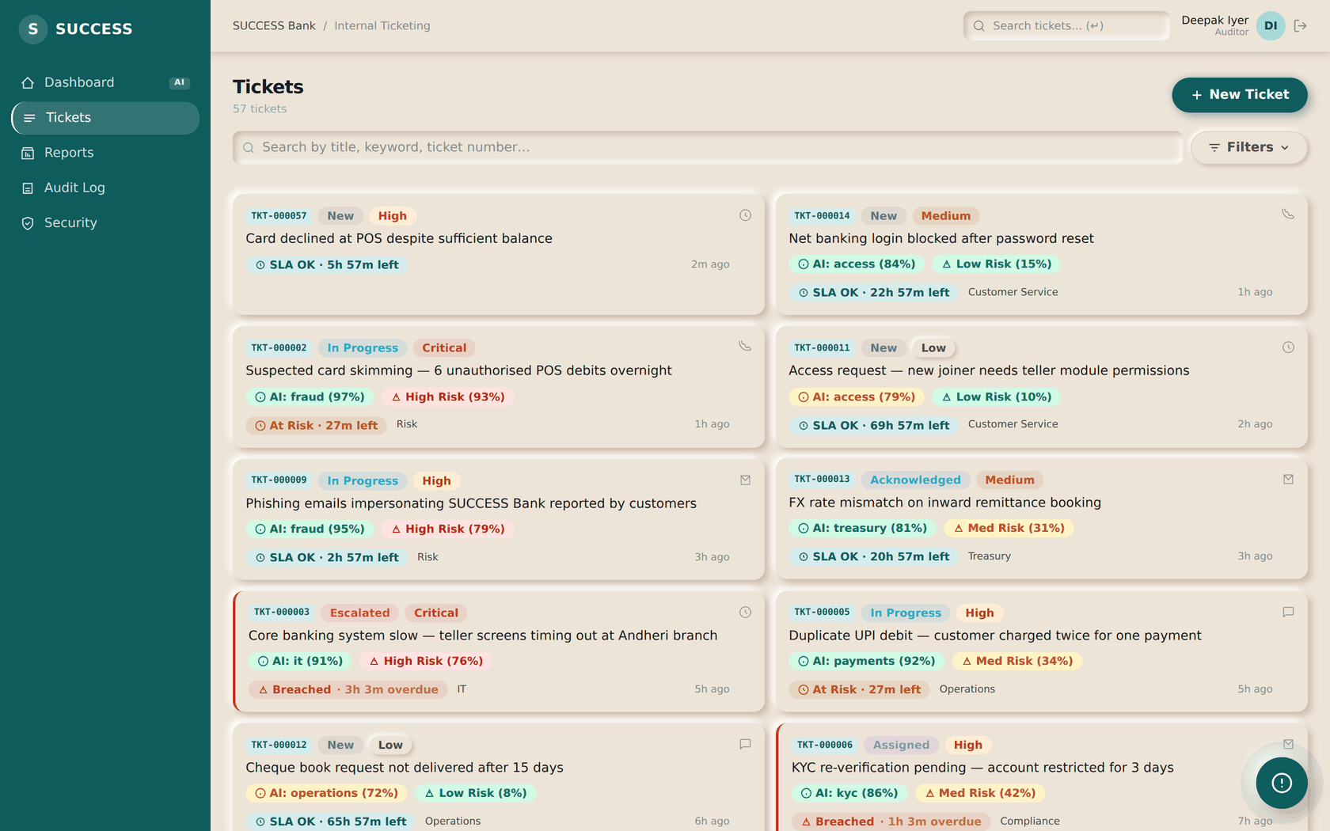
STEP 27
Inspect any ticket
AUDITOR
ACTION
Open any ticket and read its comments, attachments and timeline.
RESULT
There is no scope limit — an auditor sees every ticket, not a subset. Internal notes are visible to them too. Write controls are not offered, and would be refused if called directly.
NEXT
This is the end of the auditor's workflow — there is nothing to submit.
SUCCESS Bank — Internal Ticketing · Standard Operating Procedure
Step 27

Slide 49
A caveat worth recording
Honest limitation of the audit trail as it stands today
The audit trail is append-only by convention, not by enforcement.
The application only ever inserts rows. But there is no database trigger and no revoked permission, so anything holding the database credentials could alter history. Closing this is the first item on the outstanding work list.
It is recorded here rather than left out, because an auditor is exactly the person who needs to know how much weight the trail can carry.
SUCCESS Bank — Internal Ticketing · Standard Operating Procedure
Auditor

Slide 50
SECTION 11
Attachments
Where files can be added, who can see them, and the one rule people assume wrong.
SUCCESS Bank — Internal Ticketing · Standard Operating Procedure
Section 11

Slide 51
Three places a file can be attached
The flow is the same in each: choose the files, then they upload once the thing they belong to exists
With the ticket, when it is raised
WHO
Evidence travels with the report rather than arriving afterwards.
Branch user, agent
With a reply
WHO
The file belongs to that reply, so a fix sits beside the answer explaining it.
Anyone who can comment
From the attachments panel
WHO
The file index for the whole ticket; files from replies are marked as such.
Anyone who can write
Limits: 15 MB per file. Images, PDF, Word, Excel, text and CSV are accepted. Executables and archives are refused outright — there is no malware scanner, and an unscanned archive is the usual way something nasty arrives.
SUCCESS Bank — Internal Ticketing · Standard Operating Procedure
Attachments

Slide 52
The rule people get wrong
An internal note's attachment is as invisible as the note
What agents assume
What actually happens
"The note is internal, so the requester will not read my text — but the file I attached is just a file on the ticket."
The file is hidden too. It is filtered from the list and refused on download — and the refusal is a 404, so the response does not even confirm the note exists.
This matters because the file is usually the sensitive part. Hiding the note while serving its attachment would leak exactly what the flag exists to withhold.
Related: you cannot attach a file to somebody else's comment. Without that rule an agent could hang a file off the requester's own message, where it would read as something they had sent.
SUCCESS Bank — Internal Ticketing · Standard Operating Procedure
Attachments

Slide 53
SECTION 12
The AI assistant
It answers questions about the work in front of you. It cannot change anything.
SUCCESS Bank — Internal Ticketing · Standard Operating Procedure
Section 12

Slide 54
What it can and cannot do
Three properties are enforced by the server, not by the prompt
It cannot see more than you can
Context is fetched through the same visibility rules as the rest of the application. Point it at a ticket your role cannot open and it is told the ticket is unavailable — no title, no number, nothing.
It says when it does not know
Rather than producing generic advice. An assistant that invents ticket facts in a bank is worse than one that declines.
It cannot act
It has no write access. It will not change a status, assign a ticket or post a comment. Everything it produces is for you to act on.
If it reports that it cannot connect, the cause is almost always the local model rather than the application. The message it shows includes the specific fix.
SUCCESS Bank — Internal Ticketing · Standard Operating Procedure
Assistant

Slide 55
SECTION 13
The knowledge base
Ask a question, get an answer with the passage it came from. Administrators decide which documents exist and who may search them.
SUCCESS Bank — Internal Ticketing · Standard Operating Procedure
Section 13

Slide 56
Why this is not just a search box
Three properties the server enforces, not the prompt
It can only quote what you may already read
Access is applied to the search itself, before anything is generated. A passage your role has not been granted is never retrieved, so it cannot appear in an answer — you get the same response as if the document did not exist.
Every claim carries its source
Each factual sentence is marked with the passage it came from, and you can open that document, section and page to check it. If the assistant produces a source that does not exist, the sentence it supported is removed before you see it.
It refuses rather than guessing
When the documents do not cover your question it says so and stops. That is the correct answer, not a failure — and it names what would help, such as asking an administrator whether the relevant document has been uploaded.
Find it in the sidebar under Knowledge Base. Agents, supervisors and administrators can ask questions; only administrators can upload documents or change who may search a collection.
SUCCESS Bank — Internal Ticketing · Standard Operating Procedure
Knowledge base

Slide 57
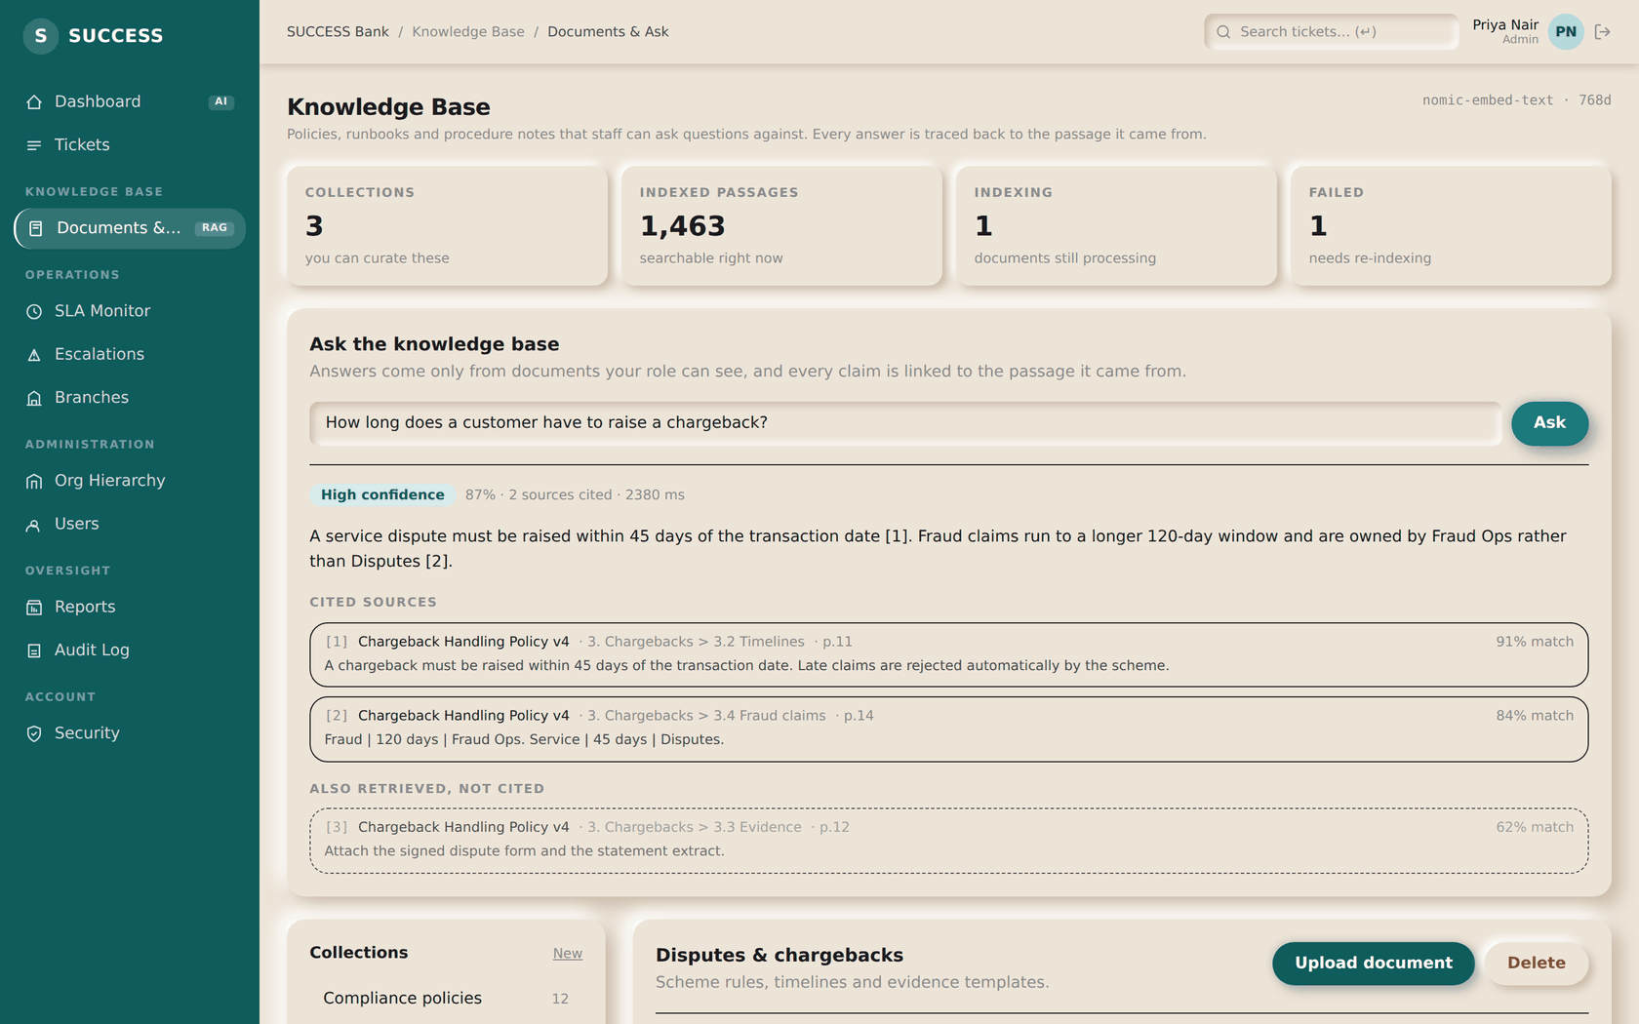
STEP 28
Ask the knowledge base
AGENT & ABOVE
ON THIS SCREEN
1
Ask in plain words — no query syntax
2
Confidence, computed from the evidence
3
Cited sources: document, section, page
4
Also retrieved but not cited
ACTION
Type your question in plain words and select Ask. There is no query syntax and no filters.
1
2
RESULT
You get an answer with a confidence band, and every factual sentence marked with the passage it came from. Cited sources are listed below with their document, section and page.
3
4
NEXT
Step 29 — read what it retrieved but did not use.
SUCCESS Bank — Internal Ticketing · Standard Operating Procedure
Step 28

Slide 58
STEP 29
Check the answer
AGENT & ABOVE
ON THIS SCREEN
1
Ask in plain words — no query syntax
2
Confidence, computed from the evidence
3
Cited sources: document, section, page
4
Also retrieved but not cited
ACTION
Read the cited sources, and the passages listed under Also retrieved, not cited.
1
2
RESULT
The second list is what the search considered and the answer did not use. Seeing both tells you how much was weighed; a thin list is a reason to treat the answer carefully.
3
NEXT
4
Step 30 — what happens when it has nothing.
The confidence band is computed from the evidence, not asked of the assistant.
SUCCESS Bank — Internal Ticketing · Standard Operating Procedure
Step 29

Slide 59
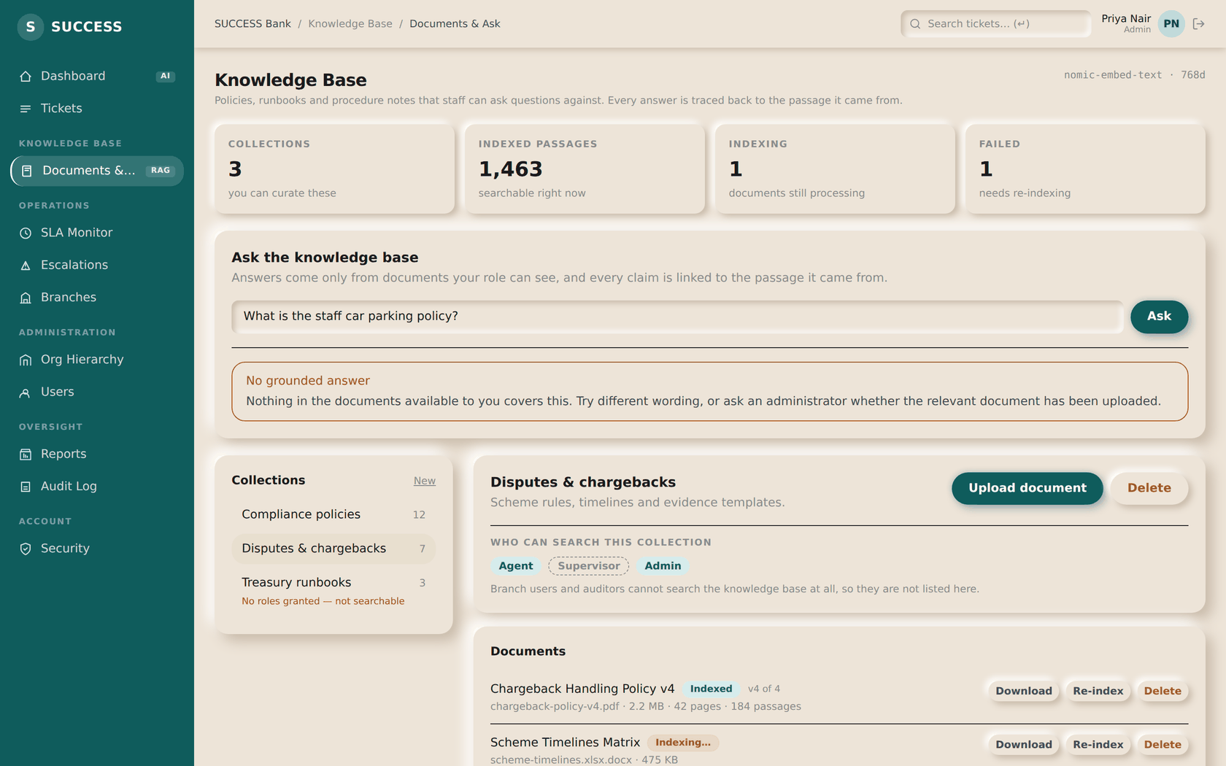
STEP 30
When it declines
AGENT & ABOVE
ON THIS SCREEN
1
It says so and stops, rather than guessing
ACTION
Ask something the uploaded documents do not cover.
RESULT
It reports that it has no grounded answer and explains why, rather than producing something plausible. Try different wording, or ask an administrator whether the document exists.
1
NEXT
Step 31 — administrators: stocking the base.
SUCCESS Bank — Internal Ticketing · Standard Operating Procedure
Step 30

Slide 60
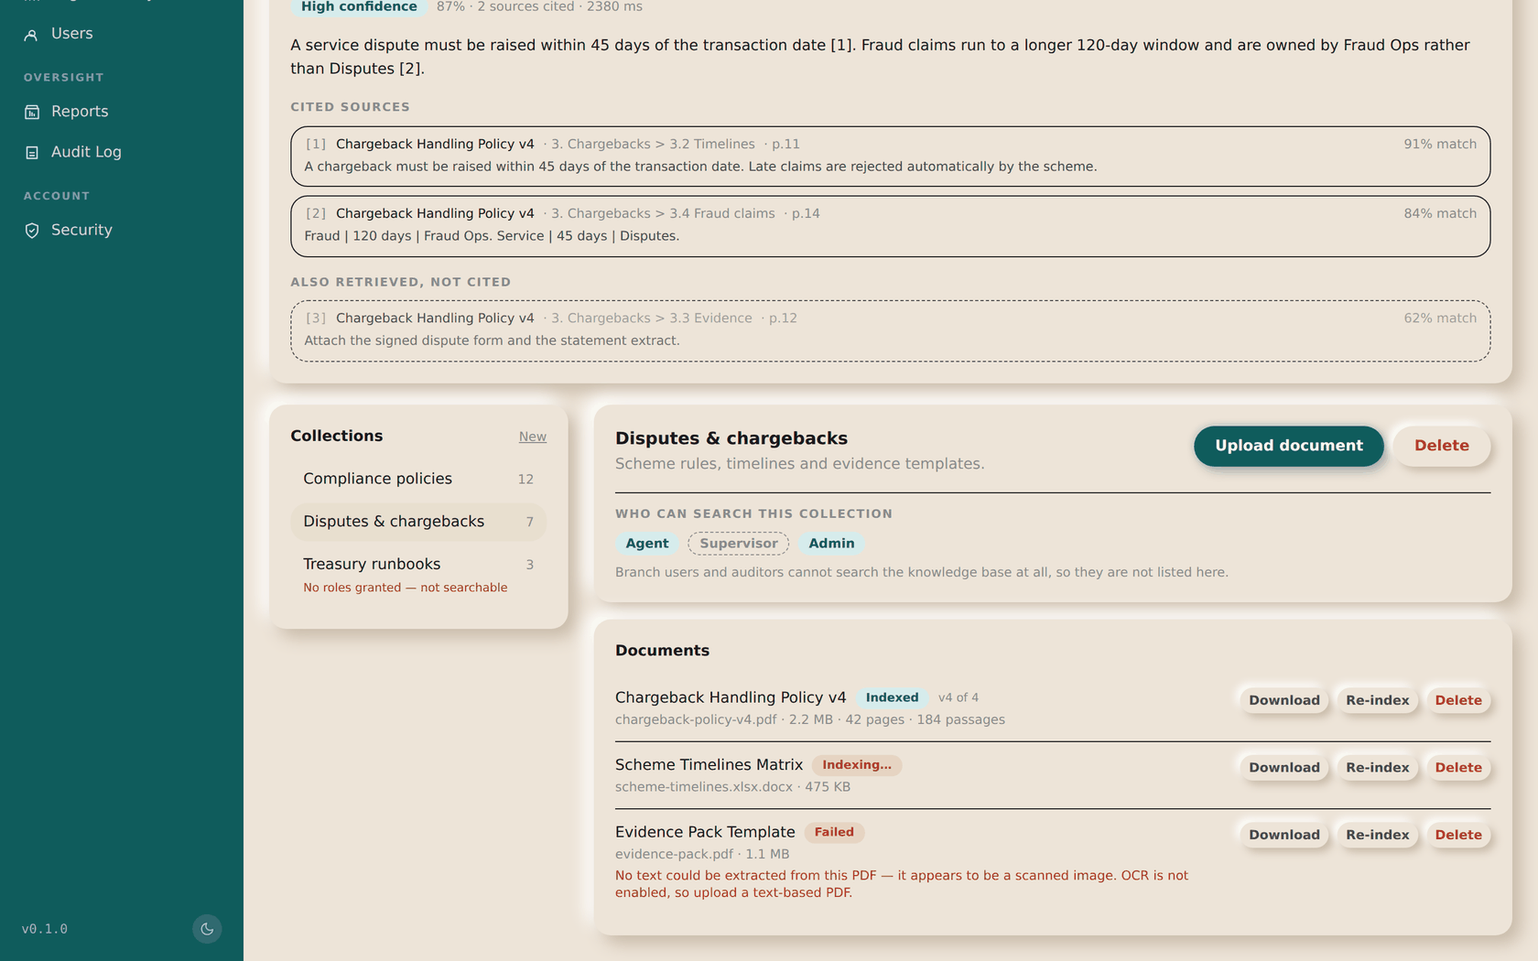
STEP 31
Upload and grant access
ADMIN ONLY
ON THIS SCREEN
1
Which roles may search this collection
2
Upload PDF, Word, Markdown, text or CSV
3
A collection nobody can read is flagged
4
A document that failed says why
ACTION
Select a collection, choose Upload document, then set which roles may search it.
2
1
RESULT
The file is parsed, split into passages and indexed. It becomes searchable only once every passage is indexed — a document is never half-available.
3
NEXT
Step 32 — the two states worth knowing.
4
SUCCESS Bank — Internal Ticketing · Standard Operating Procedure
Step 31

Slide 61
Two states you will meet
Both are the system being honest rather than broken
“No roles granted — not searchable”
A new collection is readable by nobody until you grant a role. It will accept uploads and answer nothing until you do, so the list says so rather than leaving you to wonder why search returns silence.
A document marked Failed, with the reason
Most often a scanned PDF with no text layer, or the local model being unreachable. The previous version of that document keeps answering throughout — select Re-index once the cause is fixed.
Branch users and auditors cannot search the knowledge base at all, and there is no navigation entry for them. It holds internal staff procedure, and an auditor is an oversight role rather than a working one.
SUCCESS Bank — Internal Ticketing · Standard Operating Procedure
Knowledge base

Slide 62
SECTION 14
Common scenarios
Four situations, start to finish, naming who does what at each hop.
SUCCESS Bank — Internal Ticketing · Standard Operating Procedure
Section 14

Slide 63
Scenario A — a duplicated debit
The everyday case: raised with evidence, worked, resolved
Branch user
Raises the ticket with a screenshot, the statement and a CSV of the transactions
System
Numbers it and stamps both SLA deadlines. It does not pick an owner
Supervisor
Assigns it — by hand, or with Auto-assign to take the lightest queue
Agent
Moves it to In Progress, checks the evidence, confirms the duplicate
Agent
Replies with the corrected statement attached to that reply, then resolves
Branch user
Sees the explanation and the corrected file together, and the ticket closes
SUCCESS Bank — Internal Ticketing · Standard Operating Procedure
Scenarios

Slide 64
Scenario B — nobody picked it up
What happens when a deadline passes and no one is watching
System
The SLA worker finds the ticket past its resolution deadline
System
Marks the breach, matches the most specific escalation rule
System
Moves it to Escalated, reassigns to the least-loaded holder of the target role
System
Writes an escalation event, then emails the target and the managers
Supervisor
Sees it in the escalation queue and confirms someone is on it
SUCCESS Bank — Internal Ticketing · Standard Operating Procedure
Scenarios

Slide 65
Scenario C — the agent needs more information
The two-way exchange that used to happen over email
Agent
Replies asking for the account number and a clearer screenshot
Branch user
Answers on the ticket and attaches the new screenshot
Agent
Continues, adding an internal note with findings the requester should not see
Branch user
Sees neither the internal note nor the file attached to it
Agent
Resolves with a public explanation
SUCCESS Bank — Internal Ticketing · Standard Operating Procedure
Scenarios

Slide 66
Scenario D — it was not actually fixed
Reopening, and what it does to the counts
Branch user
Reads the resolution and finds the problem still occurring
Branch user
Reopens the ticket, explaining what is still wrong
System
The ticket returns to the open set and counts against the dashboard again
Agent
Picks it back up from Assigned and works it a second time
Agent
Resolves again — the whole history stays on the one ticket
SUCCESS Bank — Internal Ticketing · Standard Operating Procedure
Scenarios

Slide 67
SECTION 15
Quick reference
The desk copy. Statuses, who does what, and where things live.
SUCCESS Bank — Internal Ticketing · Standard Operating Procedure
Section 15

Slide 68
Status reference
Who can move a ticket into each state, and what it means
Status | Means | Set by
new | Raised, not yet looked at | System, on creation
acknowledged | Seen, not yet owned | Agent
assigned | Has an owner | Supervisor, or agent; system after the delay
in_progress | Actively being worked | Agent
on_hold | Waiting on someone outside the team | Agent
escalated | Handed up — by hand or by SLA breach | Agent, or the SLA worker
resolved | Fixed; only from in_progress or escalated | Agent
closed | Finished, or withdrawn; reachable from any open state | Agent, or the requester
reopened | Was not actually fixed; returns to the open set | Requester or agent
SUCCESS Bank — Internal Ticketing · Standard Operating Procedure
Reference

Slide 69
Where to click
The shortest path to the thing you need
I want to… | Go to | Who can
Raise a problem | Tickets → New Ticket | Everyone
Follow my ticket | Tickets → open it | Everyone (own only, for branch users)
Find what is breaching | Dashboard → SLA Breached tile | Agent and above
Give a ticket an owner | Ticket → Assignee → Assign | Agent and above
Let the router choose | Ticket → Assignee → Auto-assign | Supervisor, admin
Say someone is away | Users → Leave | Supervisor, admin
See what escalated | Escalations | Supervisor, admin
Check deadlines | SLA Monitor | Supervisor, admin
Add or change a user | Users | Admin
Change the org tree | Org Management | Admin
Export figures | Reports → CSV / PDF / Excel | Supervisor, admin, auditor
Review who changed what | Audit | Admin, auditor
Turn on my second factor | Security | Everyone
SUCCESS Bank — Internal Ticketing · Standard Operating Procedure
Reference

Slide 70
What this system does not do
Stated plainly, so nobody waits for a feature that is not coming today
No approval workflow
Nothing routes for sign-off before proceeding.
No in-app notifications
Notifications are email only. There is no bell icon.
No ticket merging
Duplicates can be marked as such, but two tickets cannot be combined into one.
No customer portal
Every account is an employee account; branch staff raise tickets on customers' behalf.
No per-user permissions
One role per user. Anything finer is expressed through the org tree.
If one of these would help, it belongs on the ticket list — not in a workaround.
SUCCESS Bank — Internal Ticketing · Standard Operating Procedure
Reference

Slide 71
Questions, or something here that does not
match what you see?
This deck describes the application at commit 37f71d3. If a screen has changed, the deck is wrong and not the application — raise it so this can be recaptured.
Operational procedures — deploying, restoring, what to do at 3am — are in docs/runbook.md.

