Slide 1
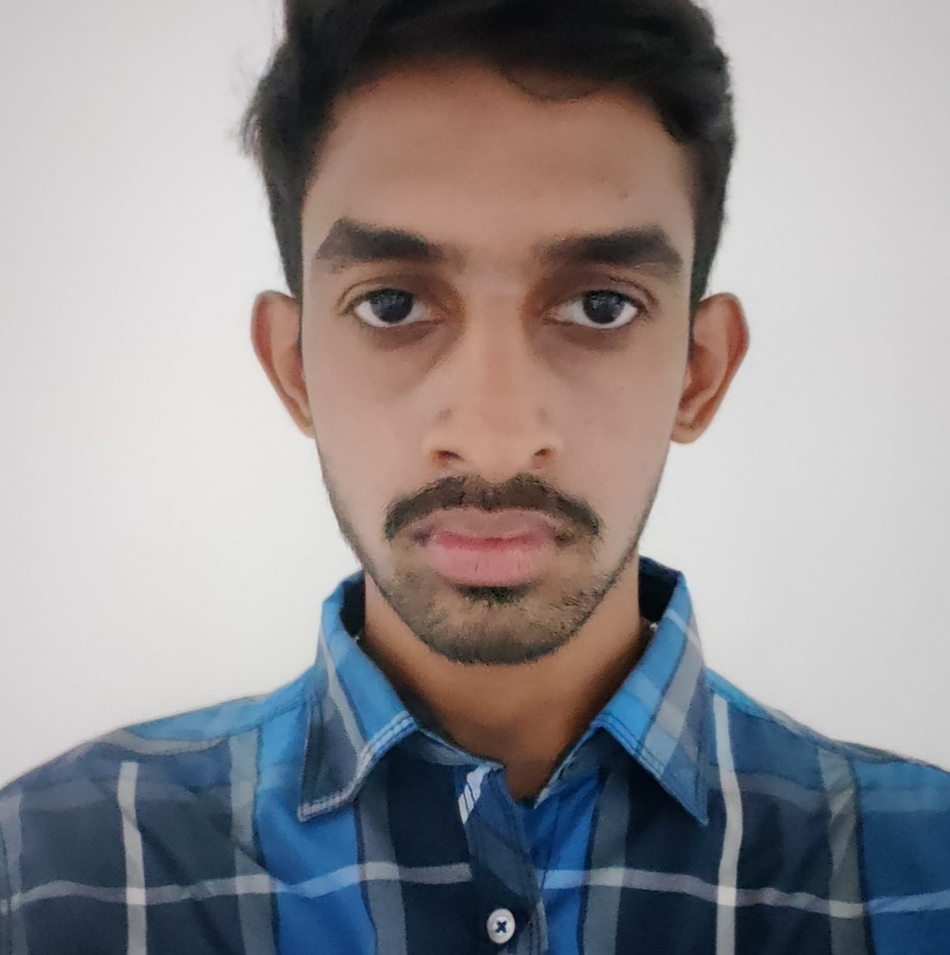


PRAJWAL S
Analyst/Software Engineer
Bachelor of Engineering
Computer Science: 2017- 2021
Skills Java 8 /J2EE
Spring Boot
Spring MVC
React
Bootstrap
Backend
Spring Boot
Hibernate
REST-API
Database
SQL database – MySQL,
Postgres SQL
Web Technologies
HTML5
CSS3
JavaScript
Bootstrap
Tools
SpringTool ,Visual Studio,Swagger
Postman
Additional Details
Leadership
Good Communication Skills
Team management
Bangalore
xxxxxxxxxx@capgemini.com
+91 xxxxxxx300
A4
Full Stack Developer
Hands on experience in developing web pages using HTML5, CSS3, Object Oriented Java script, ES6, JSON, XML.
Eager to work in a team of dedicated people and serve a key role in the enhancement and development of the project.
Has working knowledge on ReactJS , Java Microservice Development using Spring framework on an intermediate level.
Software Engineer who is Strong in design and integration with intuitive problem-solving skills. Passionate about implementing and launching new projects.
Mumbai Dabbawala Food Delivery Application
Completed end to end case study of Mumbai Dabbawala food with the help of Spring boot and Postgre SQL database, React framework used for user interface.
Designed Static and Dynamic Web Pages
Where Customers can order food based on their preference.
Developed website with HTML5 and CSS3 along with React framework to make website interactive and colorful.
Check out my work on GitHub & Video Profile

