Slide 1
Netzwerk Academy
Name : Prajwal t h
Assignment -2

Slide 2
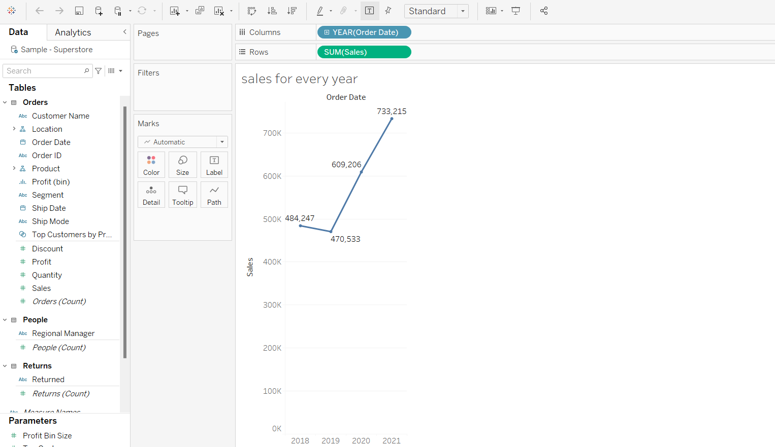
1.Find the sales for every year

Slide 3
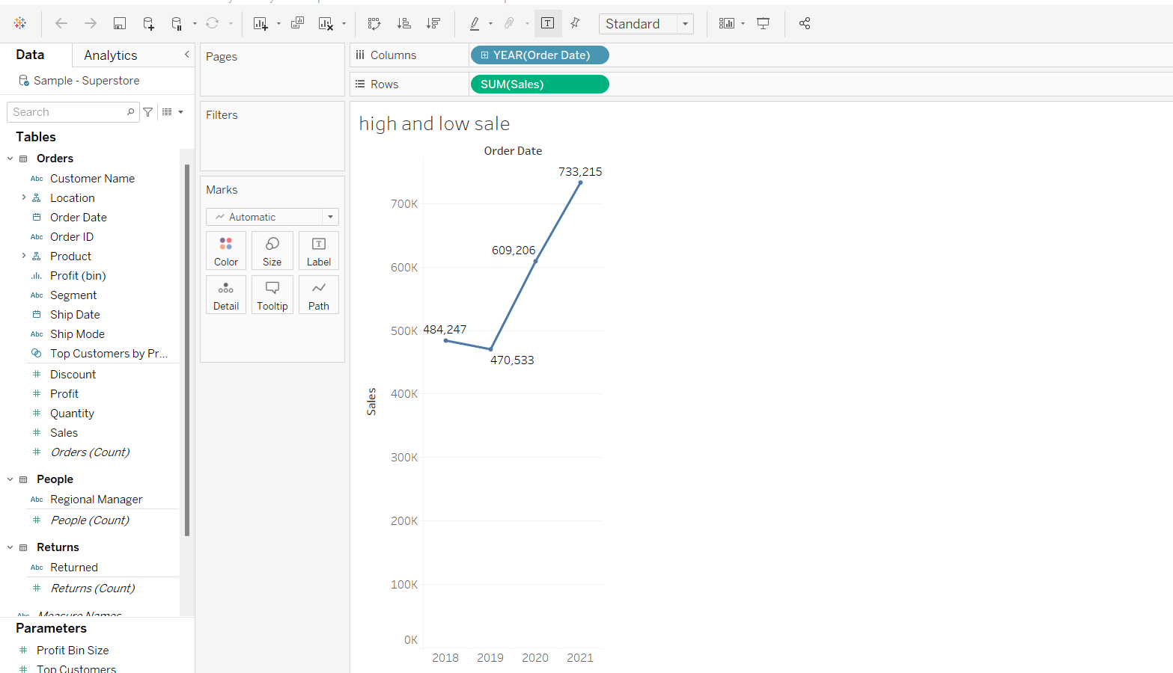
2&3 Find year for highest sales and lowest sales respectively
Year 2019 has lowest and 2021 highest sale.

Slide 4
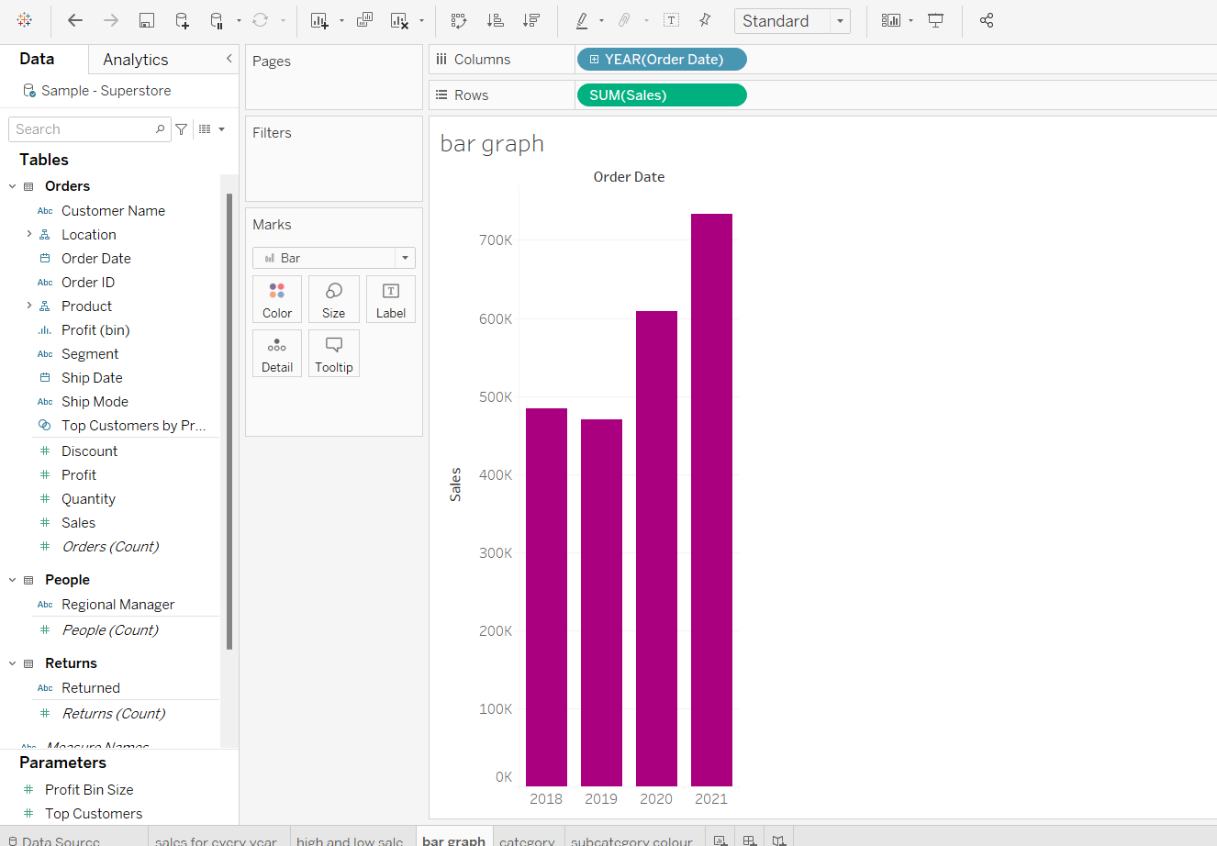
4.show the view in bar graph.

Slide 5
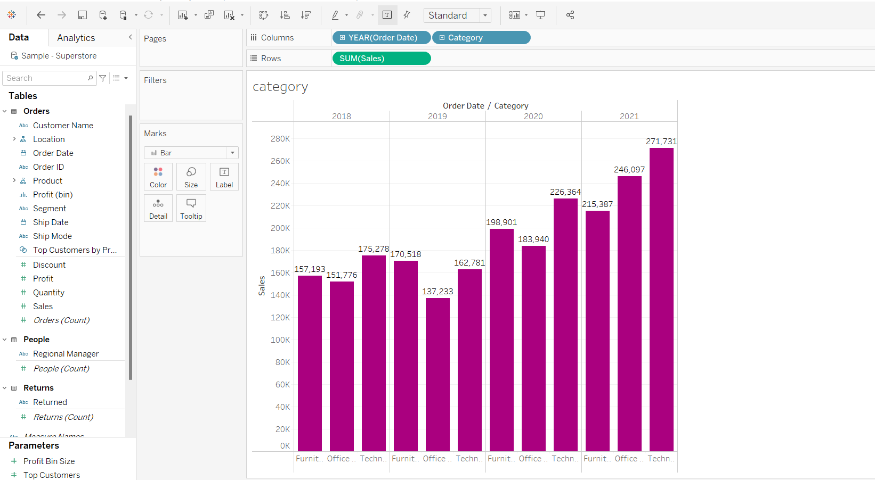
5. Find the category wise sales for every year
In 2020 – 2021 technology has a highest sale

Slide 6
6. Based on the analysis of the year 2020 & 2021. give some suggestions to improve Sales in the year 2022.
→We should be providing more budget to the technology sector as they have the highest sales in both the years i.e in 2020 and 2021.
→We should be going through the overall process of furniture in order to see where we are lacking as it has got the lowest sales in both the years.

Slide 7
8. Display subcategory and find some insights from the view about max and min sales under every category.
We need to check out the reason behind declination in the sales of envelope as in 2021 , it is recorded that the minimum sales i.e 3379 was recorded in the latest year 2021.

Slide 8
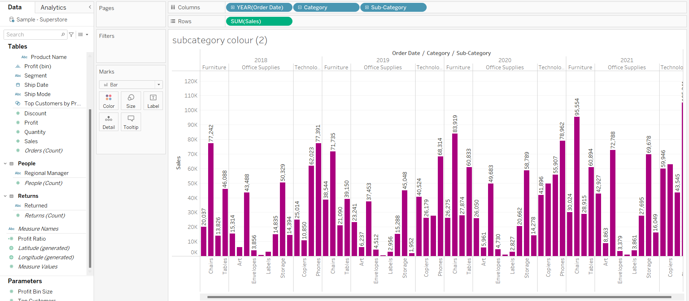

Slide 9
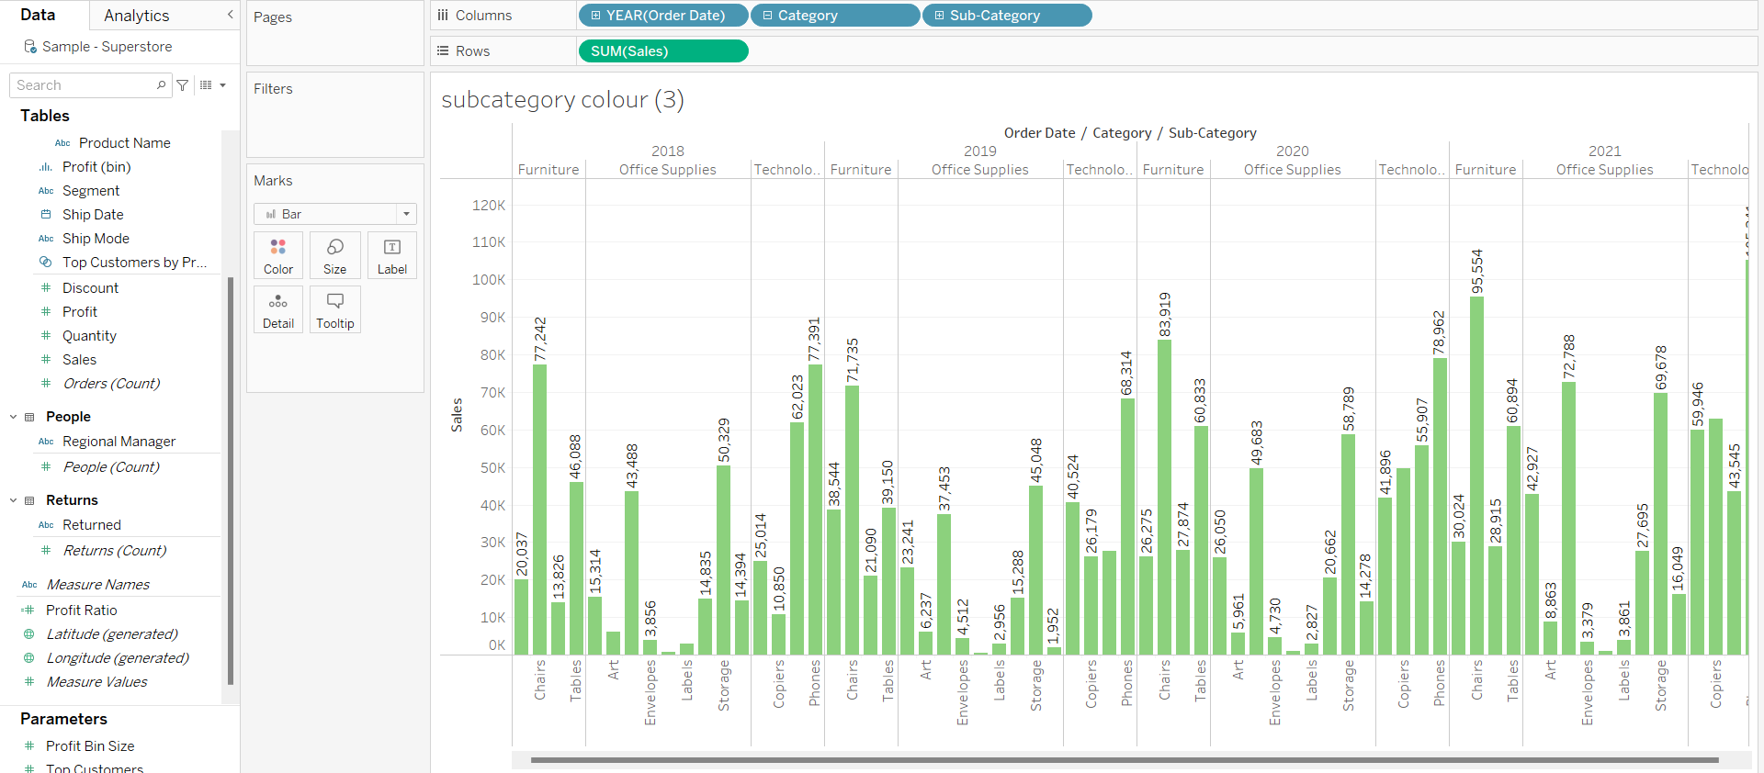
9. Change the color of your visual.

Slide 10
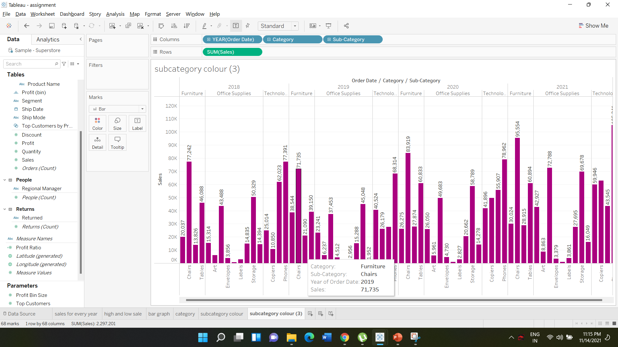
10 .Check The tool tip

Slide 11
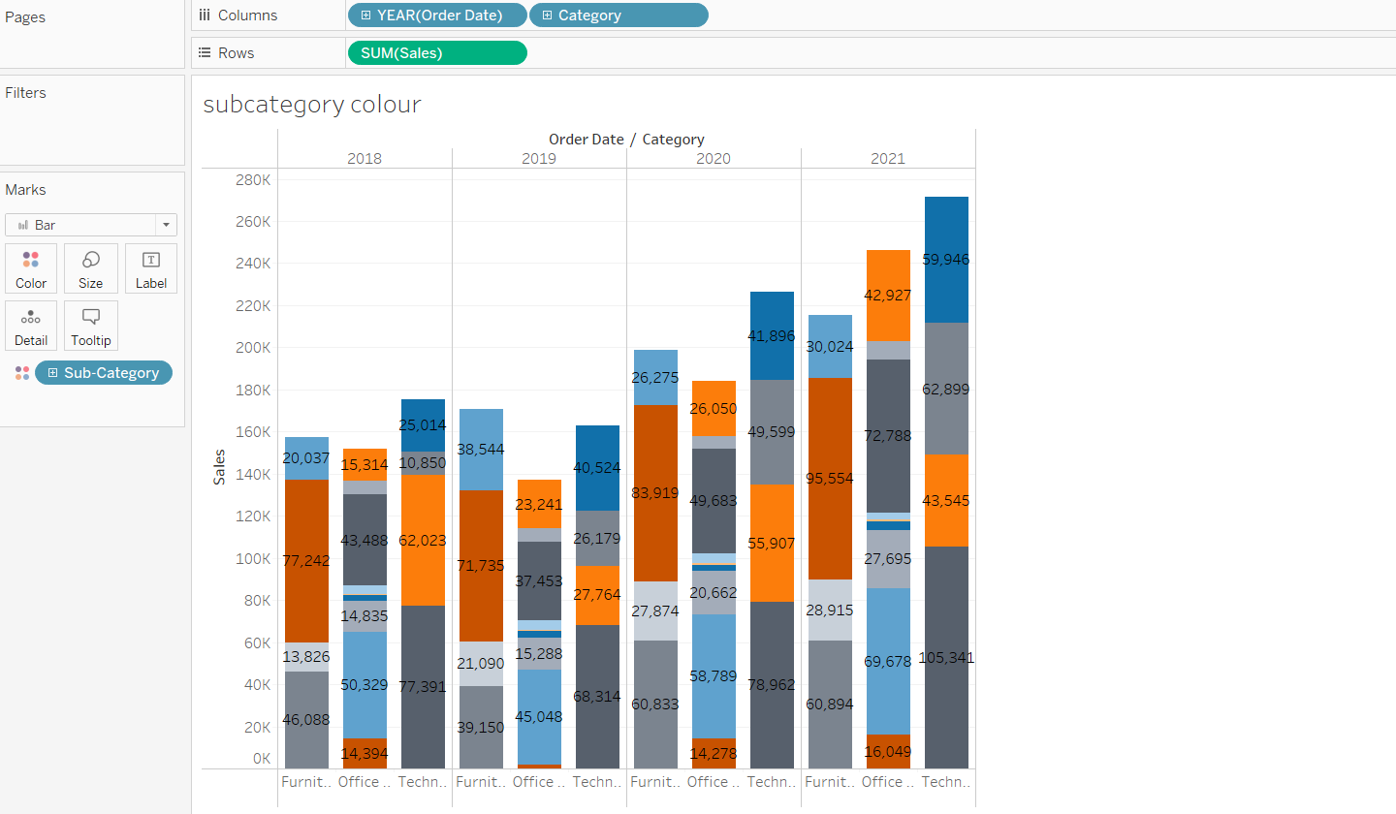
11.In your bar graph, present subcategory under each bar of category using colour card

Slide 12
THANK YOU…

