Slide 1
VISVESVARAYA TECHNOLOGICAL UNIVERSITY
Belagavi – 590 018
C. BYREGOWDA INSTITUTE OF TECHNOLOGY
Approved by AICTE New Delhi · Accredited by NAAC with B++ Grade · Recognized by Govt. of Karnataka
Affiliated to VTU Belagavi · ISO 9001:2015 Certified Institute
DEPARTMENT OF ARTIFICIAL INTELLIGENCE & MACHINE LEARNING
Internship Final Review
Company: PySpiders, BTM Bengaluru
Domain: Generative AI · Knowledge Graphs · Retrieval-Augmented Generation
Project Title: KG + RAG INTELLIGENCE – HYBRID KNOWLEDGE-GRAPH AND RAG Q&A SYSTEM
Presented by:
Internship Guide:
▸ Prajwal H D
▸ 1CK22AI038
▸ 8th Semester
▸ Dept. of AI & ML
▸ Prof. Vanitha L B
▸ Assistant Professor
▸ Dept. of AI & ML
▸ CBIT, Kolar

Slide 2
Internship Final Review
Organization Overview
▸ PySpiders is a well-known training and development organization specializing in software technologies including Python, Data Science, Artificial Intelligence, and Web Development.
▸ The organization focuses on bridging the gap between academic learning and industry requirements by providing hands-on training and real-time project exposure.
▸ During the internship I worked in the Python with Data Science / AI domain, where I gained practical knowledge in building intelligent retrieval and reasoning systems using LangChain, FAISS, and Google Gemini.
Dept of AIML, CBIT-Kolar
2026
2

Slide 3
Internship Final Review
Abstract
▸ This project presents a Hybrid KG + RAG Intelligence System capable of answering natural-language questions over any uploaded PDF or text document.
▸ The system fuses two complementary indexes built from the same source: a FAISS vector store of semantic chunks and a NetworkX knowledge graph of LLM-extracted subject-predicate-object triplets.
▸ Each query is grounded by retrieving both relevant text chunks and connected graph facts, then forwarded to Google Gemini for citation-backed answer generation.
▸ The goal is to reduce LLM hallucination and improve multi-hop reasoning by combining semantic similarity with explicit relational structure — accessible through a polished Streamlit interface.
Dept of AIML, CBIT-Kolar
2026
3

Slide 4
Internship Final Review
Introduction
▸ Knowledge work today depends on synthesizing information across long documents — a task that scales poorly for humans.
▸ Pure Retrieval-Augmented Generation (RAG) systems can fetch relevant passages but struggle with structural questions like 'who reports to whom' or 'what causes X to Y'.
▸ Knowledge Graphs encode such relationships explicitly but are expensive to construct manually and brittle to maintain.
▸ Recent advances in LLM-based information extraction make automatic graph construction feasible, opening the door to hybrid systems that combine the recall of RAG with the precision of graph traversal.
▸ This project introduces such a system — an end-to-end agent that ingests a document, builds both indexes automatically, and answers questions grounded in fused context.
Dept of AIML, CBIT-Kolar
2026
4

Slide 5
Internship Final Review
Internship Objective
▸ Design and develop a Hybrid KG + RAG Q&A System that combines vector retrieval with knowledge-graph traversal — without requiring any manual annotation.
▸ Solve a real-world problem: extracting accurate, citation-backed insights from long documents for non-technical users.
Specific goals — automate:
▸ Document ingestion and chunking (PDF + TXT, recursive character splitting)
▸ Vector embedding and FAISS indexing for semantic retrieval
▸ LLM-driven triplet extraction (subject-predicate-object) to populate a NetworkX directed graph
▸ Hybrid context fusion and grounded answer generation via Google Gemini
▸ Citation-rich UI with chat history, interactive graph view, and report export
Dept of AIML, CBIT-Kolar
2026
5

Slide 6
Internship Final Review
Technology Stack
The project was developed using a modern Python AI/ML stack:
▸ Language: Python 3.12
▸ UI Framework: Streamlit 1.31 (chat, tabs, st.status, custom CSS)
▸ Orchestration: LangChain 0.1.11 (loaders, splitters, prompt templates)
▸ Vector Database: FAISS-CPU 1.8.0 (local persistence, no Docker required)
▸ Knowledge Graph: NetworkX 3.2.1 — directed graph of extracted triplets
▸ LLM + Embeddings: Google Gemini via langchain-google-genai
▸ Graph Visualization: PyVis 0.3.1 (vis-network, in-line bundling)
▸ Document Parsing: PyPDF 4.1.0 for PDF, native TextLoader for .txt
▸ Auxiliary: gTTS for voice readback · Playwright for UI smoke tests · Pytest for validation
Dept of AIML, CBIT-Kolar
2026
6

Slide 7
Internship Final Review
Project Description
▸ The project builds an intelligent retrieval agent that ingests any PDF/TXT document and answers questions about it with grounded, citation-backed responses.
The system acts like a virtual research assistant by performing:
▸ Document parsing and recursive chunking that preserves semantic boundaries
▸ Parallel index construction: FAISS embeddings + LLM-extracted knowledge graph
▸ Hybrid retrieval that fuses chunk-similarity hits with relational graph facts
▸ Grounded answer generation through Google Gemini with source-document citations
▸ Interactive knowledge-graph visualization with force-directed physics layout
▸ Markdown report export of the extracted intelligence
▸ This reduces hallucination, supports multi-hop reasoning, and speeds up decision-making for non-technical users.
Dept of AIML, CBIT-Kolar
2026
7

Slide 8
Internship Final Review
Methodology / Approach
The system follows a structured pipeline:
▸ User uploads a PDF / TXT document through the Streamlit sidebar
▸ PyPDFLoader / TextLoader reads the raw content into LangChain Documents
▸ RecursiveCharacterTextSplitter chunks the text (chunk_size = 1000, overlap = 200)
▸ Chunks fan out in parallel: FAISS Embedder builds the vector store, LLM extracts JSON triplets that populate a NetworkX DiGraph
▸ On query: the Validator gates length/format, FAISS returns top-K semantic matches, the KG retriever pulls neighboring relations for matched entities
▸ Vector context + graph facts are fused into a single prompt and sent to Gemini for answer generation
▸ Streamlit renders the answer, source-chunk citations, and the live knowledge-graph visualization
An agile, iterative development approach with hot-reload was used to refine the UI and prompts.
Dept of AIML, CBIT-Kolar
2026
8

Slide 9
Internship Final Review
System Architecture
1. Document Upload (PDF / TXT)
2. Loader → Chunker
3a. FAISS Vector Index
3b. KG Triplet Extraction → NetworkX
4. User Query
5a. Vector Retriever (top-K)
5b. KG Retriever (keyword → neighbors)
6. Context Fusion → Gemini LLM
7. Streamlit UI (answer + citations + graph)
Dept of AIML, CBIT-Kolar
2026
9

Slide 10
Internship Final Review
Work Done
▸ During the internship I independently designed and implemented the complete system end-to-end. My key contributions:
▸ Document loading pipeline supporting PDF (PyPDF) and TXT inputs with extension validation
▸ Recursive chunking pipeline tuned for LLM token windows (chunk_size=1000, overlap=200)
▸ FAISS vector store with persistence and re-load logic to avoid duplicate embedding cost
▸ LLM-driven triplet extraction with prompt-engineered JSON output, parsed into a NetworkX DiGraph
▸ Hybrid retriever fusing top-K FAISS results with keyword-matched graph facts
▸ Premium Streamlit UI: chat input, source citations, force-directed PyVis graph, status pills, hero gradient
▸ Programmatic driver (driver.py) with health probe, screenshot, and smoke commands via Playwright
▸ Pytest validation suite (5 tests, 100% passing) covering imports, config, chunker, validator, KG structure
Dept of AIML, CBIT-Kolar
2026
10

Slide 11
Internship Final Review
Results
The system successfully delivers the following outputs:
▸ End-to-end Q&A over uploaded documents with grounded, citation-backed answers
▸ Automatic knowledge graph extraction (typical: 60+ entities and 40+ relations on a 4-chunk document)
▸ Interactive force-directed graph visualization with hover tooltips, degree-based sizing, and 6-color palette
▸ Source-chunk citations rendered inline with chunk number, source file, page number, and 420-char snippet
▸ Markdown intelligence-report export listing extracted triplets
▸ Optional voice readback of answers via gTTS
▸ All five pytest validation tests pass under Python 3.12 in ~47 seconds
Results demonstrate that the system can handle real-world documents and reduce hallucination through fused retrieval.
Dept of AIML, CBIT-Kolar
2026
11

Slide 12
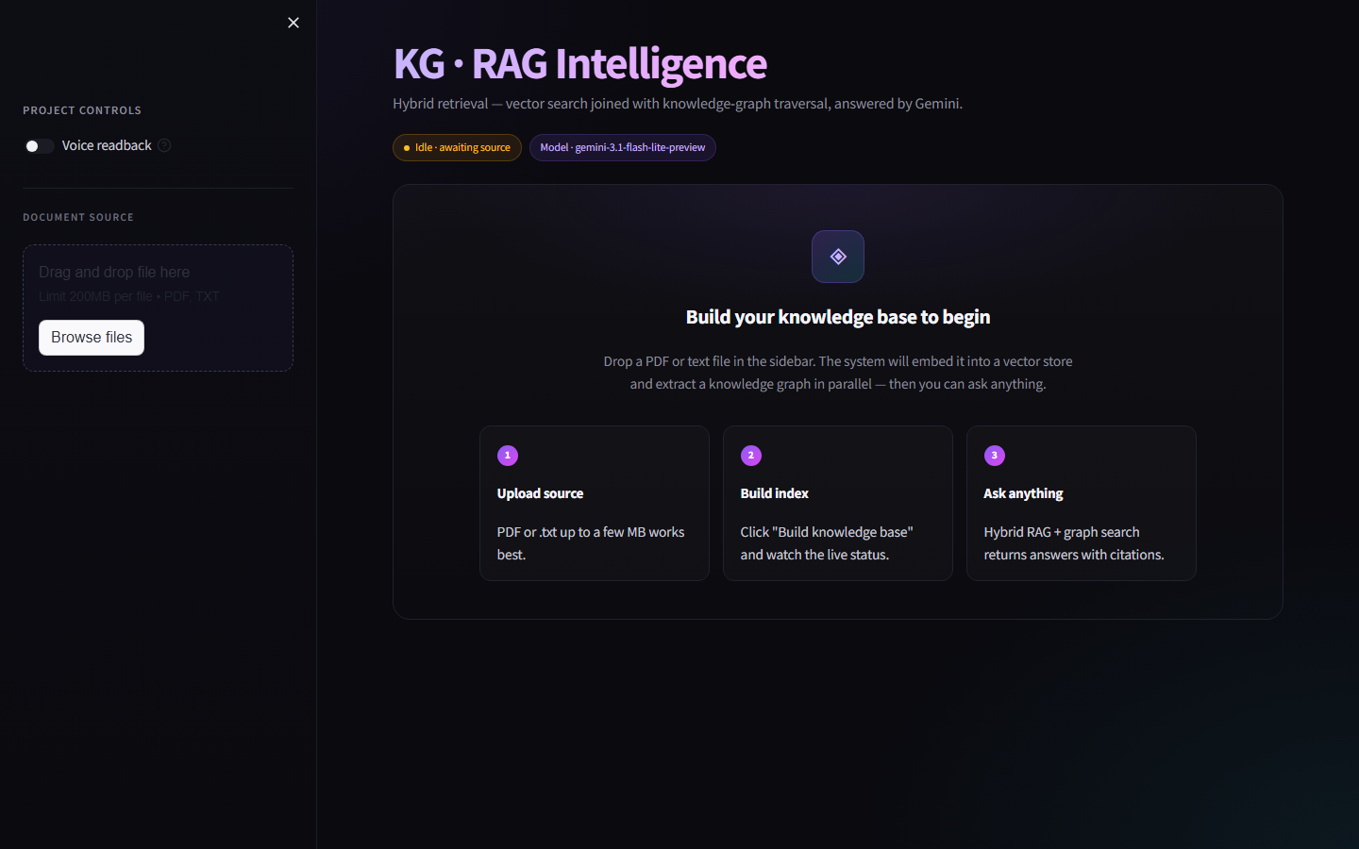
Internship Final Review
Snapshots
Figure 1: KG + RAG Intelligence — empty state with status pills, sidebar controls, and onboarding card
Dept of AIML, CBIT-Kolar
2026
12

Slide 13
Internship Final Review
Snapshots (continued)
Additional UI panels captured during user testing:
▸ Indexing status block — live stepped progress: Loading → Chunking → Embedding → Extracting KG
▸ Chat tab — assistant messages with bot avatar, expandable Sources panel showing chunk metadata
▸ Knowledge graph tab — Entities / Relationships / Graph density metric tiles and interactive PyVis canvas
▸ Sidebar — Voice readback toggle, Document source uploader, Export controls, Reset session
▸ Intelligence Report — Markdown export with entity counts and up to 50 triplets
Refer to the live demo at http://localhost:8501 for full interactivity.
Dept of AIML, CBIT-Kolar
2026
13

Slide 14
Internship Final Review
Challenges Faced
▸ Handling PDFs whose pages contain images instead of extractable text (PyPDFLoader returns empty chunks).
▸ Streamlit's WebSocket-driven hydration broke naive `chrome --headless --screenshot` testing — virtual time does not advance the websocket exchange.
▸ PyVis save_graph attempted to write into ./lib/bindings, which failed with WinError 5 on a OneDrive-synced project root where lib/ was already locked.
▸ Streamlit's chat_message rejected the custom Unicode glyph `◈` because it is not in the emoji whitelist, falling through to a missing-file open.
▸ The shipped venv was a Python 3.9 shim hard-coded to another user's machine path, blocking every Python invocation until rebuilt.
▸ Limited prompt-engineering budget to coax stable JSON triplets out of the LLM across diverse document genres.
Dept of AIML, CBIT-Kolar
2026
14

Slide 15
Internship Final Review
Solutions & Learning
Solutions applied:
▸ Documented the PDF-extraction caveat in the run skill and validated extensions early via validate_file_extension.
▸ Replaced ad-hoc screenshotting with a Playwright-based driver that waits for the .hero-title selector before capturing.
▸ Switched PyVis to cdn_resources='in_line' and generate_html() — no filesystem writes, no lib/ permission issues.
▸ Swapped invalid Unicode avatars for real emoji (🤖, 🧑, 🧠) accepted by Streamlit's validator.
▸ Rebuilt the venv with the local Python 3.12 interpreter and force-reinstalled all wheels.
Key learnings:
▸ Hybrid AI architectures combining vector retrieval with structured graphs
▸ LLM-driven information extraction and prompt design for structured JSON output
▸ Streamlit advanced UI patterns: chat, status blocks, custom CSS, components.html
▸ Headless web-app testing with Playwright and CDP-driven hydration waits
Dept of AIML, CBIT-Kolar
2026
15

Slide 16
Internship Final Review
Applications
▸ The system has broad applicability wherever long-form documents need to be questioned and cross-referenced:
▸ Enterprise document Q&A — internal policies, SOPs, technical manuals
▸ Legal and contract analysis — clause lookup, cross-reference, obligation extraction
▸ Academic research — literature review and citation discovery across PDFs
▸ Medical record summarization — patient history Q&A with relational grounding
▸ Compliance and audit — regulation traceability across multi-section documents
▸ Construction project management — RFI / drawing-set / specification queries (directly relevant to A N Prakash CPMC)
It empowers non-technical users to extract structured insights without writing code.
Dept of AIML, CBIT-Kolar
2026
16

Slide 17
Internship Final Review
Conclusion
▸ The project successfully demonstrates that combining vector retrieval with automatically-extracted knowledge graphs produces a more grounded and reasoning-friendly Q&A agent than either approach alone.
▸ The Hybrid KG + RAG Intelligence system reduces hallucination, supports multi-hop reasoning via graph traversal, and presents results in a polished, citation-rich Streamlit interface.
▸ End-to-end automation — from document ingestion to graph visualization — makes the system usable by non-technical stakeholders without sacrificing rigor.
▸ The project deepened my understanding of LLM orchestration, retrieval architectures, and production-quality web UI engineering, and serves as a strong foundation for further work on agentic retrieval systems.
Dept of AIML, CBIT-Kolar
2026
17

Slide 18
Internship Final Review
Thank You
Q & A
Questions, suggestions, and discussion welcomed.
— Prajwal H D · 1CK22AI038 · 8th Semester · Dept. of AI & ML, CBIT Kolar —
Dept of AIML, CBIT-Kolar
2026
18

