Slide 1
Smart Multilingual Chatbot for PGRKAM Platform
CSE7101- Capstone Project
Review-5
Batch Number: CSE_37
Under the Supervision of,
Ms.Tintu Vijayan
School of Computer Science and Engineering
Presidency University
Roll Number | Student Name
20221CSE0355 | PRAJWAL A
20221CSE0457 | SRUJAN S
20221CSE0458 | SHREE SAI PAVAN E
Name of the Program: B.TECH CSE
Name of the HoD: Dr. Asif Mohammed
Name of the Program Project Coordinator: Dr.Jayavadivel Ravi & Mr.Muthuraju V
Name of the School Project Coordinators: Dr.Samapth A K & Dr.Geetha Arjunan

Slide 2
Content
Problem Statement
Objectives
Background and Related work for title Selection
Analysis of Problem Statement
Innovation or Novel Contributions
Git-hub Link
Timeline of the Project
References

Slide 3
Problem Statement:
Category: Software
Job seekers on the PGRKAM portal face challenges navigating large, text-heavy pages.
Limited accessibility for rural, non-English-speaking users.
Lack of personalized guidance and interactive assistance.
Absence of multilingual support and inclusivity.
Inefficient navigation and long search times.

Slide 4
Objectives
Develop a multilingual chatbot supporting Punjabi, Hindi, and English.
Integrate LLMs with translation frameworks for contextual accuracy.
Provide accessibility support (screen reader, audio output).
Evaluate user satisfaction, accuracy, and efficiency improvements.
Ensure scalability for additional languages and AI-based enhancements.

Slide 5
Background and Related Work
Existing government job portals lack real-time, personalized assistance.
AI chatbots (Galadima et al., 2024) improve accessibility with multilingual features.
Responsible AI (Liu & Fu, 2024) highlights the need for ethical, bias-free design.
LLMs face challenges in low-resource languages (Lai et al., 2023), requiring fallback translation.
Our project integrates multilingual LLMs, translation APIs, and accessibility tools to overcome these gaps.

Slide 6
Technology Stack Components
https://github.com/prajwal37-a/Smart-Multilingual-Chatbot-for-PGRKAM-Platform

Slide 7
Problem Statements
Limited accessibility for rural/non-English users.
Lack of real-time, guided navigation in portals.
Time-consuming manual search process.
Limited personalization and inclusivity in existing systems.

Slide 8
Proposed Methodology
User Dashboard: Multilingual chatbot panel for Punjabi, Hindi, English.
Admin Dashboard: Usage analytics, logs for query-response evaluation.
Role-Based Authentication: Separate user/admin privileges.
Accessibility Features: Screen reader, audio outputs for inclusivity.
Workflow: Query → Translation/Processing → Response Generation → Contextual Reply.

Slide 9
Innovation or Novel Contributions
Multilingual chatbot tailored for PGRKAM job seekers.
Combines LLMs with translation APIs for contextual accuracy.
Accessibility features for inclusivity (screen reader, audio).
Personalized job recommendations from interaction history.
Extensible to more Indian languages and AI-driven personalization.

Slide 10
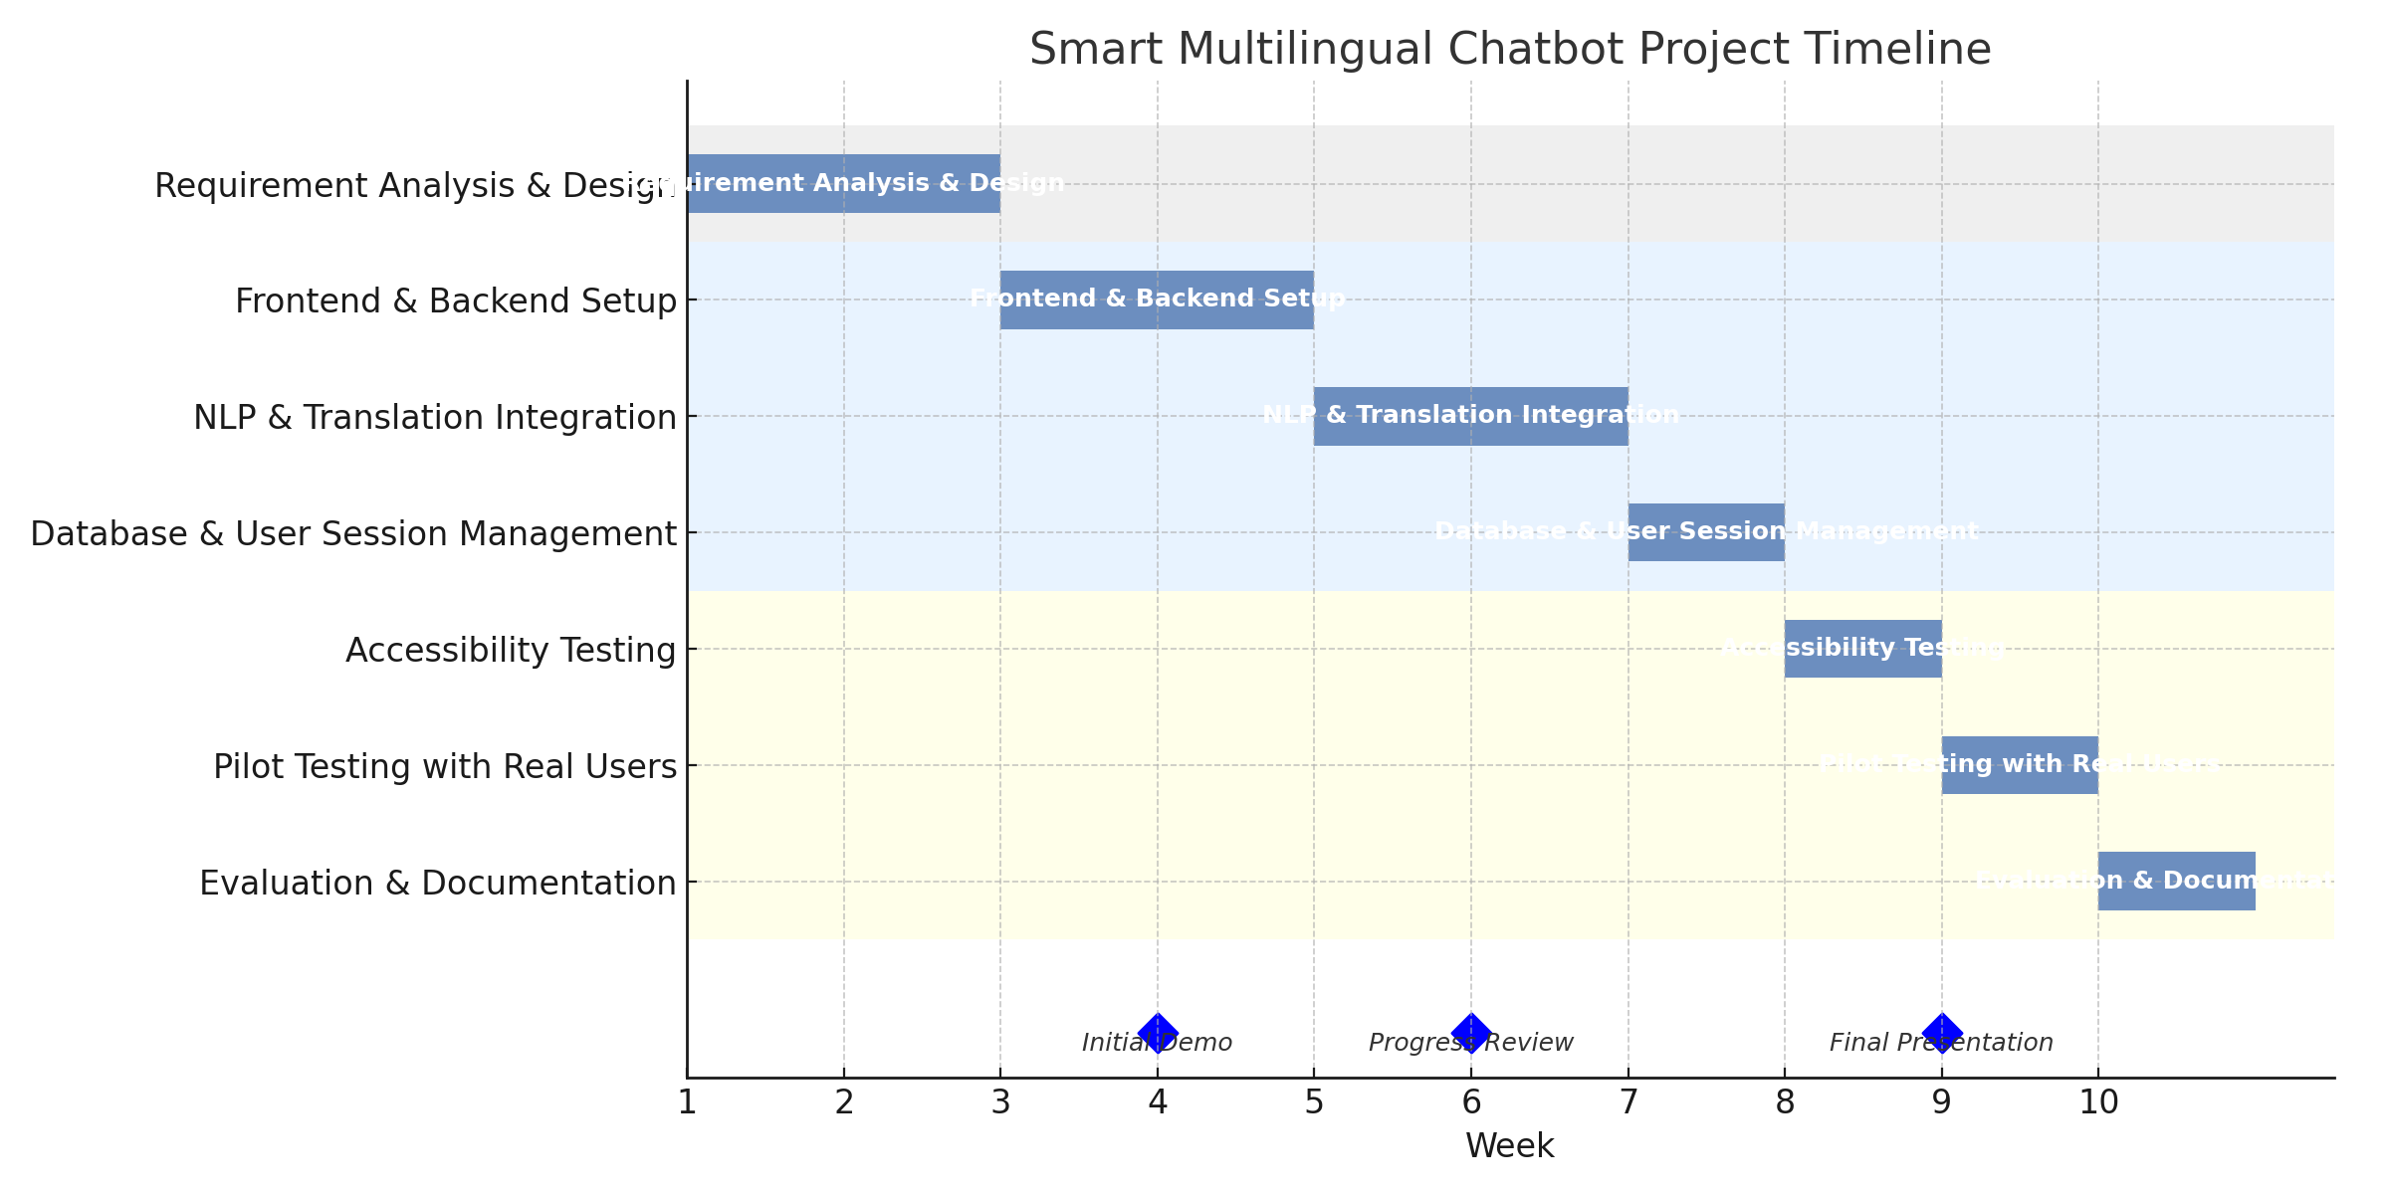
Timeline of the Project (Gantt Chart)

Slide 11
Future Plans
Add voice-based interactions for rural accessibility.
Expand chatbot to additional Indian languages.
Develop a mobile app for wider reach.
AI-driven job recommendations & personalization.
Integrate knowledge graphs for context-aware responses.

Slide 12
References (IEEE Paper format)
[1] Tuan, N. T., Moore, P., Thanh, D. H. V., & Pham, H. V. (2024). A Generative Artificial Intelligence Using Multilingual Large Language Models for ChatGPT Applications. Applied Sciences, 14(7).
https://doi.org/10.3390/app14073036
[2] Liu, J., & Fu, B. (2024). Responsible Multilingual Large Language Models: A Survey. arXiv.
https://arxiv.org/abs/2410.17532
[3] Lai, V. D., Ngo, N. T., Veyseh, A. P. B., Man, H., Dernoncourt, F., Bui, T., & Nguyen, T. H. (2023). ChatGPT Beyond English: Towards a Comprehensive Evaluation of LLMs in Multilingual Learning. EMNLP 2023.
https://doi.org/10.18653/v1/2023.findings-emnlp.878
[4] Galadima, K. R., Nkurikiyeyezu, K., & Emmanuel, L. (2024). A Multi-Lingual Conversational AI Chatbot for Effective Educational Consultations. International Journal of Emerging Multidisciplinary Computer Science and AI, 3(1), 1-9.
https://ojs.ijemd.com/index.php/ComputerScienceAI/article/view/312

Slide 13
References (IEEE Paper format)
[5] Paswan, D. K., & Dadhich, Y. (2025). ChatSense: A Multilingual AI Assistant Leveraging Pre-Trained LLMs and Knowledge Graphs. IJSRST.
https://www.ijsrst.com/index.php/home/article/view/IJSRST251222689
[6] ResearchGate. Multilingual Chatbot for Indian Languages.
https://www.researchgate.net/publication/375558397_MULTILINGUAL_CHATBOT_FOR_INDIAN_LANGUAGES
[7] ResearchGate. Implementation of Multilingual Chatbot.
https://www.researchgate.net/publication/353334652_Implementation_of_Multilingual_Chatbot
[8] IJSRST. ChatSense: A Multilingual AI Assistant.
https://ijsrst.com/index.php/home/article/view/IJSRST251222689

Slide 14


