Slide 1
Feature Selection Inspired Classifier Ensemble Reduction
Prajwal Kailas (prajwal967@gmail.com), 14CO132, 9632080195 National Institute Of Technology Karnataka

Slide 2
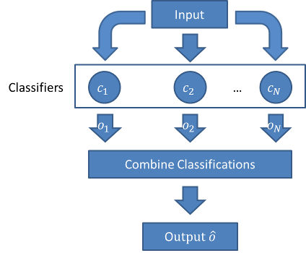
Introduction
Ensemble learning is a machine learning paradigm where multiple learners are trained to solve the same problem. In contrast to ordinary machine learning approaches which try to learn one hypothesis from training data, ensemble methods try to construct a set of hypotheses and combine them to use.

Slide 3
Introduction
Classifier Ensemble Reduction involves reducing the number of classifiers, C1, C2...CN to C1, C2...CK, where K<N. This is done such that the final output does not change. The target of classifier ensemble reduction is to reduce the amount of redundancy in a pre constructed classifier ensemble, to form a much reduced subset of classifiers that can still deliver the same classification results.

Slide 4


Objectives
:
Ensemble Build an ensemble of classifiers.
Feature Selection Locate the optimal feature subset.
Ensemble Reduction Optimal subset of classifiers, the final output.

Slide 5
KEY METHODOLOGIES/TECHNIQUES in Feature Selection Inspired Classifier Ensemble Reduction

Slide 6

Ensemble Methodologies
The first step is to build the base classifiers, classifiers such as Gradient Boosting (XGBoost), Multi Layer Perceptron, Random Forest Classifier, Decision Tree, Linear Regression, Logistic Regression can be used. The desired parameter values for these models are selected and then the base models are trained.

Slide 7
Ensemble Methodologies
Upon training the models, the trained models are used to obtain predictions on the cross validation data, the predictions obtained from the base models will be used to construct a data frame (a new dataset), which will be used to train the ensemble classifier. The techniques that can be used for building an ensemble classifier are stacking, blending, weighted average etc.

Slide 8
Feature Selection With Harmony Search
The objective of harmony search is to find a solution vector which is an optimized version of the cost function. Harmony search is based on musicians and notes. The analogy is, the a musician is a decision variable, the notes generated by the musician are values corresponding to the decision variables.

Slide 9
Feature Selection With Harmony Search
The variables and values are then permuted to find the global optimum which is the best harmony that is produced by the notes played by the musician.
In computational terms, the musician is analogous to the feature selector, and the features are analogous to the notes.

Slide 10
Feature Selection With Harmony Search
Each musician votes/selects a feature that needs to be included in the harmony. Finally a voting methodology is used to select the optimum notes/features which forms the optimum harmony/cost function.

Slide 11
Approaches
Classifier Ensemble Reduction

Slide 12
Classifier Ensemble Reduction
The first step is forming a pool of base classifiers, any machine learning classifier can be used in forming the pool. Once the base classifiers are constructed their predictions are gathered. Using these predictions a new dataset is constructed.

Slide 13
Classifier Ensemble Reduction
In the new dataset, each column represents an artificially generated feature, each row corresponds to a training instance. This can be thought of as a ensemble decision matrix.

Slide 14
Classifier Ensemble Reduction
Harmony search is then performed on this new dataset, and an optimal subset of features from this dataset is selected. Finally this optimal feature subset is used to build the ensemble classifier. Once the classifier ensemble is constructed, new objects are classified by the ensemble members, and their results are aggregated to form the final ensemble decision output.

Slide 15
Challenges
Testing with UCI benchmarked datasets which have large size and dimension, there are significant challenges in constructing and reducing the ensembles.

Slide 16
Issues
Since the optimal subset calculation varies, the overall/average execution time varies, so it is difficult to accurately measure the execution time. Also a substantial amount of time is required in the reduction process.

Slide 17
Advantages
Reduces memory usage.
Reduces system runtime and computational overhead.

Slide 18
Disadvantages
There can be a reduction in accuracy
Harmony search is expensive

Slide 19
Implementation
The implementation process will contain:
Forming a pool of base classifiers, the algorithms included will be Linear Regression, Gradient Boosting (XGBoost), Random Forest Classifier, Decision Tree, Logistic Regression, Multilayer Perceptron.
Tweak the parameters of these models and select optimum values.
Building an ensemble classifier using stacking, blending and weighted average techniques.

Slide 20
Implementation
The implementation process will contain:
Apply the harmony search algorithm to the ensemble classifier.
Test the final ensemble classifier with a benchmarked dataset.
Language: Python
Libraries: functools, numpy, sklearn, keras, xgboost, joblib, hyperopt, category_encoders

Slide 21
Summary
The Classifier Ensemble Reduction is based on applying feature selection techniques to minimize redundancy (reduce the size of the ensemble) which is done by transforming an ensemble decision matrix. This is done while while maintaining and improving classification accuracy and efficiency.

