Slide 1

Mastercard Identity Check Mobile
Delivering secure yet simple authentication
Frequently Asked Questions
Advise on image to use

Slide 2


Mastercard Identity check Mobile
Q: Why is authentication important?
The challenge…
Authentication can help…
Physical
Approval rate¹
Fraud rate²
Approval rate¹
96%
1x
11%
Transaction approval rates rise by 11% when fully authenticated
A: Payments in the digital world should be as safe and simple as they are in the physical world
Fraud rate³
Digital
Less than
Issuers that implement dynamic authentication experience the lowest CNP fraud
83%
3x
8BPS
©2016 Mastercard. Proprietary and Confidential.
Approval Rate Source: Mastercard Data Warehouse.
Fraud Rate Source: Javelin Strategy & Research, July 2013
Mastercard SecureCode cardholder verification method (CVM) fraud study, 2013.
41

Slide 3




Mastercard Identity check Mobile
Q: Who wants an alternative to passwords? A: Customers, issuers, merchants, and regulators
*****
Passwords are inconvenient and frustrating | Passwords are no match for today’s fraudsters | Passwords will not meet new authentication regulations | Forgotten passwords cause abandoned shopping carts
Ketchum Global Research & Analytics, survey of consumers in 17 countries commissioned by Mastercard, 2015

Slide 4
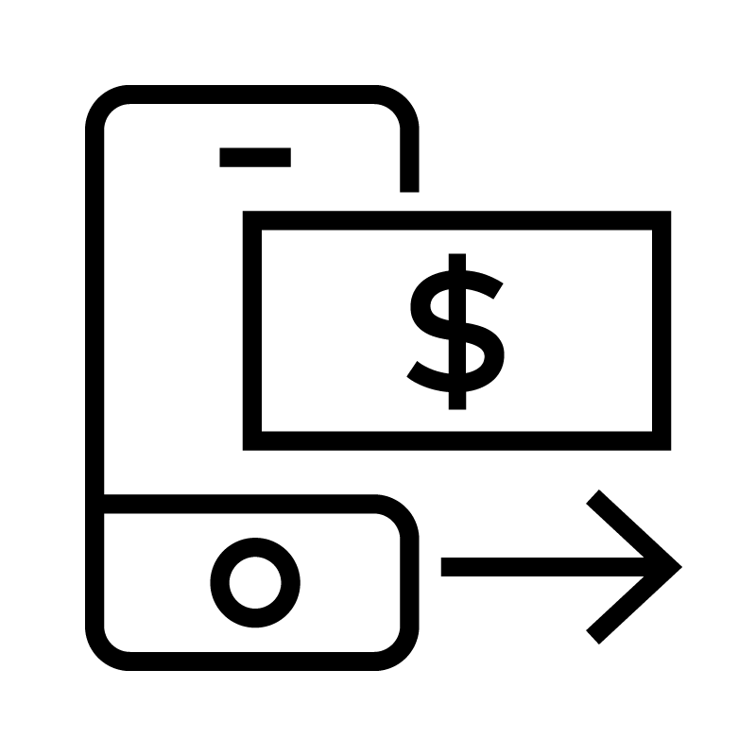



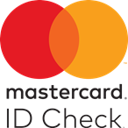



Mastercard Identity check Mobile
Q: Where can IDCM be used?
A: Across multiple use cases & channels
Digital Payments
OTP via SMS
Digital Wallets
Login Password
Intuitive experience • Low friction • Dynamic • Multi-factor •
Mobile Banking
Login Password
KBA w/ Call Center
Suspect Transaction Validation
Gov’t ID
In-Branch
TYPICAL AUTHENTICATION SOLUTIONS
KBA
Call Center
+ New Devices/Use Cases

Slide 5

Mastercard Identity check Mobile
Q: What is IDCM?
A: A simple & secure way to authenticate shoppers/mobile banking app users
Comprised of two main components
1
Front-end mobile app
2
Back-end biometric authentication platform
Deployment models
©2016 Mastercard. Proprietary and Confidential.
1
Co-Branded Identity Check Mobile App
2
Software Development Kit (SDK) for Issuer’s Mobile Apps

Slide 6


Mastercard Identity check Mobile
Q: Which biometric modalities are supported by IDCM?
A: Today, fingerprint & facial recognition
1
Fingerprint
2
Facial recognition
More coming soon
©2016 Mastercard. Proprietary and Confidential.

Slide 7


Mastercard Identity check Mobile
Q: What are the benefits for consumers & FIs?
Consumer Benefits | Financial Institution Benefits
Provides a more consistent, satisfying experience at each authentication touchpoint Eliminates the frustration of managing and remembering passwords Provides strong protection for consumer’s financial data Empowers cardholders to control their digital identity | Delights digitally savvy consumers with an intuitive and consistent shopping and banking experience Addresses emerging regulatory requirements in many markets for strong two-factor authentication Decreases fraud and operational costs Enhances customer engagement and loyalty Increases revenues by enabling increased transaction completion and approval rates

Slide 8
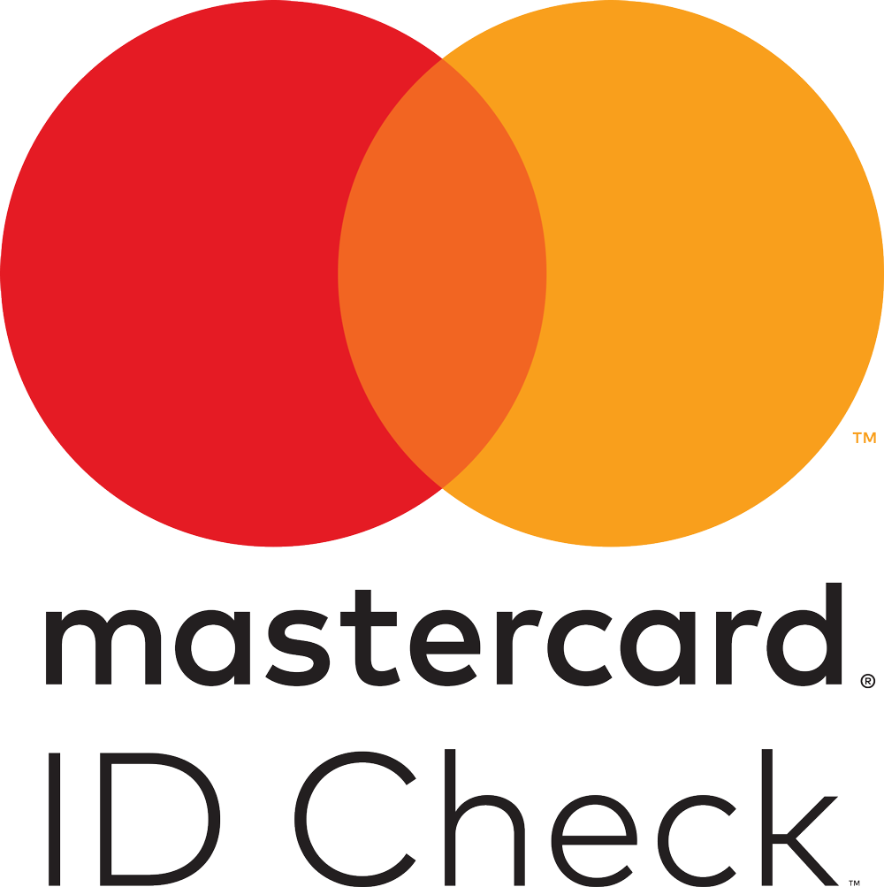

Mastercard Identity check Mobile
Q: What do early adopters think of the solution?
#1
Outperformed all other authentication methods for security and convenience
9 out of 10 Would definitely like to replace their password with Identity Check Mobile biometric
49% faster Identity Check Mobile using fingerprint was 49% faster than a static password
©2016 Mastercard. Proprietary and Confidential.
9 out of 10
Cardholders rated Identity Check Mobile app high on convenience and security
72% safer Believe using the Identity Check Mobile app for shopping online will reduce fraud
41

Slide 9

Mastercard Identity check Mobile
Q: What do industry watchers think of the solution?
A: IDCM has already received numerous awards
PYMNTS Innovation Award | Gold Best Newcomer
CNP | Judges Choice Best Mobile Solution
Gartner Eye on Innovation Award | Most Innovative Digital Customer Service or Product
PR Week Global Awards | Winner Consumer Launch

Slide 10
Mastercard Identity check Mobile
Q: How do I get more information?
A: Lisa Rode, Global Commercialization Lead
lisa.rode@mastercard.com

