Slide 1
<Company Name & Logo>
Project Title
Template for Pitching

Slide 2
Scoring Criteria
Parameter | Marks | Evaluation Criteria
Innovation & Differentiation | 20 | Novelty, uniqueness, use of emerging technologies
Technical Soundness | 15 | Architecture, reliability, robustness
Product Readiness (TRL ≥ 7) | 15 | Deployment readiness, maturity
Applicability to Government Use | 15 | Relevance, contextual fit, usability
Scalability | 10 | Potential to scale across geographies/departments
Integration Capability | 5 | Compatibility with existing systems
Socio-Economic Impact | 10 | Impact on governance, economy, and citizen services
Team Capability | 5 | Expertise and execution ability
Grants / Government Support Received | 5 | Prior grants, funding, or institutional support
Sustainability & Maintenance | 5 | Long-term viability and support

Slide 3
Important Submission Guidelines
Please ensure that the Pitch Deck is submitted strictly in the prescribed format.
The Pitch Deck must be submitted in PDF format only.
The presentation must adhere to the prescribed slide sequence, slide numbering, font style (Arial), font size (11), layout (1.5 spacing), and overall formatting guidelines provided by the organizers.
The final PDF file size must not exceed 10 MB.
Applicants are advised to thoroughly review their submissions before uploading to ensure compliance with all specified requirements.
Any deviation from the prescribed format, including non-adherence to the required slide structure, font specifications, formatting standards, file format, or file size limit, may result in the application being rejected without further consideration.
Submission of the Pitch Deck shall be deemed as acceptance of the above conditions.

Slide 4
Introduction about the Company
Company Name (As per Incorporation only)
Company Website/URL
Contact details (city, e-mail, mobile)
Date (DD/MM/YYYY) of Incorporation (CIN)/ Registration
Name of the Director(s)/ Partner (s)
Please add more rows if there are more Directors/ Partners
# | Name (As per the RoC or Partnership Deed) | DIN Number (In case of RoC Company) | No of Shares

Slide 5
Problem Statement
How will you be solving the problem ?
Use visuals and quantifiable data to make the explain the problem statement.
Mention what they are currently doing and how your product/service is a better solution
Any relevant data or reports or press clippings available to support this assumption. Please mention the source

Slide 6
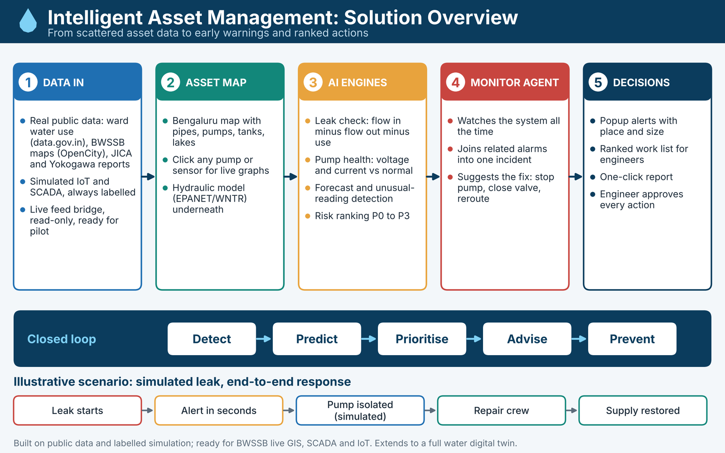
1. Product/ Solution - Innovation
Innovation: Intelligent asset management bringing GIS, SCADA and IoT into one view.
1st of its kind?: No, an improvement. Adds cross-asset analytics over pump AI.
Unique: Flow-balance leak range, pump health via voltage/current, P0-P3 ranking, advice.
Target customer: BWSSB and urban water supply and sewerage boards across Karnataka.
Need: Find failures early, reduce water loss, prevent pump trips, know what to fix.
How we deliver: Live asset map, early alert popups, ranked work orders, one-click reports.
Better than others: Unified view, open standards, explainable rules, engineer approval.
Key note: Built on public data; ready for real data. Can also deliver a full digital twin.
Figure: Intelligent Asset Management, solution overview.

Slide 7
2. Product/ Solution - Readiness Level
Current stage: Concept | Prototype/MVP (working software prototype) | Live / Early Traction | Growth Stage
Technology Readiness Level: TRL 4 to 5 today: working system prototype validated in the lab on public BWSSB data and labelled simulation. Pilot goal: reach TRL 7 by running it on live BWSSB data at one pumping station and one supply zone (DMA).
Data used: Public internet data plus labelled simulation; ready for real BWSSB data.
[Add screenshot: Asset map of Bengaluru]
[Add screenshot: Pump voltage and current graphs]
[Add screenshot: Leak alert popup]
Feature | What it does | Technology | Status
Asset map (GIS) | Pipes, pumps, tanks, lakes; zoom from city to station | MapLibre, deck.gl, OpenStreetMap, BWSSB open GIS data | Built
Pump health | Voltage, current, ON/OFF, start-up and drift alerts | Median/MAD baselines, rule engine | Built / Simulated
Leak detection | Flow in minus flow out minus use; loss estimate and location range | Mass balance, EPANET/WNTR | Built / Simulated
Monitoring agent | Joins alarms into one incident, suggests isolation and repair steps | Python asyncio agent | Built / Simulated
Risk ranking | Assets ranked P0 to P3 with reasons | Weighted risk score model | Built / Planned

Slide 8
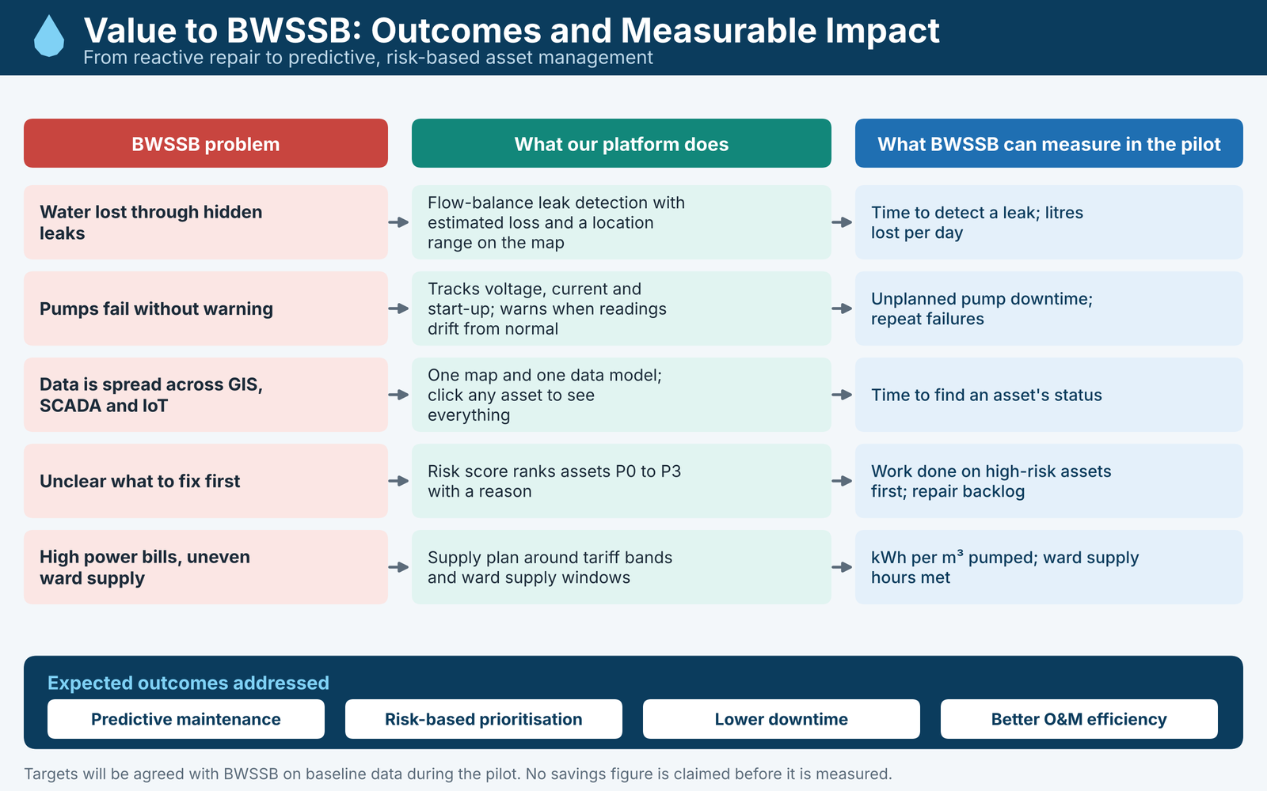
3. Applicability to Government Use
Addresses the problem: One view of asset condition, early warnings and a ranked repair list for utility teams.
Fits government workflow: Views by role; alerts become advice; engineer approves every action; never auto-switches.
Effort to adopt: Software only at first; reads existing GIS and SCADA exports; zero change to field PLCs.
Works with existing systems: Designed for OPC-UA, Modbus and MQTT; adapters tested against simulators; read-only default.
Validation so far: Tested on public BWSSB data and simulated leak, pump and sensor scenarios. No pilot yet.
Pilot plan: Validate on live data at 1 station and 1 supply zone; measure slide 11 KPIs.
Figure: Value to BWSSB, outcomes and measurable impact.

Slide 9
4. Scalability of the Solution
Multi-Department Applicability: The same platform can be adapted for other urban water boards and city bodies (water supply, sewage, borewells) with changes to settings, not code. It can also be extended to a full digital twin for water management.
Geographical Scalability: Networks, pumps, tariffs and limits are in config files, nothing is hard-coded to Bengaluru. A new city needs its GIS layers and asset list loaded. Works for large cities and smaller towns.
Technical scale: Runs in containers; data layer can move from SQLite to PostgreSQL/PostGIS (planned).
Proposed plan: Phased scale-up roadmap from pilot to state-wide adoption
Phase 1 (Months 1-3)
1 pumping station + 1 supply zone
• Validate live data
• Test leak alerts
• Calibrate baseline
• Train operators
Phase 2 (Months 4-6)
One full division
• Multiple stations
• Multiple wards
• Energy tariff optimization
• Incident reports
Phase 3 (Months 7-12)
Bengaluru core network
• Cauvery trunk corridors
• Major city GLRs
• Full risk ranking (P0-P3)
• Cross-zone balance
Phase 4 (Year 2)
Other Karnataka boards
• Multi-city deployment
• Tier-2 urban water boards
• Central dashboard
• Enterprise SLA

Slide 10
5. Integration Capability of the Solution
Integration Readiness: Built for BWSSB GIS, SCADA and IoT adapters; lab-tested on public and simulated feeds; telemetry bridge ready.
System Compatibility: OPC-UA, Modbus TCP, MQTT, REST, GeoJSON; adapters simulator-tested; live field feeds planned for pilot.
Interoperability & Security: Unified data model; role logins (RBAC), rate limits and audit log; read-only field access.
BWSSB Systems
• GIS pipeline maps
• SCADA pump telemetry
• IoT edge meters
• Maintenance records
Today: public data + sim
Pilot: live BWSSB feeds
Gateway Adapters
• OPC-UA bridge
• Modbus TCP
• MQTT Sparkplug
• REST / GeoJSON
Read-only default
Asset Platform
• Unified data model
• Mass balance engine
• Pump health (MAD)
• Risk priority (P0-P3)
• Monitoring agent
Decision Support
• Early failure alerts
• Ranked repair list
• Engineer advice
• One-click reports
• Secure REST APIs

Slide 11
6. Socio-Economic Impact of the Project
Society: Fewer supply cuts from pump trips and faster leak repair give steadier water.
Environment & SDGs: Supports UN SDG 6 and 11 by cutting water loss and wasted energy.
Economy: Less lost water, less unplanned repair work, and lower pumping power bills.
Jobs in Karnataka: [FILL: number and type of jobs the company will create in Karnataka]
Simple arithmetic: 1 MLD saved = 1,000 m3/day = 365,000 m3/year. Rupee value set with BWSSB.
Measure | Baseline | Target | How measured
Time to detect a leak | From BWSSB data | To be agreed with BWSSB | Mass-balance and pressure drop alert timestamp
Litres lost per day | From BWSSB data | To be agreed with BWSSB | Flow imbalance calculation before and after repair
Unplanned pump downtime | From BWSSB data | To be agreed with BWSSB | SCADA motor trip and maintenance log comparison
Energy per m3 pumped | From BWSSB data | To be agreed with BWSSB | Multifunction energy meter kWh divided by bulk flow m3

Slide 12
7. Team Size, Background, Strength /Capability and Resources
[Add photo]
[Add photo]
[Add photo]
[Add photo]
Name | Designation | Exp / Qualification | Previous Co worked | Role in this project | Founder / Member / Employee
[FILL: Name 1] | [FILL: Lead Architect] | [FILL: B.E., X yrs] | [FILL: Prev Co 1] | [FILL: System Architecture] | [FILL: Co-Founder]
[FILL: Name 2] | [FILL: IoT Lead] | [FILL: B.E., X yrs] | [FILL: Prev Co 2] | [FILL: SCADA/IoT Gateway] | [FILL: Founding Member]
[FILL: Name 3] | [FILL: AI / ML Lead] | [FILL: B.Tech, X yrs] | [FILL: Prev Co 3] | [FILL: ML & Analytics Models] | [FILL: Employee]
[FILL: Name 4] | [FILL: Full-Stack Lead] | [FILL: B.E., X yrs] | [FILL: Prev Co 4] | [FILL: GIS & UI Platform] | [FILL: Employee]
Our strength: Robotics, automation, motor control, IoT and software engineering at Ignomagine Pvt. Ltd.; we built the prototype end to end. [FILL: add any water or utility experience]
Gap and plan: [FILL: name the water/hydraulic domain advisor or partner, or write "we will onboard a water-utility domain advisor and work with BWSSB engineers during the pilot"].

Slide 13
8. Revenue Model
This section details the specifics of your income streams and how you will make money from this business opportunity.
Revenue Model: Pricing and Revenue Forecast across years and how it will grow.
Pricing Strategy: Explain your pricing logic (e.g., competitive, value-based) and state the price clearly (e.g., ₹499/month).
Revenue Streams: List all the ways you generate income. Be specific.
  Examples: Subscription Fees, Direct Product Sales, Transaction Fees/Commission, Licensing, Freemium Model, Advertising.
Customer Lifetime Value (LTV): Briefly estimate how much revenue you expect from a single customer over their entire relationship with your business.

Slide 14
9. Grants / Government Support Received - Financial Projections
Provide a simple, high-level forecast to show the financial potential of your business.
Grants, Funding & Institutional Support: Provide details of any grants, funding, accelerator/incubator support, research partnerships, or other institutional backing received by the startup, along with their contribution to product development, validation, or commercialization.
3-Year Revenue Forecast: Use a simple chart or table to show your projected revenue for the next three years. This demonstrates ambition and a clear vision for growth.

Slide 15
10. Sustainability & Maintenance - Business Model & Strategy
This section explains the operational framework of your business. Be clear and concise.
Target Customer: Define exactly who you are selling to (e.g., B2B - small manufacturers in Karnataka; B2C - urban working mothers).
Value Proposition: What unique value do you provide to your target customer?
Sales & Distribution Channels: How will you reach your customers and deliver your product/service? (e.g., Direct Sales Team, Online Store, Channel Partners, Mobile App).
Long-Term Viability & Support: Describe the sustainability of the solution, including the Business Model, maintenance and support framework to ensure continued operation and effectiveness over the long term.

Slide 16
Project Milestones
Define two distinct milestones that align with the two tranches of the Government First Work Order.
Milestone 1: Strategy -(First 45 to 60 days days)
Milestone 2: Strategy - (90 days and till completion)

Slide 17
Total Budget
Total Work Order amount you are requesting from the Government First program- INR 25 Lakhs (maximum)
Provide a detailed budget breakdown across the proposed expenditure categories, along with a brief justification for each allocation.
Explain how the proposed budget will support the development, deployment, testing, and validation of the solution within the identified government environment.
Provide a tranche-wise fund utilization plan, outlining the activities, milestones, and deliverables proposed to be undertaken using the initial 25% advance payment.
Describe how the remaining 75% of the project cost will be utilized to achieve pilot implementation, performance validation, project milestones, and final deliverables.
Identify the key cost assumptions, milestones, expected outcomes, and measurable impact proposed to be achieved through the utilization of the project funds.

Slide 18
THANK YOU

