Slide 1
MUSICLY
GUIDE:
R V RAMANA CHARY
TEAM:
PRAJWALA – 18211A1211
BALU ARYAN – 18211A1209

Slide 2
ABSTRACT:
The functions of playing music and multimedia have become essential in one device since the smart phone appeared.
Musicly is a artificial intelligence powered music player for your music library
Musicly is a offline app where anyone can play their downloaded songs by giving voice commands.
It offers automated and simple way to listen music.

Slide 3
Existing system and its limitations:
We have many music applications but some of them don’t work if the mobile doesn’t have internet.
We have music apps that take voice commands if we have proper bandwidth
Play music is an app where we can find our downloaded apps but it has some limitations such as it doesn’t take voice commands.
And many music apps needed to be subscribed to play songs on their apps.

Slide 4
Proposed system:
We have developed an app named MUSICLY that uses Artificial Intelligence .
This app allows the downloaded songs in our storage that can be accessed by giving voice commands such as
1. play next song – to play the next song
2. pause (or) stop – to stop the present song
3. play previous song – to play the previous song
We can use this app in offline mode also.
If we don’t want to give voice commands, we can shift to voice disabled mode.

Slide 5
System requirements:
SOFTWARE REQUIREMENTS
Android studio or Eclipse
Android SDK
Java
HARDWARE REQUIREMENTS
2GB Ram
Minimum 10MB space

Slide 6
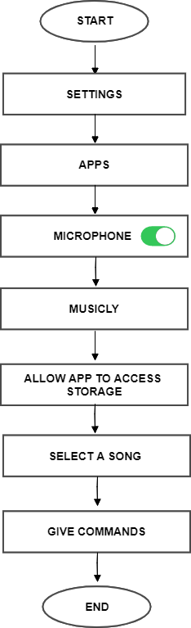
Flow chart:

Slide 7
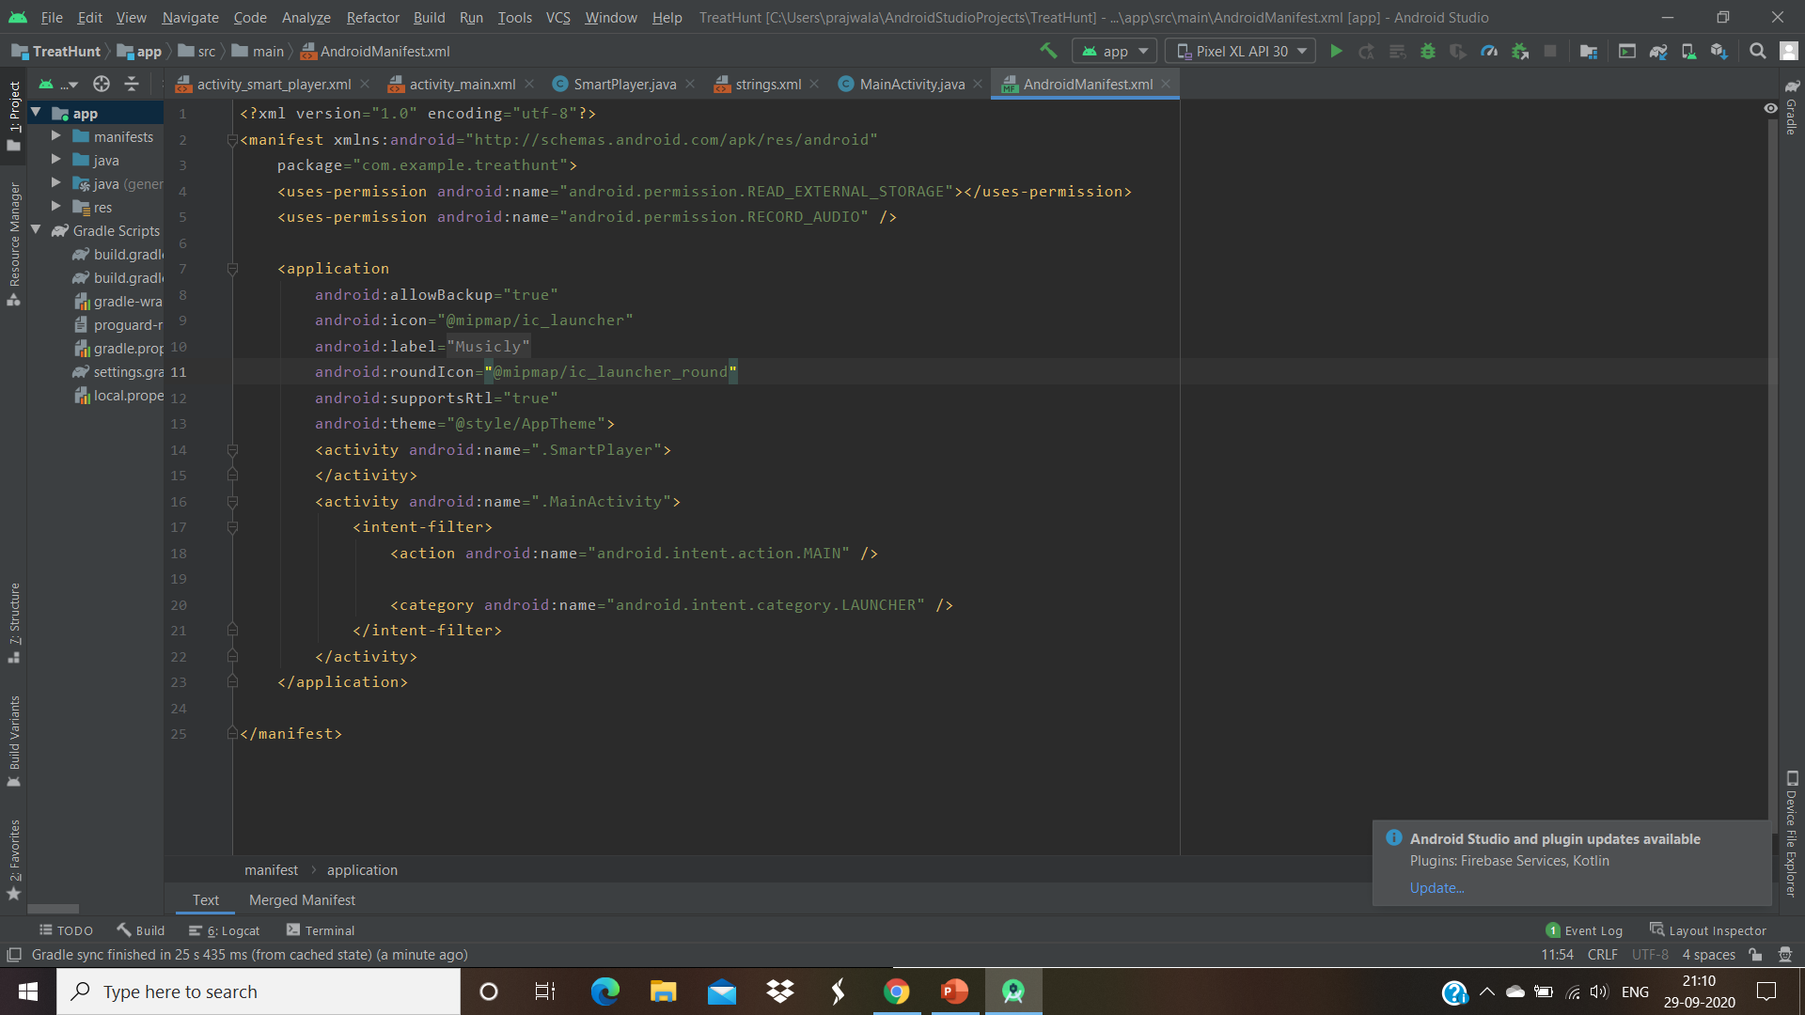
Code outputs:

Slide 8
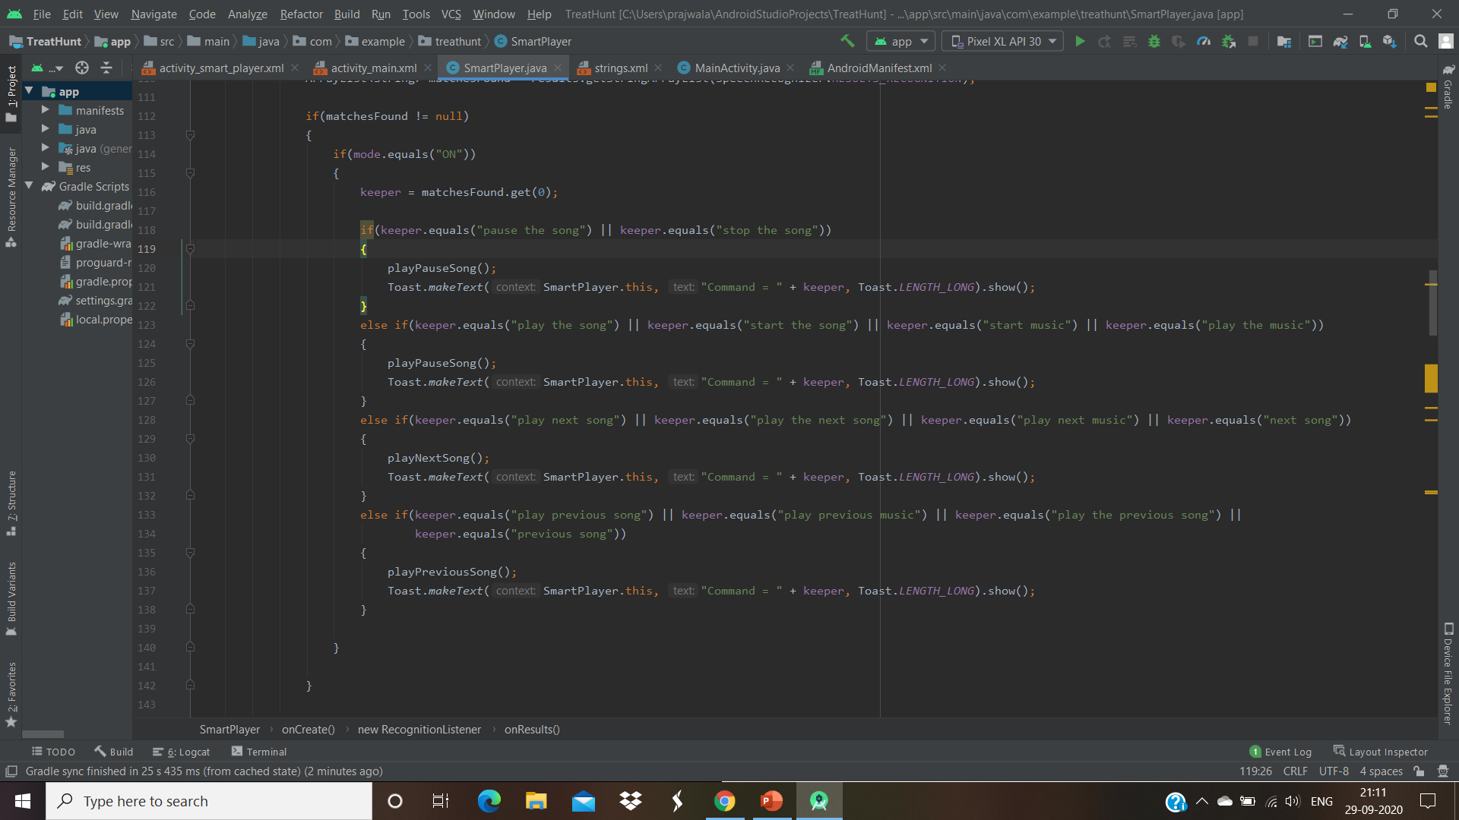

Slide 9
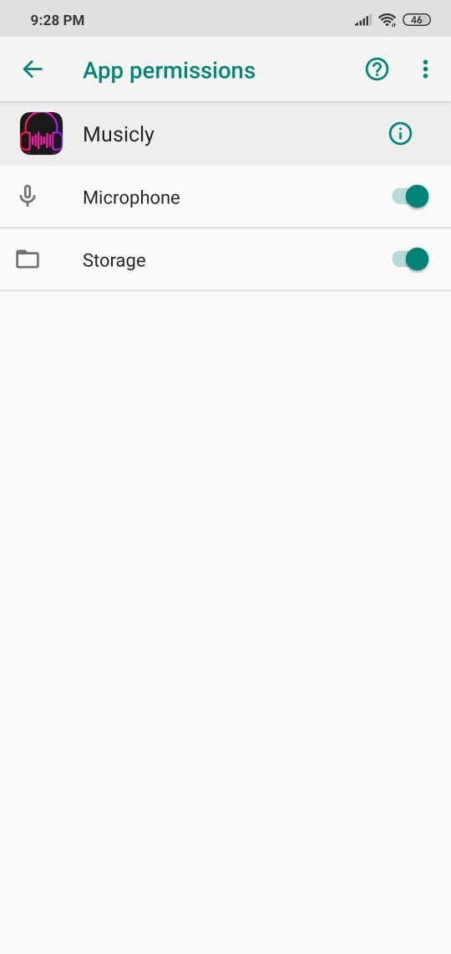
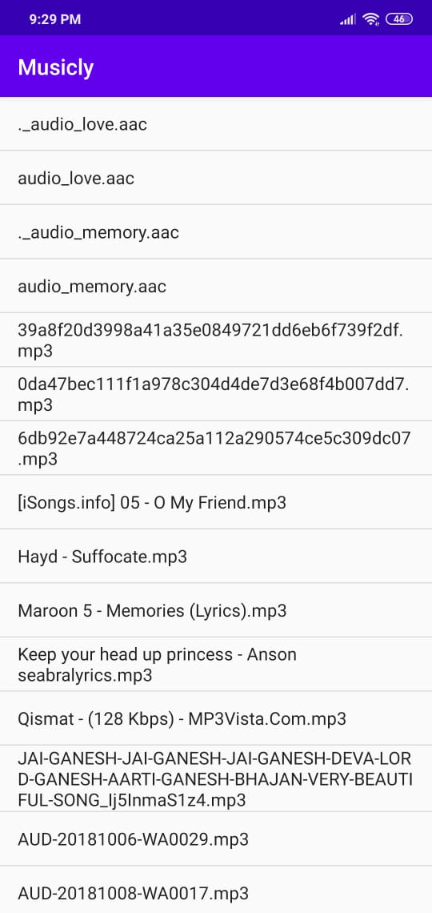
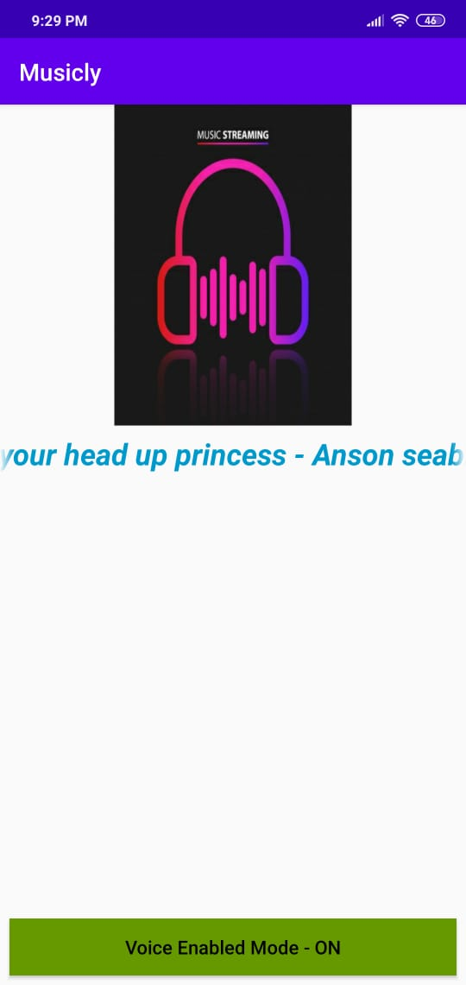
Screenshots of modules

Slide 10
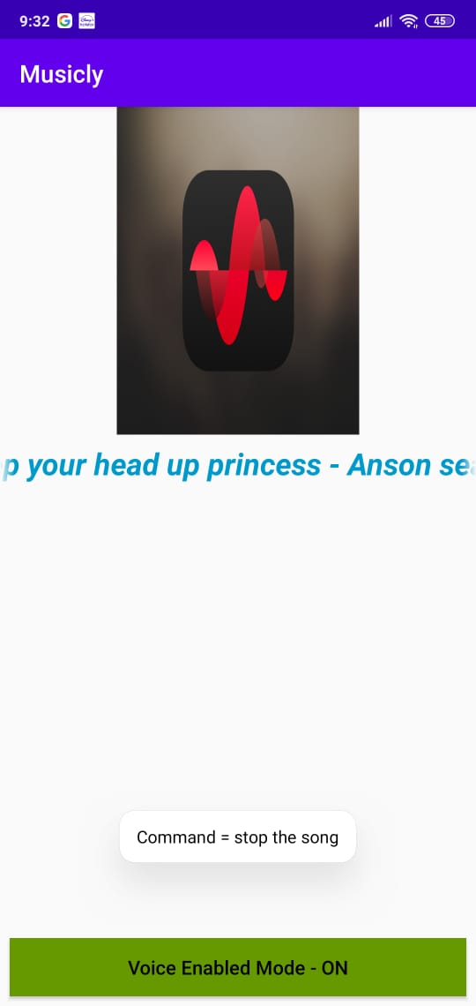
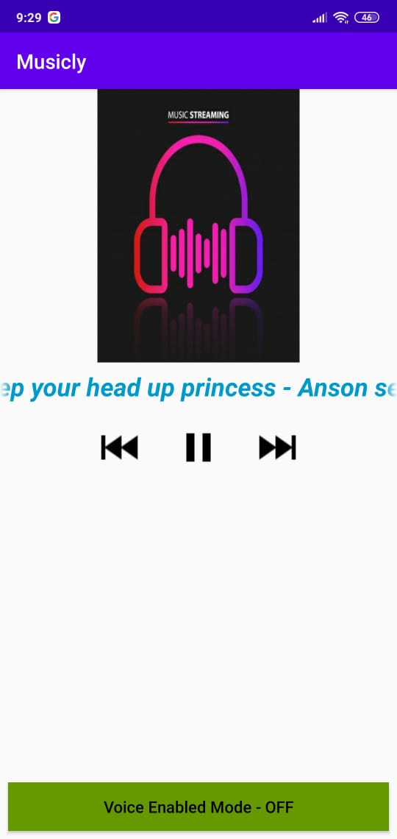

Slide 11
THANK YOU….

