Slide 1

Towards sustainable energy management : Federated Learning
By
Vatsa Khatri (BT21CSE006)
Prajwal Sam Rachapudy (BT21CSE015)
Harsh Deshmukh (BT21CSE020)
Rashmi Sharma (BT21CSE022)
Under guidance of
Dr. PVN Prashanth

Slide 2
Review of last evaluation/Where we left last time
We encountered two challenges with FL:
1) Asynchronous challenge
2) Data Heterogenity

Slide 3
Review of last evaluation/Where we left last time
Solution to Asynchronous Challenge
Directed Acyclic Graph (DAG) Approach
C1
S
C2
C3
(Updated DAG)

Slide 4
Structure of Node in the DAG
The updated model parameters (coefficients and intercept)
Client ID
TimeStamp
Latitude, Longitude(Location of the client)
Structure of a Node

Slide 5
Client-Client Relation
Before we have considered the relation between client and server only but in real life scenario there can be relation between client and client based on the following two parameters:
Proximity Approximation: With the help of (latitude,longitude) for each client we can find the distance with the other clients and if their distance > threshold value then we can establish a relation between the clients.
Model Similarity: If the similarity score between the models of two clients is greater than a threshold then we can establish a relation between the clients.

Slide 6
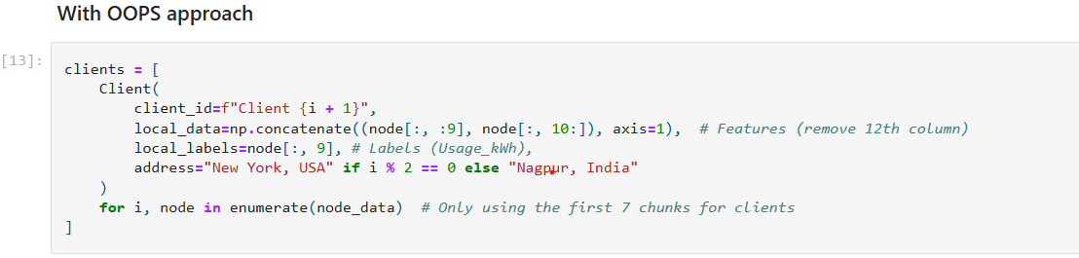
Implementing DAG Approach
We are initialising a list of clients where each client is an independent object of the Client class (which will be discussed later in this presentation).
In the client object, we are adding an address field to apply the proximity approximation.

Slide 7
Till now, we have been using sequential method to handle all the clients and then send the update to the global model.
But here we used the concurrent approach to simulate multiple clients.

Slide 8
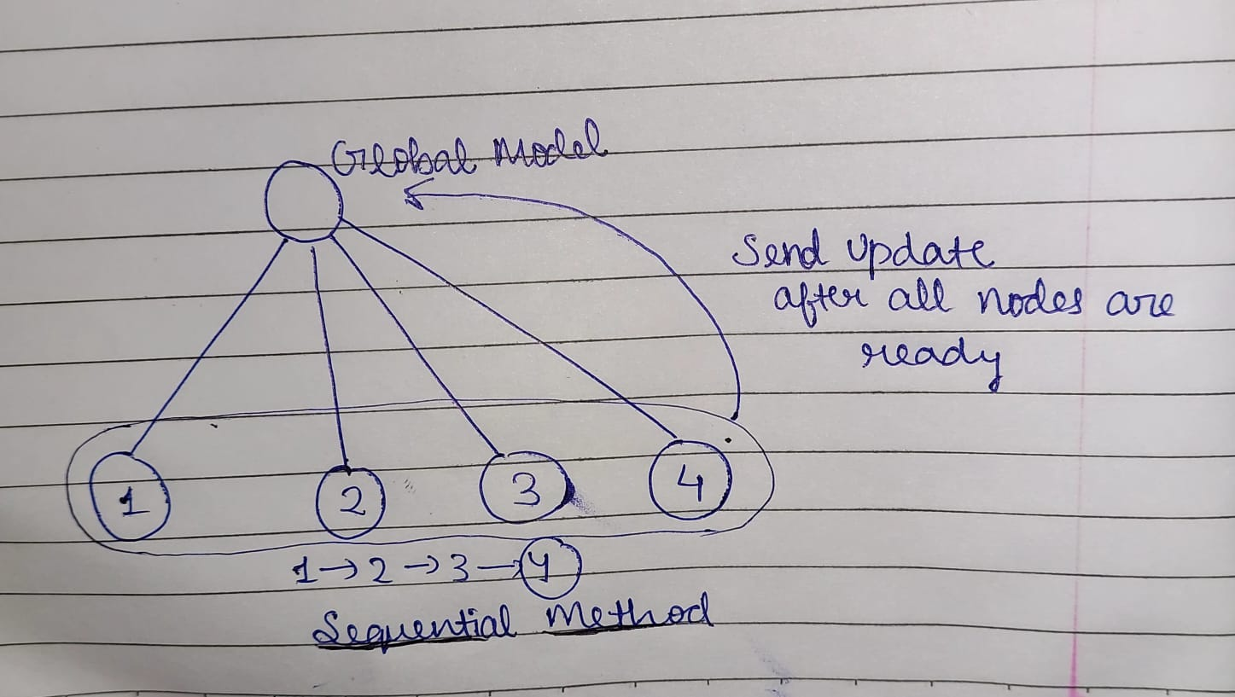
Concurreny Approach
Sequential Method

Slide 9
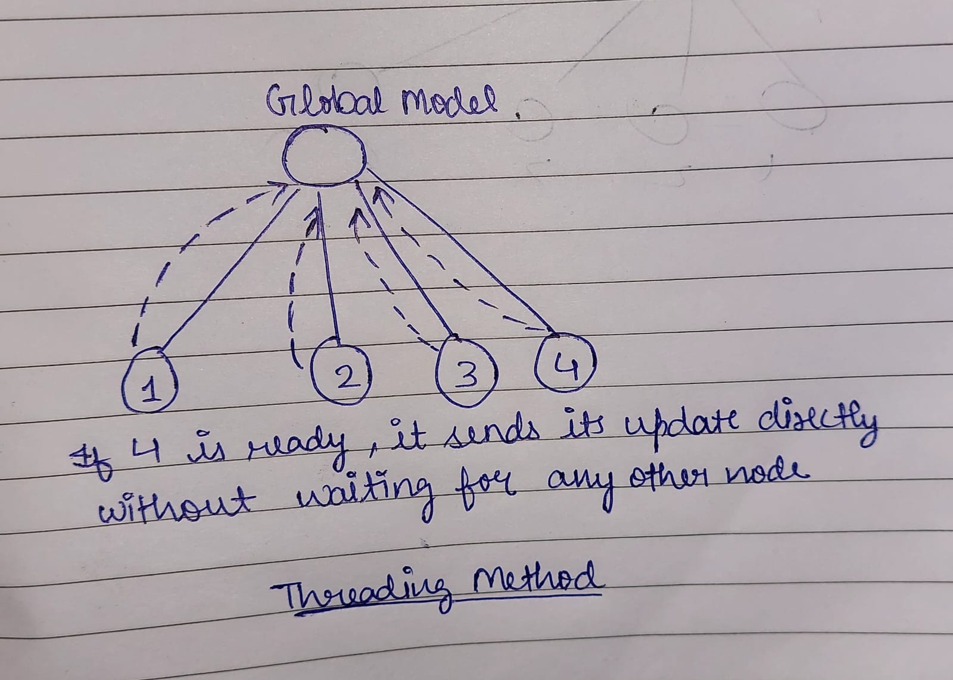
Concurreny Approach
Concurrent Method

Slide 10
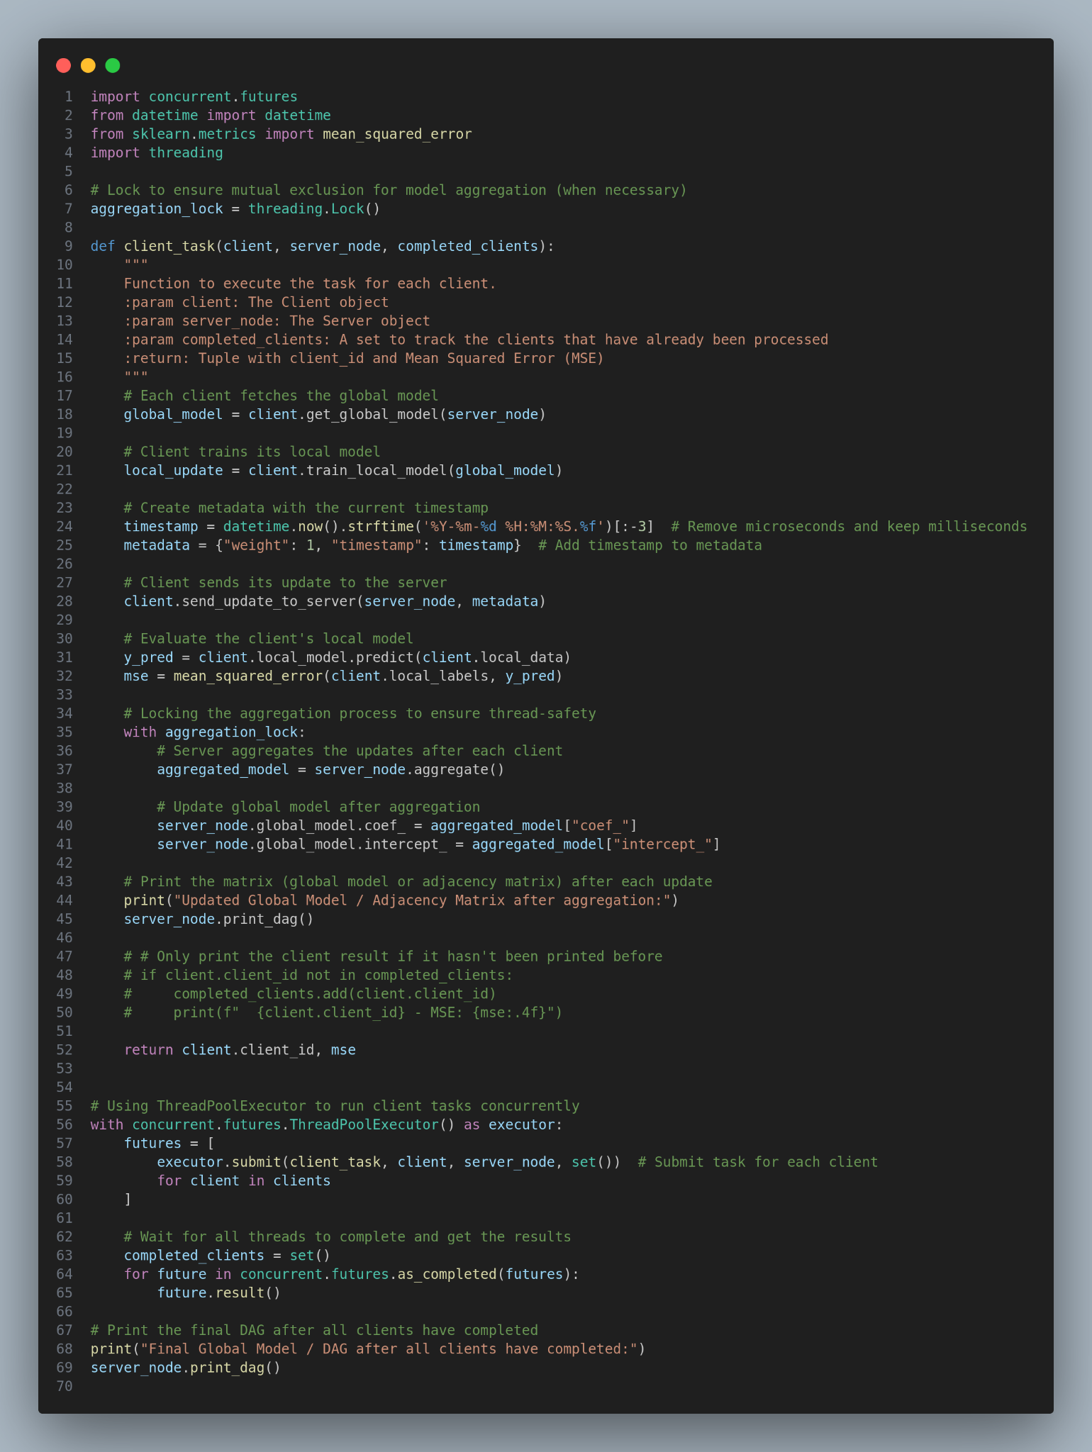
Concurrent Approach

Slide 11
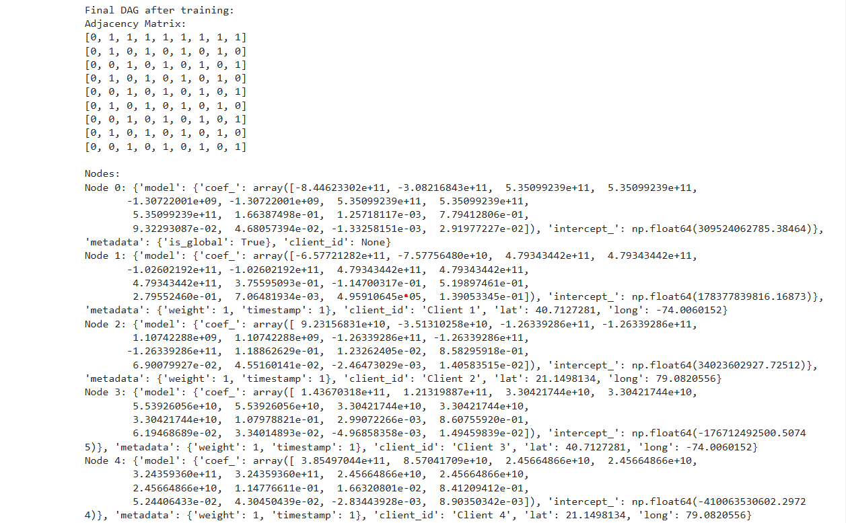
Concurrent Approach

Slide 12
Drawbacks of this method
As Concurrency is limited to single file , independent clients(files or machines)can be better handled using multiple files approach.

Slide 13
Better Solution
As we know that the real world scenarios are represented better by multiple file approach.

Slide 14
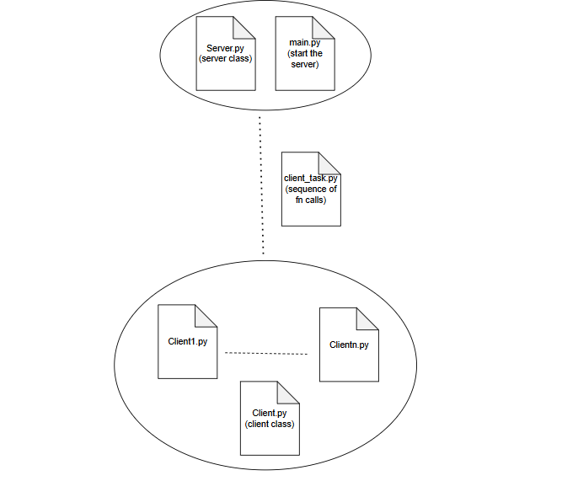
A Realistic CLient Server Approach: Better Solution

Slide 15
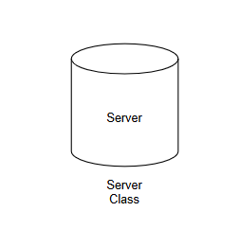
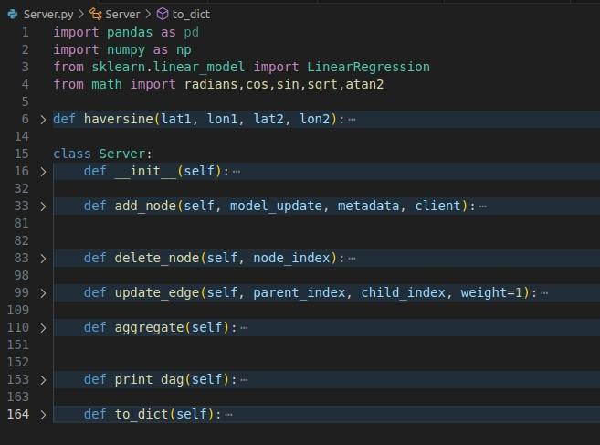
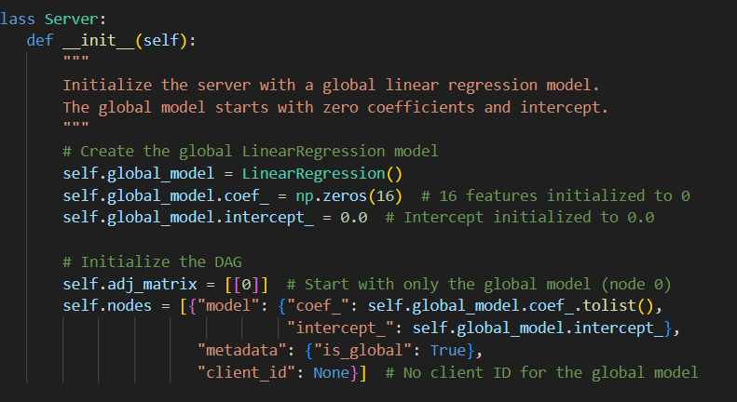
Structure of Client and Server Class
SERVER
CLASS

Slide 16

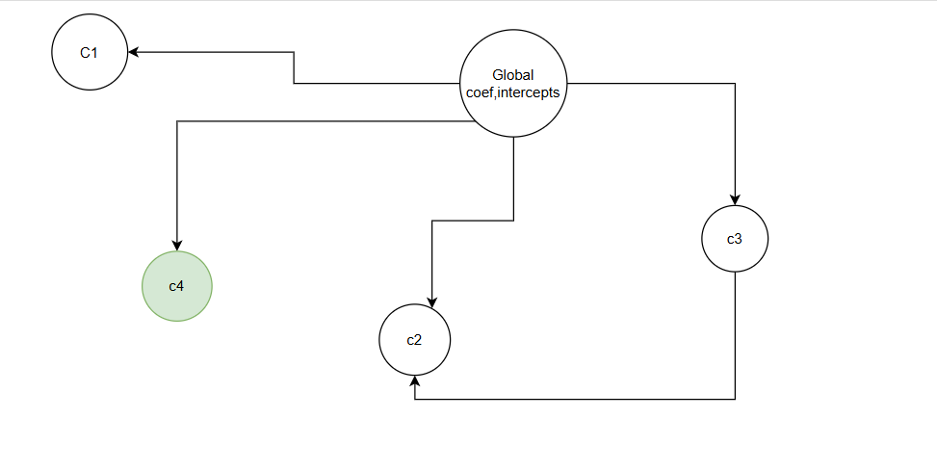
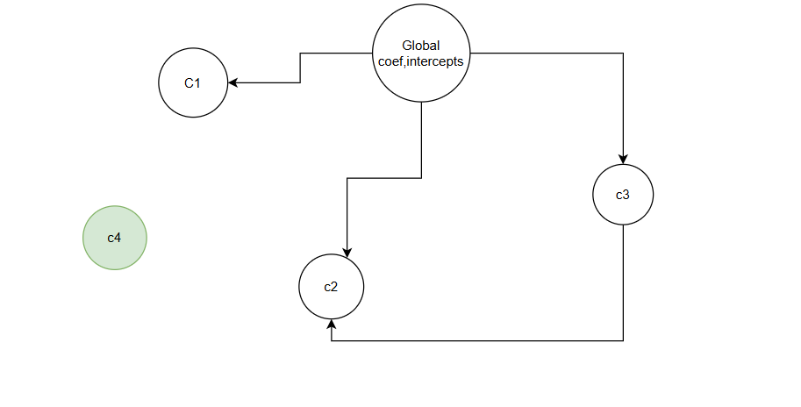
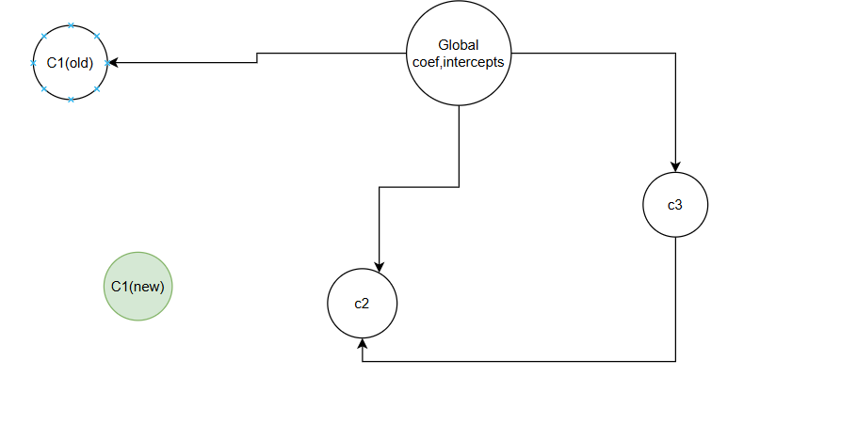
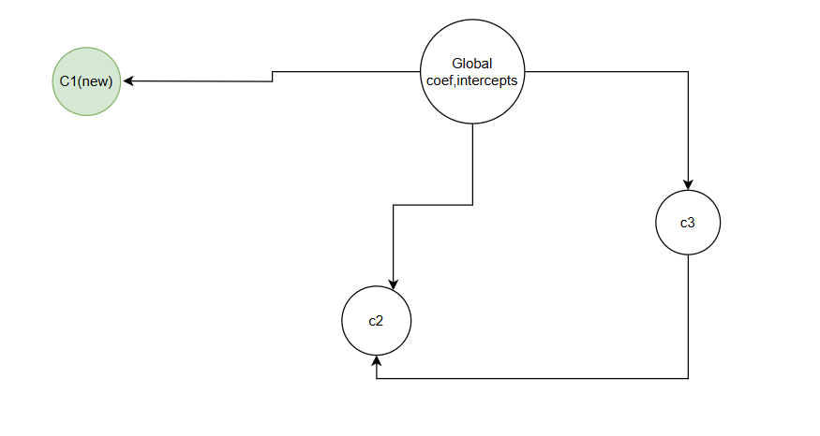

Slide 17

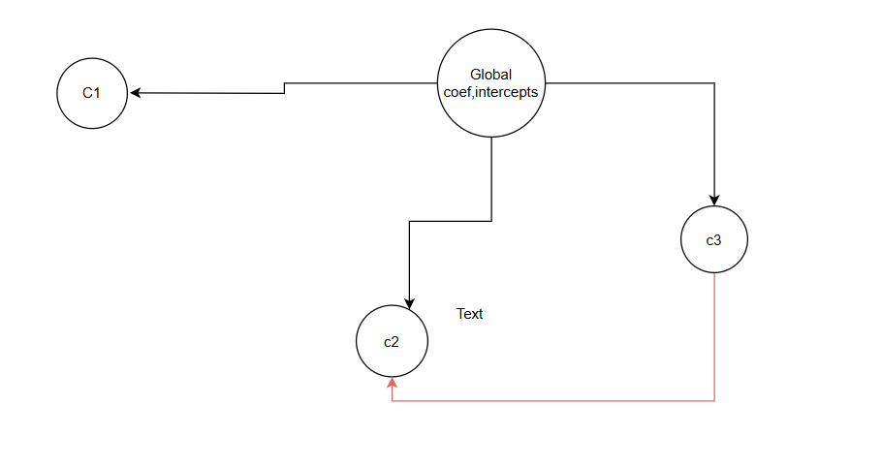
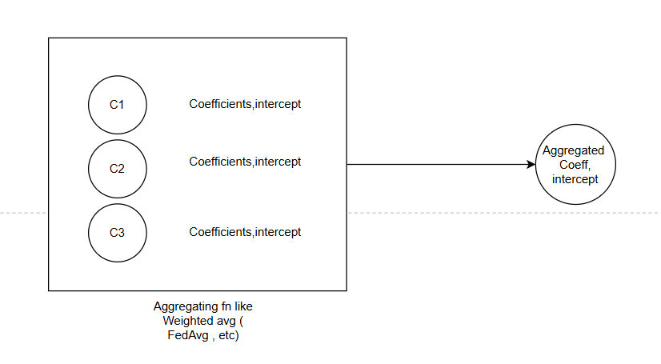
Aggregate models from all leaf nodes directly connected to the global model (node 0).
:return: The updated global model coefficients and intercept

Slide 18

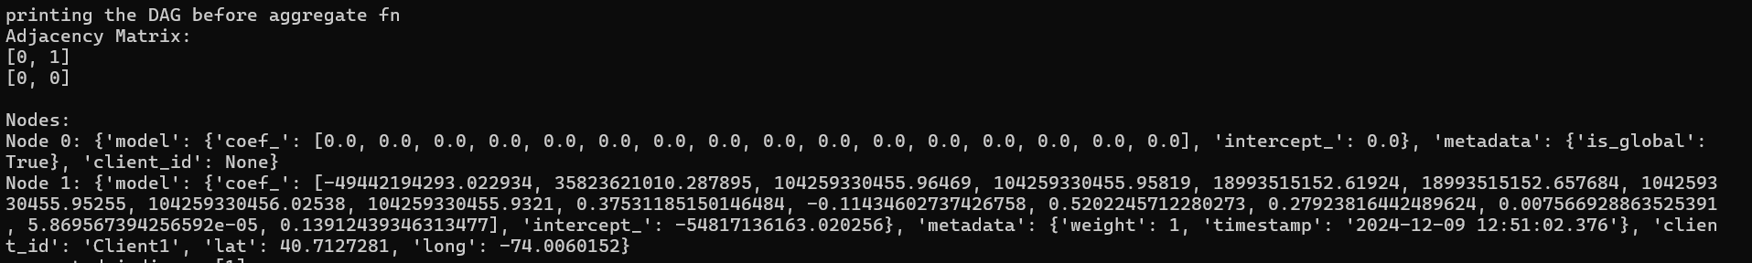

Slide 19
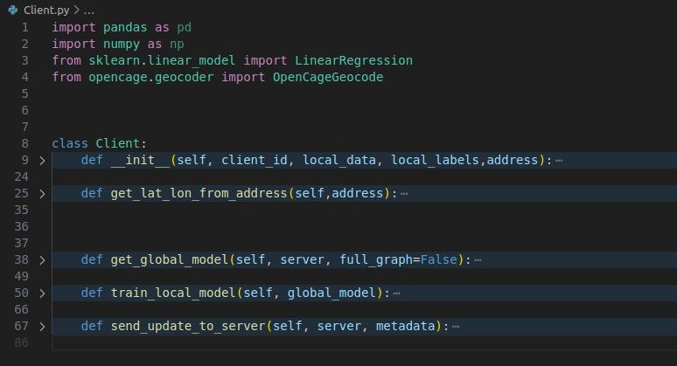
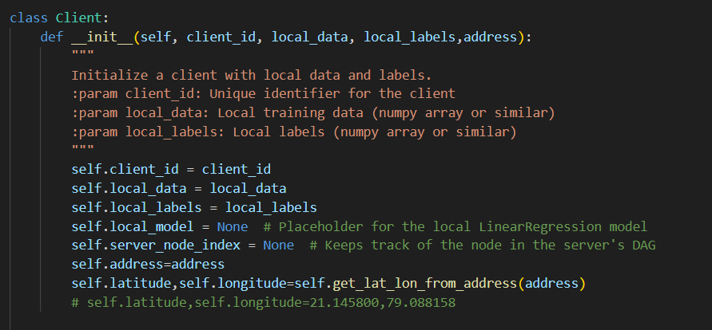
Structure of Client and Server Class
CLIENT
CLASS

Slide 20
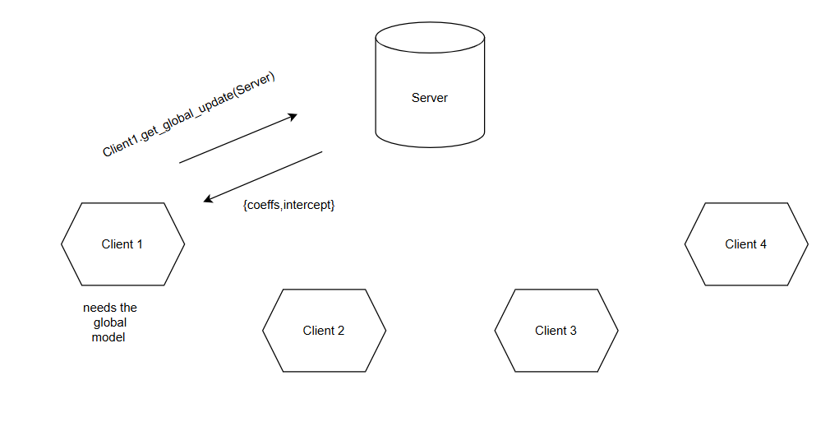

Slide 21

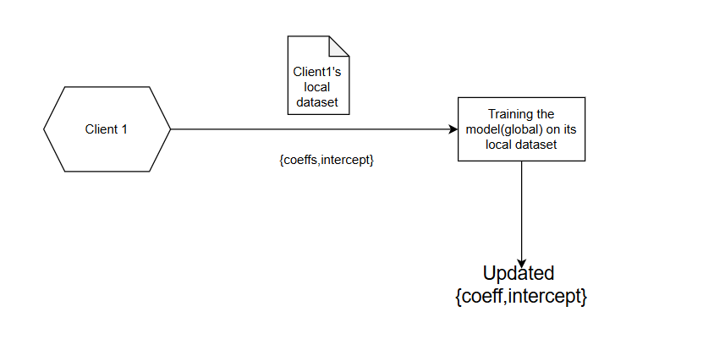

Slide 22

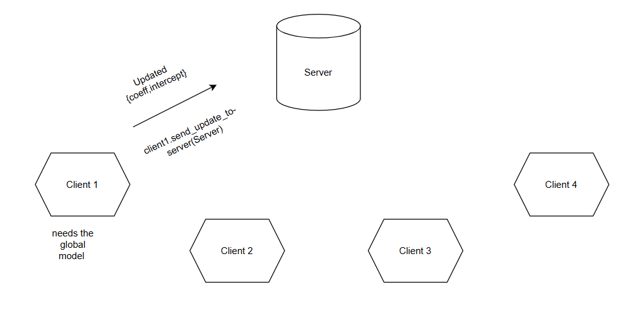

Slide 23
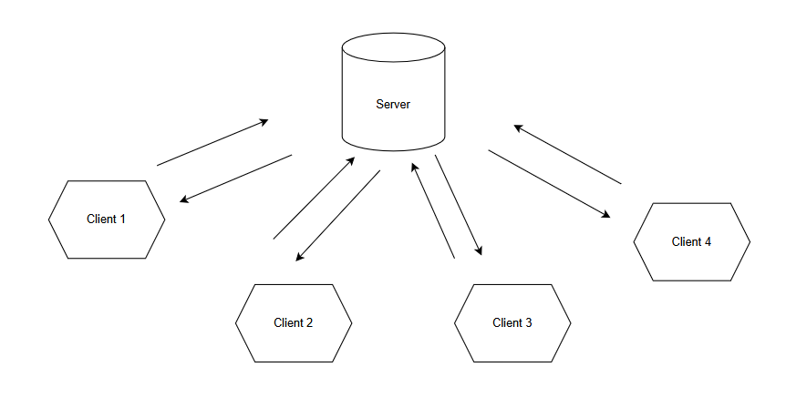
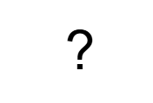
Communication between Server and Clients

Slide 24
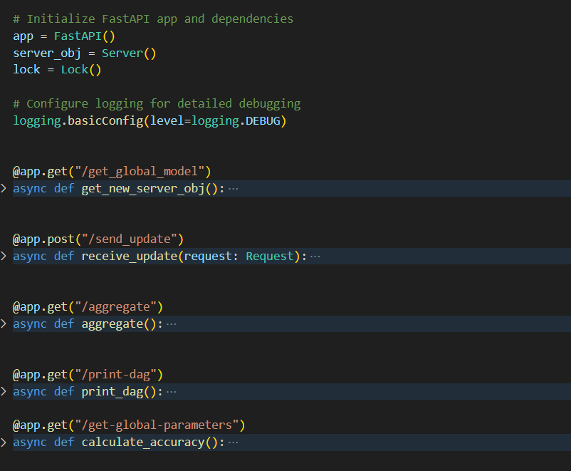
Communication between Server and Clients - API Calls

Slide 25
Endpoints at Server
1) “/send_update”
Client calls the endpoint to send their updates to the server
2) “/aggregate”
As soon as the updates are sent client calls this endpoint to initialize aggreagtion
3) “/get_global_model”
API to retrieve the global model and DAG

Slide 26
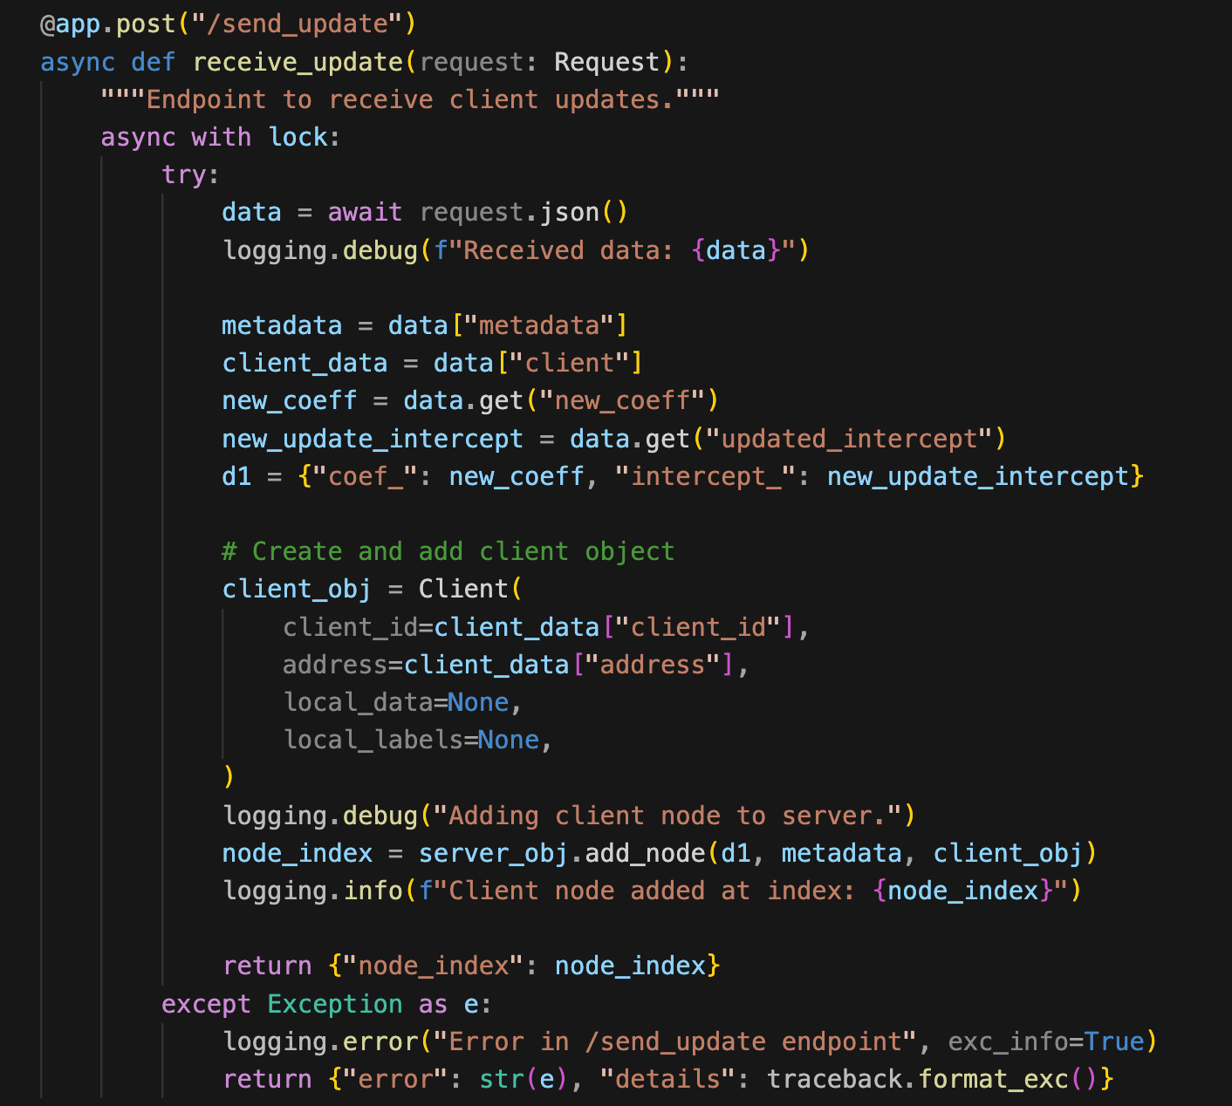

Slide 27
DAG (updated) - node added
{
"metadata": metadata,
"Client": { "client_id": client.client_id,
"address: client.address },
"new_coeff": updated_coeff,
"updated_intercept": updated_intercept
}
“/send_update”
C1
S1
C1

Slide 28
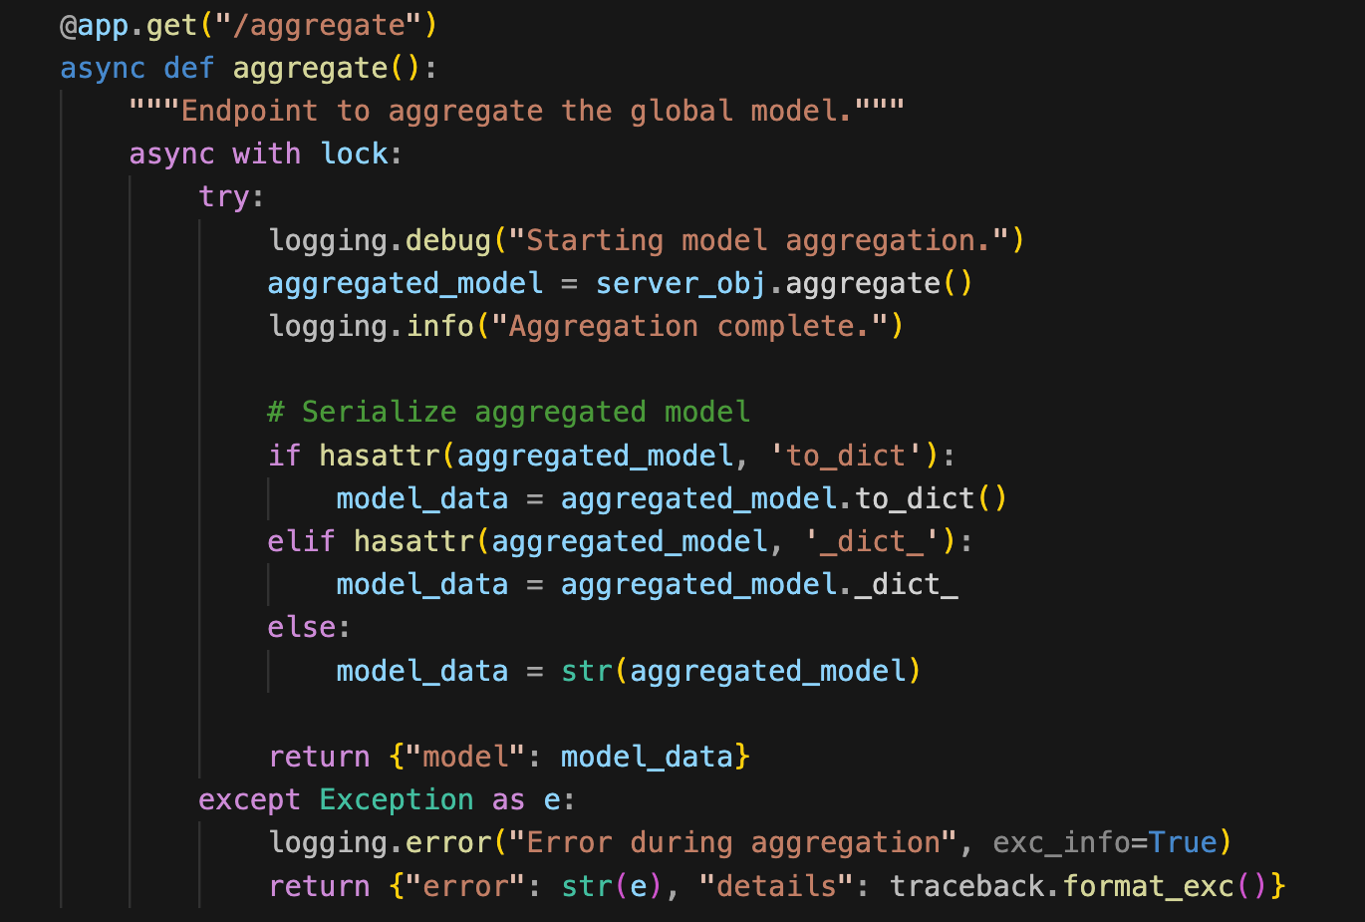

Slide 29
“/aggregate”
C1
Client requests the server to perform aggregation
{
“coeff”:global_coeff,
“Intercept”:global_intercept
}
C1

Slide 30
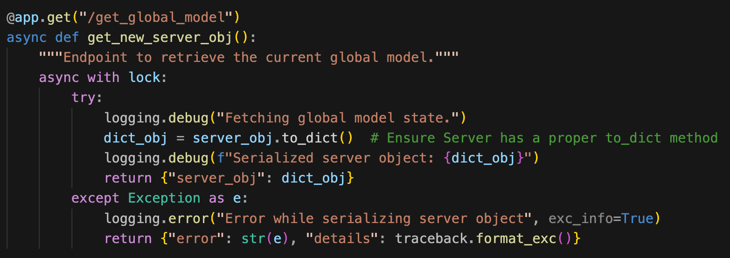

Slide 31
Response of “/get_global_model” api
{
“Global_model”:{“coeff”:global_coeff,
“Intercept”:global_intercept}
“Dag”:adj_matrix
“Nodes”: [dag_nodes]
}
C1

Slide 32
WALKTHROUGH
1) Initially Client1 sends its updates to the server it will call the aggregate api
Changes: i) node added to DAG
ii)server-node coeff and intercept updated
2)CLient2 sends model updates and calls aggregation api
Changes: i) node added to DAG
ii)server-node coeff and intercept updated
3)Client3 (in near proximity to Client2) send updates and aggregation api
Changes: i) node added to DAG(edge between server-client3 & client2-client3)
ii)server-node coeff and intercept updated
4)Again Client1 sends its updates and calls aggregation api
Changes: i) No node added to DAG(client1 node over-written with updated timestamp)
ii)server-node coeff and intercept updated

Slide 34
THANK YOU

