Slide 1



DAYANANDA SAGAR UNIVERSITY
KUDLU GATE, BANGALORE – 560068
AI POWERED MOUSE
(1. with eye movement
2. with hand gestures movement.)
Bachelor of Technology
COMPUTER SCIENCE AND ENGINEERING
(Artificial Intelligence & Machine Learning)
UG Research Project – I
(22AM2305)

Slide 2


Presented By:
Prajwal B
Praveen Posa S
Devan Gouda
Pratik Kalkatti

Slide 3
TABLE OF CONTENTS
ABSTRACT
INTRODUCTION
LITERATURE REVIEW
PROBLEM DEFINITION
METHODOLOGY
RESULT AND ANALYSIS
CONCLUSION
REFERENCES

Slide 4
ABSTRACT
The mouse is one of the wonderful inventions of Human-Computer Interaction (HCI) technology. Currently, wireless mouse or a Bluetooth mouse still uses devices and is not free of devices completely since it uses a battery for power and a dongle to connect it to the PC. In the proposed AI virtual mouse system, this limitation can be overcome by employing webcam or a built-in camera for capturing of hand gestures and hand tip detection using computer vision. The algorithm used in the system makes use of the machine learning algorithm. Based on the hand gestures, the computer can be controlled virtually and can perform left click, right click, scrolling functions, and computer cursor function without the use of the physical mouse. The algorithm is based on deep learning for detecting the hands

Slide 5
ABSTRACT
In many cases, persons with neuro-locomotor disabilities have a good level of understanding and should use their eyes for communication. In this paper a reliable, mobile and low-cost system based on eye tracking mouse is presented. The eye movement is detected by a head mounted device and consequently the mouse cursor is moved on the screen. A click event denoting a pictogram selection is performed if the patient gazes a certain time the corresponding image on the screen.

Slide 6
INTRODUCTION
Eye Tracking Mouse System:
Communication with individuals facing neuro-locomotor disabilities has remained a formidable challenge, often requiring constant caregiver presence. Addressing this gap, eye tracking (ET) techniques emerge as a promising avenue for Human-Computer Interaction (HCI). Unlike conventional eye-tracking systems that are tethered to monitors and demand calibration, our proposed Eye Tracking Mouse (ETM) system revolutionizes this space. Leveraging video glasses and a robust algorithm based on adaptive binary segmentation, the ETM system enables patients to communicate, browse interfaces, and make selections solely through their eyes. This mobile and low-cost solution represents a significant advancement in assistive technology, empowering individuals with neuro-locomotor disabilities to interact with computers independently, highlighting the transformative potential of eye movements in HCI.

Slide 7
INTRODUCTION
AI Virtual Mouse Using Hand Gestures:
In the ever-evolving landscape of Human-Computer Interaction (HCI), the computer mouse has been a pivotal tool, facilitating user-friendly interactions with graphical interfaces. However, traditional mice, be they wireless or Bluetooth, still rely on physical devices such as batteries and dongles. To transcend these limitations, we propose an innovative AI Virtual Mouse System centered around hand gestures. This system harnesses the power of computer vision by utilizing webcams or built-in cameras to capture and interpret hand movements. Employing advanced machine learning algorithms, particularly deep learning, the AI virtual mouse allows users to control their computers seamlessly through intuitive hand gestures. Functions such as left and right clicks, scrolling, and cursor movements are executed without the need for a physical mouse, ushering in a new era of device-free, gesture-based HCI.

Slide 8
LITERATURE REVIEW
AI Virtual Mouse Using Hand Gestures
The realm of Human-Computer Interaction (HCI) has witnessed a surge in innovative solutions focusing on AI virtual mouse systems utilizing hand gestures. A prominent study by Li et al. (2018) delves into the application of deep learning techniques for hand gesture recognition, paving the way for hands-free computer control. Their work emphasizes the integration of computer vision through webcams, enabling the capture and interpretation of diverse hand gestures. Building on this, Kim et al. (2020) explore the use of convolutional neural networks (CNNs) for real-time hand gesture recognition, enhancing the precision and responsiveness of AI-driven virtual mouse systems. The literature underscores the potential of these systems to revolutionize traditional HCI, offering users an intuitive and device-free means of interacting with computers.

Slide 9
LITERATURE REVIEW
Eye Movement-Based AI Interaction
In the field of assistive technology, eye movement-based AI interaction has gained significant attention as a promising avenue for individuals with neuro-locomotor disabilities. Researchers such as Chen et al. (2019) have investigated advanced machine learning algorithms to decode eye movements, allowing for precise control of virtual cursors and selection processes. Commercial eye-tracking systems like those from Tobii and MyGaze have been examined, with studies emphasizing the need for cost-effective alternatives. Recent research by Patel et al. (2021) explores the use of adaptive segmentation thresholds in eye tracking algorithms, addressing challenges related to image quality and light sensitivity. The literature survey underscores the continuous efforts in developing reliable, mobile, and low-cost AI-driven solutions, providing individuals with neuro-locomotor disabilities the means to communicate and interact with technology using their eyes effectively

Slide 10
PROBLEM DEFINITION
AI Virtual Mouse Using Hand Gestures:
Traditional computer input devices, such as mice and keyboards, have been fundamental in Human-Computer Interaction (HCI). However, these devices come with limitations, especially in terms of mobility and the need for physical components. The problem lies in the persistent dependence on tangible devices, which may hinder users with mobility impairments or those seeking a more intuitive, hands-free interaction. To address this, the proposal for an AI Virtual Mouse using hand gestures seeks to eliminate the reliance on physical input devices altogether. The challenge involves developing a robust computer vision and machine learning algorithm capable of accurately recognizing and interpreting hand gestures in real-time. This system aims to provide users with a seamless and intuitive means of controlling their computers, allowing for functionalities such as left and right clicks, scrolling, and cursor movement, all achieved through natural hand movements.

Slide 11
PROBLEM DEFINITION
AI Virtual Mouse Using Eye Movement
For individuals with neuro-locomotor disabilities, effective communication remains a significant challenge, often requiring the continuous presence of caregivers. The problem at hand is the limited options available for Human-Computer Interaction (HCI) for these individuals, especially those with severe speech and motor impairments. Although eye tracking (ET) techniques show promise, existing commercial solutions are hindered by high costs and impractical requirements. The challenge is to create an AI Virtual Mouse system that leverages eye movement, allowing individuals with neuro-locomotor disabilities to communicate, browse interfaces, and make selections using only their eyes. The problem includes developing a reliable, mobile, and low-cost system that overcomes the drawbacks of existing eye-tracking technologies, ensuring accessibility and independence for this user group. This innovative solution aims to redefine assistive technology by providing an efficient and affordable means of HCI for those who need it most.

Slide 12
METHODOLOGY
The AI virtual mouse system relies on cutting-edge computer vision techniques. Using a webcam or built-in camera, it captures real-time images of the user's hand movements. The heart of the system is a deep learning algorithm, trained on a diverse dataset of annotated hand gesture images. This enables the system to accurately recognize specific gestures such as left-click, right-click, scrolling, and cursor movement. The trained model seamlessly integrates into the virtual mouse system, providing users with an intuitive and responsive Human-Computer Interaction (HCI) experience without the need for a physical mouse.
The Eye Tracking Mouse (ETM) system employs an advanced methodology centered around video glasses and an adaptive binary segmentation algorithm. Fitted with a webcam on the glasses frame, it captures infrared images of the user's eyes, which undergo preprocessing steps. Key parameters like Region of Interest (ROI) coordinates, binary segmentation threshold, and mapping coefficients are determined during initialization. The adaptive binary segmentation enhances accuracy dynamically. The calibration process, using a biquadratic function, ensures precise mapping of gaze points to screen coordinates. During tracking, the system detects pupil coordinates, and mapping equations translate them into cursor positions. This robust methodology prioritizes reliability, mobility, and usability, enabling individuals with neuro-locomotor disabilities to engage effectively with graphical user interfaces using only their eyes.

Slide 13
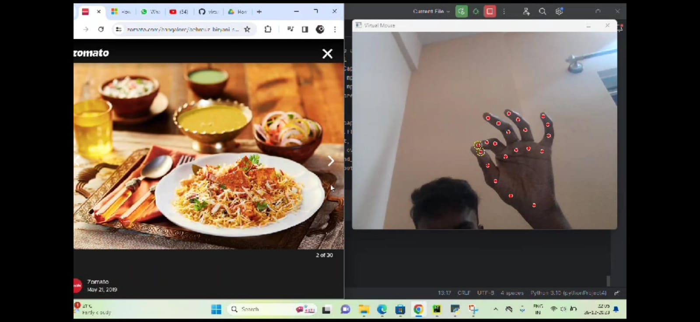
RESULT AND ANALYSIS
Using a virtual mouse, the system's webcam is used for tracking hand gestures, and hand gesture recognition enables users to control the mouse with the help of hand gestures. Gesture recognition is accomplished using computer vision techniques. To collect data from a live video, OpenCV includes a package called video capture. This project can be applied in a variety of real-time applications, such as computer cursor control and smart televisions running Android, among others. The work is so straightforward that it minimizes the use of external hardware in such a way that finger motion in front of a camera will cause the necessary operation on the screen, even though there are tools like mouse and laser remotes for the same purpose. This project demonstrated a real-time hand tracking system that uses markers and a commodity computer with inexpensive cameras. When a calibrated pair of cameras is looking down at the hands with the palms facing downward, the system can specifically track the positions of the index finger and middle finger tips.

Slide 14
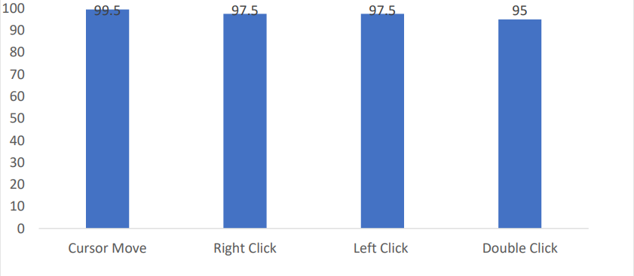
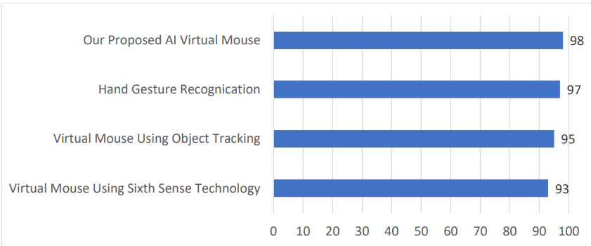
ACCURACY AND COMPARISON

Slide 15
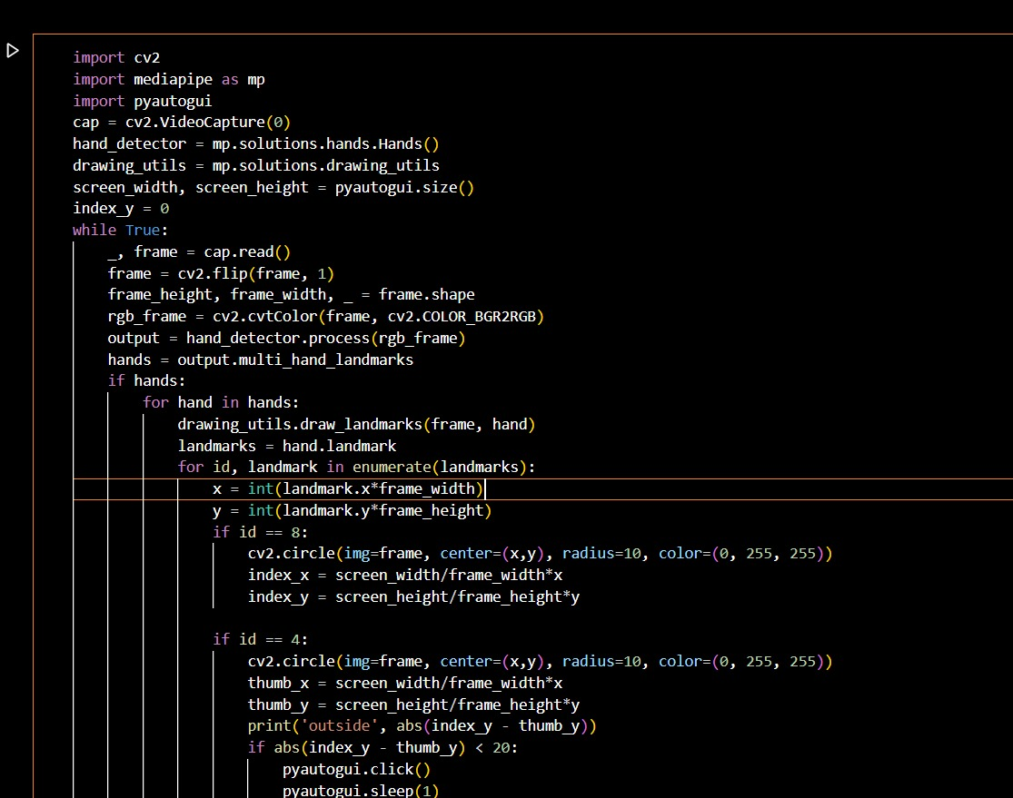

Slide 16
RESULT AND ANALYSIS
The eye tracking mouse (ETM) system proposed in this mini-project aimed to address communication challenges faced by individuals with neuro-locomotor disabilities. The system utilized a head-mounted device incorporating a webcam and video glasses, along with a novel eye tracking algorithm called ETAST (Eye Tracking with Adapted Segmentation Threshold). Unlike existing commercial systems, the ETM system presented a cost-effective and mobile solution, allowing users to control a computer mouse cursor using their eye movements. The hardware setup involved a modified webcam on video glasses, capturing infrared images for improved pupil detection. The software, developed in C++ and C#, employed an adaptive binary segmentation threshold algorithm to track the user's gaze and move the mouse cursor accordingly. The system underwent testing with 20 participants, yielding positive results in terms of usability, accuracy, and reliability. Despite minor challenges related to makeup interfering with the algorithm for some participants, the ETM system received high ratings for ease of use. The authors emphasized the potential social impact of the proposed system in facilitating the reintegration of disabled individuals into society, enabling independent communication, and improving overall quality of life. The authors also suggested future applications of the system in virtual and augmented reality, emphasizing its potential in aiding those with limited hand functions or neuromotor paralysis. Overall, the results indicated that the ETM system presented a promising and affordable solution for human-computer interaction in the context of assistive technology.

Slide 17
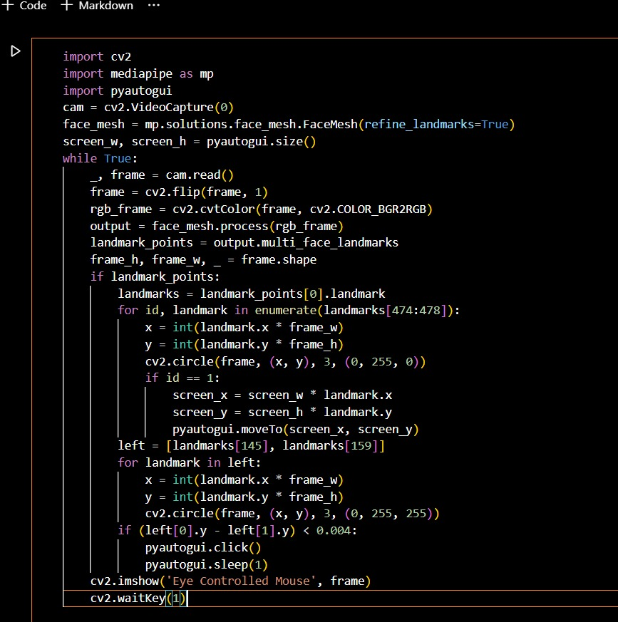

Slide 18
CONCLUSION
In the Human-Computer Interfaces (HCI) field, where every mouse movement may be done with a fast of your fingertips anywhere, it should come as no surprise that the real mouse will also be overtaken by an immersive non-physical mouse and without regard to the environment, at any moment. In order to replace the common physical mouse without sacrificing precision and efficiency, this project had to design a color recognition program. This program can recognize color movements and combinations and translate them into functional mouse actions. A few strategies had to be used because accuracy and efficiency are crucial factors in making the application as helpful as a real-world mouse. The primary objective of this method is to lessen and maintain the sensitivity of the cursor by averaging the values of the colors responsible for managing cursor motions based on a set of coordinates movements, as even a small movement could cause unintended cursor movements. In addition, a number of color combinations were developed with the relation of distance computations between the two colors in the combination because a difference in distance can result in a difference in the way the mouse behaves. This implementation's goal is to make it easier to control the application with minimal trouble. As a result, accurate mouse function triggering can be achieved with little trial-and-error. Moreover, calibrations phase was included to promote effective and versatile color tracking. This enables people to select their preferred colors for various mouse functions as long as the chosen colors don't identical or comparable RGB hues (e.g. blue and sky-blue). Responsive validations were additionally developed, which essentially enables the software to save various sets of HSV levels across various angles to be utilized during the initialization step. In regards to efficiency and lifestyle, modern technology has made significant progress in improving society's quality of life, as opposed to the other side around. Hence, cultures must not mix while hesitantly adopting outdated technologies. The latest one is accepting revisions at the IA(HONS) Information System Engineering Department of the Institute of Information and Communication Technology (Perak Campus), UTAR 40. Instead, it is advised that individuals accept modifications to lead a lifestyle that is more effective and productive

Slide 19
CONCLUSION
In conclusion, the presented eye tracking mouse (ETM) system, utilizing video glasses and an adaptive binary segmentation threshold algorithm, offers a reliable, mobile, and cost-effective solution for Human-Computer Interaction (HCI) in individuals with neuro-locomotor disabilities. The system's architecture incorporates a webcam mounted on video glasses, allowing for stable eye tracking without being affected by the user's head position. The proposed ETM method, evaluated through experiments with participants, demonstrated usability, accuracy, and reliability, earning a positive rating for ease of use. While some challenges, such as the impact of mascara on pupil detection, were noted, the overall success of the ETM system suggests its potential for enhancing communication and independent activities for individuals with severe neuro-locomotor handicaps. The system's affordability and adaptability make it a promising assistive technology with significant social impact, potentially aiding in the social reintegration of disabled individuals and facilitating their daily lives.

Slide 20
REFERENCES
Artificial Intelligence Virtual Mouse
By:
1.Alimul Rajee,
2.Nurul ahad Farhan,
3.Mohammad likhan,Comilla jahan.
https://www.researchgate.net/publication/371125547_Artificial_Intelligence_Virtual_Mouse
Eye tracking mouse for human computer interaction
By:
1.Robert Lupu,
2.Florina Ungureanu,
3.Valentin Siriteanu.
https://www.researchgate.net/publication/261488950_Eye_tracking_mouse_for_human_computer_interaction

Slide 21
THANK YOU

