Slide 1
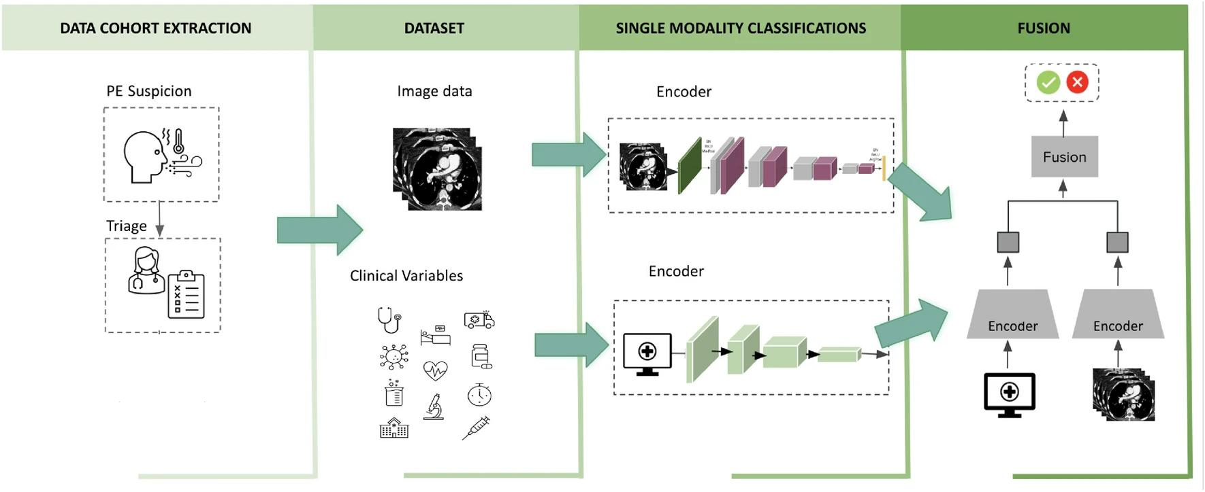
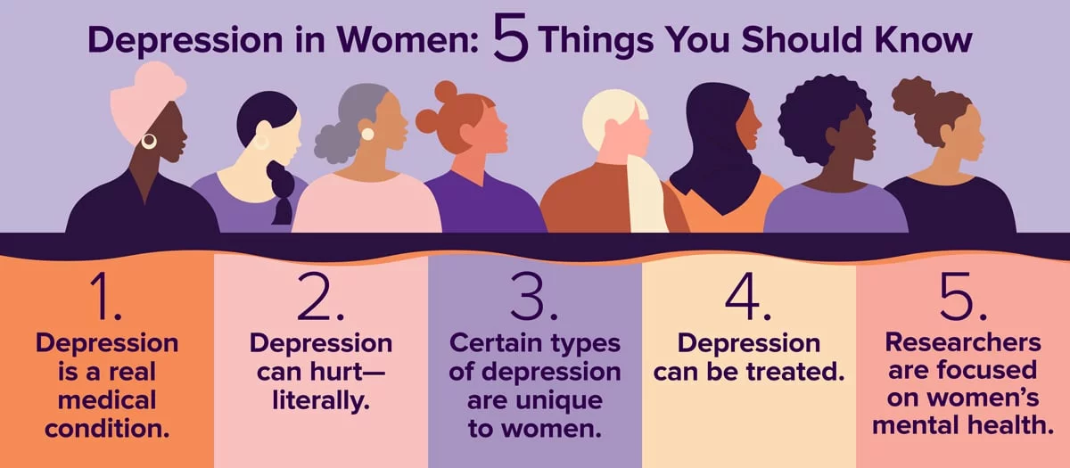
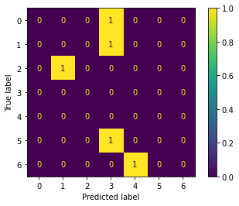

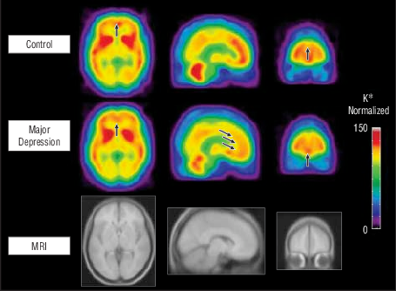
Detecting and Analyzing Depression in Women Using Multimodal AI
Materials:
Results:
Datasets
Text Data: Transcripts from interviews, social media posts, or written diaries.
Audio Data: Recorded speech samples, interviews, or voice notes.
Video Data: Recorded video interviews, facial expression datasets, or video diaries.
Physiological Data:
Breathing Monitoring: Data from respiratory sensors.
Heart Rate Variability: Data from heart rate monitors.
Sleep Tracking: Data from sleep tracking devices.
Software and Tools
Programming Languages: Python, R, etc.
Libraries and Frameworks: TensorFlow, PyTorch, scikit-learn, OpenCV, etc.
Pre-trained Models: BERT for text analysis, VGGFace for facial recognition, etc.
Hardware
Computing Resources: High-performance computing systems or cloud services like AWS, Google Cloud, or Azure for training models.
Annotation Tools
Tools for labeling and annotating data, such as Labelbox or VGG Image Annotator.
Evaluation Metrics
Metrics like accuracy, Confusion Matrix, precision, recall, RMSE (Root Mean Square Error) for assessing model performance.
Methods:
Introduction:
Data Collection
Text Data: Transcripts from interviews, social media posts, written diaries.
Audio Data: Recorded speech samples, interviews, voice notes.
Video Data: Recorded video interviews, facial expression datasets, video diaries.
Physiological Data: Breathing monitoring, heart rate variability, sleep tracking.
Data Preprocessing
Text: Tokenization, stop-word removal, stemming/lemmatization.
Audio: Feature extraction (e.g., MFCCs, pitch).
Video: Facial landmarks, expressions, movements.
Physiological: Normalization of sensor data.
Feature Extraction
Text: BERT, TF-IDF, word embeddings.
Audio: OpenSMILE, librosa.
Video: VGGFace, optical flow.
Physiological: Heart rate variability metrics, sleep patterns, respiratory rates.
Modeling
Text: BiLSTM, Transformer-based models.
Audio: SVM, CNN.
Video: XGBoost, CNN.
Physiological: Random Forest, RNN.
Multimodal Fusion
Feature Fusion: Concatenation, attention mechanisms.
Model Fusion: Voting, stacking, blending.
Evaluation
Metrics: Accuracy, precision, recall, Confusion Matrix.
Validation: Cross-validation techniques.
Deployment
Integration: User-friendly application or platform.
Monitoring: Continuous monitoring and updates.
Mental health is vital for overall well-being but is often overlooked, especially among women. Women are the backbone of families and communities, yet many face mental health challenges, with depression being particularly prevalent.
In India, around 31% of women suffer from depression. This highlights the urgent need for effective mental health interventions. Unfortunately, depression is often considered taboo, preventing many women from seeking help.
Our project leverages multimodal AI to detect and analyze depression in women. By combining various data sources and advanced AI techniques, we aim to provide a comprehensive understanding of depression and promote better mental health support for women.
Montgomery–Åsberg Depression Rating Scale :
The questionnaire includes questions on ten symptoms:
Apparent sadness
Reported sadness
Inner tension
Reduced sleep
Reduced appetite
Concentration difficulties
Lassitude
Inability to feel
Pessimistic thoughts
Suicidal thoughts
Each item yields a score of 0 to 6; the overall score thus ranges from 0 to 60.Higher MADRS score indicates more severe depression.
Objective:
Our research aims to create a powerful multimodal AI framework for identifying and understanding depression in women. By integrating data from various sources such as text, audio, and video, we strive to improve the precision and dependability of depression diagnosis.
Conclusion:
The integration of text, audio, video, and physiological data in a multimodal AI approach has proven to be highly effective in detecting and analyzing depression in women.
This comprehensive method significantly improves accuracy and robustness compared to single-modality methods, offering a deeper understanding of depression and its symptoms for early intervention. While challenges like data quality, privacy concerns, and computational resources must be addressed, embracing advanced AI techniques is crucial for advancing in mental health care, emphasizing the importance of women’s health in shaping society.

