Slide 1
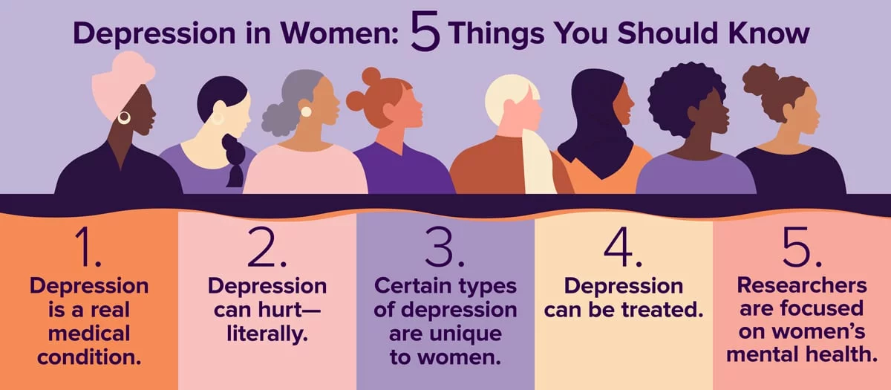
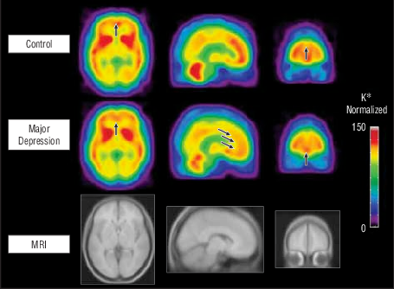
Detecting and Analyzing Depression in Women Using Multimodal AI
Materials And Methods:
Introduction:
Mental health is vital for overall well-being but is often overlooked, especially among women. Women are the backbone of families and communities, yet many face mental health challenges, with depression being particularly prevalent.
In India, around 31% of women suffer from depression. This highlights the urgent need for effective mental health interventions. Unfortunately, depression is often considered taboo, preventing many women from seeking help.
Our project leverages multimodal AI to detect and analyze depression in women. By combining various data sources and advanced AI techniques, we aim to provide a comprehensive understanding of depression and promote better mental health support for women.
Objective:
Our research aims to create a powerful multimodal AI framework for identifying and understanding depression in women. By integrating data from various sources such as text, audio, and video, we strive to improve the precision and dependability of depression diagnosis.

