Slide 1

Diabetes Prediction

Slide 2
Problem statement
Objective
To identify accurately whether the subject under analysis
has diabetes or not based on a set of variables and
compare the accuracy obtained from implementing
different models
Diabetes is one of the deadliest diseases in the world. It is not only a disease but also creator of different kinds of diseases like heart attack, blindness etc.Since the disease burden of diabetes is increasing by the day, diagnosis of diabetes at an early stage of the disease is essential for effective treatment and control of diabetes.

Slide 3
About the Data
This dataset is originally from the National Institute of Diabetes and Digestive and Kidney Diseases.In particular, all patients here are females at least 21 years old of Pima Indian heritage.
The dataset consist of 768 samples, out of which 500 are non diabetic while 269 are diabetic people.
All patients are females of at least 21 years of age.
The dataset has total 9 attributes out of which 8 are independent variables and one is the dependent variable i.e. target variable which determines whether patient is having diabetes or not.

Slide 4

Data Dictionary
Pregnancies | The no. of times a subject was pregnant
Glucose | Level of Plasma Glucose Concentration
Blood Pressure | Diastolic blood pressure of the subject
Skin Thickness | Triceps skin fold thickness (mm)
Insulin | Serum Insulin for the subjects
BMI | Body mass Index of the subjects
DiabetesPedigreeFunction | Likelihood of diabetes based on family history
Age | Age of the subjects
Outcome | 1 if the subject is Diabetic, 0 if not

Slide 5
Exploratory Data Analysis
From an initial analysis of the data, there are certain features in our dataset which had zero values as observations in them like Blood Pressure.These variables cannot have 0 values and so we are going to consider them as error or outliers and remove them.
In the pregnancies column also we had some zero values, but that means that the subject under consideration has not been pregnant throughout. So we don’t remove these observations.
The data does not contain any missing values.

Slide 6
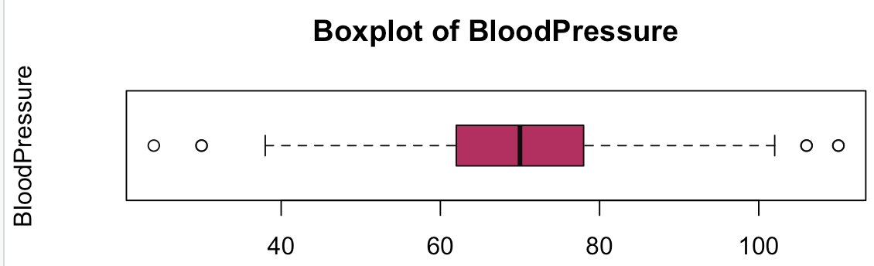
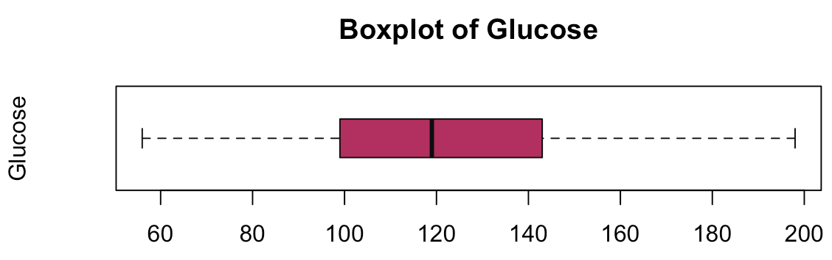
Data Preprocessing
A univariate analysis of the data shows that the variables BMI, Glucose, Blood Pressure, Insulin, Skin Thickness contains outliers. Hence we remove these outliers by means of complete case analysis.

Slide 7
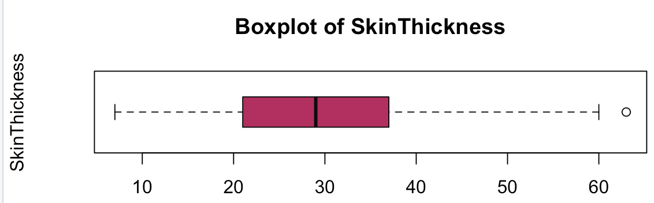
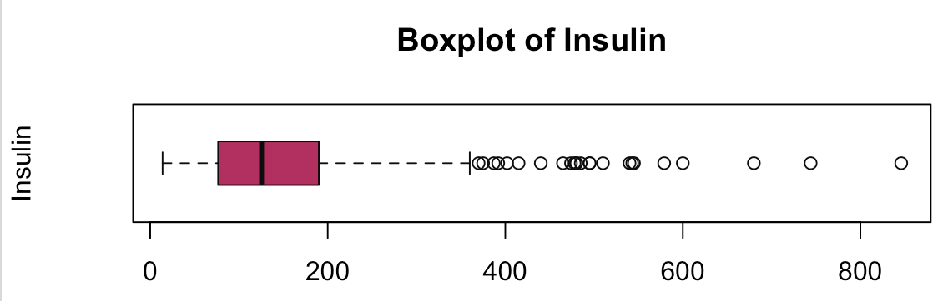
Now the total number of observations comes down to 392.
From the correlation matrix, we find that none of the variables are highly correlated. Hence we do not need to drop any of the variables from our analysis.
Our train data had 305 observations and test data had 87 observation
The train test split ratio was 80:20

Slide 8
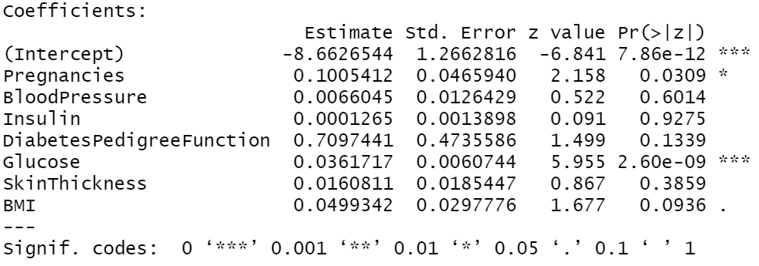
Logistic Regression
From all the coefficients Glucose and Pregnancies variables were found to be significant
Out of all variables, Diabetes Pedigree Function has more variance.

Slide 9
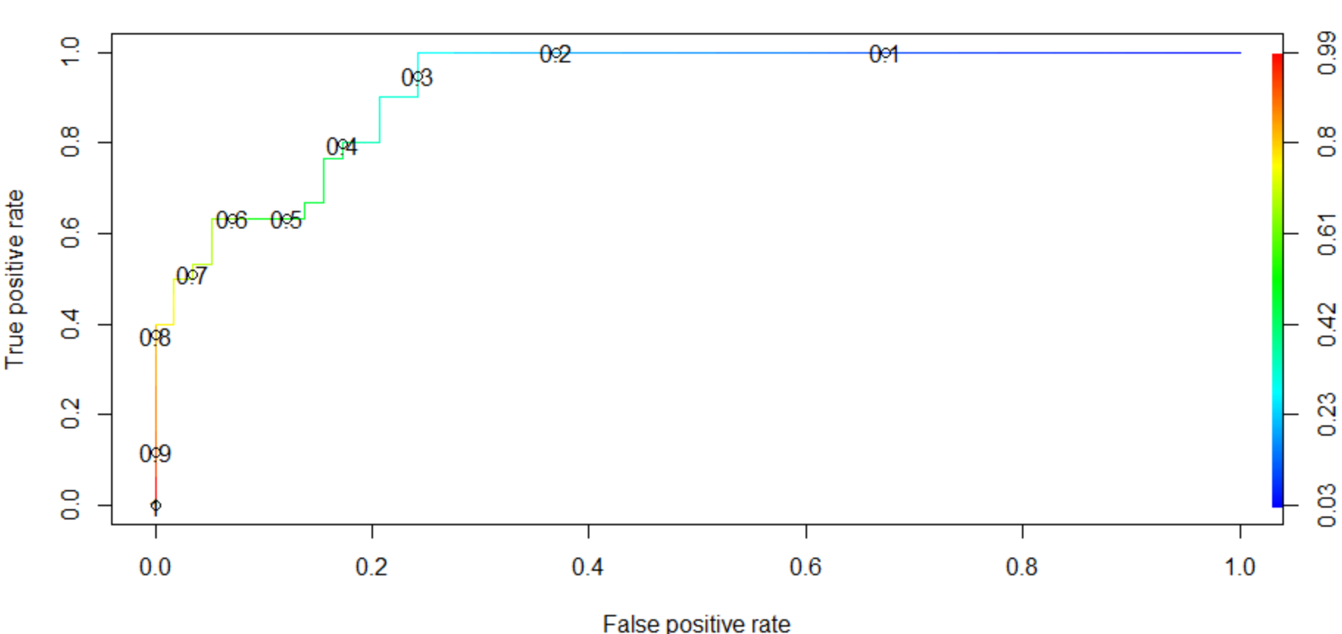
ROC Curve
From the ROC curve it is observed that the optimal probability values for classification is in between 0.5 and 0.6. Hence we have set our decision boundary to 0.6

Slide 10
Logistic Regression Model
Note that Logistic regression model has low TPR, which means it is not performing well to predict positive cases.
Predicted
 | 0 | 1
0 | 54 | 6
1 | 15 | 5
Actual
Specificity is good. Which means model is doing good in predicting negative cases.
Accuracy= (54+5) /(54+6+15+5)* 100 = 73.75 %
True Positive Rate = 5/ (15+5) *100 = 25%
Specificity = 54/ (54+6) *100 = 90%

Slide 11
Decision Tree Model
Note that Decision tree model has low TPR, which means it is not performing well to predict positive cases.
Predicted
 | 0 | 1
0 | 57 | 6
1 | 18 | 7
Actual
Specificity is good that means model is doing good in predicting negative cases.
Accuracy= (57+7) /(57+6+18+7)* 100 = 72.72%
True Positive Rate = 7/ (18+7) *100 = 28%
Specificity = 57/ (57+6) *100 = 90.4%

Slide 12
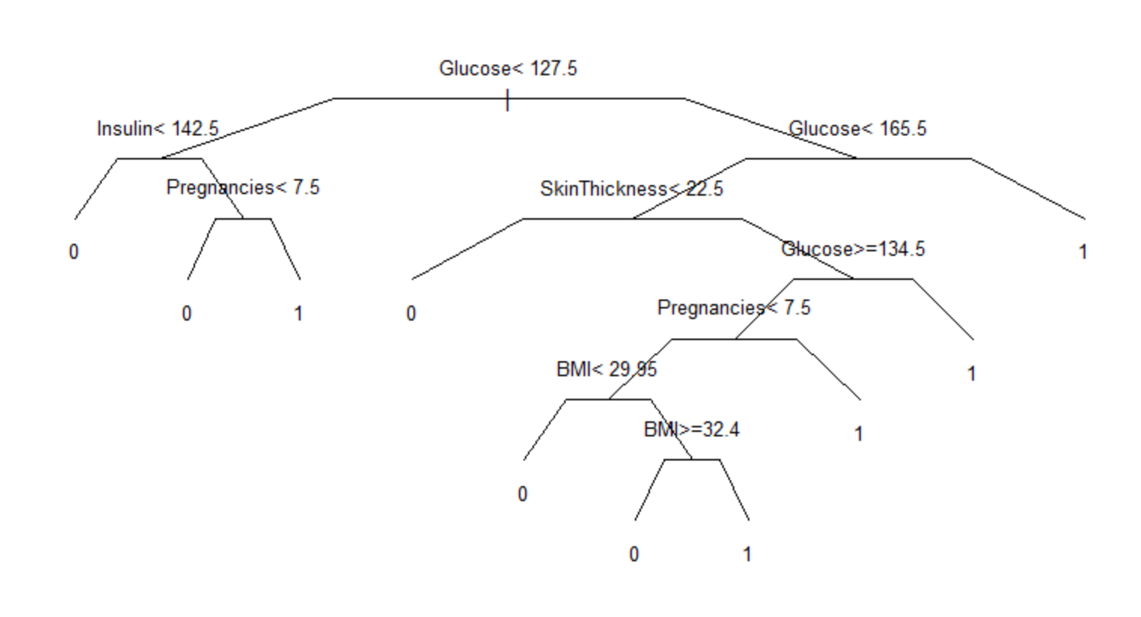
n-splits | Error
0 | 1
1 | 0.82
2 | 0.75
3 | 0.77
7 | 0.72
Pruning of the DT also gives us 71.2 % accuracy because as we see in the splits, after 2 splits, the error increased and
after 3 splits its decreasing, in this case its passing pre pruning so we get the same accuracy.

Slide 13
Decision Tree Pruned Model
Note that Decision tree pruned model has low TPR, which means it is not performing well to predict positive cases.
Predicted
 | 0 | 1
0 | 51 | 4
1 | 21 | 11
Actual
Specificity is good. Which means model is doing good in predicting negative cases.
Accuracy= (51+11) /(51+4+21+11)* 100 =71.2%
True Positive Rate = 11/ (11+21) *100 = 34.3%
Specificity = 51/ (51+4) *100 = 92.72%

Slide 14
Random Forest Model
Note that Random forest model has comparatively good TPR, which means it is predicting positive cases better than all our previous model.
Predicted
 | 0 | 1
0 | 44 | 9
1 | 10 | 23
Actual
Specificity is good. Which means model is doing good in predicting negative cases.
Accuracy= (44+23) /(44+9+10+23)* 100 = 77.9%
True Positive Rate = 23/ (23+10) *100 = 69.9%
Specificity = 44/ (44+9) *100 = 83%

Slide 15
Selection of Model based on Accuracy
From the above accuracy details we prefer Random forest over Logistic regression over Decision tree.
The best TPR was found for Random Forest Model ie. 69.9% compared to DT(pruned) = 34.3% and LR = 25%
MODEL | ACCURACY
Logistic Regression | 73.75 %
Decision tree Full Grown | 72.7%
Decision Tree Pruned Model | 71.2%
Random Forest | 77.9 %

Slide 16
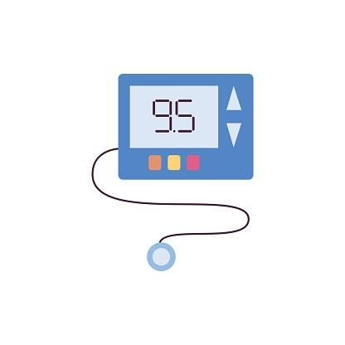
Conclusion
Random Forest model has highest accuracy compared to Logistic Regression and Decision Tree.
We can predict with 78% accuracy whether the person has diabetes or not.
Pruning did not help much in improving accuracy for this data.
There is around 21% uncertainty in misclassifying the person with disease, though we can improve the model with more more data.

Slide 17
THANK YOU

