Slide 1
C9
COUNCIL OF NINE
Candidate Intelligence
The AI Recruiting Brain
An explainable engine that reads profiles instead of counting keywords — ranking 100,000 candidates in ~2 minutes on CPU, fully offline.
Team: Rainlight
Team Leader: Varshith P
Track 1 — The Data & AI Challenge · Intelligent Candidate Discovery & Ranking
India Runs by Redrob AI · Idea Submission

Slide 2
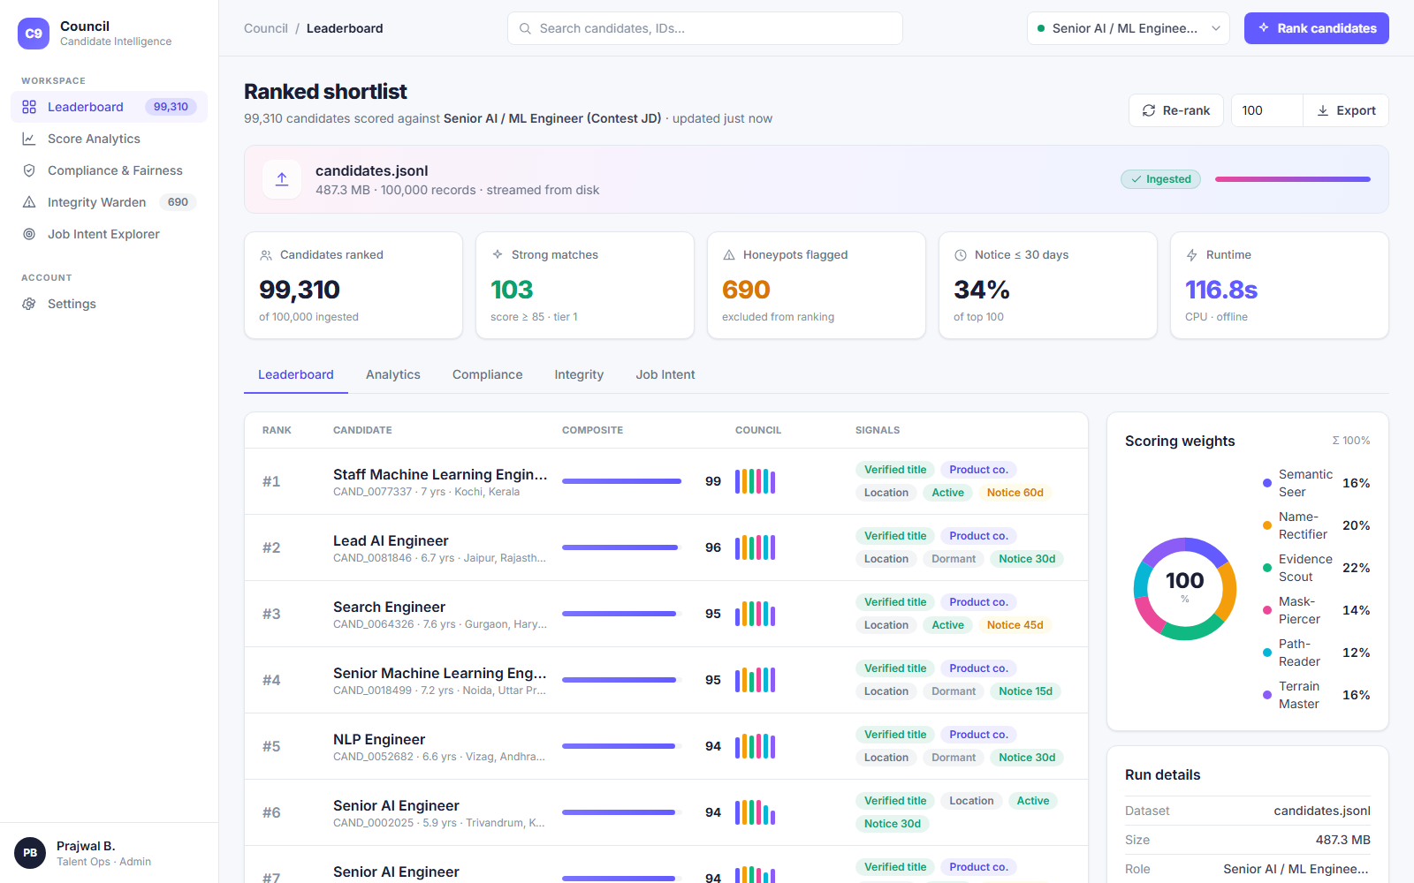
SECTION 1
2 / 11
Solution Overview
What is our proposed solution?
● The “Council of Nine” — a candidate-ranking engine where nine interpretable sub-scorers each judge a different dimension of fit, then fuse into one calibrated score.
● It reads the career narrative (titles, role descriptions, tenure, company type) far above the self-declared skills list.
● Ships an end-to-end product: drag-drop dataset, role selector, tunable weights, ranked leaderboard, per-candidate reasoning, Excel export, and a live activity log.
What differentiates us from traditional matching?
Evidence > assertion. We discount skills that aren't backed by endorsements or real usage — neutralising keyword-stuffers.
Trap-resistant. An Integrity Warden floors logically impossible “honeypot” profiles.
Explainable & fast. Every rank carries a grounded reason; runs CPU-only, offline.

Slide 3
SECTION 2
3 / 11
JD Understanding & Candidate Evaluation
Key requirements extracted from the JD
Signals that determine relevance (beyond keywords)
● Production embeddings / retrieval, vector DBs & hybrid search
● Demonstrated ranking / search / recommendation systems at product companies
● 5–9 yrs experience (6–8 ideal); strong Python; ranking-eval literacy (NDCG/MRR/MAP)
Hard dis-qualifiers: services-only careers, title-chasers, <12-mo LangChain-only, CV/speech-only without NLP/IR.
Role identity — current title must match reality (an “HR Manager” with AI skills is penalised).
Career evidence — mining role descriptions for “built / shipped / scaled a system”.
Skill trust — proficiency × endorsements × usage-duration × assessment score.
Behavioural availability — recency, recruiter-response rate, open-to-work, notice period.
Trajectory — experience band fit + tenure stability (anti job-hopper).

Slide 4
SECTION 3
4 / 11
Ranking Methodology
Retrieve → Score (Council of Nine) → Gate → Calibrate → Rank
final = council_core × integrity × negative_screen × availability + soft_nudges → calibrated 0–100
1 · Semantic Seer
2 · Name-Rectifier
3 · Evidence Scout
dense JD↔profile similarity
title matches reality (anti-stuffer)
“shipped a system” proof
4 · Mask-Piercer
5 · Path-Reader
6 · Terrain Master
verified skill-trust
experience band + tenure
product-vs-services + domain
7 · Neti-Neti Gate
8 · Integrity Warden
9 · Availability Oracle
negative screen (multiplier)
honeypot / plausibility gate
behavioural modifier
Each scorer maps a tested judgement principle (Confucius’ “rectification of names”, Sun Tzu, Kautilya’s Arthashastra, Japanese honne/tatemae) to a concrete, measurable feature.

Slide 5
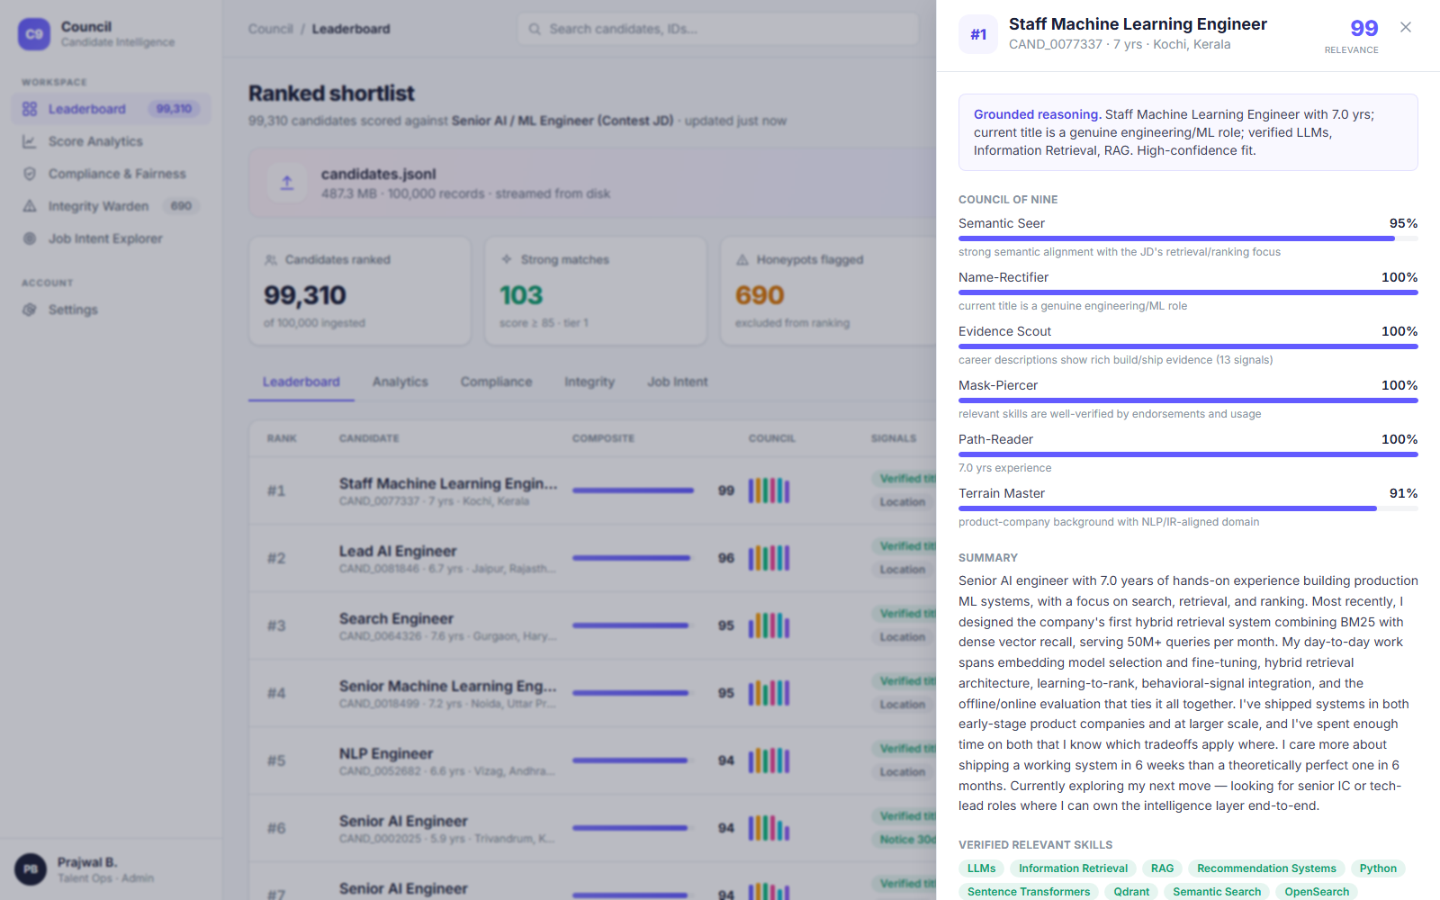
SECTION 4
5 / 11
Explainability & Data Validation
How decisions are explained. Every candidate gets a 1–2 sentence grounded reason plus the full breakdown of all nine scores with a one-line rationale each.
No hallucinations. Reasoning is assembled only from fields that exist in the profile; skills are surfaced only if verified (endorsed / actually used) — the model can never cite a skill the candidate doesn’t hold.
Honest concerns. Flaws are stated, not hidden (e.g. “strong fit, but 120-day notice”). Tone matches the rank.
Suspicious / low-quality profiles. The Integrity Warden runs logical-consistency checks — a role longer than the whole career, a skill used longer than the career, “expert” with 0 months — and excludes these honeypots from the ranking.

Slide 6
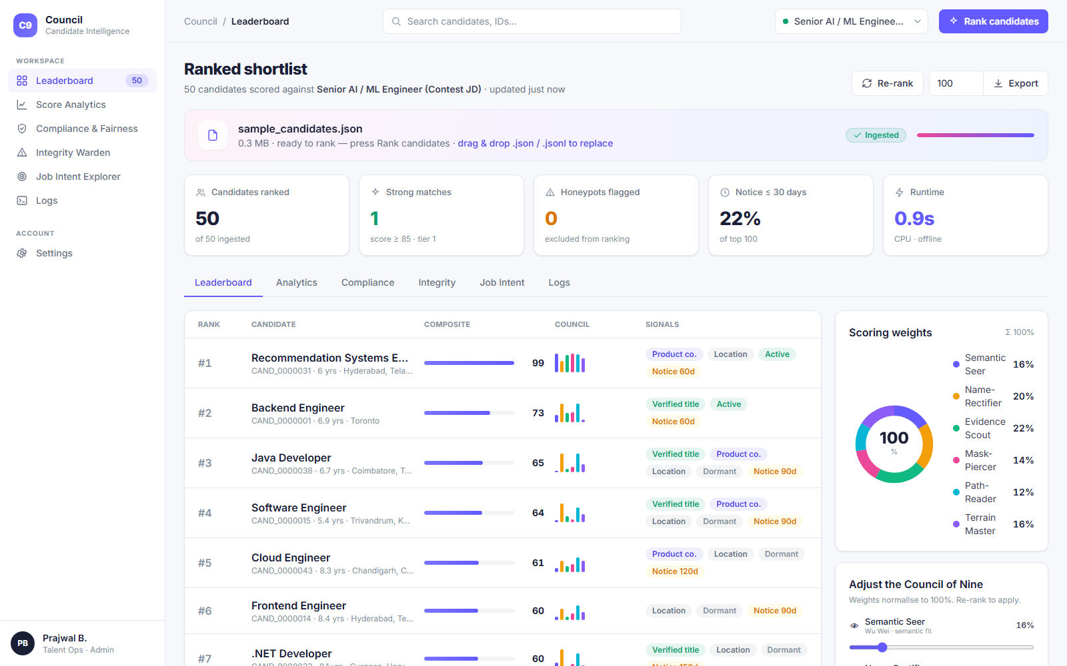
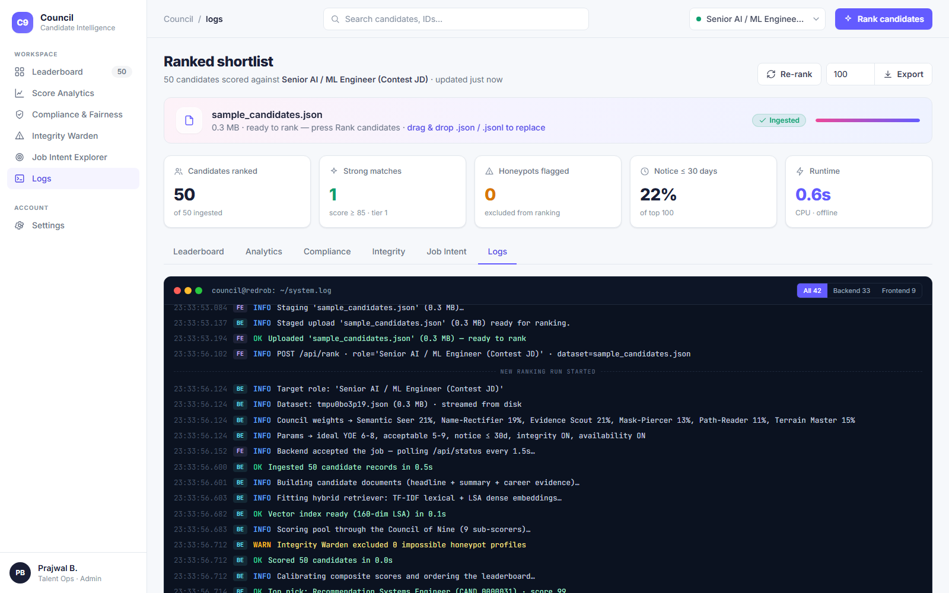
SECTION 5
6 / 11
End-to-End Workflow
1. Ingest
2. Configure
3. Rank
4. Explore & Export
Drag-drop a .json/.jsonl pool (any size) or use the default dataset.
›
Pick the target role; tune the nine weights & parameters (YOE, notice, toggles).
›
Retrieve (TF-IDF + LSA) → score the whole pool → gate honeypots → calibrate.
›
Leaderboard, candidate drawer, analytics, fairness, logs → export Excel.

Slide 7
SECTION 6
7 / 11
System Architecture
Frontend · Next.js 14
API · FastAPI
Engine · Council of Nine (src/)
● Stripe-style dashboard (Tailwind)
● Drag-drop upload, role + weights
● Leaderboard, drawer, analytics
● Live Logs console
● Background ranking job + polling
● /rank /status /leaderboard
● /candidate /analytics /compliance
● /honeypots /export /logs
● load · features · retrieve
● council (9 scorers) · integrity
● fairness · reasoning · score
● CPU-only, offline, deterministic
→
→
Two-phase design: heavy index-building runs once; the online ranking step produces the shortlist in ~2 min on CPU with no network calls — meeting the challenge’s ≤5-min / 16 GB / offline constraint.

Slide 8
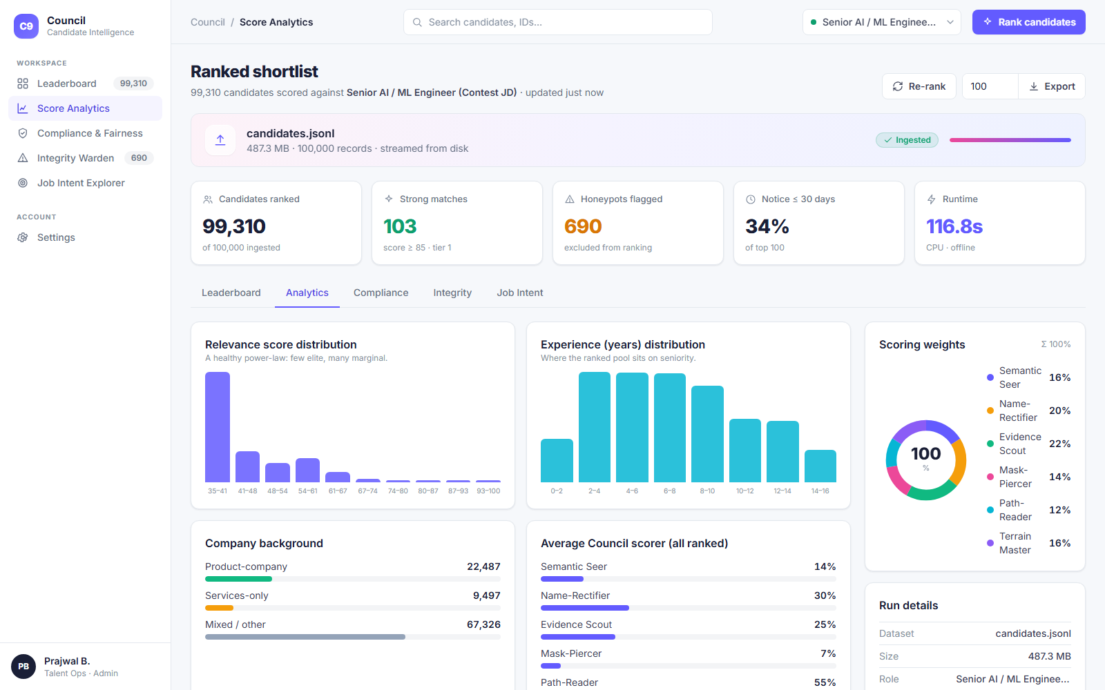
SECTION 7
8 / 11
Results & Performance
100,000
~90–135s
0.04–0.7%
10 / 10
candidates ranked
CPU · offline runtime
honeypots flagged (DQ at 10%)
engine tests passing
Right people at the top. On the full pool, ranks 1–N are genuine Staff/Lead/Senior ML, AI, NLP & Search engineers — not keyword-stuffers.
Trap-resistant. Plain-language “hidden gems” beat keyword-perfect wrong-role profiles in our test suite.
Format-valid. Output passes the official validate_submission.py (“Submission is valid.”).
Budget-safe. ~2 min for 100K on CPU — ~2.5× under the 5-minute limit.

Slide 9
SECTION 8
9 / 11
Technologies Used
Engine
Serving
Frontend
Quality & sandbox
● Python 3.13
● scikit-learn — TF-IDF + LSA
● NumPy / SciPy
● pandas + openpyxl (export)
● FastAPI + Uvicorn
● Background jobs + polling
● Pydantic models
● CORS / proxy
● Next.js 14 + React 18
● Tailwind CSS
● SVG charts & donut
● Live logs console
● Streamlit (hosted demo)
● Playwright (UI tests)
● Pluggable: Nomic/SPLADE/
● Qwen3 + ONNX (upgrade path)
Why this stack: a CPU-first, dependency-light core guarantees the engine reproduces inside the contest’s offline 5-minute budget, while the architecture leaves a clean drop-in path to 2026 SOTA models (Nomic Embed, SPLADE v3, Qwen3-Reranker, ONNX) for production.

Slide 10
SECTION 9
10 / 11
Submission Assets
GitHub repository
github.com/<your-username>/AI-RECRUITING
Full implementation — engine, API, web UI, tests, docs.
Demo video
Rainlight_Council_Demo.mp4
Recorded walkthrough of the working system (this submission).
Live sandbox
<your-sandbox-url>
Hosted demo to run the ranker on a sample (Streamlit Cloud / HF Spaces).
Ranked results
submission.csv
Top-100 shortlist in the required CSV format (validator-passed).
This deck
Rainlight_Redrob_Submission.pdf
Approach, architecture & results (PDF + PPTX).

Slide 11
Rainlight — The AI Recruiting Brain
We don’t match keywords. We read careers, verify claims, weigh availability, and explain every decision — at India scale, on a laptop.
Team Rainlight · Varshith P
India Runs by Redrob AI · Track 1 — The Data & AI Challenge

