Slide 1

Presentation on "Books4U"
Notes:
NOTE: Want a different image on this slide? Select the picture and delete it. Now click the Pictures icon in the placeholder to insert your own image.

Slide 2
Introduction
Internet
E-commerce
Online Shopping

Slide 3

Objectives
Simple and Powerful medium
Easy User Interface
Reasonable Price
Increase book purchases
Varieties of books

Slide 4
modules

Slide 5
Admin Module
Login
View Books
View Transaction
View User

Slide 6
User Module
Registration
Login
View Books
Buy Books
Add Books
My Orders
View Buyer

Slide 7
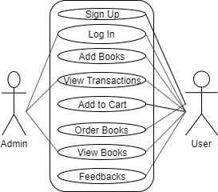
Case Diagram

Slide 8
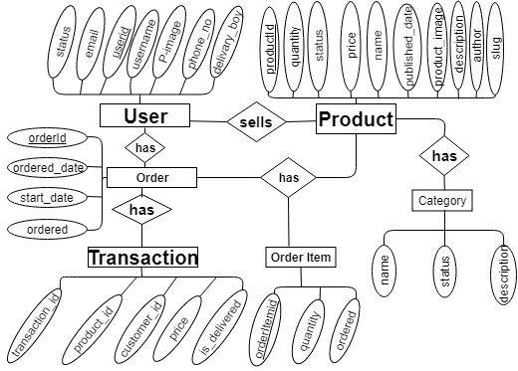
ER Diagram

Slide 9
Task Completed
The login page is created where the user can sign in to the app.
Users will be able to add product in their cart.
Users will be able to add the books for sale.
Homepage and product page are created

Slide 10
Output Obtained
Log In page is seen at the starting
Easy user interface is seen
Product can be added & deleted from cart

Slide 11
Analysis and Evaluation
Auth SYSTEM was completed
Login System is completed
Review system is completed

Slide 12

Thank You !!!

